Slide 1
Worker Training
Worker Protection Standard Agricultural Worker Pesticide Safety Training
EPA Worker PST 00017
Notes:
Welcome to the Worker Protection Standard (WPS) pesticide safety training for agricultural workers. The WPS regulation requires agricultural employers to provide employees with information and training on ways to avoid exposure to pesticides and pesticide residues.

Slide 2
EPA has approved this material for training agricultural workers on pesticide safety in accordance with the 2015 WPS expanded training content (40 CFR Part 170). The approval number is EPA Worker PST 00017.
​This work is licensed under a Creative Commons Attribution-NonCommercial-ShareAlike 4.0 International License by The Regents of the University of California, Davis campus, 2017. For information contact PERCsupport@ucdavis.edu.
Notes:
EPA has approved this material for training agricultural workers on pesticide safety in accordance with the 2015 WPS expanded training content (40 CFR Part 170). The approval number is EPA Worker PST 00017.
Copyright and license conditions apply.
Additional guidance about the applicable copyright is available at http://pesticideresources.org/AdoptedPERCPolicies.pdf

Slide 3
Using these slides to train: Pesticide Workers
This presentation provides the information required to train workers under the Environmental Protection Agency’s Worker Protection Standard. Additional state rules may apply.
This worker training material can be used in 2017, 2018 and beyond.
This presentation must be presented in its entirety.
If you intend to add or remove slides from this EPA-approved presentation, then refer to the EPA guidance in the notes section.
The notes section of the PowerPoint presentation contains important information for the trainer. Please review the notes prior to conducting the training.
Trainings must be conducted in a manner that the workers understand the information completely.
Notes:
Notes for trainers of agricultural workers:
Trainers must provide the training as required by the rule. Training administration revisions in the 2015 rule are required starting January 2, 2017.
Please review the National Worker Protection Standard: Manual for Trainers of Agricultural Workers and Pesticide Handlers and/or the accompanying training PowerPoint for training preparation and requirements.
If you intend to add or remove slides from this set, refer to this EPA Guidance below:
EPA’s Office of Pesticide Programs offers the following preliminary guidance on modifications to EPA-approved training materials for workers, handlers, and trainers under the Worker Protection Standard (WPS):
- Users of training materials MUST use the EPA-approved materials in their entirety and as they are provided, except as provided in the next paragraph. Changes to the content, the order of the information, or images in the presentation by a user may negate the approval for that specific use. However, users may present exercises, handouts, and additional images in their sessions to illustrate the points in the presentation (without adding these to the approved material). It is not necessary for EPA to review these additional materials, as EPA expects that they will not conflict with the original EPA-approved materials.
- If a user determines that state- or region-specific information (such as crop specific images and information, or information about state/local regulations that modify those of the WPS) will enhance the presentation for their audiences, EPA prefers for those to be included separately, as described above. If it will be disruptive or impractical from a presentation standpoint (for example, to switch from one presentation to another), EPA agrees that slides – preferably as few as possible - may be added to the presentation. The added slides MUST have a statement that identifies the source, and the slide must look distinct from the EPA-approved materials. It is not necessary for EPA to review these slides, as EPA expects that they will not conflict with the original EPA-approved materials.

Slide 4
Employee Tasks
Notes:
The WPS protects agricultural workers, pesticide handlers, and other persons during pesticide applications.

Slide 5
Agricultural Worker Tasks
Work in treated fields
Agricultural activities
Exposed to pesticide residues
DO NOT HANDLE PESTICIDES
Image credit: Chazzbo Media
Notes:
Information required to be covered:
You will be working as an agricultural worker. An agricultural worker is any person working in a field that has been sprayed with any type of pesticide, or that has had a Restricted-Entry Interval (REI) in effect within the last 30 days. The REI is the amount of time that must pass after a pesticide application before it is safe for workers to enter the area without the proper training and protection.
You will be doing agricultural tasks with high-contact: weeding, moving irrigation equipment, pruning, harvesting, etc.
You will NOT handle pesticides.
Notes for trainers of agricultural workers:
Start this section with a discussion question. “The person in this picture is an agricultural worker. As a worker, what kinds of tasks does she do?”

Slide 6
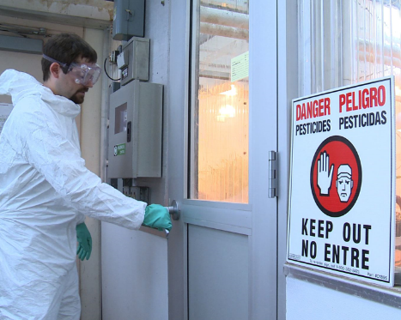
Early-Entry Worker Tasks
Enter into a treated field during the restricted-entry interval (REI)
Additional early-entry specific training and protections before entering a treated field
Must be at least 18
DO NOT HANDLE PESTICIDES
Image credit: Betsy Buffington, Iowa State University
Notes:
Information required to be covered:
Early entry means entry into a treated field or other area after the pesticide application is complete, but before the restricted-entry interval (REI) or other restrictions on entry for that pesticide have expired.
If you are required to go into treated areas before the REI expires you are an early entry worker. Your employers must provide you with early-entry specific training and protection before directing you to perform early-entry activities.
The new minimum age for early entry workers is 18 years old.

Slide 7
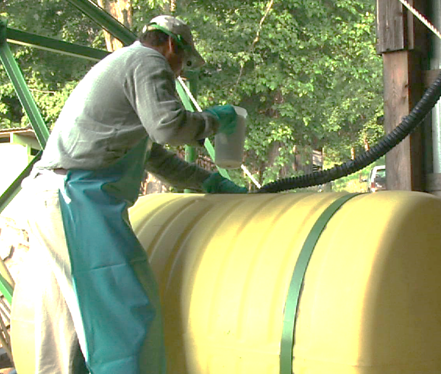
Pesticide Handler Tasks
Mix, load, apply pesticides
Fix application equipment
YES! Mechanics MAY BE handlers
Must be 18 years old
Image credit: Chazzbo Media
Notes:
Information required to be covered:
Pesticide handlers are people employed to:
Apply pesticides
Assist with pesticide applications
Mix, load, or transfer pesticides into application equipment
Clean, repair, or maintain pesticide application equipment – such as boom sprayers, backpack sprayers, or hoppers – that may contain pesticide residues
Work on equipment that has been used to mix, load, or apply, or otherwise have pesticide residues on them
Dispose of pesticides or materials with pesticides on them, such as containers
Act as a flagger
Perform tasks as a crop advisor (this includes Pest Control Advisors, or PCAs, in California) during the pesticide application or during the REI
The new minimum age for handlers is 18.
Agricultural employers are prohibited by the rule from allowing or directing a worker to mix/load/or apply pesticides or assist in their application unless trained as a handler.
Notes for trainers of agricultural workers:
Start this section with a discussion question. “What kind of tasks does a handler do?”

Slide 8
Where You May Encounter Pesticides at Work
Notes:
You may encounter pesticides and pesticide residues at your workplace.

Slide 9
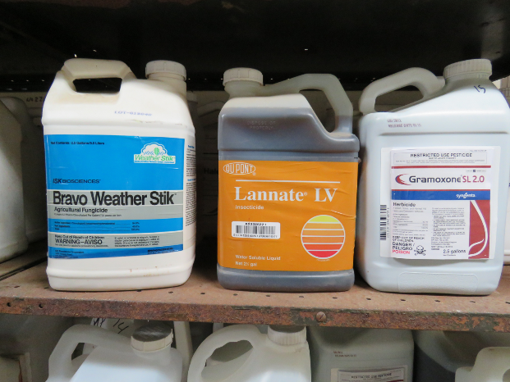
Pesticide Types
Insecticides – control insect
Herbicides – control weeds
Fungicides – control fungi and disease organisms
Image credit: Ed Crow, Penn State Pesticide Education Program
Notes:
Information required to be covered:
Pesticides protect plants from pests such as insects, weeds, fungi, and rodents.
People often use the term "pesticide" to refer only to insecticides, but it actually applies to all the substances used to control pests.
Well known pesticides include: insecticides, herbicides, and fungicides.

Slide 10
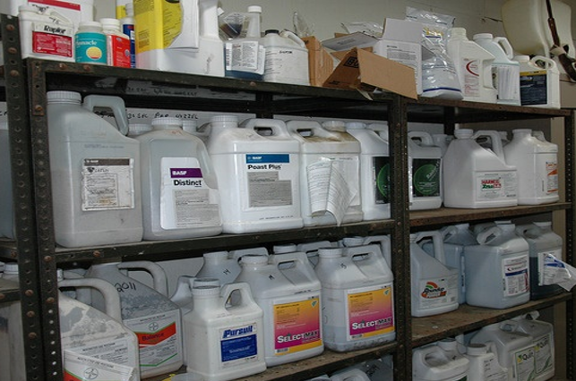
Pesticide Formulations
Liquids
Dusts
Powders
Granules
Pellets
Gases
Gels
Aerosols
Image credit: Penn State Extension, The Pennsylvania State University
Notes:
Information required to be covered:
Pesticides are formulated in different ways and are applied to agricultural crops and cropland in a variety of different forms. Some of the most commonly-used formulations are: liquids, dusts, powders, granules, pellets, gases, gels, and aerosols.

Slide 11
At Work, Pesticides and Pesticide Residues May be Found:
In or on treated plants (leaves, stems, fruit and vegetables)
In or on the soil where pesticides were applied
Tractors, sprayers, and other application equipment
Used work clothing, shoes, and personal protective equipment (including gloves)
Pesticide mixing and loading areas
In the air as drift from a nearby application
In the irrigation water or irrigation equipment, if the irrigation system is used to apply pesticides, called chemigation
In or on pesticide containers (including empty pesticide containers)
Notes:
Information required to be covered:
You must understand where you may encounter pesticides or pesticide residues at your workplace. Even people who do not mix, load, or apply pesticides can come into contact with pesticides or pesticide residues.
Pesticides and pesticide residues can be found:
On leaves, stems, and fruit of treated plants
In the soil where pesticides have been applied
In some irrigation water and on irrigation equipment if pesticides are applied through irrigation system
In the air (as droplets, dust or vapors)
On application equipment
In or on pesticide containers including empty pesticide containers
In the form of drift during a nearby pesticide application
In mixing and loading sites
In pesticide storages
Notes for trainers of agricultural workers :
Make sure you cover this information with scenarios that are relevant to workers. For example, some tractor operators may become in contact with pesticide residues on tractors that have not been decontaminated after the pesticide application has been done.

Slide 12
How Pesticides Can Enter Your Body
Notes:
Pesticides and pesticide residues can enter your body.

Slide 13
There are Four Routes of Pesticide Entry into the Body:
Skin (Dermal)
Eyes (Ocular)
Nose (Inhalation)
Mouth (Oral)
Notes:
Information required to be covered:
There are four routes of pesticide entry into the body:
Skin (dermal)
Eyes (ocular)
Nose (inhalation)
Mouth (oral)

Slide 14
Routes of Entry: Dermal
Some pesticides when contacted can pass through the skin into the blood stream
Notes:
Information required to be covered:
Pesticides can enter your body through the skin if there is exposure. This route of entry is also called dermal absorption.
The majority of agricultural pesticide injuries or poisonings occur due to skin exposure. Some types of pesticides can pass through your skin into the blood stream.
It is important to remember that there are many factors affecting absorption. Some pesticides are more likely to be absorbed through the skin than others. There are also different parts of the body where skin absorption happens more than others. The form of pesticides that come in contact with skin also matters.
Notes for trainers of agricultural workers :
The majority of agricultural pesticide injuries or poisonings occur due to skin exposure. When pesticides get onto the skin, they can cause redness, rash, blisters, and irritation. Some types of pesticides readily penetrate the skin and enter the blood stream.
The skin can be exposed to pesticides and their residues through contact with treated plants or soil. Even contact with irrigation water may result in pesticide exposure if pesticides are applied through an irrigation system—or residues from soil, plants or application equipment get into the irrigation water. Skin exposure can also occur when careless pesticide applications result in pesticides drifting onto people who are working nearby or if workers are directly sprayed. Pesticides can be transferred from dirty hands to other parts of the body if workers do not wash their hands before eating, grooming or using the bathroom.

Slide 15
Routes of Entry: Ocular
Significant amounts of pesticide can penetrate the outer tissues of the eye and enter the blood stream
Notes:
Information required to be covered:
Drift from nearby applications or applications of pesticides to areas where you are working can result in getting pesticides in your eyes.
You can also transfer pesticides from their hands into their eyes. These residues can cause eye irritation or worse.
The eye may or may not be damaged during the pesticide absorption process, depending on the corrosive nature of the chemical and its ability to penetrate the outer tissues.

Slide 16
Routes of Entry: Inhalation
Once pesticides have been inhaled, they enter the lungs and bloodstream
Notes:
Information required to be covered:
Pesticide drift from nearby applications can endanger you if you breathe in some of the pesticide vapor, dust or spray droplets.

Slide 17
Routes of Entry: Oral
Pesticide illness can occur if pesticide residues are transferred to consumed food from unwashed hands
Notes:
Information required to be covered:
While working in the fields, you can transfer residues remaining on treated plants into your mouths if you eat, drink or smoke without washing their hands beforehand.
Do not eat unwashed produce or fruit taken directly from the fields.

Slide 18
Signs and Symptoms of Pesticide Poisoning
Notes:
It is important to know the signs and symptoms of pesticide poisoning.

Slide 19
Common Signs and Symptoms
Eye irritation
Nose and throat pain
Skin rash
Dizziness
Headache
Muscle aches or cramps
Exhaustion
Nausea
Diarrhea
Chest pain
Breathing difficulties
Blurred vision
Excessive salivation or drooling
Very small, pinpoint pupils
Lack of muscle control
Convulsions or seizures
Unconsciousness
Notes:
Information required to be covered:
Symptoms are any abnormal condition or change in health function that a person sees or senses, or that can be detected by medical examination or laboratory tests. These symptoms indicate the presence of an injury, disease, or disorder.
The following is a list of symptoms that may be the result from pesticide exposure.
Eye irritation, Nose and throat pain, Skin rash, Dizziness, Headache, Muscle aches or cramps, Exhaustion, Nausea, Diarrhea, Chest pain, Breathing difficulties, Blurred vision, Excessive salivation or drooling, Very small, pinpoint pupils, Lack of muscle control, Convulsions or seizures, Unconsciousness

Slide 20
Symptoms of Exposure to Fumigants
Irrational behavior
Elevated body temperatures
Notes:
Information required to be covered:
In addition, if you are exposed to certain fumigants you may experience irrational behavior, or elevated body temperatures.

Slide 21
Pesticide Poisoning Symptoms Can be Confused with Other Illnesses
Cold
Flu
Heat illness
Food poisoning
Hangover
Notes:
Notes for trainers of agricultural workers:
If you feel sick while handling pesticides or when working in a pesticide-treated area it may be difficult to determine if the symptoms you are experiencing are related to pesticide exposure. Some common pesticide symptoms mimic those of a cold, flu, heat stress, morning sickness, food poisoning or a hangover. Diagnoses usually require careful medical examination, laboratory tests and observation.
If you start feeling sick or showing symptoms of illness, start by identifying possible causes.
For example, you left your house feeling fine, but it has been very hot out and you have not had much water to drink. You suddenly feel weak and your head begins to hurt. Your symptoms can be due to heat exhaustion.
After having lunch you experience a stomachache and nausea. You remember that your food had a funny smell. You could be experiencing food poisoning.
You start to have a sore throat and runny nose. You might be coming down with a cold or the flu.
Before thinking it might be some other type of illness, stop and ask yourself if you have entered a field where pesticides have been applied recently, and if you started feeling sick after you started working. In this case, your symptoms could be due to pesticide poisoning.
Now that you have identified the cause of the symptoms, do not wait for symptoms to worsen.
Leave the contaminated area immediately and tell your supervisor that you suspect you have been exposed to pesticides and are experiencing pesticide poisoning symptoms.

Slide 22
Mild Symptoms
Eye irritation
Skin rash
Nose and throat pain
Dizziness
Notes:
Information required to be covered:
Symptoms vary in severity from mild to severe.
Mild symptoms include:
Eye irritation
Nose and throat pain
Skin rash
Headache
Dizziness
Diarrhea
Muscle aches or cramps
Exhaustion
Nausea

Slide 23
Moderate Symptoms
Excessive saliva or drool
Breathing difficulties
Blurry vision
Notes:
Information required to be covered:
Moderate symptoms include excessive saliva or drool, breathing difficulties, and blurry vision.

Slide 24
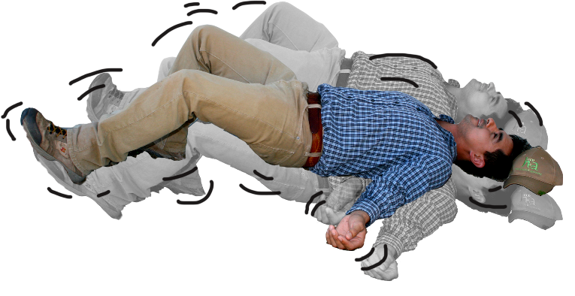
Severe Symptoms
Pinpoint pupils
Trembling, lack of muscle control
Violent convulsions or seizures
Notes:
Information required to be covered:
Severe symptoms include:
Pinpoint pupils
Trembling, lack of muscle control
Violent convulsions or seizures
Unconsciousness or death

Slide 25
The Type and Severity of Symptoms Depend on:
The pesticide
The route of exposure
The length of exposure
How often you are exposed
Age of the person
Health of the person
Notes:
Information required to be covered:
The probability that pesticides will affect your health depends on various things:
The type of pesticide
Poisoning symptoms vary among classes of pesticides and pesticides within a class. For example, pesticides that control weeds (herbicides) can be less toxic than some pesticides used to control insects (insecticides), but some insecticides are more toxic than others.
One pesticide may cause only mild eye irritation if splashed in a person’s eye, while exposure to another product may result in blurred vision. Some pesticides are extremely toxic if swallowed but not harmful if inhaled. Finally, there are also pesticides that, when used correctly and according to the safety measures listed on the label, cause no known adverse health effects.
The amount of pesticide that you are exposed to
The severity of symptoms is usually proportional to the amount of pesticide (dosage) entering the person’s body.
The type and severity of exposure symptoms can also be influenced by the amount absorbed into the body or how fast the body absorbs and excretes it.
Age and health of the person
The severity of symptoms is related to the person’s sensitivity to certain chemical ingredients.
Another factor that can significantly influence the type and severity of reaction to pesticide exposure is the overall health and genetic makeup of the individual. Each person is different. People who are elderly, sick or who have compromised immune systems may not have sufficient resistance to some types of pesticides.
People who have medical conditions such as asthma may experience breathing difficulties when working in an area where pesticides have been applied even after the restricted-entry interval (REI) has expired.

Slide 26
Potential Hazards
Notes:
Pesticides and their residues present potential hazards to workers, handlers, and other people.

Slide 27
Hazards to Children and Pregnant Women
Pregnant women
Miscarriage
Birth defects
Children
Still small
Still developing
Notes:
Information required to be covered:
Pesticide exposure can be extremely hazardous for pregnant women and may result in miscarriage or cause harm to their unborn child.
Children are also susceptible to the effects of pesticides as their bodies are small and their internal organs are still developing and may be negatively impacted by exposure.

Slide 28
Potential Hazards from Pesticides
1. Acute
2. Chronic
Short-term
Symptoms appear shortly after exposure
Single exposure
Mild to serious illnesses
Long-term
Symptoms appear months or years later
Repeated exposures to a small dose
Mostly causes serious illnesses
3. Delayed effects
Notes:
Information required to be covered:
You might experience immediate (acute) and long-term (chronic) health effects if you are exposed to some types of pesticides, depending on the dosage.
The onset of acute illness or injury occurs shortly after exposure. These acute illnesses or injuries can be serious, and could cause days off work or treatment by a doctor. In most cases, acute effects are resolved relatively quickly and the exposed person fully recovers.
Long-term or chronic effects are illnesses or injuries that persist over long periods. They may result from a single exposure incident involving an extremely toxic or a large amount of pesticide or be caused by many repeated exposures at a level that is too low to produce noticeable immediate illnesses or injury.
Delayed effects are health effects that appear after a couple of hours to days from exposure. These are not chronic health effects which can take months to years to develop (i.e., cancer). However, delayed effects can appear as symptoms that were described in short-term and long- term effects.

Slide 29
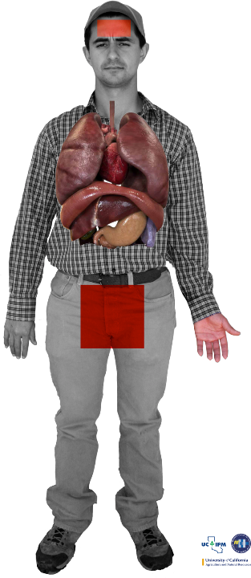
Chronic Pesticide Hazards
Cancer
Fertility problems
Respiratory illness
Nervous system disorders
Birth defects
Immune system disorders
Image credit: Sarah Risorto, UC Statewide IPM Program
Notes:
Information required to be covered:
Long-term health effects associated with exposure to certain pesticides include: cancer, inability to become pregnant (infertility), spontaneous abortion, birth defects in the children of exposed parents, nervous system damage, damage to specific organs such as the lungs or liver and damage to the immune system among other conditions.
Notes for trainers of agricultural workers:
Take for example, Miguel, pictured here. Each of the colored dots on Miguel’s body represents a low level of exposure to pesticide residues, that could have been avoided if Miguel did a better job of protecting himself. Washing up when he left the treated area to get his lunch or make a call, washing after work, and wearing clean clothes that cover his skin could reduce his exposure.
Each day you go to work, you encounter pesticide residues in the dust beneath your feet. It sticks to the bottom of your shoes and to the legs of your pants.
So little by little pesticide residues enter your body.
Each time you are exposed to a pesticide you absorb residues. The first time you might not feel any effect, but as your body absorbs more and more residues you can become sick.
Remember the saying: “little by little the jug is full” or in Spanish, “de poquito en poquito, se llena el jarrito”? This is how over the long term, you can end up with high levels of pesticides in your body.
Repeated contact with residues can lead to pesticide poisoning.
In these situations, the health effects can take years to appear. This is because small doses of different pesticides enter your body at different times and are absorbed into your internal organs.

Slide 30
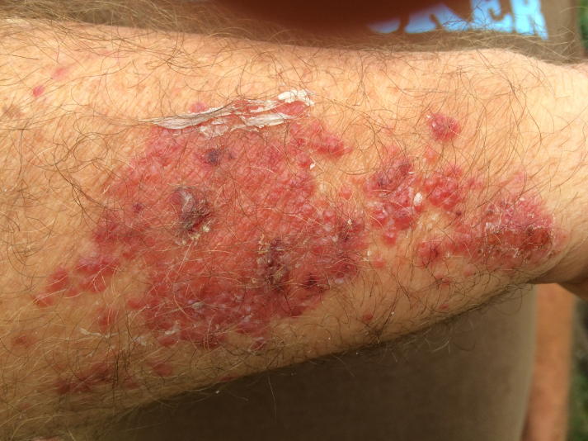
Sensitization
Not overexposure or poisoning
Allergic reaction that develops over time
Skin irritation
Respiratory problems
Image credit: Metere Pinker and Mark Morrison
Notes:
Information required to be covered:
Sensitization is the gradual development of an allergic reaction to a type of pesticide or chemicals in general. Some people get headaches, rashes, or experience dizziness each time they work with a pesticide or enter an area where pesticides were recently used.
Sometimes, even if you protect yourself you can become more sensitive to pesticides. You can start having an allergic reaction. Maybe you had no reaction to pesticides when you began working in the field, but over time you do.
Most commonly, increased sensitivity causes skin irritation or respiratory problems.
Notes for trainers of agricultural workers:
Agricultural workers and pesticide handlers may better understand sensitization if it is compared to an allergic reaction to poison oak or poison ivy. Not everyone will have an adverse skin reaction the first few times they come in contact with the plants. However, after repeated exposures some people will become sensitized and develop a rash that becomes worse with each additional exposure.
Sensitivity to pesticides is not the same thing as overexposure to pesticides. It is important to identify the causes of your symptoms so you know how to treat them.
Becoming sensitive to pesticides can take months or years depending on the person and the type of pesticide to which they are exposed.
Skin irritation means itchiness, redness, pain, or skin blisters when you come into contact with pesticide residues.
Respiratory problems mean sneezing, coughing, shortness of breath, difficulty breathing, even full asthma attacks.
If you notice you are more sensitive to pesticides, let your supervisor know. There are some steps you can take to protect yourself, like wearing a respirator or protective gloves.
Most people don’t develop allergies to pesticides, however all of us need to be careful.

Slide 31
Ways to Reduce Pesticide Exposure
Notes:
The WPS offers ways to reduce pesticide exposure.

Slide 32
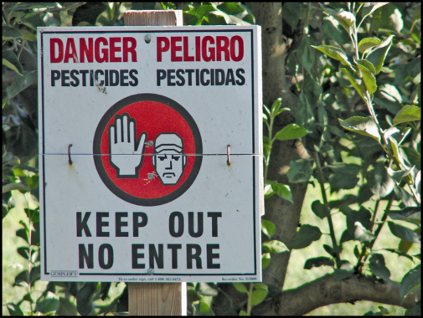
Recognize and Understand the Meaning of Posted Warning Signs
If you see this sign- or one similar to this one - Do Not Enter!
This sign means that there may be pesticides or pesticide residues present in the area
You need to receive training and special protection to enter those areas
Image credit: Chazzbo Media
Notes:
Information required to be covered:
Whenever you see this sign it means that the area is under a restricted-entry interval (REI) and pesticides may not have broken down/dissipated yet to safe levels.
Under certain circumstances, employers are required to post warning signs in pesticide treated areas to indicate REI.
The REI is the amount of time that must pass after a pesticide application before it is safe for workers to enter the area without the proper training and protection.
During the REI, only appropriately-trained and equipped pesticide handlers and early-entry workers are allowed in the area.

Slide 33
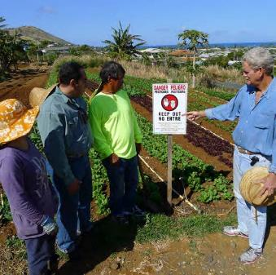
Follow Directions and/or Signs About Keeping Out of Pesticide Treated Areas
Keep out of treated areas or areas being treated with pesticides
Your supervisor will post signs or notify you verbally about what areas are under a restricted-entry interval (REI)
Stay away from the application equipment during pesticide applications
Image credit: James Hollyer, Associate Director for Extension, University of Guam
Notes:
Information required to be covered:
If a field is posted, it means that there are pesticides or pesticide residues.
Obey the signs in order to protect your health.
As long as the signs remain posted, do not enter the area even if the date on the sign indicates that the REI has expired.
In outdoor production: Do not enter treated areas or application exclusion zones (AEZs), which ranges from 0 to 100 feet surrounding the equipment during pesticide applications.
Notes for trainers of agricultural workers:
Workers must clearly understand the following information:
The significance of the posted signs
The importance of obeying oral and posted warnings
One of the possible ways workers may be exposed to pesticides is by entering into treated areas while the REI is still in effect. This may result from the employer failing to notify workers or to post a restricted area. It may also be the result of employers asking workers to enter into treated areas or workers disregarding posted signs or oral warnings.
Pesticide handlers should always communicate to their supervisor and worker crew supervisors about known effective REI’s and on-going pesticide applications.
More information on AEZ’s is covered later in this presentation (Your Employer’s Responsibilities).

Slide 34
You Can Limit Your Exposures to Pesticides By:
Wearing work clothes and/or personal protective equipment that protect your skin
Keeping out of areas indicated by your supervisor
Leaving the area if pesticides are carried towards the area where you are working
Washing with soap and water after working and before eating, chewing tobacco or using the bathroom and before any physical contact with your family
Notes:
Information required to be covered:
You should use clothes (e.g., long sleeve shirt, long pants, shoes plus socks and a hat) that protect your skin when working in treated areas.
You should stay away from areas indicated by your supervisor or that are being treated with pesticides.
If you feel they are being drifted on, you must inform your supervisor and leave the area immediately.
Wash with soap and water after working in fields that have been treated with pesticides before you put anything in your mouth and before you use the bathroom.

Slide 35
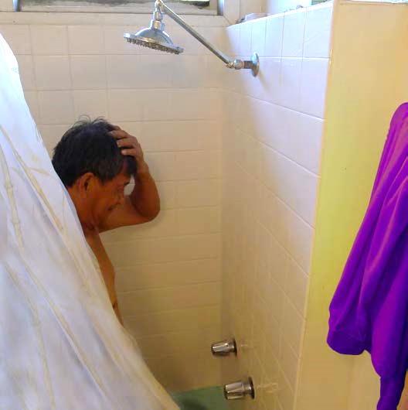
Wash and Change into Clean Clothes
Wash or shower with soap and water and shampoo hair as soon as you can after working with or in areas treated with pesticides
Change into clean clothes after washing
Image credit: James Hollyer, Associate Director for Extension, University of Guam
Notes:
Information required to be covered:
Wash your body with plenty of soap and water and shampoo your hair as soon as you can after applying pesticides or working in treated fields.
Change into clean clothes after washing.

Slide 36
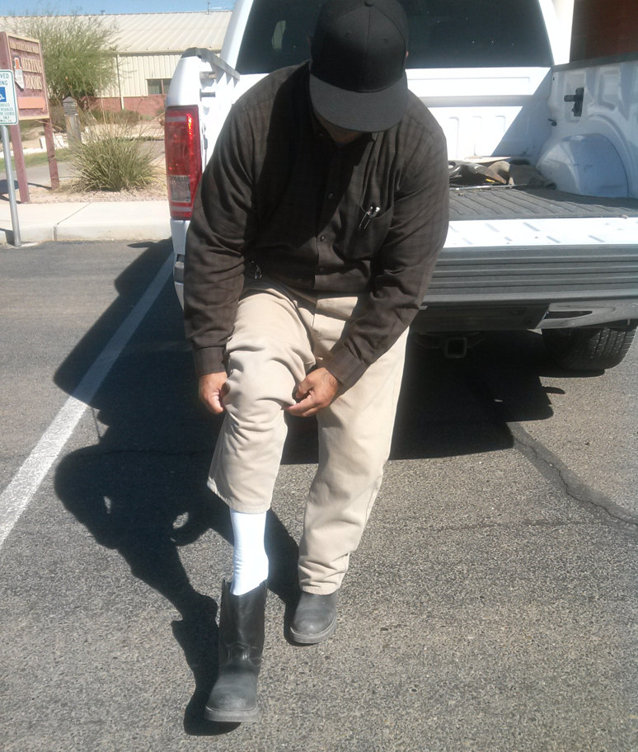
After Working in Pesticide Treated Areas
Remove work boots or shoes before entering your home
Remove work clothes and wash or shower before physical contact with children or family members
Image credit: Jennifer Weber, Arizona Department of Agriculture
Notes:
Information required to be covered:
Remove contaminated work boots or shoes before entering your home –significant amounts of pesticide can be carried in work boots and shoes. It is highly recommended to remove them before entering vehicles and entering your home.
Remove work clothes and shower before having physical contact with children and other family members.

Slide 37
Reduce Pesticide Residue on Clothing
Wear work clothes only once
Put work clothes in a plastic bag after use
Notes:
Information required to be covered:
Pesticide residues that remain on work clothing (such as long pants, long sleeve shirts, shoes, and socks) can be another source of hazard.
You can reduce your risk of exposure to these residues by:
Wearing clothing only once and have at least two sets of work clothes to avoid wearing potentially contaminated clothes before they are washed.
Keeping work clothes that may contain residues separate from other clothing (by putting it into a plastic bag, for instance) to prevent others from coming in contact with them

Slide 38
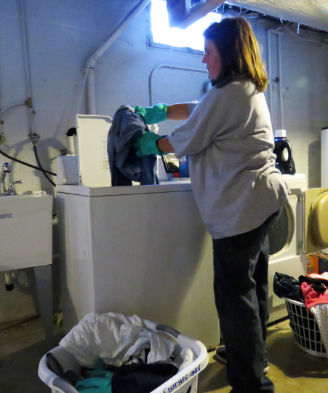
Wash Work Clothes
Wash work clothes before wearing them again
Wash work clothing separate from family laundry
Use hot water
Decontaminate washing machine
Image credit: Ed Crow, Penn State Pesticide Education Program
Notes:
Information required to be covered:
Pesticide residues that remain on clothing can be a source of pesticide exposure for you and your family. There are several ways you can avoid these hazards:
Inform people who wash agricultural work clothing that the clothes may contain pesticide residues and provide them with steps to protect themselves.
Wash work clothes after each use.
Wash work clothes separately from other clothing.
Use hot water for work clothing.
Decontaminate the washing machine by running another full wash cycle with hot water and detergent to remove any remaining pesticide residues from the machine.
Dry laundry outside in the sun to further break down pesticide residues left on the clothes.

Slide 39
Do Not Take Pesticides or Pesticide Containers Used at Work to your Home
Never take pesticides or pesticide containers home – they may contain pesticide residues that may harm you and/or your family
Typically pesticides used in agriculture are not to be used at home
Notes:
Information required to be covered:
Never take any pesticide from work because they are not safe for use around the home.
Never take any pesticide containers home, even empty ones. Pesticide containers are never completely free of pesticide residue and can never be safely used for any other purpose.
Agricultural pesticides, for the most part, are more concentrated and should never be used at home.
Do not pour pesticides from their original containers into drinking containers - Pouring pesticides from their original container into drinking containers is dangerous and illegal. Some unsuspecting person can mistake it for something edible.
Notes for trainers of agricultural workers:
Pesticide poisoning can happen when someone accidentally eats or drinks a pesticide that has been placed into a food or beverage container or drinks from a container that has been used to measure pesticides. Storing or mixing pesticides in food containers is illegal!
Avoid bringing pesticide residues home – it could be very complicated to get rid of them once they are inside.

Slide 40
Keep Children and Family Members Away from Pesticide Treated Areas
Keep children out of places where pesticides may be found
Nonworking family members should not enter into pesticide treated areas
At home – keep pesticide out of reach of children
Image credit: Ashley Estes, Arizona Department of Agriculture
Notes:
Information required to be covered:
Do not allow minor children to enter into pesticide treated areas.
Nonworking family members should stay out of areas under a restricted-entry interval or areas that have been recently treated with pesticides.
At home, keep pesticides out of reach of children.

Slide 41
Decontamination and First Aid
Notes:
It is important to understand how to minimize exposure to pesticides and their residues and how to respond if an emergency occurs.

Slide 42
What is Decontamination?
Routine Decontamination
Emergency Decontamination
Cleansing face, hands or the entire human body to minimize exposure to pesticide residues
Removing pesticides from eyes, skin or clothes during emergency situations
Notes:
Information required to be covered:
Decontamination is the process of cleansing your body, clothing, personal protective equipment, and the application equipment in order to remove pesticides or pesticide residues.
There are two types of decontamination: routine decontamination and emergency decontamination.
Routine decontamination is the process of cleansing of your face, hands or your entire body to minimize exposure to pesticide residues. Washing your hands with soap and water before eating or going to the bathroom and washing work clothes are examples of routine decontamination. Routine decontamination takes place anytime you leave the work area and at the end of the work day.
Emergency decontamination is the process of removing pesticides from your eyes, skin and/or clothes during emergency situations as soon as possible after exposure to avoid adverse health effects. For example, if you get drifted on, you should wash, as soon as possible, your skin with soap and water to prevent pesticides from being absorbed and getting into your body. To remove pesticide from your eye, hold the eyelid open and wash with a gentle drip of clean running water for at least 15 minutes.
Notes for trainers of workers and pesticide handlers:
Make sure you cover the following item during this portion of the training:
How to carry out routine and emergency decontamination, including emergency eye flush techniques.

Slide 43
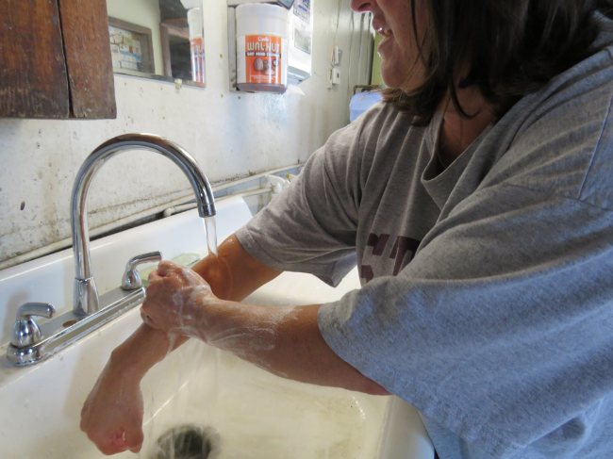
Agricultural Workers Routine Decontamination
Wash hands before eating, drinking, smoking, using the bathroom; before touching eyes or mouth; and before getting into vehicles
Change into clean clothes and shoes
Shower or bathe
Image credit: Ed Crow, Penn State Pesticide Education Program
Notes:
Information required to be covered:
There are several things that you can do as part of your daily routine to minimize exposing yourself and your family to pesticides and pesticide residues. These include:
Washing your hands before eating, drinking, smoking, or using the bathroom while at work.
Washing your hands before touching your eyes or mouth while you are working.
Washing your hands after work and before getting into your vehicles.
Changing into clean clothes and shoes before getting into your vehicles to drive back home.
Showering or bathing, using soap and water and shampooing your hair immediately as soon as possible after work.
Washing your work clothes separately from other clothes before wearing them again.

Slide 44
Emergency Decontamination Procedures for Skin Exposure
Remove contaminated clothing as quickly as possible
Rinse the pesticide from the skin immediately with clean water
Wash with soap and water and shampoo hair as soon as possible
Put on clean, uncontaminated clothes
Report to supervisor or person in charge
Get medical care immediately if symptoms of pesticide poisoning develop or are suspected
Notes:
Information required to be covered:
Emergency decontamination for skin exposure
Remove contaminated clothing as quickly as possible.
Rinse the pesticide from your skin immediately with clean water. Use decontamination supplies to wash immediately or rinse off in the nearest clean water, including springs, streams, lakes or other sources if more readily available than decontamination supplies.
Wash with soap and water and shampoo your hair as soon as possible.
Put on clean, uncontaminated clothes.
Report to your supervisor or person in charge.
Get medical care immediately if symptoms of pesticide poisoning develop or are suspected.
Notes for trainers of agricultural workers:
If pesticides are spilled or sprayed on the body, workers must be trained to use decontamination supplies to wash immediately. Emergency decontamination procedures are extremely important because they will help reduce the severity of the injury in case of exposure.
Important Change to the Rule: EPA has removed from the regulatory text the provision that allows employers to permit workers and handlers to use clean water from springs, streams, lakes or other sources if that water is more accessible in remote locations where the decontamination supplies are farther than one-quarter mile from where workers and handlers are working. Removal of this provision does not prohibit the practice of allowing workers or handlers to use clean water from springs, streams, lakes, or other sources to decontaminate if such water is closer than the provided decontamination supplies, but it removes the responsibility from the employer to ensure that such water meets the standard of being of a quality and temperature that will not cause illness or injury if it contacts the skin or eyes or if it is swallowed. Under the final rule, when workers or handlers are performing tasks at remote sites more than one-quarter mile from the nearest point of vehicular access, employers must provide all required decontamination supplies (soap, single-use towels, and water, plus clean change of clothing if required) at the nearest point of vehicular access. Employers are required to make the decontamination supplies available as close as possible to the remote site (as determined by how close a vehicle can get) but employers do not have to check or confirm that water from springs, streams, lakes or other sources at remote sites meets the standard of being of a quality and temperature that will not cause illness or injury.

Slide 45
Safety Data Sheets
Provide information about the pesticide product
Refer to the SDS if there is an exposure
SDS for all pesticides used on the establishment are located at central location
SDS should match up with the pesticide application records
Notes:
Information required to be covered:
The purpose of the safety data sheet (SDS) is to provide information about chemical and physical hazards, toxicity, first aid, PPE, emergency medical treatment and other information about the pesticides used on the establishment that workers and handlers might come in contact with.
You should refer to safety data sheets if there is an exposure.
Your employer should display SDS’s for all pesticides used on the establishment at the central location and they will be available to you during normal working hours.
SDS’s should match up with pesticide application records.
Notes for trainers of agricultural workers:
Ensure workers understand what a SDS is and its purpose.
It is the responsibility of the employer to do all the following:
Display SDS’s for all pesticides used on the establishment. Copies of the SDS’s used on the establishment must be displayed at a central location on an agricultural establishment that is readily accessible at all times during normal work hours and can be easily seen and read by workers and handlers. Usually this is a location where employees congregate such as where they check in or out of work, change clothes, eat, etc.
Provide workers information about location of the SDS’s on the establishment
Provide workers unimpeded access to SDS’s during normal working hours.

Slide 46
How and When to Obtain Emergency Medical Care
Seek medical attention immediately
Employer will provide transportation
Image credit: Jennifer Weber, Arizona Department of Agriculture
Notes:
Information required to be covered:
You should seek medical attention as soon as possible if you believe you have been poisoned, injured, or made ill by pesticides.
The name, address and telephone number of a nearby medical care facility capable of providing emergency medical treatment is listed at the central location
Your agricultural employer will provide transportation. They can “make transportation available” by: taking you to the medical care facility, by calling an emergency vehicle, such as an ambulance, or by making sure you have a ride to the medical care facility with someone else.

Slide 47
First Aid for Skin Exposure
Help the victim to:
Remove contaminated clothing
Rinse with water
Wash with plenty of soap and water
Image credit: Jennifer Weber, Arizona Department of Agriculture
Notes:
Information required to be covered:
If pesticide gets on your skin, the faster the chemical is washed off, the more minor the injury. The following steps should be taken in the event of a skin exposure:
Remove clothing carefully but as quickly as possible. Try to limit contact with the skin.
Rinse skin.
Cleanse skin and hair thoroughly with soap and water.
Dry and cover the victim with any clean item available.
If there is a chemical skin burn avoid using ointments, lotions, powders, and other drugs in first aid treatments of burns, and
Get medical attention if necessary.
You should refer to the safety data sheets for information about first aid instructions and potential symptoms if there is an exposure.
Notes for trainers of agricultural workers:
Agricultural workers need to know about the correct first aid procedures for pesticide injuries or poisoning. There are some things workers can do immediately to lessen a potential injury before the person (victim) is taken to the medical facility.

Slide 48
First Aid for Eye Exposure
Help the victim to:
Immediately, using a gentle stream of water, flush the eye. Keep the eye open and as wide as possible while flushing
Continue flushing for at least 15+ minutes
Report to supervisor and get medical attention
Image credit: Chazzbo Media
Notes:
Information required to be covered:
If pesticide gets into someone’s eye, help the victim to:
Rinse the eye gently with clean water.
Hold the eye under a shower, or pour water into the eye using a clean water container. Keep the eye open and as wide as possible while flushing. Continue flushing for at least 15 minutes.
Report to your supervisor or person in charge.
Seek immediate medical treatment after flushing.
You should refer to the safety data sheets for information about first aid instructions and potential symptoms if there is an exposure.
Notes for trainers of agricultural workers:
Workers need to know how to assist a person if pesticides get into his or her eyes. Knowing what to do for an eye emergency can save valuable time and possibly prevent vision loss.
If a contact lens is in the eye, begin flushing over the lens immediately. Then, if possible, help the victim remove the lens. Lens might hold the chemical against the cornea. The person providing first aid must make sure the water is not too hot or have a temperature that might cause further damage to the eye tissue. The water flow must be gentle.
The person’s head must be turned so that the affected eye is lower than the unaffected one. This will keep contaminated water from getting into the other eye.
Never add any kind of medicine or substance to the eye rinsing water, nor administer any substance or lotion to the victim after rinsing.
DO NOT bandage the eye.

Slide 49
First Aid for Inhalation Exposure
Move the exposed person into fresh air
Loosen tight clothing
Keep air passages clear
Perform artificial respiration if necessary
Get medical attention as soon as possible
Notes:
Information required to be covered:
If a person has inhaled pesticides, the first aid responder should:
Before rescuing anyone from a closed area, make sure that you do not expose yourself to the same danger. Wear the appropriate protective equipment.
Move the person to fresh air.
Loosen any clothing that makes breathing difficult.
Give mouth to mouth resuscitation if the person is not breathing. Only a person trained in CPR should give mouth to mouth.
Get medical attention for the victim.
You should refer to safety data sheets for information about first aid instructions and potential symptoms if there is an exposure.
Notes for trainers of agricultural workers:
Make sure that workers understand that before rescuing anyone, the first aid responder must be wearing the appropriate PPE to avoid putting himself at risk.

Slide 50
First Aid for Oral Exposure
Never induce vomiting if the person is not fully conscious, or suffering convulsions
Never induce vomiting without specific instructions from the label or a medical professional
Get person to a medical facility as quickly as possible
Image credit: Ed Crow, Penn State Pesticide Education Program
Notes:
Information required to be covered:
Never induce vomiting if the victim is unconscious, suffering convulsions, or lying face up.
Some products have ingredients that make regurgitation worse, so check the label or safety data sheet (SDS) before proceeding. The label and or safety data sheet should have information about whether to induce vomiting.
Always read the label or call the poison control center.
Get medical attention for the victim.
You should refer to the safety data sheets for information about first aid instructions and potential symptoms if there is an exposure.
Notes for trainers of agricultural workers:
The most important decision a worker or handler providing first aid needs to make when a person has swallowed pesticides is whether or not to induce vomiting. The victim’s life may depend on this decision; therefore, it must be made accurately.

Slide 51
Your Employer’s Responsibilities
Notes:
Your employer must provide you specific protections under the WPS.

Slide 52
Employer’s WPS Responsibilities
The employer’s responsibility is to make sure you get annual pesticide safety training before you begin your work to remind you of the basic steps you can take to protect yourself and your family
The agricultural employer needs to provide pesticide application and Safety Data Sheets, for you to refer to if you wish to know about pesticides used on the establishment, what kinds of risks those pesticides pose, and where those restrictions on entry into an area are on the establishment
You can ask your employer for a copy of the application information and the safety data sheets, or you may designate a representative to ask on your behalf. The designation of a representative must be in writing
Notes:
Information required to be covered:
It is your employer’s responsibility is to make sure you get annual pesticide safety training before you begin your work to remind you of the basic steps you can take to protect yourself and your family.
The agricultural employer needs to provide pesticide application and Safety Data Sheets (SDS), for you to refer to if you wish to know about pesticides used on the establishment, what kinds of risks those pesticides pose, and where those restrictions on entry into an area are on the establishment.
You can ask your employer for a copy of the application information and the safety data sheets, or you may designate a representative to ask on your behalf. The designation of a representative must be in writing.

Slide 53
Employer’s WPS Responsibilities
Your employer must tell you where the central location is and where the decontamination supplies are on the establishment
The safety information display at the central location and at some places with supplies for washing up (decontamination supplies) is a reminder about the steps you can take to reduce exposures. It has the name and address of a nearby medical facility, in case of an emergency where a you are made sick from a pesticide. In case you need to report a violation involving a pesticide, contact information for enforcement is on the display
Your employer must provide water, soap, and towels near where you are working so you can wash up when you leave the work area, and if there is an accidental exposure like a spill, the supplies may be used in an emergency to remove pesticides and reduce their effect
Notes:
Information required to be covered:
Your employer must tell you where the central location is and where the decontamination supplies are on the establishment.
The safety information display at the central location and at some places with supplies for washing up (decontamination supplies) is a reminder about the steps you can take to reduce exposures. It has the name and address of a nearby medical facility, in case of an emergency where a you are made sick from a pesticide. In case you need to report a violation involving a pesticide, contact information for enforcement is on the display.
Your employer must provide water, soap, and towels near where you are working so you can wash up when you leave the work area, and if there is an accidental exposure like a spill, the supplies may be used in an emergency to remove pesticides and reduce their effect.

Slide 54
Employer’s WPS Responsibilities
If you are made sick, and pesticides may have been the cause, your employer needs to be told so he or she can make sure you are taken to a medical facility, and provide the medical personnel with information about the exposure
You must be notified by your employer of restrictions on areas where applications are taking place and where an REI is in effect. Those notifications may be in the form of oral warnings or the posted warning signs that will be around the treated area
Notes:
Information required to be covered:
If you are made sick, and pesticides may have been the cause, your employer needs to be told so he or she can make sure you are taken to a medical facility, and provide the medical personnel with information about the exposure.
You must be notified by your employer of restrictions on areas where applications are taking place and where an REI is in effect. Those notifications may be in the form of oral warnings or the posted warning signs that will be around the treated area.

Slide 55
Pesticide Safety Training
Annual training is required
Training must be provided to you before starting work in a treated area
You can ask for a record of the training
Notes:
Information required to be covered:
Pesticide safety training has to be given to you every year and you can ask your employer for a copy of the training record to give to your next employer to show you have had training in the year. The training will remind you of the steps you can take to protect yourself and your family.
Notes for trainers of agricultural workers:
The safety training reminds workers that by paying attention to warnings about application and treated areas, using the supplies provided to wash after being in an area where pesticides have been used, and being careful to wash up when they get home, they can minimize their routine exposure to pesticides.
WPS training is not required for licensed/certified crop advisors who are licensed/certified by a program acknowledged as appropriate by EPA, a state or tribe.

Slide 56
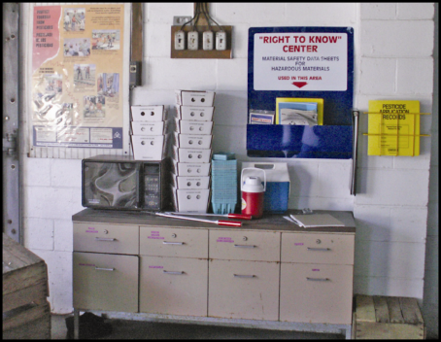
Pesticide Safety Information
Pesticide safety information must be displayed at:
Central location
Permanent decontamination supply sites
Other decontamination locations where supplies are provided for 11 or more workers
Image credit: Ed Crow, Penn State Pesticide Education Program
Notes:
Information required to be covered:
Pesticide safety information must be displayed at Central Location and also at certain places where decontamination supplies must be provided on the agricultural establishment according to the rule; specifically when the decontamination supplies are located at permanent sites or being provided at locations and in quantities to meet the requirements for 11 or more workers.
The central location is a good source of information about areas that have been treated, so you can see what was used and how long you should stay out of the area.
Pesticide safety information has traditionally been in the form of a pesticide safety poster (Far upper left in image). Information can be displayed in any format, but must be conveyed in a manner that you can understand.
The safety information poster is a reminder of the correct ways for you to limit your exposure, by washing up and avoiding areas that have been treated.
There is also a medical care facility listed on the poster that you can contact if someone is made sick. You should be familiar with the medical facility information so you can act if you, or another worker, becomes ill.
New poster will be developed by January 2, 2018.
Beginning in January 2018 the poster will include the name, address and phone number of the state or tribal regulatory agency. You can use this information to report suspected violations.

Slide 57
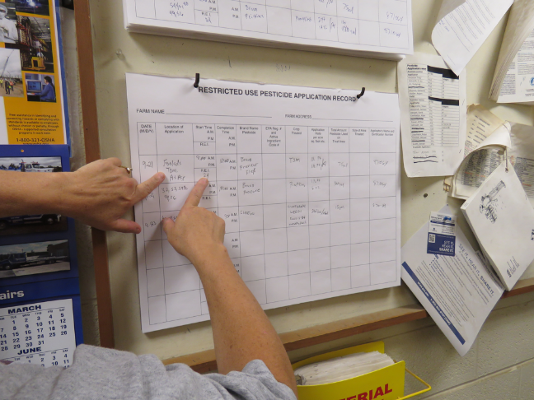
Pesticide Application Information and Safety Data Sheets
Name, EPA registration number and active ingredient
Crop or site treated and location and a description of treated area
Date(s) and times the pesticide application started and ended
Duration of the restricted-entry interval (REI) for that application
A copy of the safety data sheet (SDS)
Image credit: Ed Crow, Penn State Pesticide Education Program
Notes:
Information required to be covered:
If you are unsure of what areas are prohibited for entry, you can refer to the application information to know where there is an REI in effect and what pesticide was used.
You can use the pesticide name to look up its health hazards in the safety data sheets (SDS) that will be located there as well.
It is important for you to know where the EPA registration number is – if someone is made sick, and they are taken to a medical facility, the registration number of the pesticide is very helpful to the doctor to know more about what they may have been exposed to.
Your employer must display specific pesticide application information at a central location such as a break room or common gathering area that is accessible to all employees during their work hours.
Notes for trainers of agricultural workers:
The application information will tell workers :
where treated areas are located, and how long they should stay out of them,
what was applied, and
that the application information and the SDS can tell workers and handlers what risks from pesticides may be present to their health.
This information will enable workers to avoid areas that are being treated with pesticides or still under a REI.
The information can be displayed in any format as long as it is legible, accessible to all employees and contains:
The product name, EPA registration number, and active ingredient(s) of the pesticide
The crop or site treated and the location and description of the treated area(s)
The dates and times of the pesticide application
The time that the application was completed
The duration of the REI for that application
A copy of the SDS
The employer must display application information and SDS at central location within 24 hours of end of application and before workers enter that treated area; display both for 30 days after the REI expires; and keep application information and SDS records for 2 years from end of REI.

Slide 58
Requesting Pesticide Application Information and Safety Data Sheets
You can request the pesticide application and SDS from your employer, or you may designate a representative to do so on your behalf
A treating medical person can also request access to or a copy of the application information and SDS
Notes:
Information required to be covered:
You can request records yourself, through medical personnel or through a designated representative. A designated representative is a person, chosen, by you, who can request and obtain a copy of the pesticide application and Safety Data Sheets on your behalf.
Notes for trainers of agricultural workers:
The designated representative must be designated in writing.

Slide 59
Other Employer Responsibilities in Relation to Pesticide Information
Employers must inform you where the pesticide safety, application and hazard information is located
You have unrestricted access to the posted information
Notes:
Information required to be covered:
Your employer must inform you where the pesticide safety, application and hazard information is located.
You must have unrestricted access to the posted information.
Notes for trainers of agricultural workers:
The information is there for the worker’s reference, so they need to know the location of the central display, and that the information should be current and clear.

Slide 60
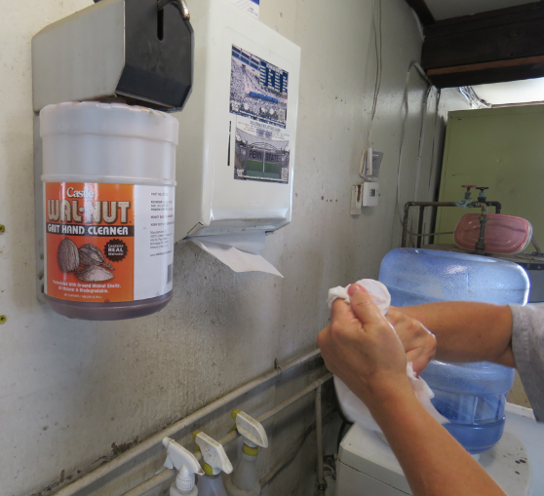
Decontamination Supplies for Agricultural Workers
Water
Soap
Single use towels
Image credit: Ed Crow, Penn State Pesticide Education Program
Notes:
Information required to be covered:
Your employer must provide at least 1 gallon of water for each worker at the beginning of the work period.
and enough soap and single use towels for the workers’ needs.
The supplies must be near your work location.
Notes for trainers of agricultural workers:
Focus the training more on the need for workers to USE the decontamination supplies, emphasizing that the supplies are nearby for their use and health and safety. The consequences of not washing up can result in, at least, uncomfortable rashes.

Slide 61
Provide Emergency Medical Assistance
If you have been made ill and it is reasonable to think it was from pesticides, you should:
Inform your employer, who must make transportation available to a medical facility
Get first aid, if there is time, but do not delay getting to medical personnel!
The employer needs to give this information to the medical personnel: the safety data sheet for the product, the name of the product, its registration number and active ingredients, and the circumstances of the use of the product and of the exposure
Notes:
Information required to be covered:
If you have been made ill and it is reasonable to think it was from pesticides, you should:
Inform your employer, who must make transportation available to a medical facility
Get first aid, if there is time, but do not delay getting to medical personnel!
Your employer needs to give this information to the medical personnel: the safety data sheet (SDS) for the product, the name of the product, its registration number and active ingredients, and the circumstances of the use of the product and of the exposure.
Notes for trainers of agricultural workers:
Emphasize that, if a person is made ill, and it might be pesticides, they should tell their employer and get to medical attention immediately.
The employer can give the information directly to the medical staff or to the worker or handler to give to medical staff. But ultimately the employer is responsible for the information getting to the medical staff.

Slide 62
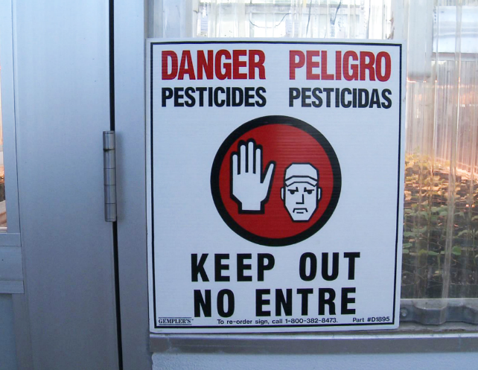
Oral and Posted Notification of Treated Areas
You must be notified by the employer of restrictions on areas where applications are taking place and where an REI is in effect
Notifications may be in the form of oral warnings or the posted warning sign that will be around the treated area
Image credits: Betsy Buffington, Iowa State University and James Hollyer, Associate Director for Extension, University of Guam
Notes:
Information required to be covered:
The notification may be either oral or posted, and you should heed the signs because the area is still under the restricted-entry interval (REI).
Even if the REI has expired, you should not enter the treated area until the signs are covered or removed. BUT your employer may, in rare cases, direct you to enter a treated area where the REI is still in effect (early entry) – but if that happens, you must get information about the pesticide that was used and its risks, information about how long they can stay in the area and what tasks you may do, and you probably would have to wear PPE.
Notes for trainers of agricultural workers:
Stress that, if workers see the sign, THEY SHOULD NOT ENTER THE AREA.
Workers should heed the oral warning as well.
Inform workers that they can refer to the application information in case they aren’t sure about an area.
Posting requirements are dependent on the label instructions and the length of the REI
Workers are prohibited from entry (except for early entry tasks or work) while signs are posted.

Slide 63
Protections During Applications: Outdoor Production
Drift can result in contact that can make you ill or contaminate your clothes worn home
If you feel drift contacting yourself, leave the area immediately and wash up as soon as is practical
Agricultural employers must keep workers and other persons must keep out of application exclusion zones (AEZs)
Notes:
Information required to be covered:
Drift can result in contact that can make you ill, or contaminate your clothes that you wear home.
If you feel drift contacting yourself, you should leave the area immediately and wash up as soon as is practical.
Agricultural employers must make sure that no workers or other people are ‘near’ the application equipment during applications.
Application exclusion zones (AEZs) are areas around a pesticide application that should (a handler may determine, for example, that wind direction is such that the person within the AEZ will not be contacted) be free of all people other than trained and equipped handlers during pesticide applications. Application exclusion zones minimize the potential for workers and other people being contacted by the application, either directly or through drift.
Notes for trainers of agricultural workers:
Emphasize that this protection is intended to help protect workers from spray drift and contact with pesticides.
Nearly all outdoor applications have an “application exclusion zone” or AEZ of 25 – 100 feet. The size of the zone depends on the type of application equipment used.

Slide 64
Application Exclusion Zone in Outdoor Production
When the application is concluded, the AEZ no longer exists.
Field
AEZ
Spray Area
Treated Area
Notes:
Information required to be covered:
During an application, an agricultural employer must keep workers and other people (anyone other than equipped and trained handlers) out of the treated area or AEZ that is within the boundary of the establishment owner’s property.
For aerial, air blast, spray, fumigant, smoke, mist, or fog pesticide applications and for applications with droplet sizes that are fine or smaller in outdoor production (farm, forest, nurseries), everyone other than equipped and trained pesticide handlers must be kept at least 100 feet away from the pesticide application equipment. For other types of applications with spray droplet sizes that are medium or larger in outdoor production, the distance is 25 feet.
Notes for trainers of workers and pesticide handlers:
Explain that this requirement only applies within the boundaries of the establishment because the agricultural employer cannot be expected to control persons off the establishment.

Slide 65
AEZs on Field Borders
AEZ
Spray Area
EVALUATE!
Can you ask the workers to move somewhere else until you are done with the application?
Proceed with caution.
SUSPEND!
There are workers from the neighboring field in the AEZ!
When the application is finished the AEZ no longer exists.
Treated Area
Yes, they agreed to move!
Neighboring Field
Your Field
Notes:
Information required to be covered:
A handler must immediately suspend the application if a worker or other person (other than handler) is in AEZ.
Can continue with application when people move or after an assessment of the situation guarantee no drift to people off the establishment
Not limited to boundaries of agricultural establishment
One of the three requirements with a delayed compliance date (January, 2018) to allow for handlers to be trained on new content
Explain that the “suspend application” provision does apply beyond the boundaries of the establishment because the handler (applicator) and handler employer do have control over the pesticide application and are subject to a WPS requirement to apply the pesticide in a way that will not contact workers or other persons on or off the establishment.

Slide 66
Protections During Applications: Enclosed Space Production
You must not enter an enclosed space structure until the air concentration level specified on the label is met or, if no air concentration level is specified, until after proper ventilation criteria is met for certain types of applications
Notes:
Information required to be covered:
During a pesticide application in an enclosed space production, agricultural employers must not allow you to enter an enclosed space structure until the air concentration level specified on the label is met or, if no air concentration level is specified, until after proper ventilation criteria is met for certain types of applications.
Notes for trainers of agricultural workers:
Emphasize that pesticide use in an enclosed space can concentrate pesticides, and that they should be very alert to signs or oral warnings.
Page 40, Table 1. Entry Restrictions During Enclosed Space Production Pesticide Applications in the How to Comply With the 2015 Revised Worker Protection Standard for Agricultural Pesticides manual, identifies the entry restrictions when applying pesticides for enclosed space production to ensure workers and other persons are not exposed to the pesticide(s) being applied. The restrictions depend on the types of pesticides or application methods used.
For example, if the pesticide is applied as a smoke, mist, or fog, the agricultural employer must keep workers and other people out of the entire enclosed space until air concentration levels or ventilation requirements are met. Then the agricultural employer must keep workers out of the entire enclosed space during the REI.
As another example, consider a pesticide that is applied as a spray with droplet sizes medium or larger. In this situation, the agricultural employer must keep workers and other people out of the treated area plus 25 feet in all directions (but not outside the enclosed space) until the application is complete. Then the agricultural employer must keep workers out of the treated area during the REI.

Slide 67
Other WPS Topics
Employer responsibilities:
Provide records or other information required by the WPS for inspection to an employee of EPA or any duly authorized representative of a federal, state or tribal agency responsible for pesticide enforcement
Employers cannot punish you for attempting to comply with WPS
Workers:
Report suspected use violations
Notes:
Information required to be covered:
Employers must provide records or other information required by the WPS for inspection to an employee of EPA or any duly authorized representative of a federal, state or tribal agency responsible for pesticide enforcement
WPS prohibits employers from retaliating against you or anyone who follows the regulation. Examples of retaliation include preventing, discouraging, firing or otherwise discriminating against an agricultural employee from complying or attempting to comply with the WPS or for ensuring that the employer complies with the regulations. Furthermore, agricultural employers cannot retaliate against agricultural employees who provide information to the EPA, state, or tribal governmental agency.
Report suspected WPS violations. The contact information of your local regulatory agency must be available to you at the central location.
Notes for trainers of agricultural workers:
Emphasize to workers that the rule prohibits employers from taking retaliatory steps if the employee tries to do what the WPS says to protect themselves.

Slide 68
Acknowledgments
Primary Author
Betsy Buffington, Iowa State University Extension
Project Coordinator
Amy Bamber, Association of American Pesticide Control Officials
Content Developers
Lisa Blecker, University of California, Davis Extension
Ofelio Borges, Washington State Department of Agriculture
Ricardo Davalos, Florida Department of Agriculture
Irene King, New Mexico Department of Agriculture
Kerry Richards, American Association of Pesticide Safety Educators
Flor Servin, Washington State Department of Labor and Industries
Thia Walker, Colorado State University Extension
U.S. EPA Office of Pesticide Programs Reviewers
Kathy Davis, Jennifer Park, Nancy Fitz, Richard Pont
PERC Administrators
Suzanne Forsyth, University of California Davis Extension
Kaci Buhl, Oregon State University
Jeff Loux, University of California Davis Extension
Jeanne Kasai, U.S. EPA
This program was developed through a cooperative agreement between the US EPA (#X8-83616301) and University of California Davis Extension in cooperation with Oregon State University.
Version Dated: May 18, 2017
Notes:
Version Dated: May 18, 2017

