Slide 1
How The Revisions to EPA’s Worker Protection Standard (WPS) Affect Organic Farms/Growers
EPA Office of Pesticide Programs June 2016

Slide 2
Acknowledgements
Thanks to Gary Fish, Pat Hastings, Thia Walker and Jane Larson for permitting the use of some of their previously developed slides and images for this presentation.

Slide 3
Outline
WPS Background
What is a Pesticide / Organic Pesticides
Scope and Applicability of the WPS
WPS Requirements at a Glance
Summary of Key WPS Revisions
Implementation Schedule
Questions?
Additional Examples of “Organic” Pesticide Product Labels

Slide 4
WPS Background

Slide 5
What is the WPS?
Federal Regulation
1974 EPA published 40 CFR, Part 170
“A Worker Protection Standard for Agricultural Pesticides”
Rule is intended to reduce the risks of illness or injury to workers and handlers resulting from occupational exposures to pesticides in the production of agricultural plants
Rule was Revised in 1992 with Amendments added in 1995, 1996, and 2004.

Slide 6
Revised WPS Rule
Published in Federal Register November 2, 2015
MOST new rule requirements go into effect January 2, 2017
A few requirements are delayed until January 2, 2018

Slide 7
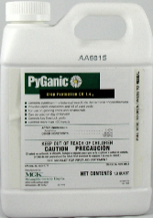
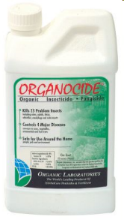
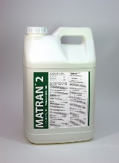
What is a pesticide?
Any substance or mixture of substances intended for:
preventing,
destroying,
repelling, or
mitigating any pest
Or, any plant regulator, defoliant or desiccant.
Does not include fertilizers or nutrients

Slide 8
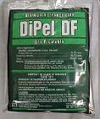
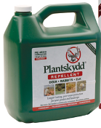
What are pesticides?
Insecticides
Botanicals
Biological controls
Deer and rabbit repellents

Slide 9
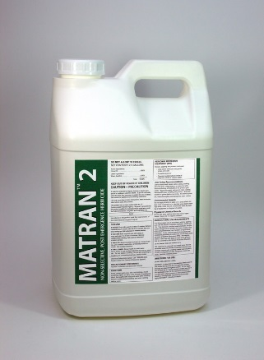
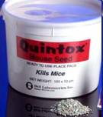
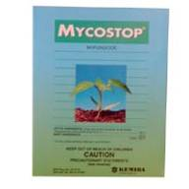
What are pesticides?
Disinfectants & bleaches
Herbicides
Rat & mouse baits
Fungicides

Slide 10
Organic Materials Review Institute (OMRI) Categories That Are Pesticides
Acetic Acid
Animal Repellents
Bacillus Thuringiensis
Beauveria Bassiana
Biological Controls
Boric Acid
Botanical Pesticides
Calcium Polysulfide
Chlorine Dioxide
Chlorine Materials
Compost Tea?
Copper Products
Corn Gluten
Cytokinins
D-limonene
Diatomaceous Earth Disinfectants
Ferric Phosphate
Nonsynthetic Fungicides
Garlic
Gibberellic Acid
Nonsynthetic Herbicides
Hydrogen Peroxide
Inoculants

Slide 11
OMRI Categories That Are Pesticides
Lime Sulfur
Microbial Products
Mined Minerals (Surround)
Neem Extract & Oils
Nonsynthetic Nematicides
Narrow Range Oils
Nonsynthetic Oils
Peracetic Acid
Pheromones
Plant Extracts
Potassium Bicarbonate
Pseudomonas
Pyrethrum
Sanitizers
Seed Treatments
Soap
Sodium Carbonate
Spinosad
Streptomycin Sulphate
Sulfur
Tetracycline
Trichoderma
Virus Sprays
Yucca

Slide 12
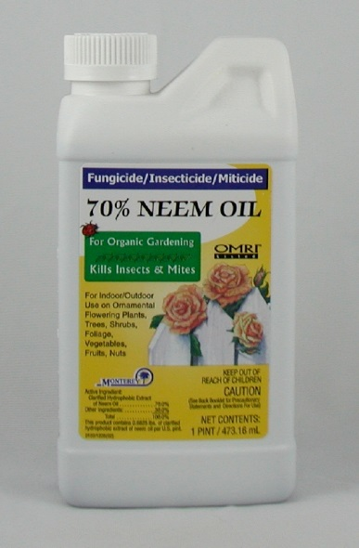
Some “Organic” Pesticide Examples
Trilogy: Neem Oil, 4 hour REI
Javelin: Btk, 4 hour REI, dust/mist filtering respirator for applicators
DES-X: insecticidal soap, 12 hour REI, eyewear, coveralls, chem-resist footwear and gloves
Champion: copper hydroxide, 48 hour REI, eyewear required
Notes:
Check labels
Trilogy – by Certis has ag use
Natria by Bayer Advanced, no ag use requirement BUT label says home and garden use

Slide 13
Scope and Applicability
The USDA National List of allowed pesticides for organic growers includes many EPA registered pesticides that include WPS labeling and compliance with the WPS requirements.
Notes:
“Don’t use bad stuff”
“Organic production” – have some label examples
Can’t fit all the details of WPS on the label so it references federal code (40 CFR 170)
Also referenced in ATCP 29
Label does list length of restricted entry interval (REI)
PPE to wear for mixer/loaders, handlers, early entry workers

Slide 14
Scope and Applicability
Keys to WPS applicability:
Use of a WPS-labeled pesticide product on an “agricultural establishment” directly related to the production of an “agricultural plant”

Slide 15
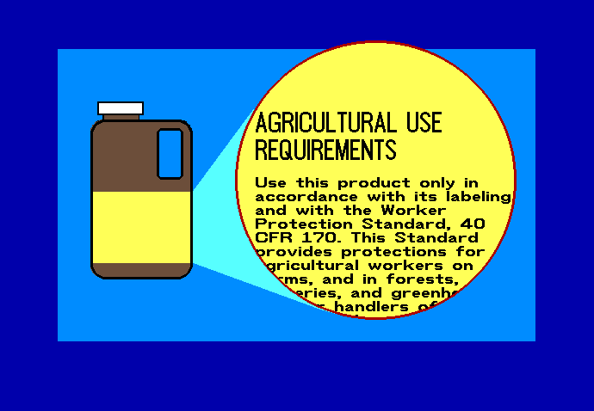
Scope and Applicability
WPS requirements are incorporated onto pesticide labeling of agricultural use products by WPS reference statement contained in the “Agricultural Use Requirements” box

Slide 16
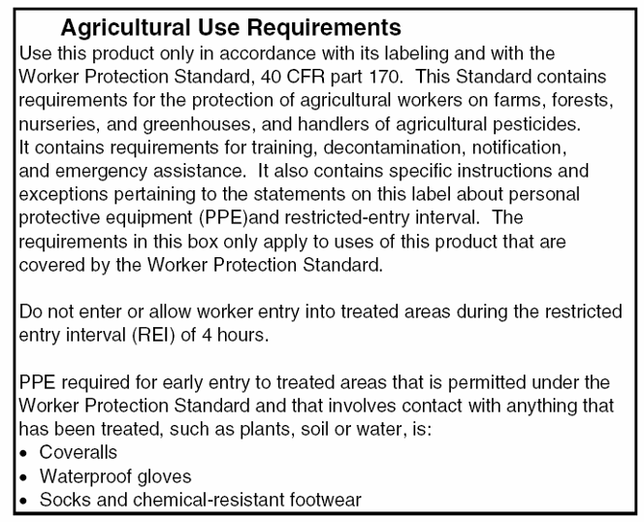
Find this statement on the label:
Notes:
The Agricultural Use Statement is in a box on the label. It instructs the user to comply with all the requirements of the Worker Protection Standard, including training of employees, decontamination, application notification, emergency assistance, and minimum restricted entry intervals and personal protective equipment. Again this section lists the REI and PPE requirements for early enter workers.

Slide 17
Scope and Applicability
Statement found on pesticide labels with crop uses:
Restricted-use pesticides
General-use pesticides
Pesticides for organic production
Notes:
“Don’t use bad stuff”
“Organic production” – have some label examples
Can’t fit all the details of WPS on the label so it references federal code (40 CFR 170)
Also referenced in ATCP 29
Label does list length of restricted entry interval (REI)
PPE to wear for mixer/loaders, handlers, early entry workers

Slide 18
Scope and Applicability
Keys to WPS applicability:
Use of a WPS-labeled pesticide product on an “agricultural establishment” directly related to the production of an “agricultural plant”
Employment of workers or handlers
Even farm owners that don’t employ workers or handlers have WPS responsibilities applicable to owners and their immediate family

Slide 19
Scope and Applicability
Who is responsible for providing the protections?
Agricultural employers on crop-producing establishments
Who is protected?
Farmworkers
Pesticide handlers
Other persons during pesticide applications

Slide 20
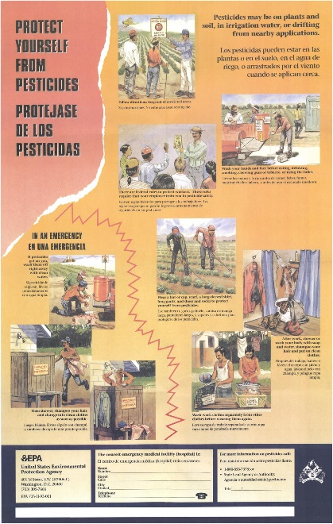
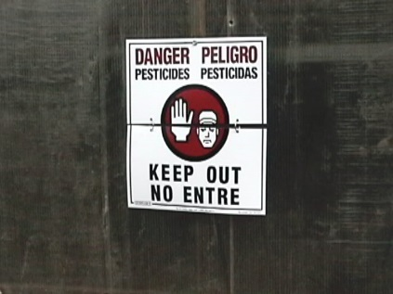
WPS Requirements at a Glance
Inform
Training
Pesticide safety information
Notification
Information exchange

Slide 21
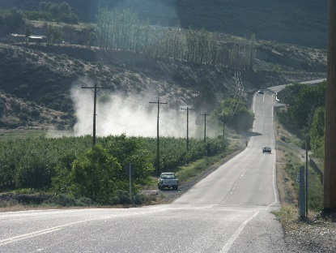
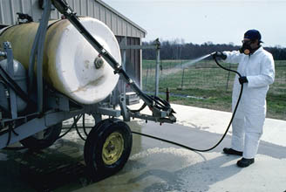
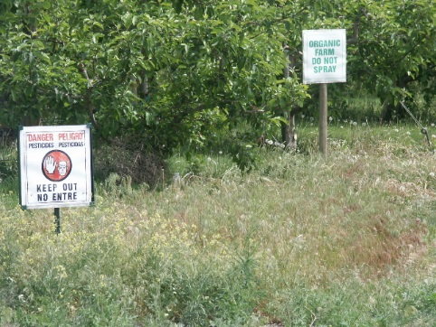
WPS Requirements at a Glance
Protect
Restricted entry intervals (REIs)
Personal protective equipment (PPE)
Application exclusion zones (AEZs)
Suspend applications

Slide 22
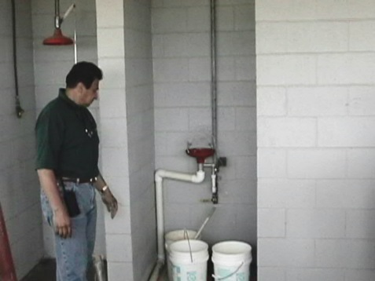
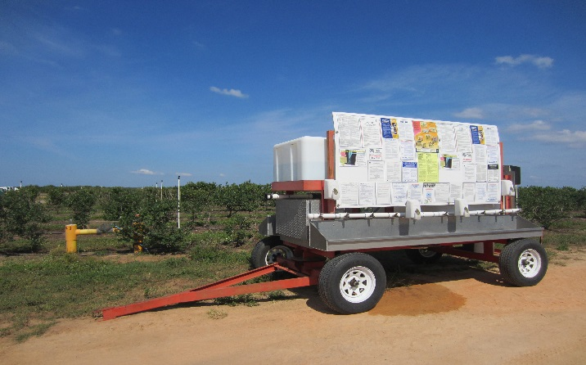
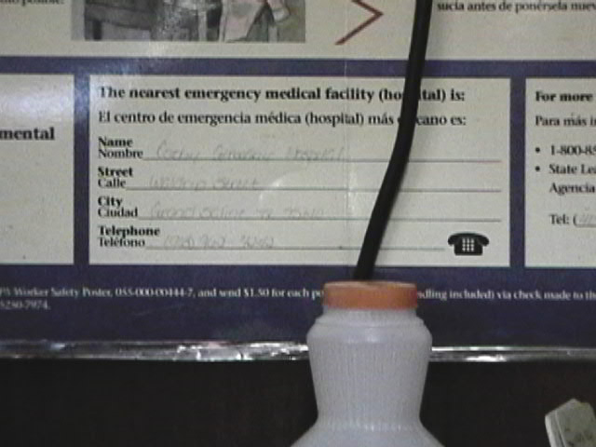
WPS Requirements at a Glance
Mitigate
Routine decontamination supplies
Emergency eyewash
Emergency assistance

Slide 23
Summary of Key WPS Revisions

Slide 24
Pesticide Safety Training
Key Requirements:
Pesticide training every year
Expand training content [Delayed implementation]
Require recordkeeping of training for 2 years
Provide worker or handler a copy upon request
No “grace period”
Keep certified applicators as trainers
Train-the-trainer programs must be approved by EPA

Slide 25
Notification
Key Requirements:
Post outdoor treated areas when REI is greater than 48 hours
Early-entry workers must be provided PPE & oral notification of:
information about the pesticide application
specific task to be performed
amount of time that the worker is allowed to remain in the treated area
the PPE required by the label
No recordkeeping of info provided to early-entry workers

Slide 26
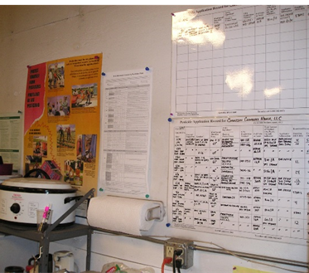
Hazard Communication
Key Requirements:
Hazard information includes the application-specific information and the pesticide safety data sheets (SDSs)
Post hazard information at central display for 30 days after REI expires and retain for 2 years
Access available from display period through retention to:
Employee (upon oral or written request)
Treating medical personnel and persons working under their supervision (oral or written request)
Designated representative (written request only)

Slide 27
Pesticide Safety Information
Key Requirements:
Safety information displayed at central location and certain decontamination sites
Additional information required on display [Delayed implementation]

Slide 28
Minimum Age for Handlers and Early-Entry Workers
Key Requirements:
Requires a minimum age of 18 for pesticide handlers and early entry workers (who enter field during restricted-entry interval (REI))
Members of owner’s immediate family are exempt from this requirement
No minimum age in WPS for workers entering field after REI expires

Slide 29
Some “Organic” Pesticide Examples
Trilogy: Neem Oil, 4 hour REI
Javelin: Btk, 4 hour REI, dust/mist filtering respirator for applicators
DES-X: insecticidal soap, 12 hour REI, eyewear, coveralls, chem-resist footwear and gloves
Champion: copper hydroxide, 48 hour REI, eyewear required
Notes:
This is to show label examples again to demonstrate that some organic products have PPE requirements that will trigger the new WPS requirements for respirators and eye flush.
Check labels!!!
Trilogy – by Certis has ag use
Natria by Bayer Advanced, no ag use requirement BUT label says home and garden use

Slide 30
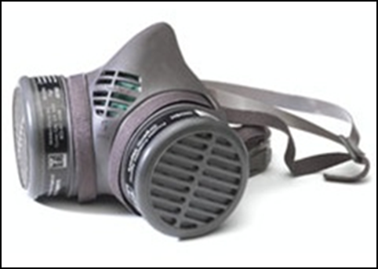
Respirator Requirements
Key Requirements:
Adopts by reference a subset of OSHA’s
standard for respirators
When a respirator is required by the labeling, handler employer must provide handlers with the following before the handler performs any activity requiring the respirator:
Medical evaluation
Fit test
Respirator training
Handler employer must maintain records for 2 years documenting completion of these
Notes:
WPS cherry-picked from OSHA’s respirator standard to only require most important elements critical to ensuring the human health of the respirator wearer. EPA/OPP’s program already carries out certain elements of the work required under the OSHA rules (risk assessment and hazard evaluation and respirator selection).
WPS does not include these elements of OSHA’s respirator program:
Written respiratory protection program
Respirator selection (assess hazards)
Proper use of respirators
Maintenance and care
Program evaluation

Slide 31
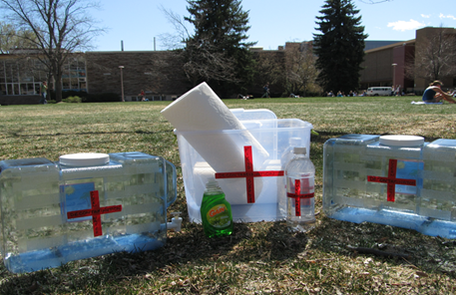
Decontamination Supplies
Key Requirements:
If handler is mixing/loading a product that requires eye protection, eyeflush water must be immediately available at the mix/load site for handler eye flushing
If applicator is using a product that requires eye protection, one pint of water must be immediately available to each applicator

Slide 32
Emergency Assistance
Key Requirements:
Employer must provide prompt transportation to emergency medical treatment facility in case of pesticide illness or injury
Requires employers to provide for each product the SDS and specific information about the product, as well as the circumstances of the application and exposure, to treating medical personnel

Slide 33
Implementation Timeline
Date | Milestone
September 28, 2015 | Revised WPS final rule signed and announced.
November 2, 2015 | Revised WPS final rule published in the Federal Register.
January 1, 2016 | Revised WPS final rule becomes effective. [Compliance is required with existing WPS during 2016.]
January 2, 2017 | Compliance is required with most of the revised WPS requirements.
January 1, 2018 | Compliance is required with all of the revised WPS requirements. Last three requirements: Cover new content in worker and handler training Include new content on pesticide safety information display Handlers suspend applications if anyone is in the application exclusion zone.

Slide 34
Questions?
Richard Pont
pont.richard@epa.gov
703-305-6448
Web site: http://www2.epa.gov/pesticide-worker-safety

Slide 35
Additional Examples of “Organic” Pesticide Product Labels and Their Associated PPE Requirements

Slide 36
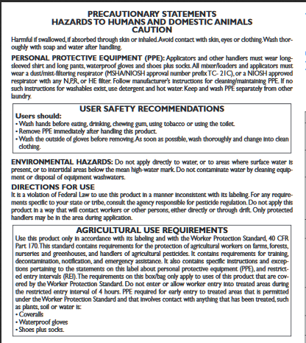
Source: http://www.cdms.net/ldat/ld5SH001.pdf
Notes:
Specimen Label Contans WG;
http://www.cdms.net/ldat/ld5SH001.pdf
EPA Reg. No: 72444-1
EPA Est. No: 72444-DEU-001
WPS-labeled
Respiratory protection required
For agricultural, greenhouse and nursery uses
Distributed by:
Sipcam Agro USA, Inc.
2520 Meridian Parkway, Suite 525
Durham, NC 27713
Manufactured by:
PROPHYTA Biologischer Pflanzenschutz GmbH
Inselstrassse 12
D-23999 Malchow/Poel, German
EPA Reg. No: 72444-1
EPA Est. No: 72444-DEU-001
http://www.sipcamadvan.com/contans-wg http://www.sipcamadvan.com/contans-wg

Slide 37
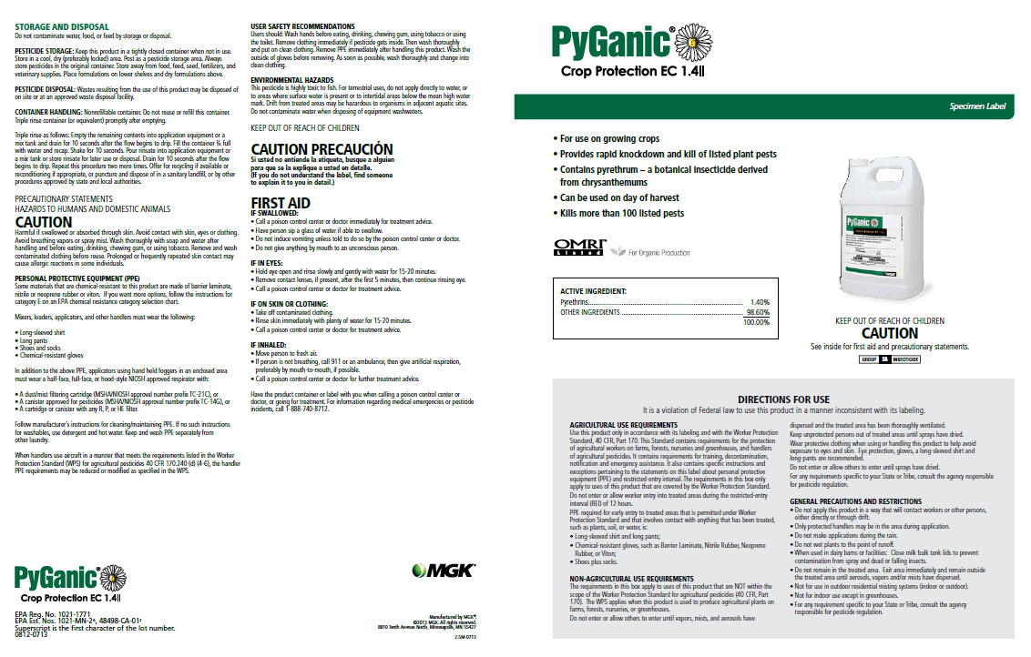
Notes:
http://www.brandt.co/Portals/0/PDFs/Insecticides/PyGanic_Crop_Protection_EC_1-4_II-MSDS.pdf
http://www.brandt.co/Portals/0/PDFs/Insecticides/PyGanic_Crop_Protection_EC_1-4_II-MSDS.pdf

Slide 38
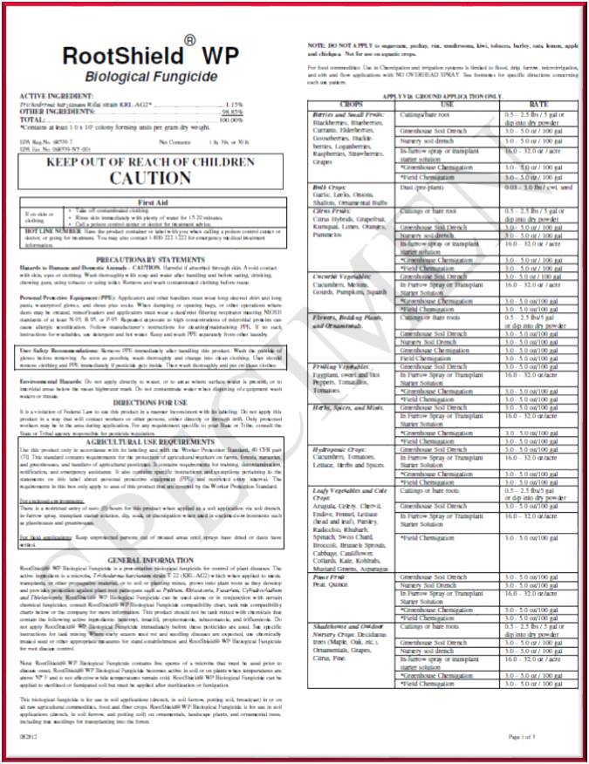
Source; www.plantproducts.com/us/images/rootshield-wp-label.pdf
Notes:
http://www.plantproducts.com/us/images/rootshield-wp-label.pdf

Slide 40
Notes:
http://www.biosafesystems.com/documents.html
http://www.biosafesystems.com/contact.htmlBioSafe Systems takes pride in prompt and effective customer service. Phones are handled by real people and you receive real results with each call. BioSafe Systems has not forgotten who is most important: our customers.
Corporate Office:
22 Meadow Street,
East Hartford, CT 06108
Phone: 860.290.8890
Fax: 860.290.8802
www.biosafesystems.com

Slide 41
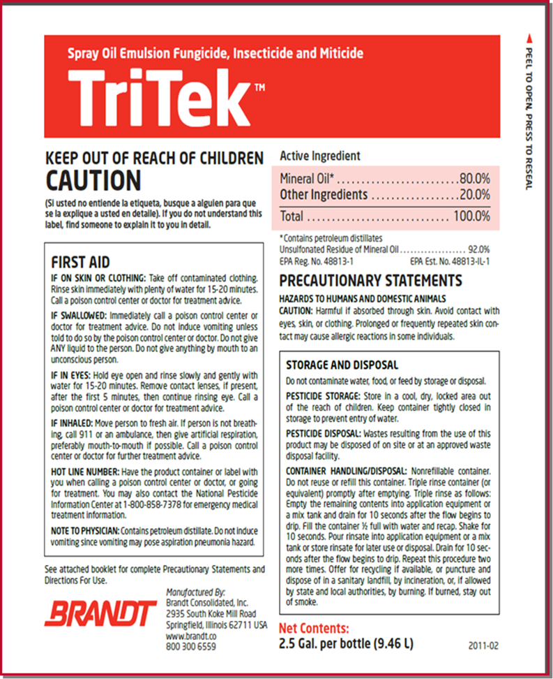
Notes:
http://www.ebay.com/itm/like/400531589204?lpid=82

Slide 42
Notes:
http://www.brandt.co/Portals/0/PDFs/Fungicides/Brandt_Lime_Sulfur-Label.pdf
http://www.brandt.co/Portals/0/PDFs/Fungicides/Brandt_Lime_Sulfur-OMRI.pdf
http://www.brandt.co/Portals/0/PDFs/Fungicides/Brandt_Lime_Sulfur-MSDS.pdf

Slide 43
OMRI listed EPA REG NJ license npr HE respirator when mix
Source: www.sipcamadvan.com/contans-wg
Notes:
Contans WG- Specimen Label (CA 2007)
http://www.cdms.net/ldat/ld5SH000.pdf
This California Specimen Label has different distributer.
EPA Reg. No: 72444-1
EPA Est. No: 72444-DEU-001
WPS-labeled
Respiratory protection required
For agricultural, greenhouse and nursery uses
Distributed by
Advan LLC
300 COLONIAL CENTER PKWY, #230
ROSWELL, GA 30076
www.advanllc.com
800-250-5024
Manufactured by:
PROPHYTA Biologischer Pflanzenschutz GmbH
Inselstrassse 12
D-23999 Malchow/Poel, German
EPA Reg. No: 72444-1
EPA Est. No: 72444-DEU-001

Slide 44
OMRI Listed
25b - no EPA Registration
Not WPS-labeled
http://www.brandt.co/Portals/0/PDFs/Insecticides/Ecotec-Label.pdf
Notes:
OMRI Listed
25b - no EPA Registration
Not WPS-labeled
Website:
Do all pesticide products have to be registered with the U.S. Environmental Protection Agency (EPA)?
No.
Minimum risk pesticides are exempt from product registration under FIFRA 25(b). Products must meet specific requirements to qualify for the exemption. Certain states require these products to be registered for use.
When products are treated with pesticides to protect the product itself, those treated articles don't have to be registered with EPA. This exemption does not apply for products treated with pesticides to protect the user of the product.
Zero REI (re-entry interval)
■ Zero PHI (post-harvest interval)
■ National Organic Program (NOP) Compliant and OMRI listed
■ University and grower proven effi cacy
ECOTEC is a unique insecticide/miticide with two modes of action:
Extensive research discovered that the patented combination of
essential oils in ECOTEC block octopamine neuroreceptors on insects
and mites. Octopamine regulates the insect’s movement, heart rate,
behavior, and metabolism. Blocking such receptors causes quick
knockdown and death of the target insect. As an essential oil, a
temporary covering of the insect’s outer membrane with a spray of
ECOTEC leads to suffocation of the pest.

