Slide 1
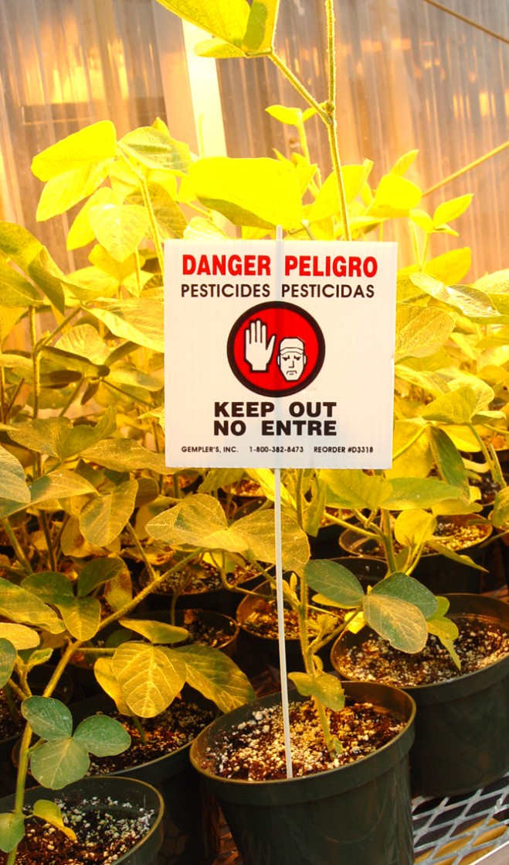
Agricultural Worker and Handler Pesticide Safety Training
2015 Worker Protection Standard
Image credit: Joyce Hornstein, Iowa State University
Image credit: Lance Cheung, USDA
Notes:
This presentation will tell you what to expect from your employer and discuss steps to protect you from exposure to pesticides and their residues at your work site.

Slide 2
EPA has approved this material for training workers and handlers on pesticide safety in accordance with the 2015 WPS expanded training content (40 CFR Part 170). The approval number is EPA Worker and Handler PST 00022.
Notes:
Note: Document the EPA approval number (EPA Worker and Handler PST 00022) in your training records when using this presentation.

Slide 3
Using these slides to train workers and handlers
This presentation provides the information required to train workers and handlers under the Environmental Protection Agency’s Worker Protection Standard.
This worker/handler training material can be used in 2017, 2018 and beyond.
To train workers, slides 1 through 39 of this presentation must be presented.
To train handlers, this presentation must be presented in its entirety.
If you add or remove slides from this set, you must submit the training to EPA for approval before it may be used to train workers/handlers.
Please review the notes section of this presentation prior to conducting the training.
Trainings must be conducted in a manner such that the workers understand the information completely.
Notes:
Trainers must provide the training as required by the revisions to the 2015 Worker Protection Standard rule. Trainers must adhere to the training administration requirements from the 2015 WPS.

Slide 4
What is the purpose of this training?
Provide you with information on the potential risks of working in areas where pesticides are being used and pesticide residues may be found
Complete annual training requirements of Worker Protection Standard
Notes:
It is the responsibility of your employer to provide you with information about, and protections from, potential risks from pesticides when you are working in areas where pesticides are being used and pesticide residues may be found. By completing this pesticide safety training, you and your employer will be in compliance with the annual training requirements of the Worker Protection Standard regulation, often referred to as “WPS.” This training will inform you of ways to minimize your exposure to pesticides and reduce your risk of being injured or made ill, and ways you can help protect your family too. If you have any questions during this presentation, make sure to ask your employer or whoever is presenting this information.
Worker/handler training topics covered on this slide: 1.a.

Slide 5
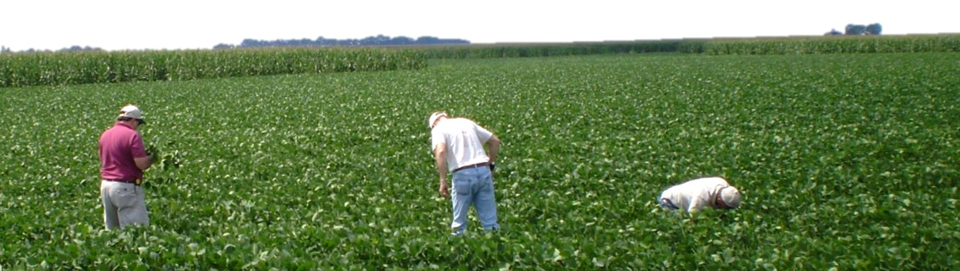
Workers
Do tasks related to the production of agricultural plants on an agricultural establishment
  Examples: weeding, planting, pruning, harvesting
CANNOT handle or apply pesticides
Image credit: Betsy Buffington, Iowa State University
Notes:
You will be trained today as either a worker or a handler.
An agricultural worker, or worker, is a person who is employed (including self-employed) on an agricultural establishment and is doing work such as harvesting, weeding, pruning, or irrigating for the production of agricultural plants on farms, forests, and in nurseries or enclosed space production areas, such as greenhouses.
Your employer must not ask or direct workers to mix, load, or apply pesticides.
Worker/handler training topics covered on this slide: 18.

Slide 6
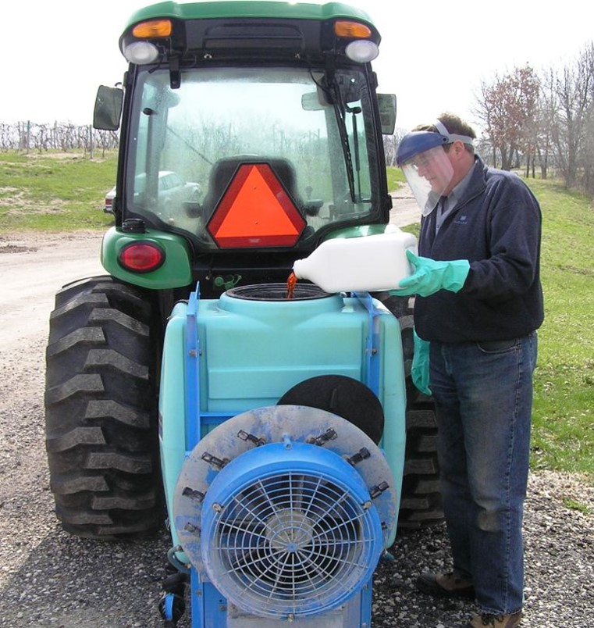
Handlers
Mix, load, transfer, and apply pesticides
Dispose of pesticides or pesticide containers
Handle open pesticide containers
Work as flaggers
Must be at least 18 years old
Image credit: Mike White, Iowa State University
Notes:
Handlers are employed to:
mix, load, or apply agricultural pesticides;
assist with the pesticide application;
dispose of pesticides or opened pesticide containers that have not been cleaned;
handle opened containers of pesticides when emptying, triple rinsing, or cleaning pesticide containers according to pesticide product labeling;
clean, adjust, handle or repair the parts of mixing, loading, or pesticide application equipment that may contain pesticide residues;
work as a flagger
Handlers also perform other tasks in direct contact with pesticides.
Handlers must be at least 18 years old.
Workers should never be asked or directed to mix, load, or apply pesticides or assist in their application without the proper training and protection as a pesticide handler.
Note: Pesticide handlers under the WPS are different than Iowa Certified Handlers. Under the WPS, handlers are employed to mix, load, transfer or apply agricultural pesticides. Iowa Certified handlers cannot apply pesticides.
Worker/handler training topics covered on this slide: 18., 35.

Slide 7
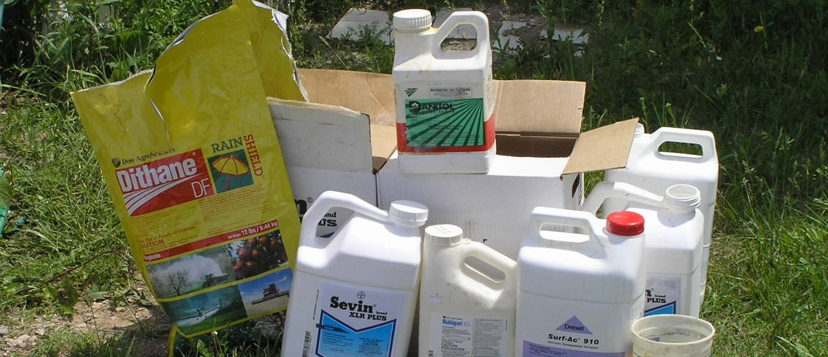
What are pesticides?
Herbicides, insecticides, and fungicides
Image credit: Mike White, Iowa State University
Notes:
Handlers work directly with pesticides; workers do not. However, since workers may work in recently treated fields or near areas where handlers mix, load, apply, or store pesticides, both workers and handlers need to know what pesticides are and when they might come in contact with them. The word “pesticide” is a general term used to describe a substance or mixture that kills a pest, or prevents or reduces the damage a pest may cause. Pests can be insects, mice or other animals, unwanted plants (weeds), fungi, bacteria, or viruses. Examples of pesticides include herbicides, insecticides, and fungicides. They are effective and safe when used properly. However, if used improperly, they can harm people and the environment.
Worker/handler training topics covered on this slide: 4.a.

Slide 8
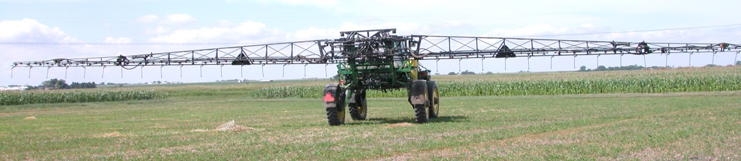
What forms of pesticides can be encountered during work activity?
Liquids
Dusts
Granules
Gases
Residues
Image credit: Kristine Schaefer, Iowa State University
Notes:
Pesticides can be found in different forms, including liquids, dusts and granules, gases (e.g., fumigants), and/or as a residue. A pesticide residue is what is left after a plant or surface has been treated. Residues are not usually visible and can remain on a plant many days after spraying.
Worker/handler training topics covered on this slide: 4.a.

Slide 9
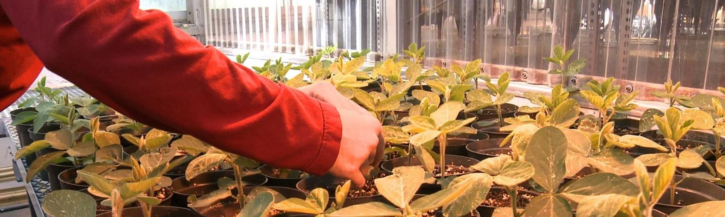
Potential sources of pesticide exposure
Treated plants and soil
Tractors, sprayers, and other application equipment
Irrigation equipment
Work clothing, shoes, and Personal Protection Equipment (PPE)
Image credit: Betsy Buffington, Iowa State University
Notes:
The contact you have with a pesticide or pesticide residue is called pesticide exposure. You may be exposed to pesticide residues found in or on soil and treated plants, and tractors, sprayers, and other application equipment. You may also come into contact with pesticide residues on work clothing, shoes, and used personal protective equipment (PPE), and in pesticide mixing and loading areas.
Worker/handler training topics covered on this slide: 4.a., 4.b., 4.c., 4.d.

Slide 10
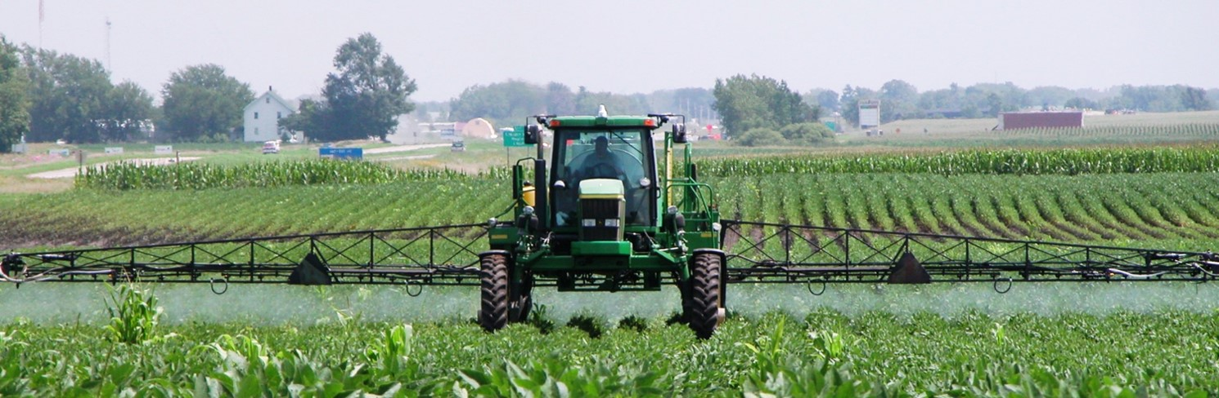
Pesticides may drift through the air from nearby applications
Drift – when a pesticide application moves beyond the application site to a place it is not wanted
Image credit: Kristine Schaefer, Iowa State University
Notes:
You may also find pesticides in the air as dust or vapors, or when a nearby pesticide application spreads beyond the application site. This is called drift. If you are working in a field where someone is applying a pesticide or if a pesticide from a nearby application is drifting into your work area, leave the area and tell your supervisor immediately.
Worker/handler training topics covered on this slide: 4.e.

Slide 11

Pesticides may be in irrigation water
Chemigation – the use of irrigation water to apply pesticides to soils and crops
Image credit: Brenda Carson, Depositphotos
Notes:
Pesticides may also be found in irrigation water as a result of pesticide runoff or chemigation. Chemigation is the use of irrigation water to apply pesticides to soils and crops. Because of this, you should never use irrigation water for drinking or washing.
Worker/handler training topics covered on this slide: 4.f.

Slide 12




Routes through which pesticides can enter the body
Oral
Inhalation
Ocular
Dermal
Notes:
Pesticides can enter your body through your mouth, nose, eyes, and skin.
Worker/handler training topics covered on this slide: 6.

Slide 13
Skin exposure
Skin comes in direct contact with pesticides or pesticide residues
Rash, blisters, skin irritations
Notes:
The majority of the reported cases of agricultural pesticide exposure involved skin exposure. This happens when your skin comes in direct contact with treated plants, soil, irrigation water, farming equipment, dirty hands, and dirty work clothing. This could appear as a rash or redness, blisters, and other skin irritations. Some types of pesticides readily penetrate the skin and get into the body.
Worker/handler training topics covered on this slide: 6.

Slide 14
Eye exposure
Pesticide drift
Rubbing eyes with unwashed hands
Notes:
Pesticides can get into your eyes from pesticide drift or pesticide-contaminated dust and plant material. You may inadvertently get pesticides in your eyes if you rub your eyes with unwashed hands.
Worker/handler training topics covered on this slide: 6.

Slide 15
Respiratory exposure
Vapor or dust from pesticide drift
Entering treated areas
Notes:
Another way you can come in contact with pesticides is by breathing them in through your nose. You can inhale vapor or dust from pesticide drift or by entering treated areas.
Worker/handler training topics covered on this slide: 6.
.

Slide 16
Oral exposure
Drink, smoke, eat, or chew gum with unwashed hands
Unwashed produce
Drinking from pesticide containers
Drinking irrigation water
Notes:
You can transfer pesticide residues from your hands to your mouth if you drink, smoke, eat, chew tobacco or chew gum without first washing your hands. Pesticide residues that remain on treated plants can contaminate food, drinks, or cigarettes brought into the field or greenhouse. Do not eat produce taken from recently sprayed areas and eat them without washing them first. Also, do not eat or drink from any container used for pesticides, even if it has been washed, and do not drink irrigation water.
Worker/handler training topics covered on this slide: 6.

Slide 17
Potential pesticide hazards
Acute effects happen quickly during or after exposure
Delayed effects may take time to develop after an exposure
Chronic effects are the result of exposures over a long period of time
Sensitization is the gradual development of an allergic reaction to pesticides
Notes:
Some people may be harmed by exposure to pesticides more than others. Exposure to some types of pesticides may be immediate or the illness or injury may appear at some later time. These illnesses or injuries can be serious and could result in lost work time and/or require medical treatment.
Acute effects happen quickly during or after exposure.
Delayed effects may take time to develop after an exposure.
Chronic effects are the result of exposures over a long period of time, perhaps as long as 10 or 20 years. These exposures can be in very small amounts that are taken in by the body, and add up over the years.
Sensitization is the gradual development of an allergic reaction to pesticides once your body reaches a certain level of exposure.
Worker/handler training topics covered on this slide: 5.a., 5.b., 5.c., 5.d.

Slide 18

Acute pesticide injury
Eye irritation
Headaches
Loss of consciousness
Nose pain
Throat pain
Chest pain
Difficulty breathing
Skin irritation
Skin rashes
Nausea
Notes:
Acute pesticide injury may include symptoms such as skin rashes, blisters, skin irritation, eye, nose, and throat pain, headaches, sweating, chest pain, difficulty breathing, vomiting or loss of consciousness. This can be serious, requiring medical treatment, absence from work, and even death.
Worker/handler training topics covered on this slide: 7.

Slide 19
Severe acute poisoning
Severe constriction of pupils
Unconsciousness
Salivation
Drooling
Chest pain Breathing difficulty
Lack of muscle control
Notes:
Severe poisoning can result in chest pain, breathing difficulties, excessive salivation or drooling, very small pupils, lack of muscle control, convulsions, and unconsciousness. If you are exposed to certain fumigant gases, poisoning symptoms may also include irrational behavior and elevated body temperature.
Worker/handler training topics covered on this slide: 7.

Slide 20
Long-term health effects
Cancer
Miscarriages
Birth defects
Nervous system disorders
Organ damage
Notes:
Long-term health effects associated with exposure to certain pesticides may include:
cancer
inability to become pregnant
miscarriage
birth defects
nervous system disorders
damage to organs, such as the lungs or liver, and
damage to the immune system
Worker/handler training topics covered on this slide:

Slide 21

Hazards to children and pregnant women
Pesticide exposure can be hazardous to pregnant women
Children are more susceptible to effects of pesticides
Keep all non-working family members and children away from pesticide areas
Image credit: Betsy Buffington, Iowa State University
Notes:
There are hazards to children and pregnant women from pesticide exposure. Pesticide exposure can be hazardous for pregnant women and may result in miscarriage or cause harm to their unborn child. Children are often more susceptible to the effects of pesticides as their bodies and internal organs are still developing and may be negatively impacted by exposure. Keep all non-working family members and children away from areas where they may risk exposure to pesticides and pesticide residues.
Worker/handler training topics covered on this slide: 20., 21.

Slide 22
Reducing the risk of pesticide exposure
During pesticide application
  Only handlers can enter and work
During REI
  Only handlers and early-entry workers can enter
After REI expires
  All WPS-trained employees can enter
Restricted Entry Interval (REI) - the amount of time that must pass before it is safe for a worker to re-enter a pesticide treated area
Notes:
Since pesticide residues are usually invisible, it is often difficult for you to avoid contact. Therefore, you should take steps to protect yourself from exposure to these residues. The first step to preventing pesticide exposure is understanding who is allowed to enter the area during the application, during the Restricted Entry Interval (REI), and after the REI expires. The REI is the amount of time that must pass after a pesticide application before it is safe for workers to enter the area without the required PPE and additional protections. The warning sign should not be posted and oral warnings must have elapsed for a worker to enter the area.
During application - Only appropriately trained and equipped handlers can enter and work in areas during a pesticide application.
During the REI – Only appropriately-trained and equipped handlers and early-entry workers are allowed in the area.
After REI expires, - All WPS-trained employees are allowed into the “treated area,” which is the term used to describe an area that was treated with a pesticide within the previous 30 days.
Worker/handler training topics covered on this slide: 3.

Slide 23
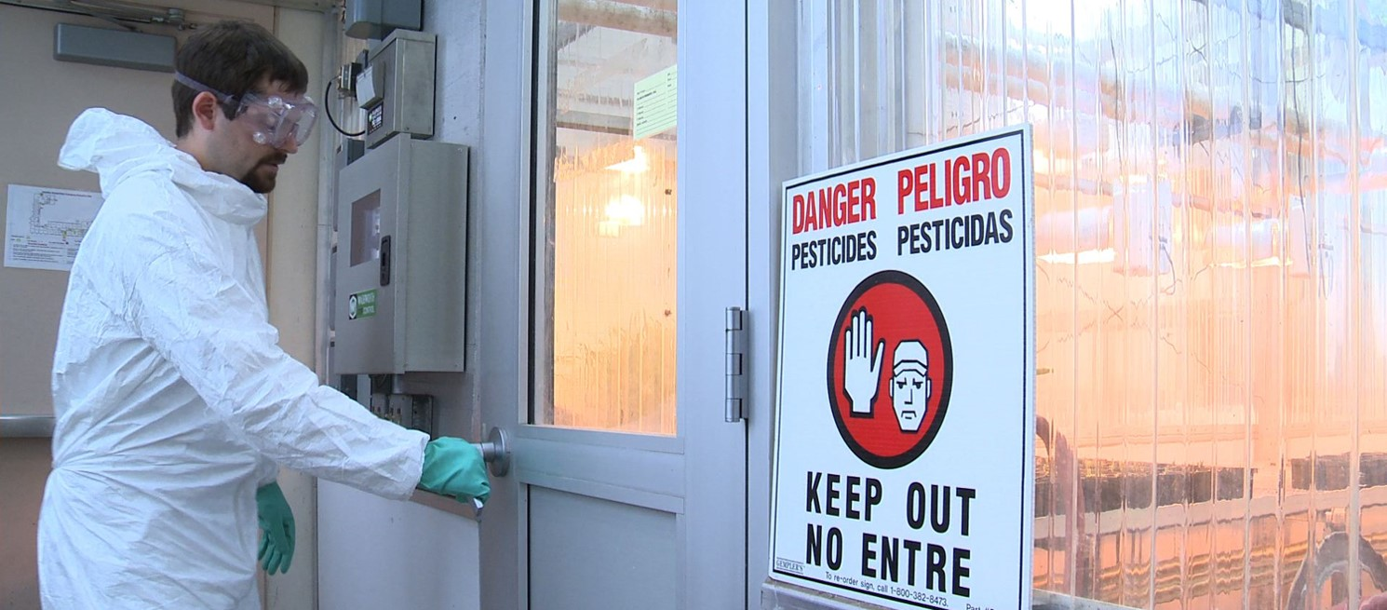
Early-entry workers
Must be 18 years of age or older
Need additional instructions and information
Image credit: Betsy Buffington, Iowa State University
Notes:
In some instances, your employer may ask you to work in a treated area before the expiration of an REI. This is called early-entry work. To do early-entry work, you must be at least 18 years old, your employer must give you additional instructions and information about the hazards of the pesticide that was applied, and the task you’re being asked to do. You would also be provided with personal protective equipment, and instructions on how to use and remove it properly.
Worker/handler training topics covered on this slide: 19.a., 19.b.

Slide 24
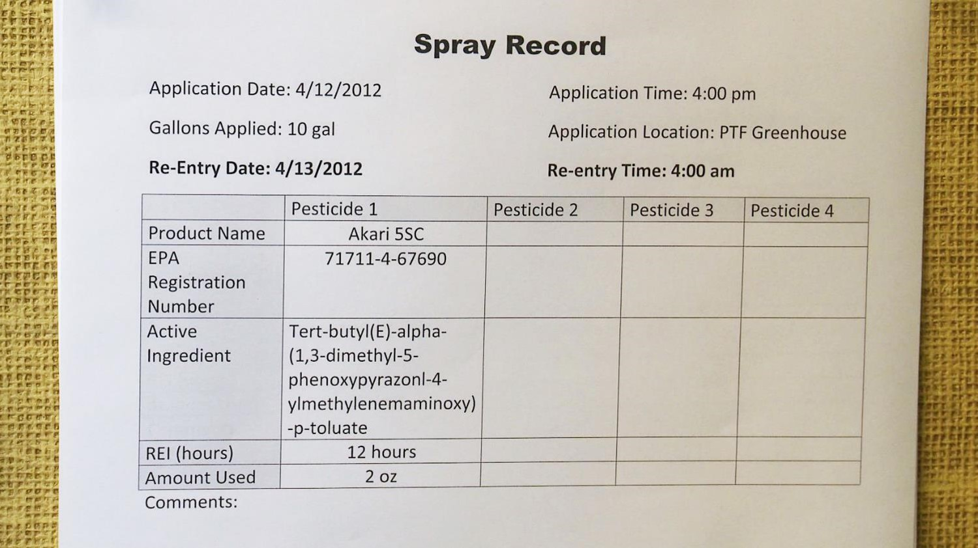
Notification about pesticide applications
Image credit: Betsy Buffington, Iowa State University
Notes:
Your employer must provide you with information about the pesticides you may come in contact with while working on the establishment. This information, and related pesticide information which we will talk about next, are located at a central location on the establishment. This is an area at the worksite that you can visit on a regular basis and that is accessible at all times during your normal work hours. Your employer must tell you where that central location is, and you must have access to it so you can refer to the information on it.
Worker/handler training topics covered on this slide: 1.b.

Slide 25
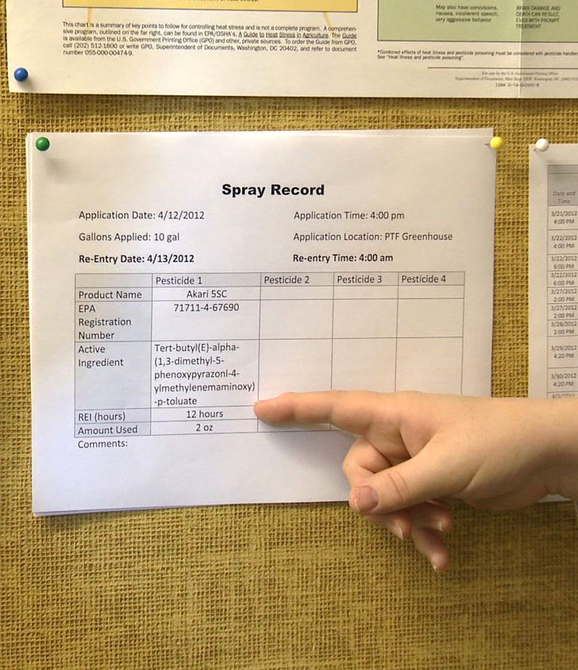
Central location
Pesticide safety information
Emergency information
Pesticide regulatory agency contact information
Pesticide application information
Image credit: Betsy Buffington, Iowa State University
Notes:
Your employer will provide information about pesticide safety, emergency contact, pesticide regulatory agency contacts, and pesticide applications at the central location.
Worker/handler training topics covered on this slide: 1.b., 17.c.

Slide 26
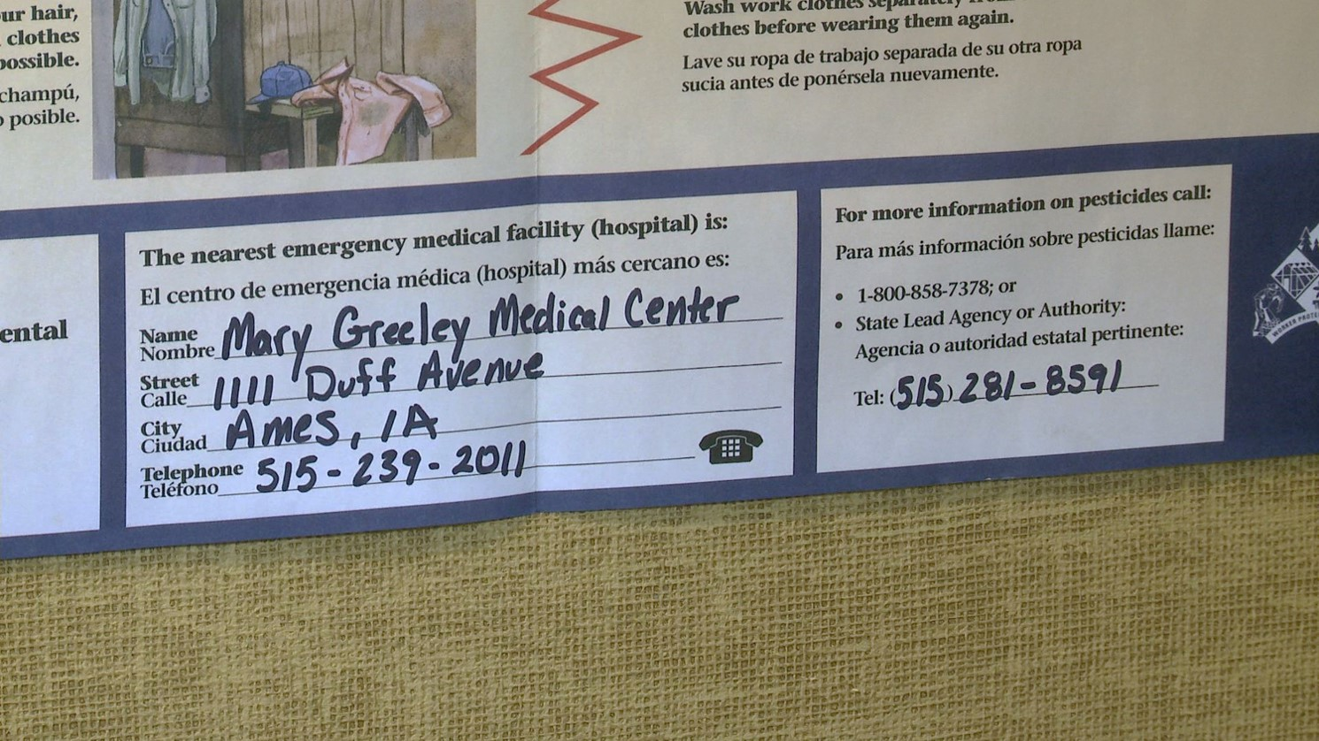
Pesticide safety information
Image credit: Betsy Buffington, Iowa State University
Notes:
Also at the central location, your employer will provide basic pesticide safety information on ways to reduce your exposure to pesticides and pesticide residues, as well as the name, phone number, and address of the nearest medical facility in case of a medical emergency. Contact information for the local pesticide regulatory agency will also be listed. In Iowa, the local regulatory agency is the Iowa Department of Agriculture and Land Stewardship.
Worker/handler training topics covered on this slide: 1.b.

Slide 27
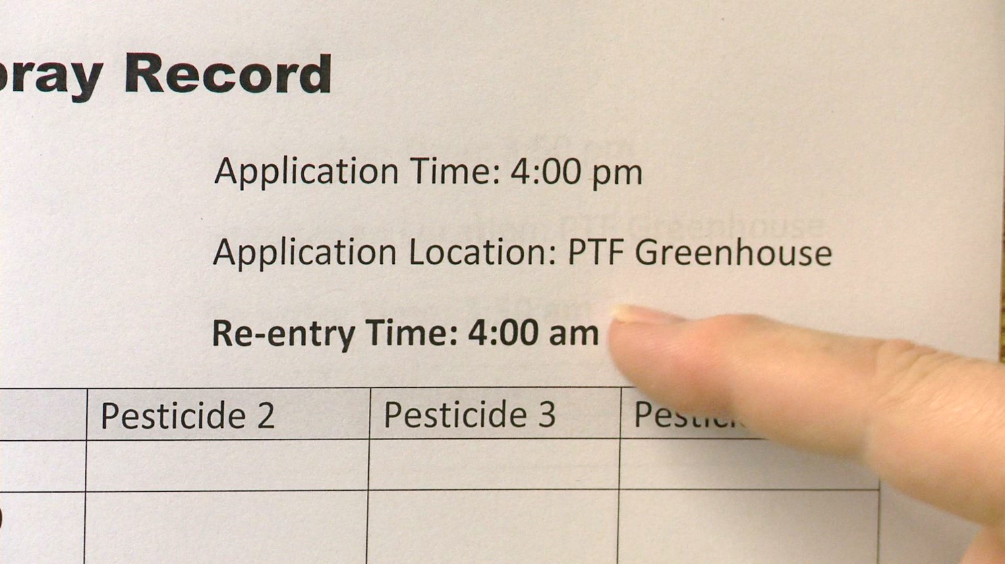
Pesticide application information
Image credit: Betsy Buffington, Iowa State University
Notes:
At the central location, your employer will provide written information on pesticides that have been applied at your worksite. This includes the length of the REI. The length of an REI is not always the same, and varies with the pesticide that has been applied.
Worker/handler training topics covered on this slide: 1.b.

Slide 28
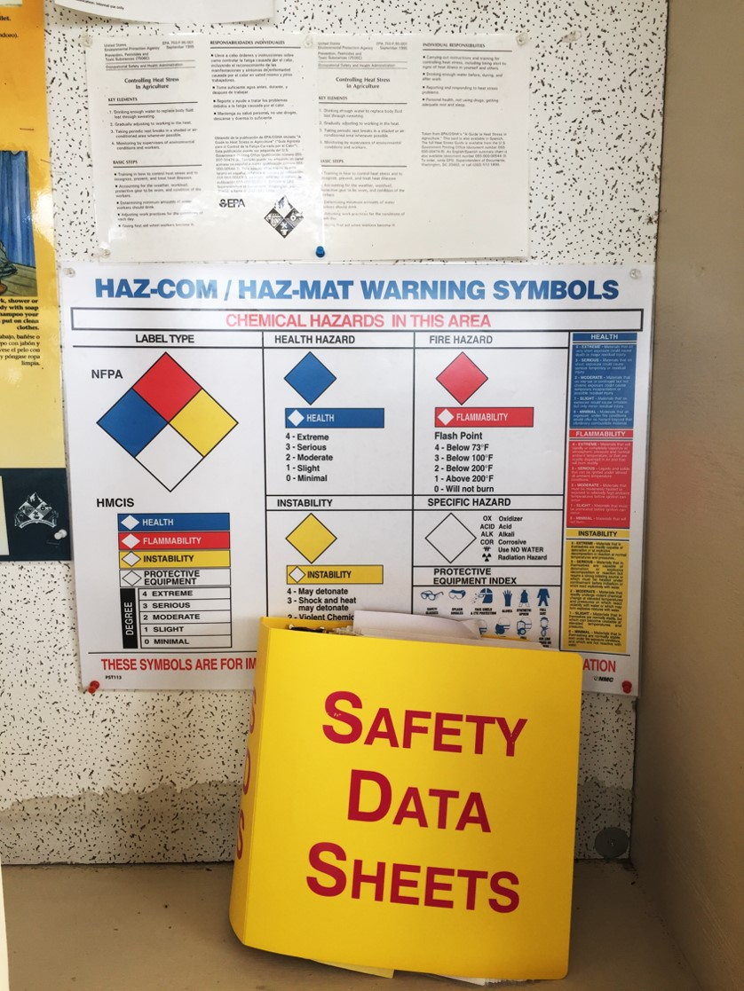
Safety Data Sheets
Image credit: Carol Black, Washington State University
Pesticide hazards
Emergency medical treatment
Notes:
Your employer will also display Safety Data Sheets, often abbreviated as SDS, at the central location for all pesticides used at the work site that you may come in contact with. Safety Data Sheets provide information about the hazards of the pesticides that are used where you work, including details of emergency medical treatment and other information.
Worker/handler training topics covered on this slide: 1.b., 16., 17.a., 17.b., 17.c.

Slide 29
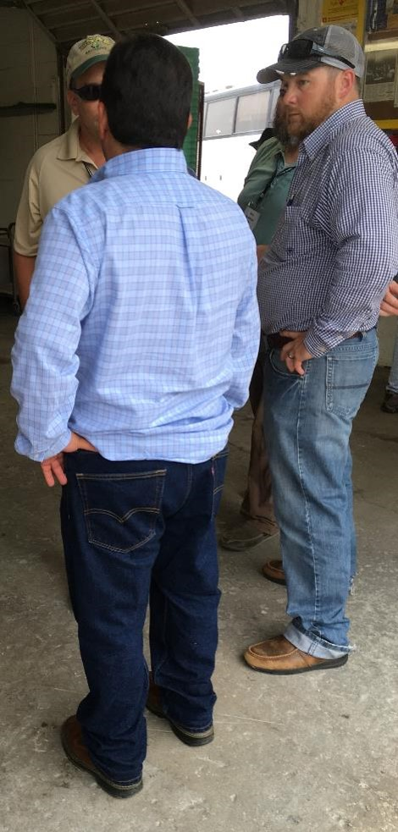
What is a designated representative?
Person chosen by worker or handler to access or request and obtain pesticide application and hazard information
Image credit: Betsy Buffington, Iowa State University
Notes:
After a pesticide has been applied, all information for that application is kept at your worksite for two years. You may request access to these records at any time. You may designate a representative to request, on your behalf, pesticide application and hazard information. A designated representative is a person, chosen, by a worker or handler, who can request and obtain a copy of the pesticide application and hazard information on behalf of the worker or handler. The designation of the representative and the request for information must be made in writing.
Worker/handler training topics covered on this slide: 1.g.

Slide 30

Oral warning and warning sign posting
Face-to-face warning
When you see this sign, do NOT go into this area!
Notes:
Your employer will tell you about pesticide applications and restrictions at your work site. This can be done orally in a language or manner that you can understand or by posting a warning sign at the application area. When you see this sign, do NOT go into this area. The sign means that the area has been treated with pesticides. After the REI has expired and all treated area warning signs have been removed or covered, you may re-enter areas that have been treated. Your employer may direct a handler to post treated areas.
Worker/handler training topics covered on this slide: 1.e., 1.f., 2., 3., 37.

Slide 31
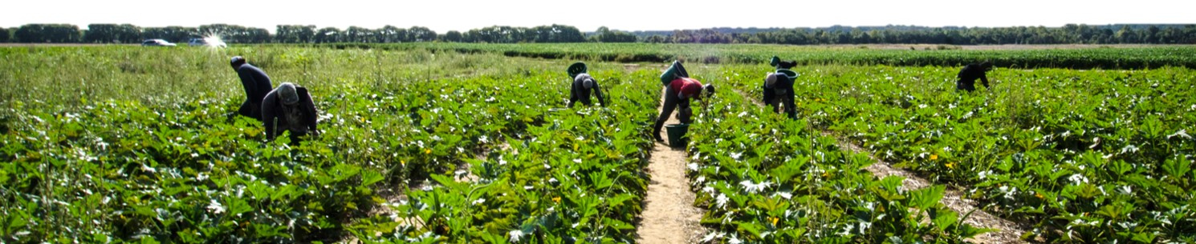
Reducing hazards from pesticide drift
Leave immediately if you are working where someone is applying a pesticide or if pesticides are drifting towards you
Image credit: Lance Cheung, USDA
Notes:
It is against the law for anyone to apply pesticides in an area where you are working, or to let pesticides drift onto you. You should leave immediately if you are working in an area where someone is applying a pesticide, or if a pesticide from a nearby application is drifting towards you. Workers and handlers can also come into contact with pesticides through drift if their homes are located near pesticide treated areas. Handlers must suspend the application if workers are in the area they are treating.
Worker/handler training topics covered on this slide: 3.

Slide 32
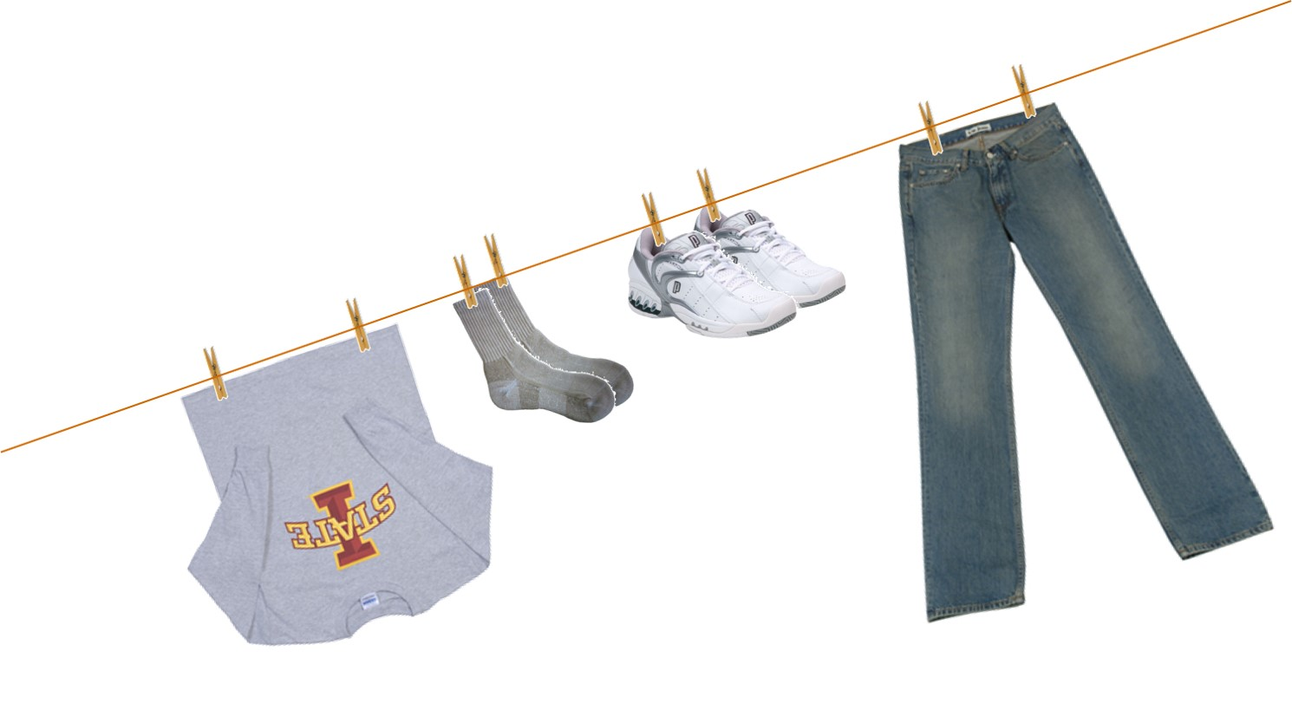
Work clothing
Always wear work clothing that protects you from pesticide residues
Notes:
Always wear work clothing that protects you from contact with pesticide residues. These include a long sleeve shirt, long pants, shoes, and socks.
Worker/handler training topics covered on this slide: 11.a.

Slide 33

Routine decontamination at work
Wash your hands before:
  Touching your eyes or mouth
  Eating
  Drinking
  Smoking
  Chewing gum
  Chewing tobacco
  Using the toilet
Image credit: Linda Naeve, Iowa State University
Notes:
Residues can be transferred from your hands to your eyes, mouth, and to sensitive skin that can readily absorb pesticides into your body. Washing your hands reduces that movement of residues. To protect your health and minimize your exposure to pesticides and pesticide residues, make the following a regular part of every work day.
Wash your hands before touching your eyes or mouth.
Wash your hands before eating, drinking, smoking, chewing gum, or chewing tobacco,
Remember to wash before using the restroom to keep pesticide residues from sensitive skin.
Worker/handler training topics covered on this slide: 11.b.

Slide 34
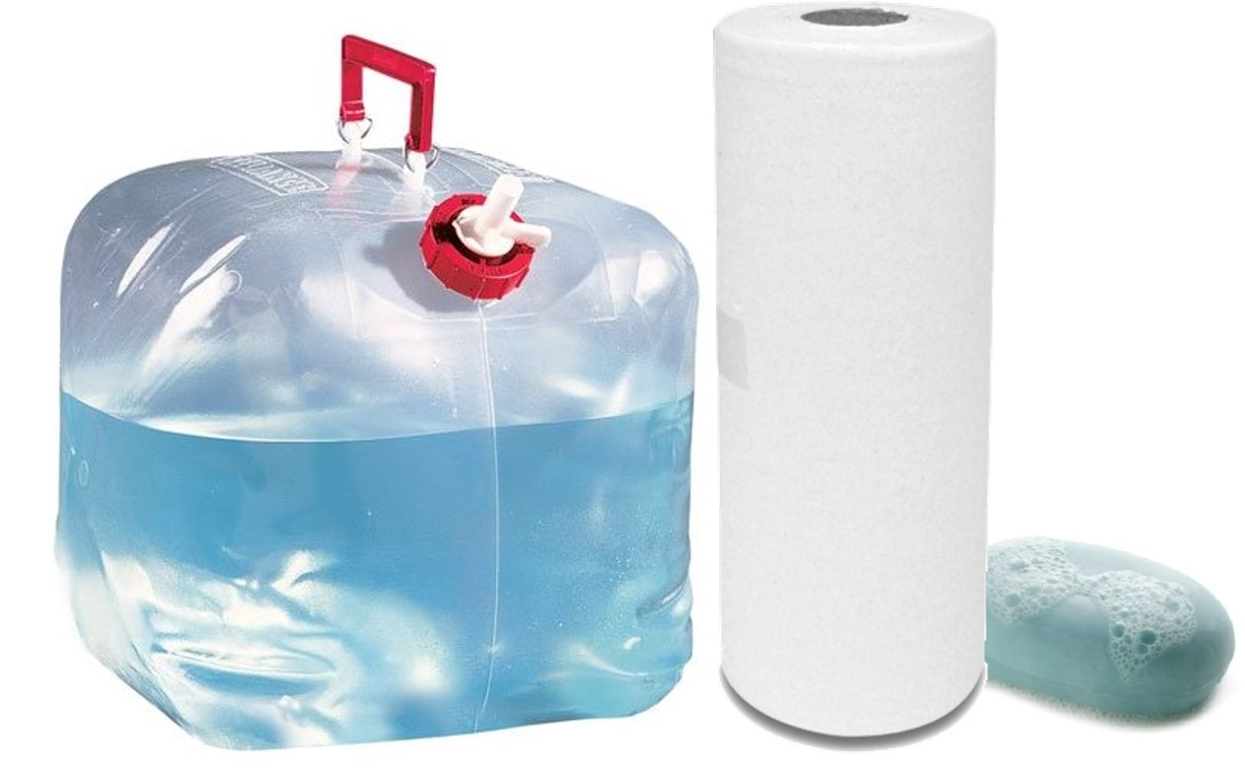
Decontamination supplies
Notes:
Your employer will have decontamination supplies nearby. These include soap, single use towels, and enough water for emergency washing, emergency eye flushing, and routine washing. For workers, supplies will generally be located within a quarter mile of your work site. Decontamination supplies for handlers must be available at the mixing sites. If another source of clean water, such as a stream, spring, or lake is closer to you than the decontamination supplies, use that water source instead. Handlers also must have access to a change of clothing to use if their work clothing or PPE becomes contaminated.
Worker/handler training topics covered on this slide: 1.c., 33.b.

Slide 35
Routine decontamination at home
Remove work shoes before entering your home
Shower/bathe and shampoo hair immediately after work
Change into clean clothes before any physical contact with children and your family
Put work clothes into a bag to prevent others from coming into contact with them
Wash work clothes before wearing them again
Wash work clothes separately from all other laundry
Tell the person washing your clothes that they may have pesticide residues on them
Notes:
At home, do the following to minimize contact with pesticides and pesticide residues.
To avoid bringing pesticide residues into your home, remove your work shoes before entering.
As soon as possible, shower or bathe after work. Wash your hair with shampoo and soap and change into clean clothes before you have any physical contact with children and your family.
Put your work clothes into a bag to prevent others from coming into contact with them.
There are potential hazards from pesticide residues on clothing. Wash your work clothes before wearing them again.
Wash your work clothes separately from all other laundry.
Tell the person washing your clothes that they may have pesticide residues on them.
Worker/handler training topics covered on this slide: 9.a., 12.a., 12.b., 13., 14.a., 14.b., 22.a., 22.b.

Slide 36
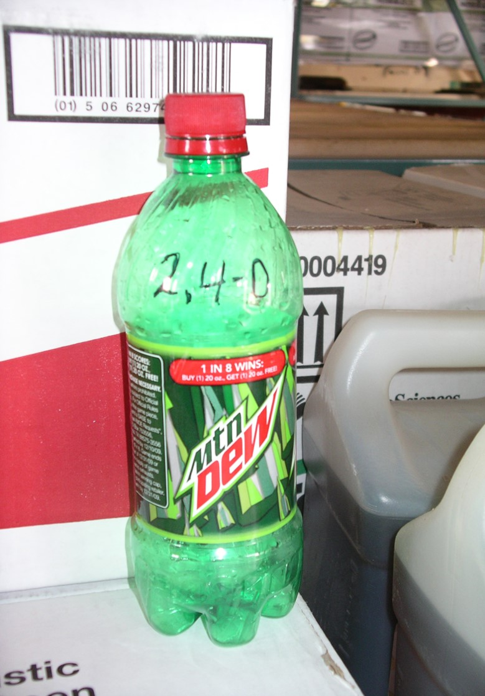

Do not take pesticides or pesticide containers used at work home with you
Image credit: Betsy Buffington, Iowa State University
Notes:
You should never take any pesticides home for use there. Pesticides used at your work are not intended for use in your home and present risks to you and your family. Never take pesticide containers home, even if empty and rinsed. A pesticide container is never completely free of pesticide residues and can never be safely used for any other purpose. It is dangerous and illegal to pour pesticides from their original containers into any container that does not have the original label, including food or beverage containers. Accidentally drinking pesticides can be fatal, and children can easily mistake a bottle with liquid in it for a drink.
Worker/handler training topics covered on this slide: 15.

Slide 37

How and when to get emergency medical care
Contact your supervisor
Employer must provide immediate transportation to nearest emergency medical facility
Image credit: Piotr Marcinski, Depositphotos
Notes:
If you think you have symptoms caused by pesticide exposure, contact your supervisor. He or she will make sure that you get medical attention immediately. In an emergency, your employer must provide you with immediate transportation to the nearest emergency medical facility. Your employer will give the emergency medical personnel a copy of the Safety Data Sheet, specific information about the product, the circumstances of application or use of the pesticide, and the circumstances of the exposure.
Worker/handler training topics covered on this slide: 1.d., 10.

Slide 38

Emergency First Aid
Skin exposure
Eye exposure
Oral exposure
Respiratory exposure
Image credit: Catalin Petolea, Depositphotos
Notes:
If you or a co-worker is exposed to a pesticide, there are some things that can be done immediately to reduce the effects of the exposure before you are taken to a medical facility. Act quickly and know where to find information about the pesticides used at your work site.
Always protect yourself before you step in to help others.
If pesticides are spilled or sprayed on your body, remove the pesticide-contaminated clothing and use decontamination supplies to wash immediately. If more readily accessible, use a nearby body of water to rinse off, then follow up with the decontamination supplies and use soap. As soon as possible, shower with soap and water, shampoo your hair, and change in to clean clothes.
If a pesticide gets into someone’s eye, the eye should be held open and rinsed for 15 minutes with a gentle stream of cool, clean water or rinsed with an eye flush kit.
Immediate and severe poisoning can occur if someone accidentally drinks a pesticide. In this case, it is very important to get the affected person to a medical facility as quickly as possible. If you are considering inducing vomiting, READ the label or Safety Data Sheet first. Induced vomiting can cause more damage, depending on the pesticide that was swallowed.
First aid for a person who has inhaled pesticide mists or vapors includes taking the person to fresh air and loosening any clothing that might make breathing difficult. Mouth-to-mouth resuscitation should be performed only by a trained person if the victim has stopped breathing.
For all these exposures, get the person to medical attention as soon as possible.
Worker/handler training topics covered on this slide: 8., 9.a., 9.b., 9.c.

Slide 39

Employee rights and protections against retaliatory acts
Employers cannot punish you for attempting to comply with WPS
Contact the Iowa Department of Agriculture and Land Stewardship (IDALS)
  515-281-8591
Image credit: Vyacheslav Volkov, Depositphotos
Notes:
You cannot be retaliated against for complying or attempting to comply with the Worker Protection Standard. If your employer is punishing you for attempting to comply with the Worker Protection Standard or you have pesticide-related questions, concerns, or complaints, contact the state pesticide agency responsible for pesticide enforcement. The contact information is available to you at the central location. In Iowa, contact the Iowa Department of Agriculture and Land Stewardship (IDALS) at 515-281-8591.
Worker/handler training topics covered on this slide: 23., 24.

Slide 40
This concludes the worker training
The remainder of the training is for handlers only
Notes:
This concludes the worker portion of this training. If you have any additional questions, ask your employer or whoever is presenting this information now.
The remainder of this presentation is for handlers only. In addition to the topics covered so far, handlers must receive training on how to safely and effectively handle agricultural pesticides.

Slide 41
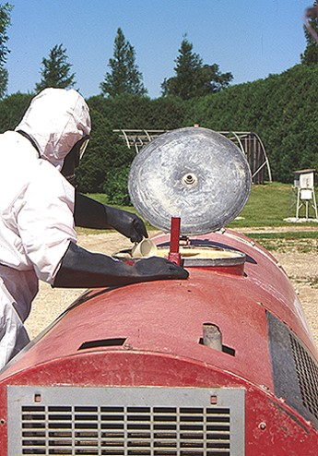
Using pesticides safely
Information for Pesticide Handlers only
Image credit: Joyce Hornstein, Iowa State University
Notes:
You must handle pesticides safely to minimize your exposure, and exposure to other people and the environment. Your job may involve mixing, loading, transferring, and/or applying pesticides; assisting with pesticide applications; disposing of pesticides or opened pesticide containers that have not been cleaned; handling opened containers of pesticides when emptying, triple rinsing, or cleaning pesticide containers according to pesticide product labeling; cleaning, adjusting, handling or repairing the parts of mixing, loading, or pesticide application equipment that may contain pesticide residues; working as a flagger and/or performing other tasks in direct contact with pesticides. You will be told by your employer of any entry restrictions, application exclusion zones or REIs that may apply when doing handler tasks. Your employer will also provide you with instructions on how to safely operate the equipment you will use to mix, load, transfer, or apply pesticides before you use it.
Worker/handler training topics covered on this slide: 25.

Slide 42
Mixing and loading pesticides
Read the label directions
Wear PPE
Measure pesticides carefully
Prevent pesticides from entering the water source
Never mix, load, or clean equipment near water sources
Notes:
Because pesticides that have not yet been mixed are often in a concentrated form, they can be especially dangerous. When mixing and loading, follow these safety practices:
Wear the personal protective equipment listed on the pesticide label for handling pesticides.
Read the label directions to find out how much pesticide you need, and then open the containers and measure it carefully. Using too much or too little can cause problems for the applicator, crop, and environment. If you are not able to read the label yourself, your employer must provide you with information and instructions about the specifics of safe use and the labeling requirements.
Prevent pesticides from entering the water source by keeping the hose above the level of the liquid in the tank or by using special equipment (a check valve) to prevent backflow.
Never mix, load, or clean equipment near ponds, streams, wells, or ditches because rinsewater containing pesticide (rinsate) could overflow and run off into these water sources.
Worker/handler training topics covered on this slide: 25., 26., 30., 33.c.

Slide 43
Applying pesticides
Follow label application instructions
Check application equipment and make repairs as necessary
Do not apply pesticides in a manner that results in contact with workers or other persons
Clean equipment
Notes:
When applying pesticides, follow these safety practices:
Follow the application instruction on the pesticide label. If you are not able to read the label yourself, your employer must provide you with information and instructions about the specifics of safe use and the labeling requirements.
After putting on the label-required personal protective equipment, check the application equipment to make sure there are no leaks. If repairs need to be made, keep your personal protective equipment on and turn equipment off before fixing the equipment.
Never apply pesticides in a manner that they may get on people – either directly or through drift.
Stay alert while you are applying the pesticide. Look at the area you have just treated to be sure you are applying the pesticide evenly and the coverage looks right.
Watch for clogged nozzles and other equipment issues during the application.
When you finish the application, clean the equipment following your employer’s instructions.
Worker/handler training topics covered on this slide: 25., 26., 30., 33.c.

Slide 44
Transporting pesticides
Transport pesticides in the truck bed, cargo area, or on the back of the spray rig
Check containers for leaks before loading and unloading
Protect containers from rain and other potential weather damage
Secure or tie down all pesticide containers in the cargo area
Monitor containers at all times during transportation
Keep containers in a locked area
Notes:
When transporting pesticides, especially containers that have already been opened, always do the following:
Transport pesticides in the truck bed, cargo area, or on the back of the spray rig
Check containers for leaks before loading and unloading
Protect containers from rain and other potential weather damage
Secure or tie down all pesticide containers in the cargo area
Monitor containers at all times during transportation
Keep containers in a locked area, if possible
Never carry pesticides in the passenger compartment of any vehicle or transport food, animal feed, or clothing with pesticide containers.
Never leave pesticide containers unattended.
Worker/handler training topics covered on this slide: 30.

Slide 45
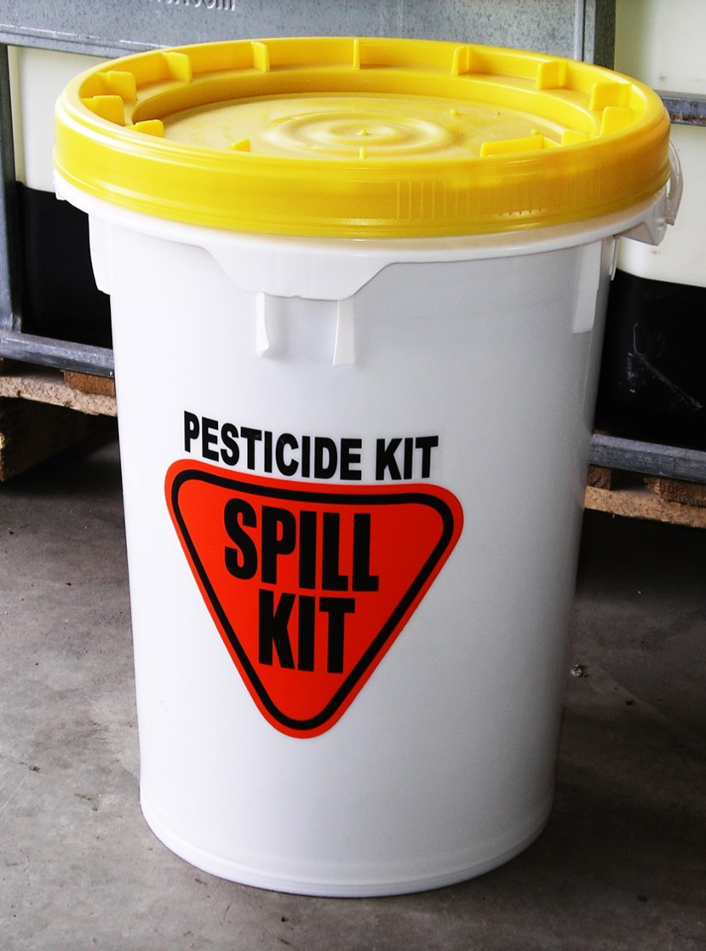
Spill cleanup
Control
Contain
Clean up
Image credit: Betsy Buffington, Iowa State University
Notes:
Pesticide spills can occur during any handler task. A good way to remember the steps to cleaning up a spill is the three C’s: Control, Contain, and Cleanup.
Put on the label-specified personal protective equipment before contacting any pesticide or breathing fumes.
Control the spill – make sure the spill is stopped by shutting off the mixing or application equipment if it is leaking. Turn the container upright if it has fallen. If the container is broken or leaking, put it inside another container.
Contain the spill – stop the spill from spreading by using commercially available “snakes” or pillows from a spill kit, or making a dike of soil, sod, or other absorbent material around the spill area. Do not use water on the spill, it will only spread it further.
Clean up the spill. Soak up liquid spills with absorbent materials (e.g., cat litter, sand, clay). If the pesticide or absorbent material is likely to blow around, moisten it very slightly with water or cover it with a sweeping compound or plastic covering. Sweep the spill and cleanup materials into a leak-proof container for proper disposal.
Worker/handler training topics covered on this slide: 30.

Slide 46
Storing pesticides
Ensure that containers are tightly closed and stored upright
Check containers for leaks, breaks, or weak spots
Clean up spills and leaks immediately
Keep storage area locked
Notes:
If you work in a storage area for pesticides or pesticide containers, make sure that the containers are closed tightly and stored upright. Check all containers for leaks, breaks, or weak spots. Tell your supervisor immediately if there is a problem. Clean up spills and leaks right away. Lock the storage area to make sure that unauthorized people and animals cannot get into the storage area.
Worker/handler training topics covered on this slide: 30.

Slide 47
Disposing of pesticides and containers
Always comply with label directions and federal, state, and local laws and regulations
Notes:
Occasionally, you may have leftover pesticides that you can no longer use. Contact the manufacturer to see if they can be returned or dispose of them as pesticide waste, according to state and local regulations. Store the pesticides carefully in a locked storage area until they can be disposed of properly.
Pesticide labels provide information on container disposal. Some containers are refillable and intended to be filled with pesticide more than once. Other containers are non-refillable and should be rinsed immediately after emptying. Always comply with label directions and with federal, state, and local laws and regulations.
Worker/handler training topics covered on this slide: 26., 30.

Slide 48
Protect sensitive areas
Drift – movement of pesticide dust, spray, or vapor away from the application site
Runoff – movement of water and associated materials on the soil surface
Non-target organisms – plants or animals that are not the intended targets of pesticide applications
  e.g., bees and other pollinators, livestock, wildlife
Notes:
Read the pesticide label before applying pesticides to avoid injury to plants, or animals and contamination of soil and water.
Drift is the movement of pesticide dust, spray or vapor away from the application site. Pesticides have a greater potential to drift when they are applied through nozzles designed to deliver small droplets. Small droplets are light weight and can be carried in the wind further than heavier medium or coarse droplets. Wind also plays an important role in the distance vapors or dust can travel. As the distance from the sprayer to the ground increases, so does the likelihood that pesticide vapors or dust will be impacted by any existing wind.
Runoff - pesticides that are not absorbed by plants or soil can move from the site and contaminate other areas. Application during precipitation events may reduce the efficacy of the application, as well as lead to off-site movement of the pesticide.
Non-target organisms are plants or animals that are not the intended targets of pesticide applications. Before applying a pesticide, check for the presence of livestock areas, and wildlife and beneficial insect habitats, that might be negatively impacted by the pesticide.
Worker/handler training topics covered on this slide: 31.

Slide 49


Application exclusion zone
Workers and other persons are restricted from entering an AEZ when pesticide applications are taking place
100’
25’
Notes:
Only properly trained pesticide handlers who are wearing the required PPE may be in the treated area while the pesticide is being applied. You must not apply pesticides in a manner that results in contact with workers or other persons. To prevent pesticide exposure, workers and other persons are restricted from entering an Application Exclusion Zone (AEZ) when pesticide applications are taking place. AEZs are areas surrounding pesticide application equipment that exist only during outdoor production pesticide applications. You and your employer should discuss the AEZ before making the application. You must temporarily suspend the application if a worker or other person is in any portion of the AEZ. You may not proceed until you can ensure that the pesticide will not contact anyone that is in the AEZ, including areas that extend beyond the boundary of the establishment.
Worker/handler training topics covered on this slide: 34.

Slide 50
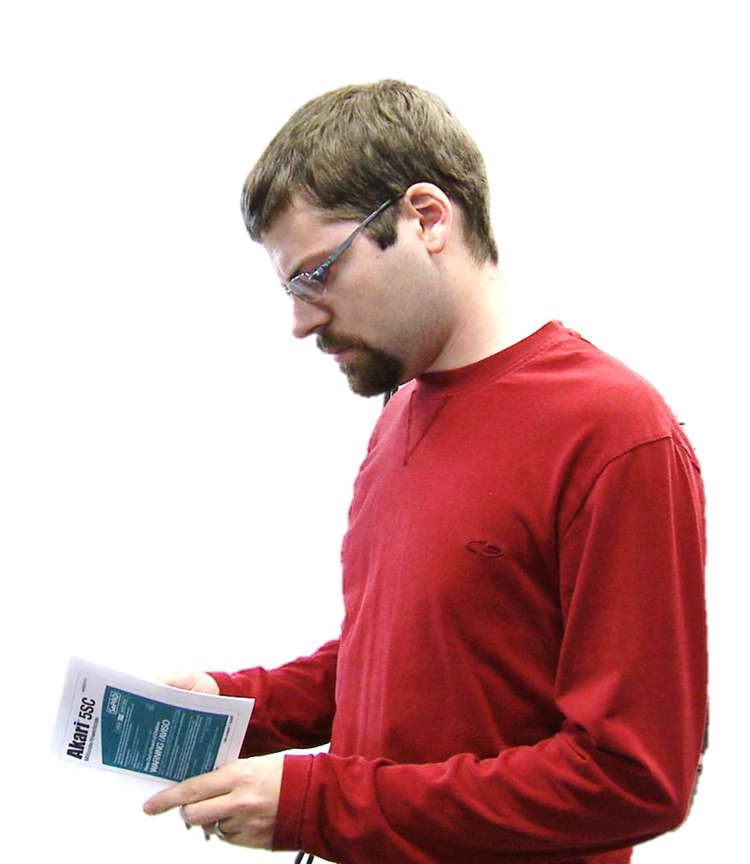
Pesticide label
Image credit: Betsy Buffington, Iowa State University
Notes:
You must either read, or be informed of, in a manner you can understand, all sections of the pesticide product labeling applicable to the safe use of the pesticide, including label use directions and restrictions. The product label is the most important part of the pesticide packaging. You must follow the portions of the labeling applicable to the safe use of the pesticide. The labeling will be available to you at all times during handler activities.
Worker/handler training topics covered on this slide: 26., 33.c.

Slide 51
Pesticide brand name, ingredients, and EPA registration number
BUGG-OUT
Insecticide
Brand name
Active Ingredient:
Imidacloprid, 1-[(6-Chloro-3-pyridinyl)methyl)]-N-nitro-2-imidazolidinimine…….……………………………………………………1.0%
Inert Ingredients: ..........................................………..…….99.0%
TOTAL 100%
EPA Reg. No. 34890-69 EPA Est. No. 5905-IA-001
Notes:
The pesticide label has a number of sections that you should be familiar with. The brand name of the pesticide is found at the top of the first page of the label. Do not choose a pesticide product by brand name alone. Many companies use the same basic name with only minor variations to designate entirely different pesticide chemicals. Below the brand name is the listing of the active ingredients that control the pest. Pesticide products with similar brand names may contain different active ingredients or different percentages of active ingredients. The EPA registration number for the product is also found on the front page of the label. EPA registration numbers indicate that the pesticide product has been registered and the label approved by EPA.
Worker/handler training topics covered on this slide: 27.

Slide 52


Signal Words and symbols
KEEP OUT OF REACH OF CHILDREN
DANGER-POISON
PELIGRO
DANGER-POISON – Highly toxic
DANGER – Highly toxic
WARNING – Moderately toxic
CAUTION – Slightly toxic
Notes:
The signal words – caution, warning, or danger – indicate how toxic the product is based on its acute toxicity. Signal words are found in large type on every pesticide label. Pesticides that are highly toxic if they are inhaled, swallowed or come in contact with the skin will contain a picture of a skull and crossbones and the words “DANGER” and “POISON” on the label. Danger products are highly toxic. Pesticides with the Warning signal word are moderately toxic. The signal word Caution means those pesticides are slightly toxic.
Worker/handler training topics covered on this slide: 27.

Slide 53
First aid statements
FIRST AID
If swallowed: | Call a poison control center or doctor immediately for treatment advice. Do not induce vomiting unless told to do so by a poison control center or doctor.
If on skin or clothing: | Take off contaminated clothing Rinse skin immediately with plenty of water for 15-20 minutes.
If in eyes: | Hold eye open and rinse slowly and gently with water for 15-20 minutes.
If Inhaled: | If person is not breathing, call 911 or an ambulance, then give artificial respiration.
NOTE TO PHYSICIAN: There is no specific antidote for BUGG-OUT. If this product is ingested, induce emesis or lavage stomach.
Notes:
The first aid section lists what you should do if you swallow or inhale the pesticide, or get it on your skin or in your eyes. The label pictured here clearly states that inducing vomiting is the correct treatment if the product is swallowed, but it is critical to refer to the label (or Safety Data Sheet) in case of an emergency to be very sure.
Worker/handler training topics covered on this slide: 27.

Slide 54
Precautionary statements
HAZARDS TO HUMANS AND DOMESTIC ANIMALS
CAUTION. Harmful if swallowed. Avoid breathing of dust. Do not take internally. Causes moderate eye irritation. Avoid contact with eyes, skin, or clothing.
PERSONAL PROTECTIVE EQUIPMENT (PPE)
Mixers, loaders, and applicators must wear: Long-sleeved shirt and long pants, chemical-resistant gloves such as polyethylene or polyvinyl chloride, shoes plus socks and chemical-resistant apron, when mixing/loading, cleaning up spills, cleaning equipment, or otherwise exposed to the concentrate.
ENVIRONMENTAL HAZARDS
BUGG-OUT is highly toxic to fish and aquatic invertebrates. Do not apply directly to water, to areas where surface water is present, or to intertidal areas below the mean high water mark. Do not contaminate water when disposing of equipment washwaters.
PHYSICAL AND CHEMICAL HAZARDS
Do not use, pour, spill or store near heat or open flame.
Notes:
The Precautionary Statements provide information about how to protect yourself and sensitive areas and organisms from exposure. Precautionary statements indicate ways in which the pesticide may be particularly hazardous to people and animals, the environment, and physical and chemical hazards. The required personal protective equipment for handlers is included in this section.
Worker/handler training topics covered on this slide: 27.

Slide 55
Directions for use
DIRECTIONS FOR USE
It is a violation of Federal Law to use this product in a manner inconsistent with its labeling.
Application: Stonefruit – Webworm, leafroller, leaftier, moth and caterpillar
Rate: 8-16 fl oz/acre
Methods: Broadcast/Foliar Ground
Timings: At first sign of larval infestation.
Limitations, Restrictions, Exceptions: Stonefruit restrictions: Do not apply after petal fall. Do not exceed 2 applications in any given season. Do not exceed 0.50 lb ai (32 fl oz) per acre in any given season. Allow at least 21 days between applications.
Webworm, leafroller, leaftier, moth and caterpillar: Apply BUGG-OUT at first sign of larval infestation. Use the higher rate for longer residual control, higher pest infestations, low crop load, larger trees or heavy dense foliage. Ground applications should be made in sufficient water for thorough coverage, using at least 50 gallons per acre for small trees (10 feet tall) and at least 100 gallons per acre for larger trees. Using insufficient water for thorough coverage and/or
Notes:
The Directions for Use section lists information on mixing, loading, application, storage, and disposal. These directions must be followed to ensure safe and effective use.
Worker/handler training topics covered on this slide: 27.

Slide 56
Agricultural use requirements
AGRICULTURAL USE REQUIREMENTS
Use this product only in accordance with its labeling and with the Worker Protection Standard, 40 CFR Part 170.
This standard contains requirements for the protection of agricultural workers on farms, forests, nurseries, and greenhouses, and handlers of agricultural pesticides…
Do not enter or allow worker entry into treated areas during the restricted-entry interval (REI) of 48 hours.
PPE required for early entry to treated areas that is permitted under the Worker Protection Standard and that involves contact with anything that has been treated, such as plants, soil, or water, is:
Long-sleeved shirt and long pants
Chemical-resistant gloves such as polyethylene
Chemical-resistant footwear plus socks
Chemical-resistant apron
Notes:
The Agricultural Use Requirements section is specific to the Worker Protection Standard. It states that the pesticide can only be used in accordance with its labeling and with the WPS. It contains the REI and PPE requirements for early-entry workers.
Worker/handler training topics covered on this slide: 27.

Slide 57
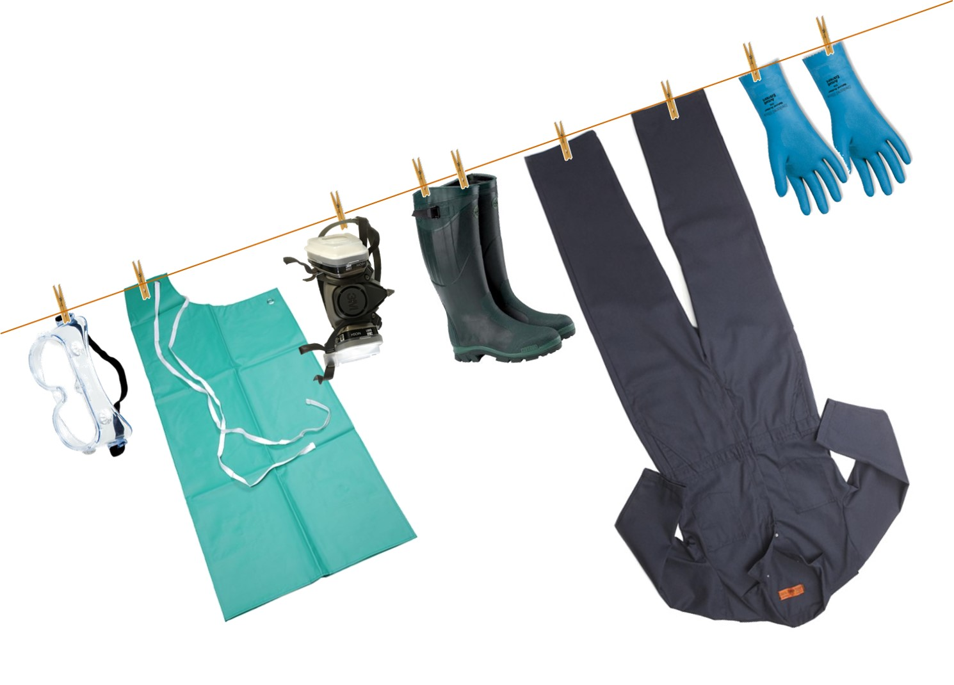
Personal protective equipment
Notes:
Personal Protective equipment (PPE), is worn to protect your body from contact with pesticides, and can best reduce exposure when worn correctly and maintained properly. The pesticide label lists what PPE must be worn. PPE may vary depending on the specific task. Make sure to review the relevant PPE requirements for mixing, loading, and/or handling in the Precautionary Statements section of the label.
Worker/handler training topics covered on this slide: 28.

Slide 58
Personal Protective Equipment
Your employer must provide you with all label-required PPE in clean and operating condition and make sure you are wearing it correctly
Inspect PPE for damage each day and discard any that cannot be repaired
Your employer must provide a clean place away from pesticide storage and pesticide use areas where you can put on and remove PPE and store your personal clothing
Do not wear home or take home PPE that has been used
Notes:
Your employer must provide you with the PPE for the job that you will be doing. PPE must be provided in clean and operating condition, and employers must make sure it is worn correctly.
Inspect your PPE before each day of use and repair or dispose of any damaged PPE.
When taking off PPE, be careful not to get pesticides on your skin or inner clothing. Wash the outside of your gloves while you are still wearing them. If possible, keep your gloves on while taking off any other PPE. Touch the outsides of PPE as little as possible when removing it. Wash your hands, face, and any other exposed skin. Use lots of soap and water.
Do not wear home or take home PPE that you have used.
Worker/handler training topics covered on this slide: 28., 33.a.

Slide 59
Personal Protective Equipment
It is the responsibility of your employer to:
Clean and dry the PPE at the end of the day
Store PPE separately from personal clothing and other personal items
Do not store PPE in a pesticide-contaminated area and never store PPE in the pesticide storage room
Keep contaminated PPE separate and wash it separately from other laundry
Make sure the person who cleans or launders PPE knows that it might be contaminated with pesticides
Notes:
It is the responsibility of your employer to do the following:
At the end of the day, clean PPE before reuse. All clean PPE must be either dried thoroughly before being stored or must be put in a well ventilated place to dry.
PPE must be stored separately from work clothing and apart from pesticide-contaminated areas. Do not store PPE in the pesticide storage area.
Any contaminated PPE must be kept separate and washed separately from any other clothing or laundry.
Any person who cleans or launders PPE at the establishment must be told:
That it may be contaminated with pesticides.
About the potentially harmful effects of exposure to pesticides.
The correct way(s) to handle and clean it to protect themselves from exposure.
Your employer may direct you to complete these tasks.
Worker/handler training topics covered on this slide: 28., 33.a.

Slide 60
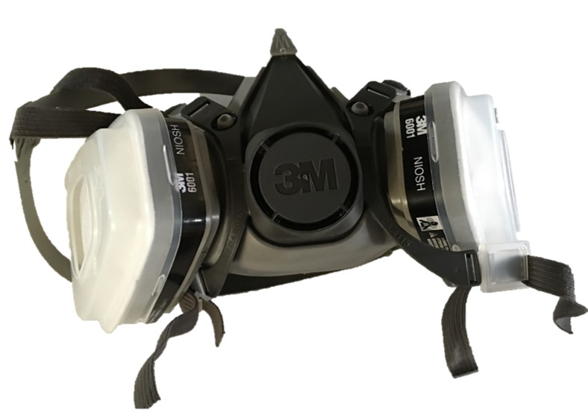
Respiratory protection
Medical evaluation
Respirator fit test
Respirator training
Image credit: Betsy Buffington, Iowa State University
Notes:
Before you work with a pesticide that requires respiratory protection, your employer must make sure that you participate in a medical evaluation, respirator fit testing, and respirator use and maintenance training.
Medical evaluation - You must be cleared by a licensed health care professional before you can wear the respirator. Based on your answers to a confidential medical history questionnaire, a physician or medical professional may require that you schedule a follow-up visit or provide additional information to determine if you are physically able to use a respirator.
Respirator fit test - If you are given medical clearance, your employer must make sure that the respirator that you will use fits properly. The respirator must be fit tested at least annually.
Respirator use and maintenance training - Once you are medically cleared, you must receive training at least annually on how to properly use, store, and care for your respirator.
Worker/handler training topics covered on this slide: 36.a., 36.b., 36.c

Slide 61

Heat stress
Many symptoms of heat illness are similar to symptoms of pesticide poisoning
Drink plenty of water before, during, and after work
Image credit: Catalin Pop, Depositphotos
Notes:
If the weather is warm or hot and you are wearing PPE, be aware of heat stress. You can get very sick if your body gets too hot. Many symptoms of heat illness are similar to symptoms of pesticide poisoning. You may feel tired and weak, have a headache, feel sick to your stomach, and get dizzy. If you are not sure what is making you ill, get help right away. Get out of the direct sunlight and away from pesticides if possible. If you suspect that someone has severe heat illness, it is very important to cool the person down as quickly as possible and then get the person to a doctor right away.
If you are new to the job or the weather suddenly becomes much hotter, you may need to adjust gradually to working the heat. Drink plenty of water before, during, and after work.
Worker/handler training topics covered on this slide: 29.

Slide 62
This concludes the handler training
This project has been funded by the Iowa Department of Agriculture and Land Stewardship through a grant from the U.S. Environmental Protection Agency.
Notes:
This concludes the handler training. If you have any questions about what has been discussed, please ask those questions now.

