Slide 1

National Worker Protection Standard: Training for Trainers
of Agricultural Workers and Pesticide Handlers
EPA WPS TTT W/H 00026
Notes:
Welcome to the National Worker Protection Standard: Training for Trainers of Agricultural Workers and Pesticide Handlers.

Slide 2

EPA has approved this train the trainer material for workers and handlers in accordance with the 2015 WPS expanded training content (40 CFR 170). The approval number is EPA WPS TTT W/H 00026.
​This work is licensed under a Creative Commons Attribution-NonCommercial-ShareAlike 4.0 International License by The Regents of the University of California, Davis campus, 2017. For information contact PERCsupport@ucdavis.edu.
Notes:
EPA has approved this train the trainer material for workers and handlers in accordance with the 2015 WPS expanded training content (40 CFR 170). The approval number is EPA WPS TTT W/H 00026.
Copyright and license conditions apply.
Additional guidance about the applicable copyright is available at http://pesticideresources.org/AdoptedPERCPolicies.pdf

Slide 3
Using these slides to train: Trainers
This presentation provides the information required to train those who will train workers and handlers under the Environmental Protection Agency’s Worker Protection Standard. Additional state rules may apply.
This train the trainer material can be used in 2017, 2018 and beyond.
This presentation must be presented in its entirety.
If you intend to add or remove slides from this EPA-approved presentation, then refer to the EPA guidance in the notes section.
Trainings must be conducted in a manner that the workers understand the information completely.
The notes section of the PowerPoint presentation contains important information for the trainer and activities designed to engage the audience and reinforce the information learned. Please review the notes prior to conducting the training.
Notes:
This presentation provides the information required to train those who will train workers and handlers under the Environmental Protection Agency’s (EPA) Worker Protection Standard. Additional state rules may apply.
EPA has approved this train the trainer material for workers and handlers in accordance with the 2015 WPS training content (40 CFR Part 170). The approval number is EPA WPS TTT W/H 00026. This train the trainer material can be used in 2017, 2018 and beyond.
This presentation must be presented in its entirety.
If you intend to add or remove slides from this set, refer to this EPA Guidance below:
EPA’s Office of Pesticide Programs offers the following preliminary guidance on modifications to EPA-approved training materials for workers, handlers, and trainers under the Worker Protection Standard (WPS):
- Users of training materials MUST use the EPA-approved materials in their entirety and as they are provided, except as provided in the next paragraph. Changes to the content, the order of the information, or images in the presentation by a user may negate the approval for that specific use. However, users may present exercises, handouts, and additional images in their sessions to illustrate the points in the presentation (without adding these to the approved material). It is not necessary for EPA to review these additional materials, as EPA expects that they will not conflict with the original EPA-approved materials.
- If a user determines that state- or region-specific information (such as crop specific images and information, or information about state/local regulations that modify those of the WPS) will enhance the presentation for their audiences, EPA prefers for those to be included separately, as described above. If it will be disruptive or impractical from a presentation standpoint (for example, to switch from one presentation to another), EPA agrees that slides – preferably as few as possible - may be added to the presentation. The added slides MUST have a statement that identifies the source, and the slide must look distinct from the EPA-approved materials. It is not necessary for EPA to review these slides, as EPA expects that they will not conflict with the original EPA-approved materials.

Slide 4

Table of Contents
Rules and Regulations
Training Preparation and Requirements
Agricultural Employee Tasks and Restrictions
Where You May Encounter Pesticides at Work and How They Can Enter Your Body
Pesticide-Related Health Effects
Ways to Reduce the Risk of Pesticide Exposure
First Aid for Pesticide Illnesses and Injuries
Additional Employer Responsibilities
Pesticide Label Information
Protecting People and the Environment When Using Pesticides
Personal Protective Equipment
Early Entry
= Worker and Handler Training Topics
= Handler Training Topics Only
Notes:
This training includes 12 sections. Sections 1 and 2 are for review and preparation for trainers. Sections 3 through 8 contain training topics for both workers and handlers. Sections 9 through 11 are training topics for handlers only. Section 12 contains instructions for early entry workers.
When in presentation view, please click on the section you would like to view. To return to the Table of Contents simply click the “Return to Table of Contents” text in the bottom-right corner at the end of each section.

Slide 5
Section 1: Rules and Regulations
Review and preparation for trainers
Return to Table of Contents
Notes:
Notes for trainers:
This section is for trainers only. It does not contain training requirements for workers or handlers.
This section will inform trainers of the rules and regulations that set the basis for the Worker Protection Standard.
Suggested Activity:
Section 1. Activities for Rules and Regulations: “Hot Potato”

Slide 6
The Worker Protection Standard
Federal Laws
Federal Insecticide, Fungicide, and Rodenticide Act (FIFRA) governs the registration, sale, and use of pesticide products in the United States
U.S. Environmental Protection Agency (EPA) regulates the use of pesticides
FIFRA also gives the EPA the authority to write regulations
Worker Protection Standard (WPS) rule reduces the effects of pesticides on farm workers by providing information, protection and mitigation measures
Notes:
Notes for trainers of workers and pesticide handlers:
The Federal Insecticide, Fungicide, and Rodenticide Act (FIFRA) governs the registration, sale, and use of pesticide products in the United States. FIFRA’s main provisions include:
Requiring the EPA to make registration decisions on pesticides and their uses and to review and approve product labeling.
Requiring the users of restricted-use pesticides to be certified as, or work under the direct supervision of, private or commercial applicators.
Establishing tolerances for residues that may remain on raw agricultural products.
Making it illegal to store or dispose of pesticides or their containers other than as directed by label requirements.
Assessing civil and criminal penalties for misuse of pesticides.
The federal agency that regulates the use of pesticides is the U.S. Environmental Protection Agency (EPA). Explain that pesticides cannot be marketed in the United States until the EPA reviews and application for registration and determines whether it meets the safety standards.
FIFRA also gives the EPA the authority to write regulations. An important regulation is the Worker Protection Standard (WPS).
The Worker Protection Standard (WPS) rule reduces the effects of pesticides on farm workers by providing information, protection and mitigation measures.

Slide 7
State Laws
Pesticide laws developed at the federal level are the minimum national guidelines that a state must follow for pesticide use and protection of people and the environment
States may enact rules or laws governing parts of the pesticide use that are stricter than the federal regulations
Some local authorities also could establish rules and/or regulations needs for local or a particular situation
Notes:
Notes for trainers of workers and pesticide handlers:
The pesticide laws developed at the federal level are the minimum national guidelines that a state must follow for pesticide use and protection of people and the environment.
Mention that some states and local authorities may set standards that apply stricter regulations than those established at the federal level but by no means could diminish the federal regulations.
Some local authorities also could establish rules and/or regulations needs for local or a particular situation.

Slide 8
What is the WPS?
Adopted into the Code of Federal Regulations in 1992; Significantly revised, with most requirements effective January 2, 2017. The remainder are effective January 2, 2018.
A regulation developed by the U.S. EPA to protect agricultural employees from the harmful effects of pesticides and their residues
Covers agricultural workers and pesticide handlers who are employed on any farm, forestry operation or nursery engaged in the outdoor or enclosed space production of agricultural plants
Notes:
Notes for trainers of workers and pesticide handlers:
In 1992, the federal Worker Protection Standard (WPS) was adopted into the Code of Federal Regulations; it was significantly revised, with most requirements effective January 2, 2017. The remainder are effective January 2, 2018.
The Worker Protection Standard (WPS) is a regulation developed by the United States Environmental Protection Agency (EPA) to protect agricultural employees from the harmful effects of pesticides and their residues.
The WPS covers agricultural workers and pesticide handlers who are employed on any farm, forestry operation or nursery engaged in the outdoor or enclosed space production of agricultural plants.
Explain that the WPS regulation requires agricultural employers to provide employees with information and training on ways to avoid exposure to pesticides and pesticide residues. Also need to provide protections and mitigation measures to avoid or minimize potential exposure to pesticides.

Slide 9
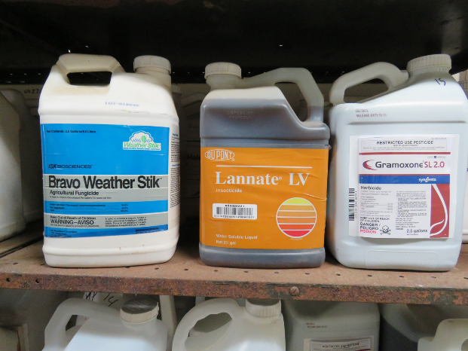
What is a Pesticide?
Any substance used to prevent, destroy, repel, or mitigate insects, weeds, fungi, rodents, nematodes, or any other organism considered a pest
Plant growth regulators
Defoliants
Desiccants
Insect repellents
Image credit: Ed Crow, Penn State Pesticide Education Program
Notes:
Notes for trainers of workers and pesticide handlers:
A pesticide is any substance used to prevent, destroy, repel, or mitigate insects, weeds, fungi (fungus), rodents, nematodes (certain types of worms), or any other organism considered a pest.
Examples include: herbicides, insecticides, fungicides, plant growth regulators, defoliants (EPA-registered pesticides that remove leaves from plants); and desiccants (EPA-registered pesticides used for drying plant foliage); Insect repellents are also among the many substances regulated as pesticides. Mention that Fertilizers are not pesticides; they are chemicals that serve as nutrients to help plants grow. Therefore, hazards associated with the use of fertilizers are not addressed by this rule.
Agricultural workers do not mix, load, apply or handle pesticides in any way. Nonetheless, they need to know what is a pesticide.
Pesticide handlers need to learn to identify pesticides.
Try to stay away from technical terminology because many workers and handlers might be unfamiliar with terms such as “substance”, “organisms”, “mitigate”, etc. If you need to use a technical term, you must explain it first.

Slide 10
Reasons for Using Pesticides
Important tools that help growers manage weeds, insects, and crop diseases
Enable growers to provide consumers with nutritious, abundant, and affordable supplies of food and fiber
Modern pesticides combined with regular pest monitoring and other non-chemical pest management methods, allow agricultural establishments to produce more food and fiber on less land
Notes:
Notes for trainers of workers and pesticide handlers:
Pesticides are important tools that help growers manage weeds, insects, and crop diseases. They enable growers to provide consumers with nutritious, abundant, and affordable supplies of food and fiber.
Modern pesticides combined with regular pest monitoring and other non-chemical pest management methods, allow agricultural establishments to produce more food and fiber on less land.
Explain that the use of pesticides, however, may also present risks to agricultural workers and pesticide handlers.

Slide 11
Who is Responsible for Providing WPS Protections?
Agricultural employers on crop-producing agricultural establishments
Commercial pesticide handling establishment employers
Notes:
Notes for trainers of workers and pesticide handlers:
The responsibility for providing WPS protections and making sure that the WPS is complied with always lies with agricultural employers on crop producing establishments and commercial pesticide handling establishment employers, those that provide pesticide applications on agricultural establishments for hire.

Slide 12
Who is Protected?
Workers – people employed to perform tasks related to production of agricultural plants
Pesticide handlers – people employed to mix, load or apply pesticides for use on agricultural establishments in the production of agricultural plants
Other persons during pesticide applications
Notes:
Notes for trainers of workers and pesticide handlers:
Explain that the WPS protects workers, pesticide handlers, and other persons during pesticide applications.
Workers are people employed to perform tasks related to production of agricultural plants.
Pesticide handlers are people employed to mix, load or apply pesticides for use on agricultural establishments in the production of agricultural plants.
Handlers are required to take measures to protect workers and other persons during pesticide applications.

Slide 13
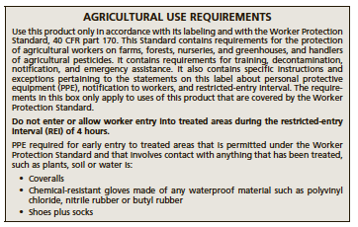
When Does the WPS Apply?
Use of a WPS-labeled pesticide product on an “agricultural establishment” directly related to the production of an “agricultural plant”
Employment of workers or handlers
There are some pesticide uses that are considered “non-agricultural uses” that are not covered under this standard
Notes:
Notes for trainers of workers and pesticide handlers:
The WPS applies when there is use of a WPS-labeled pesticide product on an “agricultural establishment” directly related to the production of an “agricultural plant” and/or the employment of workers or handlers. A WPS-labeled pesticide product contains an AGRICULTURAL USE REQUIREMENTS box under the DIRECTION FOR USE, usually near the beginning of the label.
There are some pesticide uses that are considered “non-agricultural uses” that are not covered under this standard. Explain that the WPS does not apply on agricultural establishments when pesticides are used:
As part of government-sponsored public pest control programs that the owner/employer have no control over. (e.g., mosquito abatement and Mediterranean fruit fly eradication programs).
On plants other than agricultural plants, which may include plants in home fruit and vegetable gardens and home greenhouses, and permanent plantings for ornamental purposes, such as plants that are in ornamental gardens, parks, public or private landscaping, lawns or other grounds that are intended only for aesthetic purposes.
For control of vertebrate pests, unless directly related to the production of an agricultural plant.
As attractants or repellents in traps.
On the harvested portions of agricultural plants or on harvested timber.
For research uses of unregistered pesticides.
On pasture and rangeland where the forage will not be harvested for hay.
In a manner not directly related to the production of agricultural plants, including, but not limited to livestock pest control, structural pest control and control of vegetation in non-crop areas.

Slide 14
Who is an Employer Under WPS?
An agricultural employer is anyone who is an owner of, or is responsible for the management or condition of, an agricultural establishment, and who employs any worker or handler
Commercial pesticide handler employer means any person, other than an agricultural employer, who employs any handler to perform handler activities on an agricultural establishment
Notes:
Notes for trainers of workers and pesticide handlers:
An agricultural employer is anyone who is an owner of, or is responsible for the management or condition of, an agricultural establishment, and who employs any worker or handler.
Commercial pesticide handler employer means any person, other than an agricultural employer, who employs any handler to perform handler activities on an agricultural establishment.
Explain that a labor contractor who does not provide pesticide application services or supervise the performance of handler activities, but merely employs laborers who perform handler activities at the direction of an agricultural or handler employer, is not a commercial pesticide handler employer.

Slide 15
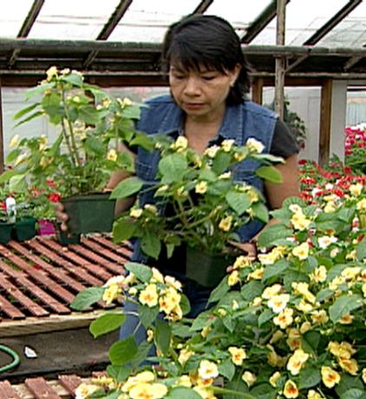
Who is an Agricultural Worker?
Any person, including a self-employed person, who is employed (receives wages or salary) and performs activities directly relating to the production of agricultural plants on an agricultural establishment
Employed and receives compensation for his/her work
Image credit: Chazzbo Media
Notes:
Notes for trainers of workers and pesticide handlers:
Worker means any person, including a self-employed person, who is employed (receives wages or salary) and performs activities directly relating to the production of agricultural plants on an agricultural establishment.
An agricultural worker is employed and receives compensation for his/her work.
Some examples are harvesting, weeding, pruning, or irrigating for the production of agricultural plants on farms, forests, nurseries, greenhouses and other enclosed space production areas. Use some specific examples of work activities for the crop or activity you are teaching.
The WPS does not establish a minimum age for agricultural workers who enter the treated area after the restricted-entry interval expires (i.e., that are not early-entry workers).

Slide 16
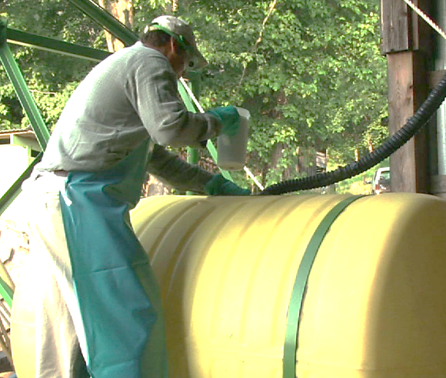
Who is a Pesticide Handler?
Handler means any person, including a self-employed person, who is employed by an agricultural employer or commercial pesticide handler employer and mixes, loads, and applies pesticides
Must be at least 18 years old
Image credit: Chazzbo Media
Notes:
Notes for trainers of workers and pesticide handlers:
Handler means any person, including a self-employed person, who is employed by an agricultural employer or commercial pesticide handler employer and mixes, loads, and applies pesticides.
There are other handler activities, such as disposing of pesticides, rinsing containers, handling opened pesticide containers, acting as a flagger and conducting crop advising tasks during a restricted-entry interval, but the main ones are mixing, loading and applying pesticides
Handlers must be at least 18 years old.

Slide 17
Who is an Early-Entry Worker?
A worker who enters an area after a pesticide application is completed, but before the restricted-entry interval (REI) has expired
Must be at least 18 years old
Notes:
Notes for trainers of workers and pesticide handlers:
An early-entry worker is a worker who enters an area after a pesticide application is completed, but before the restricted-entry interval (REI) has expired.
Early-entry workers must be at least 18 years old.

Slide 18

Immediate Family Members
Grand
parents
Father-in-law
Uncles
Parents
The owner’s immediate family members must follow label instructions when handling pesticides, but are exempt from most of the WPS provisions
Mother-in-law
Step
parents
Aunts
Spouse
Brothers-in-law
Step
children
Nephews
Children
Sisters-in-law
Foster parents
Nieces
Brothers
Sons-in-law
Foster
children
First cousins
Sisters
Daughter-in-law
Grand
children
Notes:
Notes for trainers of workers and pesticide handlers:
The agricultural establishment owner’s immediate family members must follow label instructions when handling pesticides, but are exempt from most of the provisions of the Worker Protection Standard.
Immediate family members include the agricultural establishment owner’s:
Spouse, parents, children; Stepparents and stepchildren, foster parents and foster children; In-laws; Grandparents, grandchildren; Brothers and sisters; Aunts and uncles; Nieces and nephews and first cousins.
Explain that the owner of an agricultural establishment is exempt from providing most WPS protections to himself and members of his immediately family who are performing tasks related to production of agricultural plants on their own establishment, including exemption from minimum age requirements for handler and early-entry workers.
The owner of the agricultural establishment must provide WPS protections to all employed workers, handlers and other persons who are not members of his immediate family.
The owner and his family members are not exempt from wearing the PPE listed on the label and from fit testing and medical evaluation if respiratory protection is used.

Slide 19
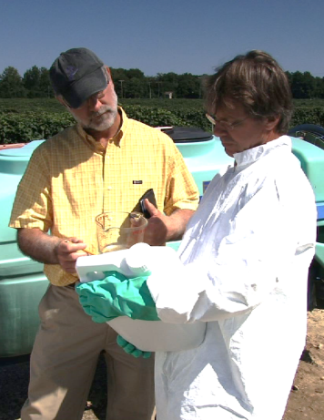
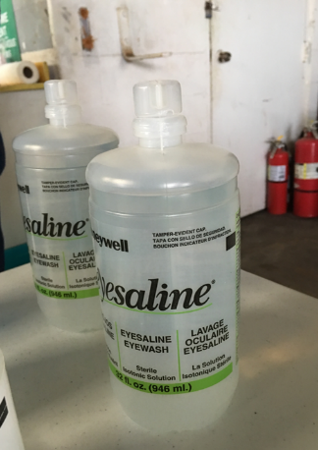
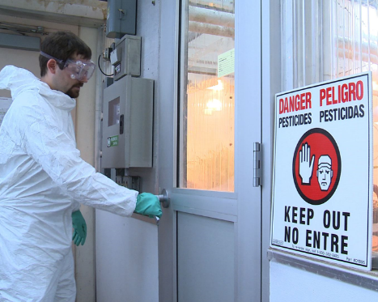
Goals of WPS
1. Inform
2. Protect
3. Mitigate
Image credits: 1- Chazzbo Media, 2,3- Betsy Buffington, Iowa State University
Notes:
Notes for trainers of workers and pesticide handlers:
Explain that the Worker Protection Standard has three major goals:
To provide information to agricultural workers and pesticide handlers so they are aware of potential exposure to pesticides and that can help them to avoid exposure.
To protect agricultural employees from pesticide exposure while they are working.
To mitigate or lessen the effects of any pesticide exposure that might occur.

Slide 20
Goal 1: Inform
Annual pesticide safety training
Pesticide safety information display at central location
Pesticide application and hazard information in the form of a safety data sheet (SDS) at the central location
Access to pesticide labeling for handlers
Notes:
Notes for trainers of workers and pesticide handlers:
Goal 1: Explain that agricultural employers must provide information to agricultural workers and pesticide handlers so they are aware of potential exposure pesticides and that can help them to avoid exposure.
This is accomplished by providing:
Agricultural workers must receive pesticide training before entering areas where pesticides have been applied or an REI has been in effect within the past 30 days. Pesticide handlers must receive pesticide training before conducting any handling task.
Annual pesticide safety training
Pesticide safety information display at central location
Pesticide application and hazard information in the form of a safety data sheet (SDS) at the central location
Access to pesticide labeling for handlers

Slide 21
Goal 2: Protect
Notify agricultural employees about when and where pesticide applications will take place
Implement application exclusion zones (AEZs) during pesticide applications and REIs for pesticide-treated areas after application
Provide personal protective equipment for handlers and early-entry workers
Notes:
Notes for trainers of workers and pesticide handlers:
Goal 2: The WPS requires agricultural employers to provide three types of protection for agricultural employees to limit workplace exposure to pesticides. These include:
Notifying agricultural workers about when and where pesticide applications will take place.
Implement application exclusion zones (AEZs) during pesticide applications.
Explain that during an application, an agricultural employer must keep workers and other persons out of the treated area or AEZ that is WITHIN the boundary of the establishment owner’s property. Keep workers and other people away from the application equipment on his/her property. “Away” is defined by the AEZ 0-100 feet.
Implement restricted-entry intervals (REIs) after application by keeping workers out of the treated area for the specified amount of time.
Providing personal protective equipment (PPE) for handlers and early-entry workers.
Also as part of the protections Handler Employers must:
Provide personal protective equipment.
Ensure that the personal protective equipment is clean, in proper operating condition and meets the requirements.
Ensure that PPE is used correctly for its intended purpose and is used according to the manufacturer’s instructions.
Must ensure that, before each day of use, all personal protective equipment is inspected for leaks, holes, tears, or worn places, and any damaged equipment is repaired or discarded.

Slide 22
Goal 3: Mitigate
Decontamination supplies at the worksite
Emergency assistance to and, if needed, transportation to a medical care facility for emergency treatment for employees who get sick or are injured by pesticide exposure while working
Return to Table of Contents
Notes:
Notes for trainers of workers and pesticide handlers:
Goal 3: The WPS reduces the effect of pesticide exposure by requiring agricultural employers to provide
Decontamination supplies at the worksite.
Explain that Agricultural employer must provide decontamination supplies for routine washing and emergency decontamination.
The decontamination supplies for workers must include at least 1 gallon of water per worker at the beginning of each worker’s work period for routine washing and emergency decontamination, soap, and single-use towels.
For early-entry workers and handlers, the decontamination supplies must include at least 3 gallons of water per worker at the beginning of the worker period, soap and single use towels. For handlers, the decontamination supplies must also include a change of clothes (such as cloth coveralls and certain mix/load sites may need an eyeflush system.
Emergency assistance to and, if needed, transportation to a medical care facility for emergency treatment for employees who get sick or are injured by pesticide exposure while working.
Also must provide emergency assistance, including transportation. The following information must be provided to the medical personnel:
Product name.
Copies of the applicable safety data.
EPA registration number(s) and active ingredient(s) for pesticides being used
The circumstances of application or use of the pesticide and the circumstances that could have resulted in exposure to the pesticide.
This concludes Section 1: Rules and Regulations. Continue on to Section 2: Training Preparation and Requirements or return to the Table of Contents by clicking on the “Return to Table of Contents” in the bottom-right corner of this slide (when in presentation view only).

Slide 23

Section 2: Training Preparation and Requirements
Review and preparation for trainers
Return to Table of Contents
Notes:
Notes for trainers:
This section is for trainers only. It does not contain training requirements for workers or handlers.
This section provides information to help prepare for training and provides the training requirements for administering worker and handler training.

Slide 24
Who Can Provide Training?
Have completed an EPA-approved train-the-trainer course
Are designated as a trainer by state, tribe, or EPA
Are a certified pesticide applicator
WPS trained handlers may NOT train workers
Notes:
Notes for trainers of workers and pesticide handlers:
Under the revised WPS, qualified trainers of workers include those who:
Have completed an EPA-approved pesticide safety train-the-trainer course for trainers of workers, such as this one.
Are designated as trainers of certified applicators, handlers, or workers by the agency responsible for pesticide enforcement or by EPA
Are certified as applicators of restricted use products under 40 CFR Part 171. Only persons who are currently certified applicators with a valid certification can train workers and handlers.
Under the revised WPS, qualified trainers of handlers include those who:
Have completed an EPA-approved pesticide safety train-the-trainer course for trainers of handlers, such as this one.
Are designated as trainers of certified applicators or handlers by the agency responsible for pesticide enforcement or by EPA
Are certified as applicators of restricted use products under 40 CFR Part 171. Only persons who are currently certified applicators with a valid certification can train workers and handlers.
NOTE: After January 2, 2017, persons who have only been trained as WPS pesticide handlers will no longer be qualified to train workers under the revised WPS unless they complete a train the trainer course.
State law or tribal ordinance may supersede these requirements and may require trainers to complete a state- or tribal-specific program.

Slide 25
When Must Workers and Handlers be Trained?
Training must be provided annually
Handlers or workers who have not been trained within the last 12 months must receive pesticide safety training
Workers must be trained before they enter an area that has been treated with a pesticide or where a restricted-entry interval has been in effect within the last 30 days
EPA has eliminated the allowance for a grace period for training workers
Handlers must be trained before they perform any handling task
Notes:
Notes for trainers of workers and pesticide handlers:
Training must be provided annually. Handlers or workers who have not been trained within the last 12 months must receive pesticide safety training.
Workers must be trained before they enter an area that has been treated with a pesticide or where a restricted-entry interval (REI) has been in effect within the last 30 days. EPA has eliminated the allowance for a grace period for training workers.
Handlers must be trained before they perform any handling task.

Slide 26
Recordkeeping Requirements
Employers are responsible for maintaining records of worker and handler training
The records must include:
  The trained handler’s or worker’s printed name and signature
  Date of the training
  Information identifying which EPA-approved training materials were used
  Trainer’s name and qualification to train (e.g., certified applicator license number, Train-the-Trainer course information)
  Worker or handler employer’s name
Employers must provide a copy of the training record to each worker or handler upon his or her request
Notes:
Notes for trainers of workers and pesticide handlers:
Employers are responsible for maintaining records of worker and handler training. The records must include:
The trained handler’s or worker’s printed name and signature.
Date of the training.
Information identifying which EPA-approved training materials were used.
Trainer’s name and qualification to train (e.g., certified applicator license number, Train-the-Trainer course information).
Worker or handler employer’s name.
Even though it is the employer’s responsibility to have these records, you as the trainer will need to work with the employer to find out what information or records they want from you.
Employers must provide a copy of the training record to each worker or handler upon his or her request.
The worker or handler can take the training record with them if they go to another establishment, and their employer would not have to train them.
A few states require pesticide safety trainers to provide each trained agricultural worker and pesticide handler with a card verifying completion of a WPS course. However, the federal WPS only requires that trainers provide verification through a training record described above. An attendance roster of the WPS training with all of the training record information meets the recordkeeping requirement.

Slide 27
WPS Training Topics
Section 3: Agricultural Employee Tasks and Restrictions
Section 4: Where You May Encounter Pesticides at Work and How They Can Enter Your Body
Section 5: Pesticide-Related Health Effects
Section 6: Ways to Reduce the Risk of Pesticide Exposure
Section 7: First Aid for Pesticide Illnesses and Injuries
Section 8: Additional Employer Responsibilities
Section 9: Pesticide Label Information
Section 10: Protecting People and the Environment When Using Pesticides
Section 11: Personal Protective Equipment
Notes:
Notes for trainers of workers and pesticide handlers:
Training topics for agricultural workers that must be covered in detail during WPS training include the following sections within this presentation:
Section 3: Agricultural Employee Tasks and Restrictions
Section 4: Where You May Encounter Pesticides at Work and How They Can Enter Your Body
Section 5: Pesticide-Related Health Effects
Section 6: Ways to Reduce the Risk of Pesticide Exposure
Section 7: First Aid for Pesticide Illnesses and Injuries
Section 8: Additional Employer Responsibilities
Training topics for pesticide handlers that must be covered in detail during WPS training include the following sections within this presentation:
Section 3: Agricultural Employee Tasks and Limitations
Section 4: Where You May Encounter Pesticides at Work and How They Can Enter Your Body
Section 5: Pesticide-Related Health Effects
Section 6: Ways to Reduce the Risk of Pesticide Exposure
Section 7: First Aid for Pesticide Illnesses and Injuries
Section 8: Additional Employer Responsibilities
Section 9: Pesticide Label Information
Section 10: Protecting People and the Environment When Using Pesticides
Section 11: Personal Protective Equipment
See Table 4.1 (pages 39-44) in the National Worker Protection Standard: A Manual for Trainers of Agricultural Workers and Pesticide Handlers for more information of what must be included in WPS training.
This concludes Section 2: Training Preparation and Requirements. Continue on to Section 3: Employee Tasks and Restrictions or return to the Table of Contents by clicking on the “Return to Table of Contents” in the bottom-right corner of this slide (when in presentation view only).

Slide 28
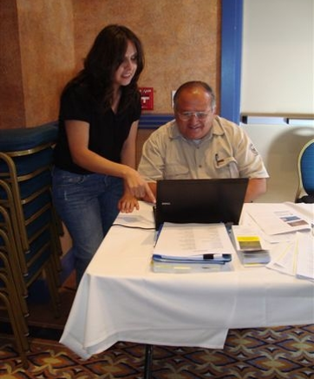
Gathering Information
Know the regulations
  Be sure you are presenting on the most current federal regulations
  Be aware of any state, tribal or local regulations governing pesticide use and safety
Image credit: Jennifer Weber, Arizona Department of Agriculture
Notes:
Notes for trainers of workers and pesticide handlers:
Your training success depends on how well you prepare BEFORE the training. It is important that you are prepared for your training and have learned as much as you can about the people you will be training prior to meeting them.
It is important to know the regulations you will be training on as well as any other regulations that might affect the employees safety.
Federal pesticide regulations can change so be sure that you review your training materials at least annually and revise them if necessary. Good sources include US EPA, the Pesticide Educational Resources Collaborative (PERC) and the National Pesticide Information Center (NPIC).
Recognize that there may be state, tribal or local regulations that govern the safe use of pesticides which are more stringent than the federal regulation. Contact local regulatory agencies or visit their websites to find out whether there might be additional information you must cover. This might include State Department of Agricultures or OSHA. If you are not familiar with state, tribal or local information, have someone at the training who can assist with that. Also have the local contact information available.

Slide 29
Gathering Information
Learn as much as you can about your audience before training
  Are you training pesticide workers, handlers or both?
  What is their background?
  What experience do they have?
  What crops do they work with?
Notes:
Notes for trainers of workers and pesticide handlers:
It is important to know ahead of time whether you will be training workers, handlers or both. On pages 201-204 of the National Worker Protection Standard: A Manual for Trainers of Agricultural Workers and Pesticide Handlers Manual there are some very good examples of the type of WPS training required based on the activity of the employee. It is important to understand the difference between workers and handlers as you may have to help the agricultural employer determine what type of training is needed, as well as who should attend. In a moment, you will see an example of how tasks and the timing in which the task is undertaken determines the type of employee under WPS.
You should know whether your trainees come from a diversity of ethnic, cultural or language backgrounds. If it will be a diverse group, is there any concern about their relationship to one another? Do they get along or is there tension? Do you know the language or will you be working with a translator? Is there a wide range of ages in the training group? You may want to tailor your training for a specific age group based on using contemporary terms or even consider the type of technology you might include in the training.
You may have to wait until the training session to find out what type of experience the group has with pesticides and whether they have had WPS training before. While waiting for training to begin, or during the first few minutes of the training, you could ask how long they have worked there, what type of work they do on the establishment, whether they have had any WPS training in the past. You could ask handlers if they know the names of any pesticides they will use or if they have worked with pesticides in the past. You should also ask if they have any concerns about working with pesticides, and if so, what that might be. You might be able to help address their concern in your training!
You should find out if the persons that you will be training are seasonal or if they will be working with a variety of crops. You can use examples of how to avoid exposure to residues based on the type of crops they will be working with and you might be able to determine what pesticides or pesticide residues they may be exposed to during work.

Slide 30
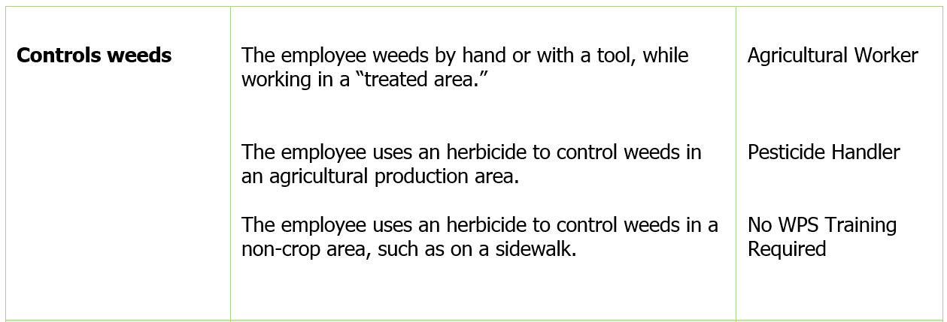
Example of how ‘tasks’ determine the type of employee under WPS
Notes:
Notes for trainers of workers and pesticide handlers:
This is a good illustration taken from page 201 of the National Worker Protection Standard: A Manual for Trainers of Agricultural Workers and Pesticide Handlers manual that may help you understand how, depending on the task, tools, and timing, an employee who is controlling weeds would be considered a worker, a handler or even not require WPS training. (Review slide). Are there any questions about this?

Slide 31
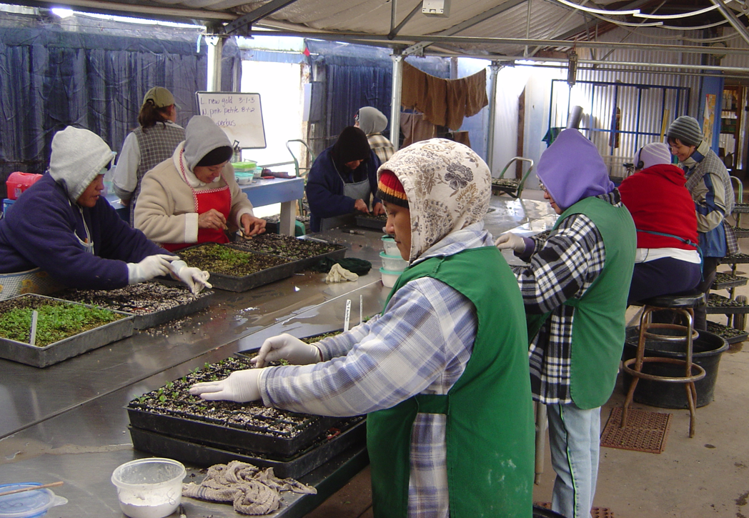
Gathering Information
Know where you will be training
  Check out the training site before the scheduled training
  Training outdoors presents specific challenges
  Setting up the site when training indoors
Image credit: Jennifer Weber, Arizona Department of Agriculture
Notes:
Notes for trainers of workers and pesticide handlers:
Learn where you will be training ahead of time so you can be prepared! The methods you use for outdoor trainings will be different than what you will use at an indoor training session.
Check out the training site before the training session, if possible. Then you will know what to bring and can anticipate what type of conditions you will have during the training session. It can increase your comfort level when you know what to expect!
Training outdoors can be especially challenging because there are usually a lot more distractions. If you will be training outdoors, you will probably have to use a flip chart or some other type of ‘tail-gate’ training tool. Training outdoors can be an opportunity to include some type of learning activity that may be too ‘messy’ for indoors, such as how to use a eye wash station. When training outdoors, you will also have to consider your comfort level by dressing appropriately and bringing enough water to keep you hydrated. But you will also have to consider the safety and comfort of the people you are training.
Training indoors requires that you set up the environment to be as distraction-free as possible. It’s important to make sure that you know how many trainees will be attending to be certain you have enough space, chairs and tables, if used. You should also learn, before training, if there are electric outlets available and whether you would need to bring extension cords. Indoor sites sometimes have the electronics available, so you should know whether you can use what is there or if you must bring your own.

Slide 32
Organizing Your Training
Create a training plan with clear objectives and a course outline
Think about how much time will be required
Think about things that require additional time
Notes:
Notes for trainers of workers and pesticide handlers:
After gathering the information you need for the training, it is time to get organized.
Creating a training plan compels you to look at the training topics you must cover and organize them into themes. For example, if your topic was the pesticide label, you might start by explaining the different sections of the label, how to find health and safety information in the first aid and personal protective equipment sections, and so on. After you have the plan, you can develop a list of training objectives. Objectives are simple statements of knowledge or skills you would like the participants to have at the end of training. In the training plan example, an objective might be that the participants can read and follow label directions for selecting the required personal protective equipment. Pages 207-209 of the National Worker Protection Standard: A Manual for Trainers of Agricultural Workers and Pesticide Handlers manual has an example of a training plan and objectives.
A course outline is a great tool to keep your training session organized and help you determine how much time you need for the topic and activities, if used. Your outline should include the topic, any activity, the amount of time to spend and any materials required for the activity.
It’s important to think about how much time will be required to cover all the topics. If you have a plan with objectives and an outline, you are more likely to stick with a schedule. If you are working with an agricultural employer, they will appreciate you telling them how much time is required and you sticking closely with that figure!
However, you should plan for situations that might add extra time to your training. A few things you should consider that would add time include:
Using an interpreter or presenting bilingually
Adding activities
Signing training records
Can you think of other things that might add time to your training?

Slide 33
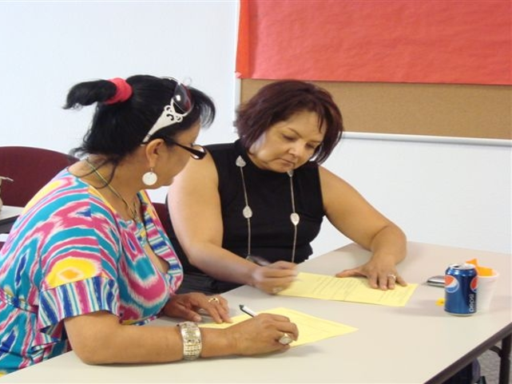
Organizing Your Training
Selecting materials and handouts to use
List of equipment and supplies needed
Additional considerations
Image credit: Jennifer Weber, Arizona Department of Agriculture
Notes:
Notes for trainers of workers and pesticide handlers:
The training tools that you might use include flip charts, DVDs, You-Tube videos, PowerPoint presentations, booklets, pamphlets and games. There are a lot of resources where you can find pesticide safety training materials including PERC, EPA and the National Pesticide Information Center (NPIC). However, remember that you must use EPA-approved training materials when training handlers and workers. When you select materials, keep in mind that they must
Cover the required information
Be correct and up-to-date with the current regulations
Approved by EPA
In a language the participants understand
Reflect the worksite as much as possible
Be presented so that employees can participate in training and ask questions.
You should make a list of everything you will need to conduct your trainings. Check the training site ahead of time to see if they have some of the equipment you will use. If you make a list of what you need for training, you can refer to it and be less likely to forget important tools you need. Page 216 of the National Worker Protection Standard: A Manual for Trainers of Agricultural Workers and Pesticide Handlers manual has a good example of an equipment and supply list.
Some additional things to consider before the training include:
Whether you must arrange for an interpreter. If so, the interpreter should be familiar with pesticide terminology and, if possible, be given a copy of the training materials beforehand.
You might also want to create an activities plan if you are using activities in your training. The plan should include the topic associated with the activity, any props or equipment needed and any materials or handouts that need to be prepared ahead of time.
You should also think about how you want to arrange the room if training indoors. If using a table, flipchart, dry erase boards, it is best to place them off to one side so you do not create a ‘barrier’ between the participants and you.

Slide 34
How is Training to be Conducted?
Training must be provided either orally from written materials or audio-visually
Training must be provided in a manner the worker or handler can understand
The training location must be reasonably free from distractions and be conducive to training
Training materials for workers or handlers must be approved by EPA
The Train-the-Trainer program used to qualify as a trainer of workers or handlers must be EPA approved
A qualified trainer must be present during the training session to respond to any questions
Notes:
Notes for trainers of workers and pesticide handlers:
The information must be presented orally, using written materials, audiovisual materials (like videos and posters), or a combination of the two.
Written and audiovisual materials should be in a language the workers and handlers understand and the information must be provided in a manner the workers and handlers understand.
If you use a translator, it is important that they have a clear understanding of pesticide terminology before the training.
The material should be presented at an appropriate educational level using non-technical terms.
Please remember that some employees may not be able to read either English or their native language.
Workers and handlers should be seated in a quiet, comfortable place during the training. If the training takes place outside, the training area should be shaded from the sun, protected from the wind, and not too warm or cool. Asking workers and handlers to stand in hot or noisy places may negatively impact the success of the training.
WPS training materials that are developed and issued by EPA will bear the official EPA logo and have an EPA publication number. WPS training materials that have been developed by states or other organizations and have been approved by EPA should bear an EPA approval number and a statement indicating the materials have been approved by EPA.
There must be a qualified trainer present (and translator if used) during the entire training to respond to questions from the audience.
Allow time for the workers to ask questions about the information provided.

Slide 35
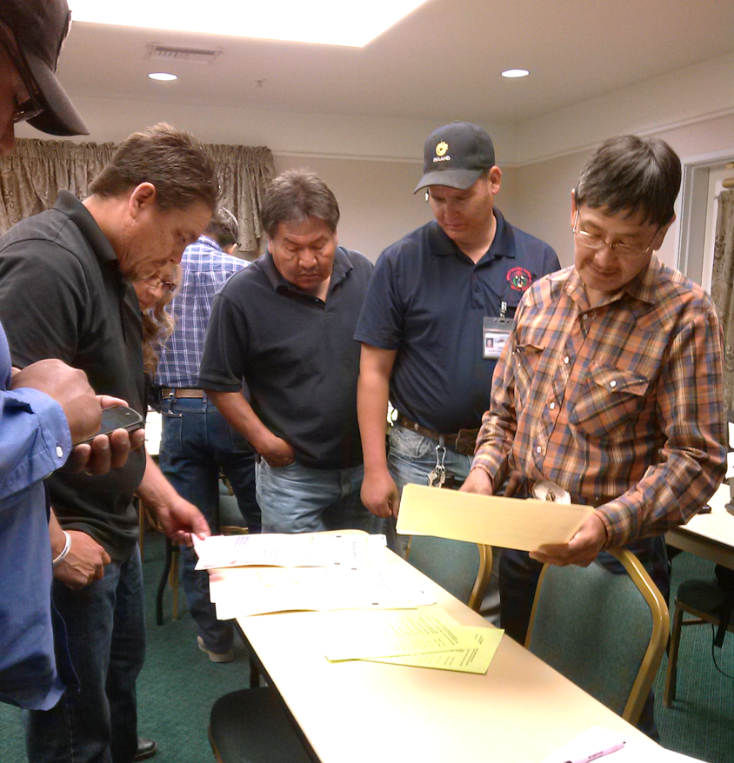
Time to Train
Give the audience some background information
Engage your audience
Have fun!
Read the crowd
Image credit: Jennifer Weber, Arizona Department of Agriculture
Return to Table of Contents
Notes:
Notes for trainers of workers and pesticide handlers:
Hopefully you are confident and ready to train now because of the preparation work you have done. Here are a few additional tips to remember as you train.
As you begin the training, give the audience some background information on you and the topic. Now is the time to stress the importance of this training as it is intended to inform them about pesticide use on the establishment, protect them from pesticide exposures and mitigate any impacts of the limited exposure to residues they may have during the course of their work activities. Remind them that this training will help them identify workplace hazards from pesticides used on the establishment and give them the knowledge and skills they need to work safely.
It is important to engage your audience from the start. Depending on the size of the group you are training, you may be able to do this by asking questions about their work, their experiences or whether they have any concerns about the work they will be doing. If you are working with a small group, you may be able to use role-playing to engage them and help you identify or solve a problem relating to WPS. For example, you might ask what they should do if they are in a field adjacent to one that is being treated and believe they may be drifted on. Or start in an unusual way by telling a story or asking a provocative question.
Don’t forget to have fun when you are training! It will be easier for the audience to relate to you if you can interject some humor or anecdotes.
Finally, read your audience! Are they listening? Are they engaged? Do they seem bored or is someone even sleeping? Don’t feel bad…it happens to the best trainers! The important thing is that you know how to respond to different situations. If they seem disengaged, it may be a good time to insert an activity. You could also ask for feedback. Or you can raise the volume of your voice to grab attention again. Even walking around the training site keeps people more focused on you as a trainer. And it provides an opportunity to walk near the distracted or disengaged person to covertly redirect their attention.

Slide 36
Section 3: Employee Tasks and Restrictions
Training Topics for both Workers and Handlers
Return to Table of Contents
Notes:
Notes for trainers:
This section contain training requirements for both workers or handlers.
This section will inform workers and handlers of employee tasks and restrictions.
Specific worker and handler training topics that are included in this section include:
The rule prohibits agricultural employers from allowing or directing any worker to mix, load, or apply pesticides or assist in the application of pesticides unless the worker has been trained as a handler.
Agricultural employers must provide specific information to workers before directing them to perform early-entry activities. Workers must be at least 18 years old to perform early-entry activities.

Slide 37
Agricultural Worker Tasks
Work in treated fields
Agricultural activities
Exposed to pesticide residues
DO NOT HANDLE PESTICIDES
Image credit: Chazzbo Media
Notes:
Information required to be covered:
An agricultural worker is any person working in a field that has been sprayed with any type of pesticide, or that has had an REI in effect within the last 30 days.
These are people that are doing agricultural tasks with high-contact: weeding, moving irrigation equipment, pruning, harvesting, etc.
Workers DO NOT handle pesticides.
Notes for trainers of workers and pesticide handlers:
Start this section with a discussion question. “The person in this picture is an agricultural worker. As a worker, what kinds of tasks does she do?”

Slide 38
Early-Entry Worker Tasks
Enter into a treated field during the restricted-entry interval (REI)
Additional early-entry specific training and protections before entering a treated field
Must be at least 18
DO NOT HANDLE PESTICIDES
Image credit: Betsy Buffington, Iowa State University
Notes:
Information required to be covered:
Early entry means entry into a treated field or other area after the pesticide application is complete, but before the restricted-entry interval or other restrictions on entry for that pesticide have expired.
Agricultural workers who are required to go into treated areas before the REI expires are early entry employees. Agricultural employers must provide early-entry specific training and protection to workers before directing them to perform early-entry activities.
The new minimum age for early entry workers is 18 years old.

Slide 39
Pesticide Handler Tasks
Mix, load, apply pesticides
Fix application equipment
YES! Mechanics are handlers
Must be 18 years old
Image credit: Chazzbo Media
Return to Table of Contents
Notes:
Information required to be covered:
You are a pesticide handler if you:
Apply pesticides
Assist with pesticide applications
Clean, repair, or maintain pesticide application equipment – such as boom sprayers, backpack sprayers, or hoppers – that may contain pesticide residues
Mix, load, or transfer pesticides into application equipment
Dispose of pesticides or materials with pesticides on them, such as containers
Act as a flagger
Perform tasks as a crop advisor (this includes Pest Control Advisors, or PCAs, in California) during the pesticide application or during the REI
The new minimum age for handlers is 18.
Agricultural employers are prohibited by the rule from allowing or directing a worker to mix/load/or apply pesticides or assist in their application unless trained as a handler.
Notes for trainers of workers and pesticide handlers:
Start this section with a discussion question. “What kind of tasks does a handler do?”
This concludes Section 3: Employee Tasks and Restrictions. Continue on to Section 4: Where You May Encounter Pesticides at Work and How They Can Enter Your Body or return to the Table of Contents by clicking on the “Return to Table of Contents” in the bottom-right corner of this slide (when in presentation view only).

Slide 40
Section 4: Where You May Encounter Pesticides at Work and How They Can Enter Your Body
Training Topics for both Workers and Handlers
Return to Table of Contents
Notes:
Notes for trainers:
This section contain training requirements for both workers or handlers.
This section will inform workers and handlers of where they may encounter pesticides at work and how pesticides can enter their body.
Specific worker and handler training topics that are included in this section include:
Where and in what form pesticides may be encountered during work activities, and potential sources of pesticide exposure on the agricultural establishment. This includes exposure to pesticide residues that may be on or in plants, soil, tractors, application and chemigation equipment, or used PPE, and that pesticides may drift through air from nearby applications or be in irrigation water.
Routes through which pesticides can enter the body.

Slide 41
Pesticide Types
Insecticides – control insect
Herbicides – control weeds
Fungicides – control fungi and disease organisms
Image credit: Ed Crow, Penn State Pesticide Education Program
Notes:
Information required to be covered:
Pesticides protect plants from pests such as insects, weeds, fungi, and rodents.
People often use the term "pesticide" to refer only to insecticides, but it actually applies to all the substances used to control pests.
Well known pesticides include: insecticides, herbicides, and fungicides.
Source:
US Environmental Protection Agency (EPA)
https://www.epa.gov/ingredients-used-pesticide-products/types-pesticide-ingredients
EPA National Core Pest Management Manual.
EPA Label Review Manual Chapter 2

Slide 42
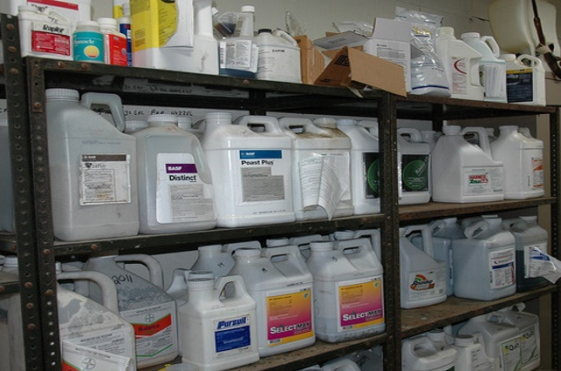
Pesticide Formulations
Liquids
Dusts
Powders
Granules
Pellets
Gases
Gels
Aerosols
Image credit: Penn State Extension, The Pennsylvania State University
Notes:
Information required to be covered:
Pesticides are formulated in different ways and are applied to agricultural crops and cropland in a variety of different forms. Some of the most commonly-used formulations are: liquids, dusts, powders, granules, pellets, gases, gels, and aerosols.

Slide 43
At Work, Pesticides and Pesticide Residues May be Found:
In or on treated plants (leaves, stems, fruit and vegetables)
In or on the soil where pesticides were applied
Tractors, sprayers, and other application equipment
Used work clothing, shoes, and personal protective equipment (including gloves)
Pesticide mixing and loading areas
In the air as drift from a nearby application
In the irrigation water or irrigation equipment, if the irrigation system is used to apply pesticides, called chemigation
In or on pesticide containers (including empty pesticide containers)
Notes:
Information required to be covered:
Workers and handlers must understand where they may encounter pesticides or pesticide residues at their workplace. Even people who do not mix, load, or apply pesticides can come into contact with pesticides or pesticide residues. Pesticide handlers can come into contact with concentrated and diluted pesticides as well as residues.
Pesticides and pesticide residues can be found:
On leaves, stems, and fruit of treated plants
In the soil where pesticides have been applied
In some irrigation water and on irrigation equipment if pesticides are applied through irrigation system
In the air (as droplets, dust or vapors)
On application equipment
In or on pesticide containers including empty pesticide containers
In the form of drift during a nearby pesticide application
In mixing and loading sites
In pesticide storages
On contaminated personal protective equipment (handlers)
On measuring devices used for mixing and loading (including the scale) (handlers)
In places where handlers remove personal protective equipment after the application is done (handlers)
On empty pesticide containers and tools to open them (handlers)
On tools used to unplug nozzles (handlers)
In tractor cabs used for pesticide applications (handlers)
Notes for trainers of workers and pesticide handlers:
Make sure you cover this information with scenarios that are relevant to workers and handlers. For example, some tractor operators may become in contact with pesticide residues on tractors that have not been decontaminated after the pesticide application has been done.
Suggested Activity:
Section 4. Activities for Where You May Encounter Pesticides at Work and How They Can Enter Your Body: “Pesticide Residue on Unwashed Fruits and Vegetables”
Source:
Washington State Department of Agriculture (WSDA) Farmworker Education Program. Worker Protection Standard Train the Trainer Manual. WSDA Pesticide Management Division. Washington State 2014.

Slide 44




There are Four Routes of Pesticide Entry into the Body:
Skin (Dermal)
Eyes (Ocular)
Nose (Inhalation)
Mouth (Oral)
Notes:
Information required to be covered:
There are four routes of pesticide entry into the body:
Skin (dermal)
Eyes (ocular)
Nose (inhalation)
Mouth (oral)
Suggested Activities:
Section 4. Activities for Where You May Encounter Pesticides at Work and How They Can Enter Your Body: “Pesticide Route of Entry into the Body Exercise”
Section 4. Activities for Where You May Encounter Pesticides at Work and How They Can Enter Your Body: “Story Telling”

Slide 45
Routes of Entry: Dermal
Some pesticides when contacted can pass through the skin into the blood stream
Notes:
Information required to be covered:
Pesticides can enter the body through the skin if there is exposure. This route of entry is also called dermal absorption.
The majority of agricultural pesticide injuries or poisonings occur due to skin exposure. Some types of pesticides can pass through the skin into the blood stream.
It is important to remember that there are many factors affecting absorption. Some pesticides are more likely to be absorbed through the skin than others. There are also different parts of the body where skin absorption happens more than others. The form of pesticides that come in contact with skin also matters.
Notes for trainers of workers and pesticide handlers:
The majority of agricultural pesticide injuries or poisonings occur due to skin exposure. When pesticides get onto the skin, they can cause redness, rash, blisters, and irritation. Some types of pesticides readily penetrate the skin and enter the blood stream.
The skin can be exposed to pesticides and their residues through contact with treated plants or soil. Even contact with irrigation water may result in pesticide exposure if pesticides are applied through an irrigation system—or residues from soil, plants or application equipment get into the irrigation water. Skin exposure can also occur when careless pesticide applications result in pesticides drifting onto people who are working nearby or if workers are directly sprayed. Pesticides can be transferred from dirty hands to other parts of the body if workers do not wash their hands before eating, grooming or using the bathroom.
Source:
Washington State Department of Agriculture (WSDA) Farmworker Education Program. Worker Protection Standard Train the Trainer Manual. WSDA Pesticide Management Division. Washington State 2014.
EPA/CAST, Proyecto Nacional de Prueba Piloto: Manual para el Entrenamiento de Entrenadores, The Science Source for Food-EPA, Washington D.C. 2003

Slide 46
Routes of Entry: Ocular
Significant amounts of pesticide can penetrate the outer tissues of the eye and enter the blood stream
Notes:
Information required to be covered:
Drift from nearby applications or applications of pesticides to areas where people are working can result in workers getting pesticides in their eyes.
Workers can also transfer pesticides from their hands into their eyes. These residues can cause eye irritation or worse.
Not wearing the required eye protection when mixing and loading or applying pesticides can result in eye exposure. Handlers can also transfer pesticide residues into their eyes when rubbing them with contaminated hands.
The eye may or may not be damaged during the pesticide absorption process, depending on the corrosive nature of the chemical and its ability to penetrate the outer tissues.
Source:
Washington State Department of Agriculture (WSDA) Farmworker Education Program. Worker Protection Standard Train the Trainer Manual. WSDA Pesticide Management Division. Washington State 2014.
EPA/CAST, Proyecto Nacional de Prueba Piloto: Manual para el Entrenamiento de Entrenadores, The Science Source for Food-EPA, Washington D.C. 2003

Slide 47
Routes of Entry: Inhalation
Once pesticides have been inhaled, they enter the lungs and bloodstream
Notes:
Information required to be covered:
Pesticide drift from nearby applications can endanger workers and handlers who may breathe in some of the pesticide vapor, dust or spray droplets.
Handlers may breathe in pesticide vapor, dust or spray droplets when mixing, loading or applying pesticides.
Source:
Washington State Department of Agriculture (WSDA) Farmworker Education Program. Worker Protection Standard Train the Trainer Manual. WSDA Pesticide Management Division. Washington State 2014.
EPA/CAST, Proyecto Nacional de Prueba Piloto: Manual para el Entrenamiento de Entrenadores, The Science Source for Food-EPA, Washington D.C. 2003

Slide 48
Routes of Entry: Oral
Pesticide illness can occur if pesticide residues are transferred to consumed food from unwashed hands
Return to Table of Contents
Notes:
Information required to be covered:
While working in the fields, workers can transfer residues remaining on treated plants into their mouths if they eat, drink or smoke without washing their hands beforehand.
Do not eat unwashed produce or fruit taken directly from the fields.
Pesticide handlers could transfer pesticides and pesticide residues to their mouths if they eat, drink, smoke or chew gum while mixing, loading, applying, transporting and repairing and calibrating equipment, etc. Oral exposure may also occur if handlers do not wash their hands before eating or smoking.
Pesticide handlers could transfer pesticide residues to their mouths while attempting to unplug a nozzle using their mouth.
Notes for trainers of workers and pesticide handlers:
This concludes Section 4: Where You May Encounter Pesticides at Work and How They Can Enter Your Body. Continue on to Section 5: Pesticide-Related Health Effects or return to the Table of Contents by clicking on the “Return to Table of Contents” in the bottom-right corner of this slide (when in presentation view only).
Source:
Washington State Department of Agriculture (WSDA) Farmworker Education Program. Worker Protection Standard Train the Trainer Manual. WSDA Pesticide Management Division. Washington State 2014.
EPA/CAST, Proyecto Nacional de Prueba Piloto: Manual para el Entrenamiento de Entrenadores, The Science Source for Food-EPA, Washington D.C. 2003

Slide 49
Section 5: Pesticide-Related Health Effects
Training Topics for both Workers and Handlers
Return to Table of Contents
Notes:
Notes for trainers:
This section contain training requirements for both workers or handlers.
This section will inform workers and handlers of pesticide-related health effects.
Specific worker and handler training topics that are included in this section include:
Signs and symptoms of common types of pesticide poisoning.
Potential hazards to children and pregnant women from pesticide exposure.
Potential hazards from toxicity and exposure that pesticides present to workers and their families, including acute and chronic effects, delayed effects, and sensitization.
Potential hazards from pesticide residue on clothing.

Slide 50
Common Signs and Symptoms
Eye irritation
Nose and throat pain
Skin rash
Dizziness
Headache
Muscle aches or cramps
Exhaustion
Nausea
Diarrhea
Chest pain
Breathing difficulties
Blurred vision
Excessive salivation or drooling
Very small, pinpoint pupils
Lack of muscle control
Convulsions or seizures
Unconsciousness
Death
Notes:
Information required to be covered:
Symptoms are any abnormal condition or change in health function that a person sees or senses, or that can be detected by medical examination or laboratory tests. These symptoms indicate the presence of an injury, disease, or disorder.
The following is a list of symptoms that may be result from pesticide exposure:
eye irritation, nose and throat pain, skin rash, dizziness, headache, muscle aches or cramps, exhaustion, nausea, diarrhea, chest pain, breathing difficulties, blurred vision, excessive salivation or drooling, very small, pinpoint pupils, lack of muscle control, convulsions or seizures, unconsciousness, death

Slide 51
Symptoms of Exposure to Fumigants
Irrational behavior
Elevated body temperatures
Notes:
Information required to be covered:
In addition, people exposed to certain fumigants may experience irrational behavior, or elevated body temperatures.

Slide 52

Pesticide Poisoning Symptoms Can be Confused with Other Illnesses
Cold
Flu
Heat illness
Food poisoning
Hangover
Notes:
Notes for trainers of workers and pesticide handlers:
If an agricultural employee feels sick while handling pesticides or when working in a pesticide-treated area it may be difficult to determine if the symptoms he or she is experiencing are related to pesticide exposure. Some common pesticide symptoms mimic those of a cold, flu, heat stress, morning sickness, food poisoning or a hangover. Diagnoses usually requires careful medical examination, laboratory tests and observation.
If you start feeling sick or showing symptoms of illness, start by identifying possible causes.
For example, you left your house feeling fine, but it is has been very hot out and you have not had much water to drink. You suddenly feel weak and your head begins to hurt. Your symptoms can be due to heat exhaustion.
After having lunch you experience a stomachache and nausea. You remember that your food had a funny smell. You could be experiencing food poisoning.
You start to have a sore throat and runny nose. You might be coming down with a cold or the flu.
Before thinking it might be some other type of illness, stop and ask yourself if you have entered a field where pesticides have been applied recently, and if you started feeling sick after you started working. In this case, your symptoms could be due to pesticide poisoning.
Now that you have identified the cause of the symptoms, do not wait for symptoms to worsen.
Leave the contaminated area immediately and tell your supervisor that you suspect you have been exposed to pesticides and are experiencing pesticide poisoning symptoms.

Slide 53




Mild Symptoms
Eye irritation
Skin rash
Nose and throat pain
Dizziness
Notes:
Information required to be covered:
Symptoms vary in severity from mild to severe.
Mild symptoms include:
Eye irritation
Nose and throat pain
Skin rash
Headache
Dizziness
Diarrhea
Muscle aches or cramps
Exhaustion
Nausea

Slide 54
Moderate Symptoms
Excessive saliva or drool
Breathing difficulties
Blurry vision
Notes:
Information required to be covered:
Moderate symptoms include excessive saliva or drool, breathing difficulties, and blurry vision

Slide 55


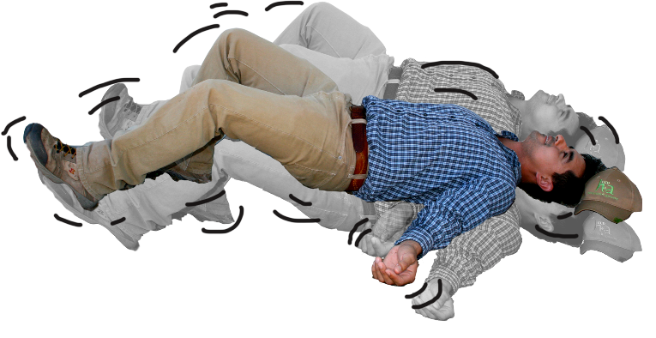
Severe Symptoms
Pinpoint pupils
Trembling, lack of muscle control
Violent convulsions or seizures
Notes:
Information required to be covered:
Severe symptoms include:
Pinpoint pupils
Trembling, lack of muscle control
Violent convulsions or seizures
Unconsciousness or death

Slide 56
The Type and Severity of Symptoms
Depend on:
The pesticide
The route of exposure
The length of exposure
How often you are exposed
Age of the person
Health of the person
Notes:
Information required to be covered:
The probability that pesticides will affect your health depends on various things:
The type of pesticide
Poisoning symptoms vary among classes of pesticides and pesticides within a class. For example, pesticides that control weeds (herbicides) can be less toxic than some pesticides used to control insects (insecticides), but some insecticides are more toxic than others.
One pesticide may cause only mild eye irritation if splashed in a person’s eye, while exposure to another product may result in blurred vision. Some pesticides are extremely toxic if swallowed but not harmful if inhaled. Finally, there are also pesticides that, when used correctly and according to the safety measures listed on the label, cause no known adverse health effects.
The amount of pesticide that you are exposed to
The severity of symptoms is usually proportional to the amount of pesticide (dosage) entering the person’s body.
The type and severity of exposure symptoms can also be influenced by the amount absorbed into the body or how fast the body absorbs and excretes it.
Age and health of the person
The severity of symptoms is related to the person’s sensitivity to certain chemical ingredients.
Another factor that can significantly influence the type and severity of reaction to pesticide exposure is the overall health and genetic makeup of the individual. Each person is different. People who are elderly, sick or who have compromised immune systems may not have sufficient resistance to some types of pesticides.
People who have medical conditions such as asthma may experience breathing difficulties when working in an area where pesticides have been applied even after the restricted-entry interval (REI) has expired.

Slide 57

Hazards to Children and Pregnant Women
Pregnant women
  Miscarriage
  Birth defects
Children
  Still small
  Still developing
Notes:
Information required to be covered:
Pesticide exposure can be extremely hazardous for pregnant women and may result in miscarriage or cause harm to their unborn child.
Children are also susceptible to the effects of pesticides as their bodies are small and their internal organs are still developing and may be negatively impacted by exposure.
For this reason all agricultural employees who work directly with pesticides (pesticide handlers) or in an area still under a restricted-entry interval (early-entry workers) must be at least 18 years old.
Suggested Activity:
Section 5. Activities for Pesticide-Related Health Effects: “Potential Hazards to Children and Pregnant Women from Pesticide Exposure”

Slide 58
Potential Hazards from Pesticides
Acute
Chronic
Short-term
Symptoms appear shortly after exposure
Single exposure
Mild to serious illnesses
Long-term
Symptoms appear months or years later
Repeated exposures to a small dose
Mostly causes serious illnesses
Notes:
Information required to be covered:
Workers and handlers might experience immediate (acute) and long-term (chronic) health effects if they are exposed to some types of pesticides, depending on the dosage.
Immediate or Acute Health Effects. The onset of acute illness or injury occurs shortly after exposure. These acute illnesses or injuries can be serious, and could cause days off work or treatment by a doctor. In most cases, acute effects are resolved relatively quickly and the exposed person fully recovers.
Delayed, Long-term or Chronic Health Effects. Long-term or chronic effects are illnesses or injuries that persist over long periods. They may result from a single exposure incident involving an extremely toxic or a large amount of pesticide or be caused by many repeated exposures at a level that is too low to produce noticeable immediate illnesses or injury.

Slide 59
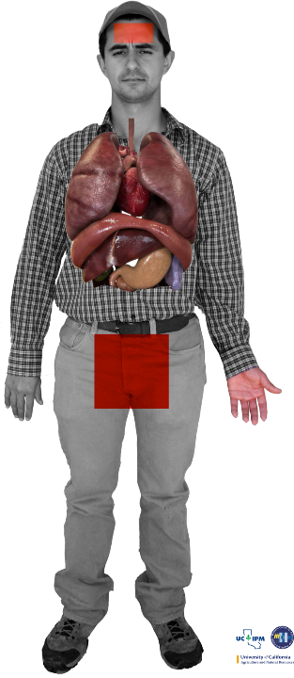
Chronic Pesticide Hazards
Cancer
Fertility problems
Respiratory illness
Nervous system disorders
Birth defects
Immune system disorders
Image credit: Sarah Risorto, UC Statewide IPM Program
Notes:
Information required to be covered:
Long-term health effects associated with exposure to certain pesticides include: cancer, inability to become pregnant (infertility), spontaneous abortion, birth defects in the children of exposed parents, nervous system damage, damage to specific organs such as the lungs or liver and damage to the immune system among other conditions.
Notes for trainers of workers and pesticide handlers:
Take for example, Miguel, pictured here. Each of the colored dots on Miguel’s body represents a low level of exposure to pesticide residues, that could have been avoided if Miguel did a better job of protecting himself.
Each day you go to work, you encounter pesticide residues in the dust beneath your feet. It sticks to the bottom of your shoes and to the legs of your pants.
So little by little pesticide residues enter your body.
Each time you are exposed to a pesticide you absorb residues. The first time you might not feel any effect, but as your body absorbs more and more residues you can become sick.
Remember the saying: “little by little the jug is full” or in Spanish, “de poquito en poquito, se llena el jarrito”? This is how over the long term, you can end up with high levels of pesticides in your body.
The majority of pesticide poisoning cases are due to repeated contact with residues over a long period of time.
In these situations, the health effects can take years to appear. This is because small doses of different pesticides enter your body at different times and are absorbed into your internal organs.

Slide 60
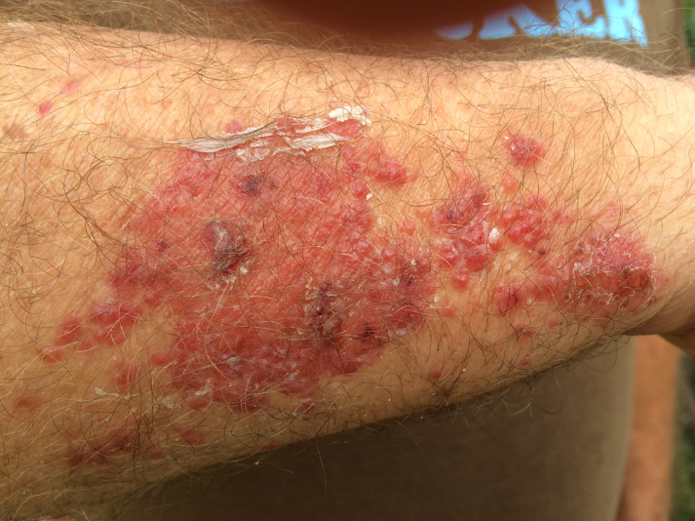
Sensitization
Not overexposure or poisoning
Allergic reaction that develops over time
Skin irritation
Respiratory problems
Image credit: Metere Pinker and Mark Morrison
Notes:
Information required to be covered:
Sensitization is the gradual development of an allergic reaction to a type of pesticide or chemicals in general. Some people get headaches, rashes, or experience dizziness each time they work with a pesticide or enter an area where pesticides were recently used.
Sometimes, even if you protect yourself you can become more sensitive to pesticides. You can start having an allergic reaction. Maybe you had no reaction to pesticides when you began working in the field, but over time you do.
Most commonly, increased sensitivity causes skin irritation or respiratory problems.
Notes for trainers of workers and pesticide handlers:
Agricultural workers and pesticide handlers may better understand sensitization if it is compared to an allergic reaction to poison oak or poison ivy. Not everyone will have an adverse skin reaction the first few times they come in contact with the plants. However, after repeated exposures some people will become sensitized and develop a rash that becomes worse with each additional exposure.
Sensitivity to pesticides is not the same thing as overexposure to pesticides. It is important to identify the causes of your symptoms so you know how to treat them.
Becoming sensitive to pesticides can take months or years depending on the person and the type of pesticide to which they are exposed.
Skin irritation means itchiness, redness, pain, or skin blisters when you come into contact with pesticide residues.
Respiratory problems mean sneezing, coughing, shortness of breath, difficulty breathing, even full asthma attacks.
If you notice you are more sensitive to pesticides, let your supervisor know. There are some steps you can take to protect yourself, like wearing a respirator or protective gloves.
Most people don’t develop allergies to pesticides, however all of us need to be careful.

Slide 61
Reduce Pesticide Residue on Clothing
Wear work clothes only once
Put work clothes in a plastic bag after use
Return to Table of Contents
Notes:
Information required to be covered:
Pesticide residues that remain on work clothing (such as long pants, long sleeve shirts, shoes, and socks) can be another source of hazard to workers.
Agricultural employees can reduce their risk of exposure to these residues by:
Wearing clothing only once and have at least two sets of work clothes to avoid wearing potentially contaminated clothes before they are washed.
Keeping work clothes that may contain residues separate from other clothing (by putting it into a plastic bag, for instance) to prevent others from coming in contact with them
Notes for trainers of workers and pesticide handlers:
This concludes Section 5: Pesticide-Related Health Effects. Continue on to Section 6: Ways to Reduce Pesticide Exposure or return to the Table of Contents by clicking on the “Return to Table of Contents” in the bottom-right corner of this slide (when in presentation view only).

Slide 62
Section 6: Ways to Reduce Pesticide Exposure
Training Topics for both Workers and Handlers
Return to Table of Contents
Notes:
Notes for trainers:
This section contain training requirements for both workers or handlers.
This section will inform workers and handlers of ways to reduce the risk of pesticide exposure.
Specific worker and handler training topics that are included in this section include:
How to recognize and understand the meaning of the posted warning signs used for notifying workers of restrictions on entering pesticide treated areas on the establishment.
How to follow directions and/or signs about keeping out of pesticide treated areas subject to a restricted-entry interval and application exclusion zones.
When working in pesticide treated areas, wear work clothing that protects the body from pesticide residues and wash hands before eating, drinking, using chewing gum or tobacco, or using the toilet.
Wash or shower with soap and water, shampoo hair, and change into clean clothes as soon as possible after working in pesticide treated areas.
After working in pesticide treated areas, remove work boots or shoes before entering your home, remove work clothes and wash or shower before physical contact with children or family members.
Wash work clothes before wearing them again and wash them separately from other clothes.
Do not take pesticides or pesticide containers used at work to your home.
Keep children and nonworking family members away from pesticide treated areas.
Suggested Activity:
Section 6. Activities for Ways to Reduce Pesticide Exposure: “Brain Storming and Group Discussion”

Slide 63
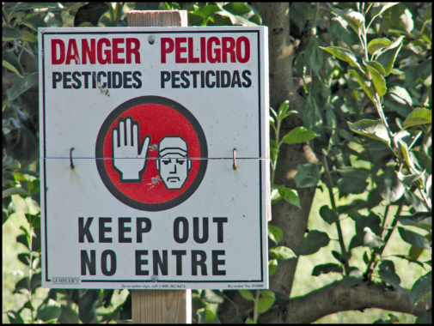
Recognize and Understand the Meaning of Posted Warning Signs
If you see this sign- or one similar to this one - Do Not Enter!
This sign means that there may be pesticides or pesticide residues present in the area
You need to receive training and special protection to enter those areas
Image credit: Chazzbo Media
Notes:
Information required to be covered:
Whenever workers and handlers see this sign it means that the area is under a restricted-entry interval (REI) and pesticides may not have broken down/dissipated yet to safe levels.
Under certain circumstances, employers are required to post warning signs in pesticide treated areas to indicate REI.
The REI is the amount of time that must pass after a pesticide application before it is safe for workers to enter the area without the proper training and protection.
During the REI, only appropriately-trained and equipped pesticide handlers and early-entry workers are allowed in the area.
Source:
Washington State Department of Agriculture (WSDA) Farmworker Education Program. Worker Protection Standard Train the Trainer Manual. WSDA Pesticide Management Division. Washington State 2014.

Slide 64
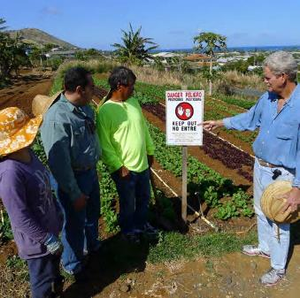
Follow Directions and/or Signs About Keeping Out of Pesticide Treated Areas
Keep out of treated areas or areas being treated with pesticides
Your supervisor will post signs or notify you verbally about what areas are under a restricted-entry interval (REI)
Stay away form the application equipment during pesticide applications
Image credit: James Hollyer, Associate Director for Extension, University of Guam
Notes:
Information required to be covered:
If a field is posted, it means that there are pesticides or pesticide residues.
Obey the signs in order to protect your health
As long as the signs remain posted, do not enter the area even if the date on the sign indicates that the REI has expired.
In outdoor production: Do not enter treated areas or application exclusion zones (AEZs), which ranges from 0 to 100 feet surrounding the equipment during pesticide applications.
Notes for trainers of workers and pesticide handlers:
Workers and handlers must clearly understand the following information:
The significance of the posted signs
The importance of obeying oral and posted warnings
One of the possible ways workers may be exposed to pesticides is by entering into treated areas while the REI is still in effect. This may result from the employer failing to notify workers or to post a restricted area. It may also be the result of employers asking workers to enter into treated areas or workers disregarding posted signs or oral warnings.
Pesticide handlers should always communicate to their supervisor and worker crew supervisors about known effective REI’s and on-going pesticide applications.
Source:
Washington State Department of Agriculture (WSDA) Farmworker Education Program. Worker Protection Standard Train the Trainer Manual. WSDA Pesticide Management Division. Washington State 2014.

Slide 65
Using Protective Clothing
Remember to use work clothes and/or personal protective equipment that protect your skin
Keep out of areas indicated by your supervisor
Leave the area if pesticides are carried towards the area where you are working
Wash with soap and water after working and before eating, chewing tobacco or using the bathroom and before you contact your family
Notes:
Information required to be covered:
Workers and handlers should use clothes (e.g., long sleeve shirt, long pants, shoes plus socks and a hat) that protect their skin when working in treated areas.
They should stay away from areas indicated by their supervisor or that are being treated with pesticides.
If workers and handlers feel they are being drifted on, workers and handlers must inform their supervisor and leave the area immediately .
Workers and handlers should wash with soap and water after working in fields that have been treated with pesticides before they put anything in their mouths and before they use the bathroom.

Slide 66
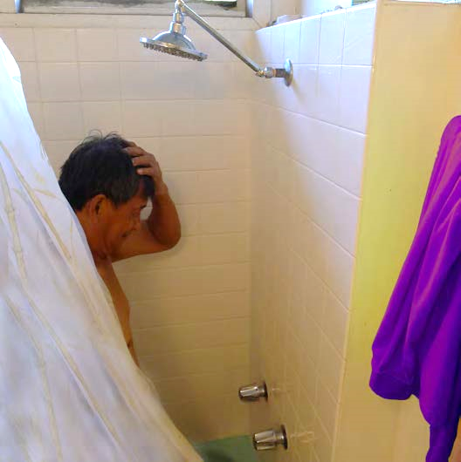
Wash and Change into Clean Clothes
Wash or shower with soap and water, shampoo hair as soon as you can after work
Change into clean clothes as soon as possible after working with pesticides or in areas treated with pesticides
Image credit: James Hollyer, Associate Director for Extension, University of Guam
Notes:
Information required to be covered:
Wash body with plenty of soap and water as soon as you can after applying pesticides or working in treated fields.
Change into clean clothes as soon as possible after applying pesticides or working in treated fields.
Source:
Washington State Department of Agriculture (WSDA) Farmworker Education Program. Worker Protection Standard Train the Trainer Manual. WSDA Pesticide Management Division. Washington State 2014.

Slide 67
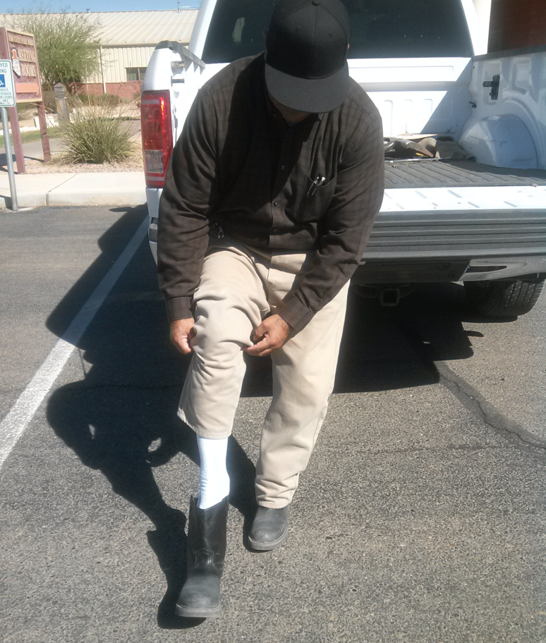
After Working in Pesticide Treated Areas
Remove work boots or shoes before entering your home
Remove work clothes and wash or shower before physical contact with children or family members
Image credit: Jennifer Weber, Arizona Department of Agriculture
Notes:
Information required to be covered:
Remove contaminated work boots or shoes before entering your home –significant amounts of pesticide can be carried in work boots and shoes, especially those worn by pesticide handlers. It is highly recommended to remove them before entering vehicles and entering home.
Remove work clothes and shower before having physical contact with children and other family members.
Handlers – if there are shower facilities at work, handlers should take showers before leaving the work area.
Source:
Washington State Department of Agriculture (WSDA) Farmworker Education Program. Worker Protection Standard Train the Trainer Manual. WSDA Pesticide Management Division. Washington State 2014.

Slide 68
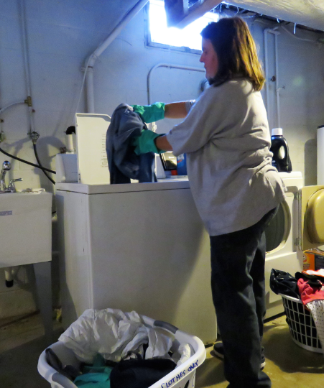
Wash Work Clothes
Wash work clothes before wearing them again
Wash work clothes separately from other clothes
Wash work clothing separate from family laundry
Use hot water
Decontaminate washing machine
Image credit: Ed Crow, Penn State Pesticide Education Program
Notes:
Information required to be covered:
Pesticide residues that remain on clothing can be a source of pesticide exposure for workers and their families. There are several ways workers can avoid these hazards:
Inform people who wash agricultural work clothing that the clothes may contain pesticide residues and provide them with steps to protect themselves.
Wash work clothes after each use.
Wash work clothes separately from other clothing.
Use hot water for work clothing.
Decontaminate the washing machine by running another full wash cycle with hot water and detergent to remove any remaining pesticide residues from the machine.
Source:
Washington State Department of Agriculture (WSDA) Farmworker Education Program. Worker Protection Standard Train the Trainer Manual. WSDA Pesticide Management Division. Washington State 2014.

Slide 69
Do Not Take Pesticides or Pesticide Containers Used at Work to your Home
Never take pesticides or pesticide containers home – they may contain pesticide residues that may harm you and/or your family
Typically pesticides used in agriculture are not to be used at home
Notes:
Information required to be covered:
Never take any pesticide from work because they are not safe for use around the home.
Never take any pesticide containers home, even empty ones. Pesticide containers are never completely free of pesticide residue and can never be safely used for any other purpose.
Agricultural pesticides, for the most part, are more concentrated and should never be used at home.
Do not pour pesticides from their original containers into drinking containers - Pouring pesticides from their original container into drinking containers is dangerous and illegal. Some unsuspecting person can mistake it for something edible.
Notes for trainers of workers and pesticide handlers:
Pesticide poisoning can happen when someone accidentally eats or drinks a pesticide that has been placed into a food or beverage container or drinks from a container that has been used to measure pesticides. Storing or mixing pesticides in food containers is illegal!
Avoid bringing pesticide residues home – it could be very complicated to get rid of them once they are inside.
Avoid contaminating vehicles with pesticides or pesticide residues – Handlers can transport significant amounts of pesticides in their work shoes that can heavily contaminate their vehicles. Workers can transfer pesticide residues to their vehicles from contaminated work clothes.
Handlers – Do not carry contaminated PPE in vehicles or take it home.
Source:
Washington State Department of Agriculture (WSDA) Farmworker Education Program. Worker Protection Standard Train the Trainer Manual. WSDA Pesticide Management Division. Washington State 2014.

Slide 70

Keep Children and Family Members Away from Pesticide Treated Areas
Keep children out of places where pesticides may be found
Nonworking family members should not enter into pesticide treated areas
At home – keep pesticide out of reach of children
Image credit: Ashley Estes, Arizona Department of Agriculture
Return to Table of Contents
Notes:
Information required to be covered:
Do not allow minor children to enter into pesticide treated areas
At home, keep pesticides out of reach of children
Nonworking family members should stay out of areas under a restricted-entry interval or areas that have been recently treated with pesticides.
Notes for trainers of workers and pesticide handlers:
This concludes Section 6: Ways to Reduce Pesticide Exposure. Continue on to Section 7: First Aid for Pesticide Illnesses and Injuries or return to the Table of Contents by clicking on the “Return to Table of Contents” in the bottom-right corner of this slide (when in presentation view only).

Slide 71
Section 7: First Aid for Pesticide Illnesses and Injuries
Training Topics for both Workers and Handlers
Return to Table of Contents
Notes:
Notes for trainers:
This section contain training requirements for both workers or handlers.
This section will inform workers and handlers of first aid for pesticide illnesses and injuries.
Specific worker and handler training topics that are included in this section include:
Routine and emergency decontamination procedures, including emergency eye flushing techniques, and if pesticides are spilled or sprayed on the body to use decontamination supplies to wash immediately or rinse off in the nearest clean water, including springs, streams, lakes or other sources if more readily available than decontamination supplies, and as soon as possible, wash or shower with soap and water, shampoo hair, and change into clean clothes.
How and when to obtain emergency medical care.
Emergency first aid for pesticide injuries or poisonings.
Safety data sheets provide hazard, emergency medical treatment and other information about the pesticides used on the establishment they may come in contact with. It is the responsibility of agricultural employers to do all of the following:
Display safety data sheets for all pesticides used on the establishment.
Provide workers and handlers information about the location of the safety data sheets on the establishment.
Provide workers and handlers unimpeded access to safety data sheets during normal working hours.

Slide 72
What is Decontamination?
Routine Decontamination
Emergency Decontamination
Cleansing face, hands or the entire human body to minimize exposure to pesticide residues
Removing pesticides from eyes, skin or clothes during emergency situations
Notes:
Information required to be covered:
Decontamination is the process of cleansing the human body, clothing, personal protective equipment, and the application equipment in order to remove pesticides or pesticide residues.
There are two types of decontamination: routine decontamination and emergency decontamination.
Routine decontamination is the process of cleansing the face, hands or the entire human body to minimize exposure to pesticide residues. Washing the hands with soap and water before eating or going to the bathroom, and washing reusable personal protective equipment and the application equipment are examples of routine decontamination. Routine decontamination takes place at the end of the application or when taking a break.
Emergency decontamination is the process of removing pesticides from the eyes, skin and/or clothes during emergency situations as soon as possible after exposure to avoid adverse health effects. For example, if workers get drifted on, they should wash as soon as possible their skin with soap and water to prevent pesticides from being absorbed and get into the body.
Notes for trainers of workers and pesticide handlers:
Make sure you cover the following item during this portion of the training:
How to carry out routine and emergency decontamination, including emergency eye flush techniques
Source:
Washington State Department of Agriculture (WSDA) Farmworker Education Program. Worker Protection Standard Train the Trainer Manual. WSDA Pesticide Management Division. Washington State 2014.

Slide 73
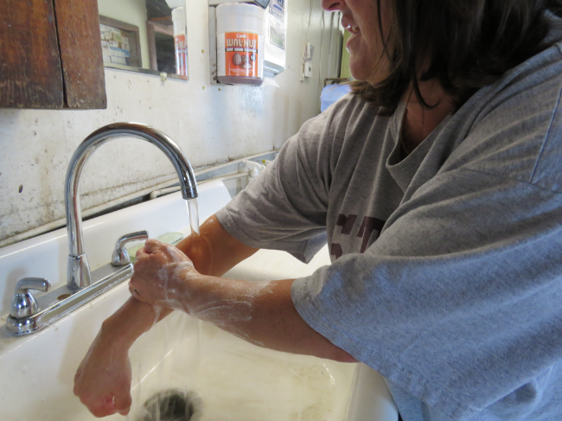
Agricultural Workers
Routine Decontamination
Wash hands before eating, drinking, smoking, using the bathroom; before touching eyes or mouth; and before getting into vehicles
Change into clean clothes and shoes
Shower or bathe
Image credit: Ed Crow, Penn State Pesticide Education Program
Notes:
Information required to be covered:
Agricultural workers need to be instructed on how to perform routine decontamination.
There are several things that workers can do as part of their daily routine to minimize exposing themselves and their families to pesticides and pesticide residues. These include:
Washing their hands before eating, drinking, smoking, or using the bathroom while at work.
Washing their hands before touching their eyes or mouth while they are working.
Washing their hands after work and before getting into their vehicles.
Changing into clean clothes and shoes before getting into their vehicles to drive back home.
Showering or bathing, using soap and water and shampooing hair immediately as soon as possible after work.
Washing their work clothes separately from other clothes before wearing them again.
Source:
Washington State Department of Agriculture (WSDA) Farmworker Education Program. Worker Protection Standard Train the Trainer Manual. WSDA Pesticide Management Division. Washington State 2014.

Slide 74
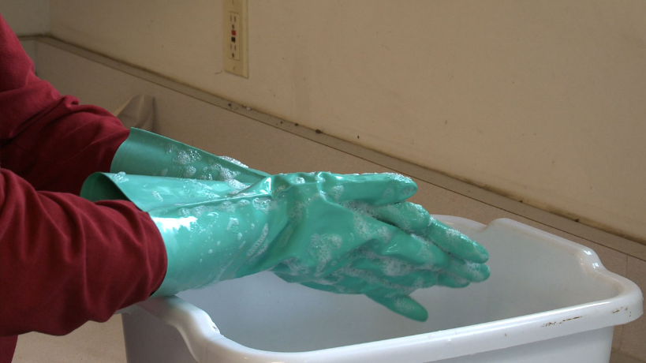
Pesticide Handlers
Routine Decontamination
Follow routine procedures for workers
Decontaminate pesticide application equipment
Decontaminate re-usable personal protective equipment (PPE)
Image credit: Betsy Buffington, Iowa State University
Notes:
Information required to be covered:
The employer needs to make sure that pesticide handlers know how to perform routine decontamination.
Pesticide handlers should follow all routine decontamination procedures for agricultural workers (see previous slide). In addition, pesticide handlers should decontaminate pesticide application equipment and re-usable personal protective equipment (PPE).
Notes for trainers of early-entry workers and pesticide handlers:
Decontamination of PPE is covered in Section 11.

Slide 75
Emergency Decontamination Procedures
Remove any PPE as quickly as possible or remove contaminated clothing as quickly as possible
Rinse the pesticide from the skin immediately with clean water
Wash with soap and water and shampoo hair as soon as possible
Put on clean, uncontaminated clothes
Report to supervisor or person in charge
Get medical care immediately if symptoms of pesticide poisoning develop or are suspected
Notes:
Information required to be covered:
Emergency decontamination for skin exposure
Remove any PPE as quickly as possible or remove contaminated clothing as quickly as possible.
Rinse the pesticide from the skin immediately with clean water. Use decontamination supplies to wash immediately or rinse off in the nearest clean water, including springs, streams, lakes or other sources if more readily available than decontamination supplies.
Wash with soap and water and shampoo hair as soon as possible.
Put on clean, uncontaminated clothes.
Report to supervisor or person in charge
Get medical care immediately if symptoms of pesticide poisoning develop or are suspected.
Notes for trainers of workers and pesticide handlers:
If pesticides are spilled or sprayed on the body, workers and handlers must be trained to use decontamination supplies to wash immediately. Emergency decontamination procedures are extremely important because they will help reduce the severity of the injury in case of exposure.
Important Change to the Rule: EPA has removed from the regulatory text the provision that allows employers to permit workers and handlers to use clean water from springs, streams, lakes or other sources if that water is more accessible in remote locations where the decontamination supplies are farther than one-quarter mile from where workers and handlers are working. Removal of this provision does not prohibit the practice of allowing workers or handlers to use clean water from springs, streams, lakes, or other sources to decontaminate if such water is closer than the provided decontamination supplies, but it removes the responsibility from the employer to ensure that such water meets the standard of being of a quality and temperature that will not cause illness or injury if it contacts the skin or eyes of if it is swallowed. Under the final rule, when workers or handlers are performing tasks at remote sites more than one-quarter mile from the nearest point of vehicular access, employers must provide all required decontamination supplies (soap, single-use towels, and water, plus clean change of clothing if required) at the nearest point of vehicular access. Employers are required to make the decontamination supplies available as close as possible to the remote site (as determined by how close a vehicle can get) but employers do not have to check or confirm that water from springs, streams, lakes or other sources at remote sites meets the standard of being of a quality and temperature that will not cause illness or injury.
Source:
Washington State Department of Agriculture (WSDA) Farmworker Education Program. Worker Protection Standard Train the Trainer Manual. WSDA Pesticide Management Division. Washington State 2014.

Slide 76
Safety Data Sheets
Provides information about the pesticide product
Refer to the SDS if there is an exposure
SDS for all pesticides used on the establishment are located at central location
SDS should match up with the pesticide application records
Notes:
Information required to be covered:
The purpose of the safety data sheet (SDS) is to provide information about chemical and physical hazards, toxicity, first aid, PPE, emergency medical treatment and other information about the pesticides used on the establishment that workers and handlers might come in contact with.
Workers and handlers should refer to safety data sheets if there is an exposure.
Handlers should note that there are details about the environmental hazards and safety precautions for handling, storing, and transporting the pesticide.
SDS’s for all pesticides used on the establishment will be displayed at the central location and available during normal working hours.
SDS’s should match up with pesticide application records.
Notes for trainers of workers and pesticide handlers:
Ensure workers and pesticide handlers understand what a SDS is and its purpose.
It is the responsibility of the employer to do all the following:
Display SDS’s for all pesticides used on the establishment. Copies of the SDS’s used on the establishment must be displayed at a central location on an agricultural establishment that is readily accessible at all times during normal work hours and can be easily seen and read by workers and handlers. Usually this is a location where employees congregate such as where they check in or out of work, change clothes, eat, etc.
Provide workers and handlers information about location of the SDS’s on the establishment
Provide workers and handlers unimpeded access to SDS’s during normal working hours.
Sources:
Washington State Department of Agriculture (WSDA) Farmworker Education Program. Worker Protection Standard Train the Trainer Manual. WSDA Pesticide Management Division. Washington State 2014.
US Environmental Protection Agency, Pesticide Worker Protection Standard “How to Comply” Manual<https://www.epa.gov/pesticide-worker-safety/pesticide-worker-protection-standard-how-comply-manual> (October 20, 2016)

Slide 77

How and When to Obtain Emergency Medical Care
Seek medical attention immediately
Employer will provide transportation
Image credit: Jennifer Weber, Arizona Department of Agriculture
Notes:
Information required to be covered:
Workers and handlers should seek medical attention as soon as possible if they believe they have been poisoned, injured, or made ill by pesticides.
The name, address and telephone number of a nearby medical care facility capable of providing emergency medical treatment is listed at the central location
The agricultural employer will provide transportation. They can “make transportation available” by: taking the employee to the medical care facility, by calling an emergency vehicle, such as an ambulance, or by making sure the employee has a ride to the medical care facility with someone else.
Suggested Activity:
Section 7. Activities for First Aid for Pesticide Illnesses and Injuries: “First Aid and How to Obtain Medical Assistance”
Sources:
Washington State Department of Agriculture (WSDA) Farmworker Education Program. Worker Protection Standard Train the Trainer Manual. WSDA Pesticide Management Division. Washington State 2014.
US Environmental Protection Agency, Pesticide Worker Protection Standard “How to Comply” Manual<https://www.epa.gov/pesticide-worker-safety/pesticide-worker-protection-standard-how-comply-manual> (October 20, 2016)

Slide 78
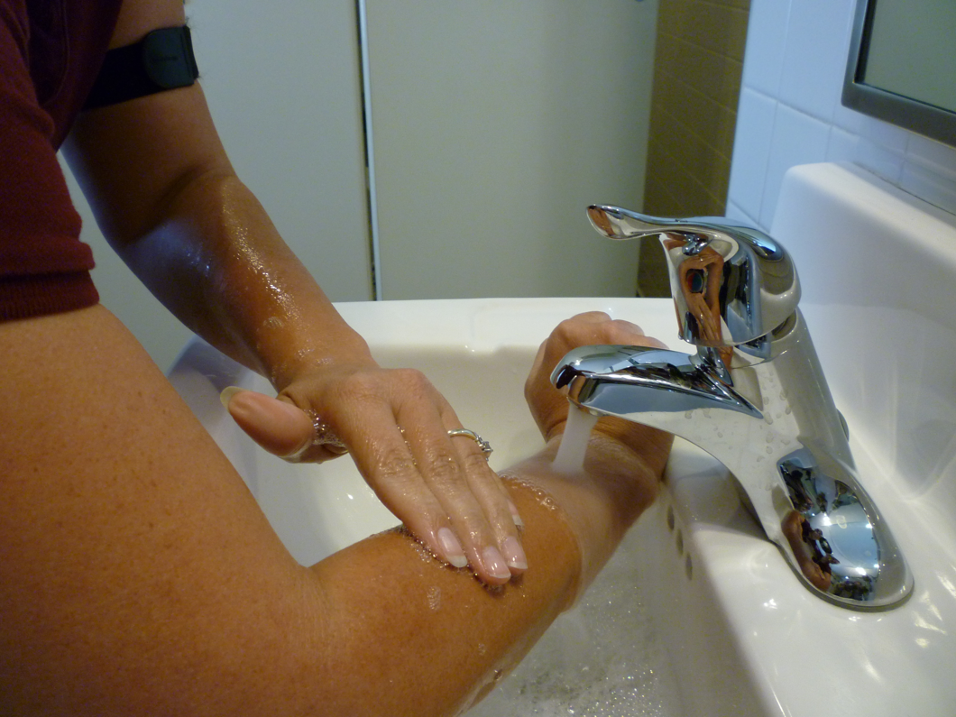
First Aid for Skin Exposure
Help the victim to:
  Rinse with water
  Remove contaminated PPE or contaminated clothing
  Wash with plenty of soap and water
Image credit: Jennifer Weber, Arizona Department of Agriculture
Notes:
Information required to be covered:
If pesticide gets on the skin, the faster the chemical is washed off, the more minor the injury. The following steps should be taken in the event of a skin exposure:
Remove clothing and PPE carefully but as quickly as possible. Try to limit contact with the skin.
Rinse skin
Cleanse skin and hair thoroughly with soap and water
Dry and cover the victim with any clean item available
If there is a chemical skin burn avoid using ointments, lotions, powders, and other drugs in first aid treatments of burns, and
Get medical attention if necessary.
Workers and handlers should refer to safety data sheets if there is an exposure.
Notes for trainers of workers and pesticide handlers:
Both agricultural workers and pesticide handlers need to know about the correct first aid procedures for pesticide injuries or poisoning. There are some things workers can do immediately to lessen a potential injury before the person (victim) is taken to the medical facility.
Suggested Activity:
Section 7. Activities for First Aid for Pesticide Illnesses and Injuries: “First Aid and Signs and Symptoms of Common Pesticide Poisoning”
Source:
Washington State Department of Agriculture (WSDA) Farmworker Education Program. Worker Protection Standard Train the Trainer Manual. WSDA Pesticide Management Division. Washington State 2014.

Slide 79
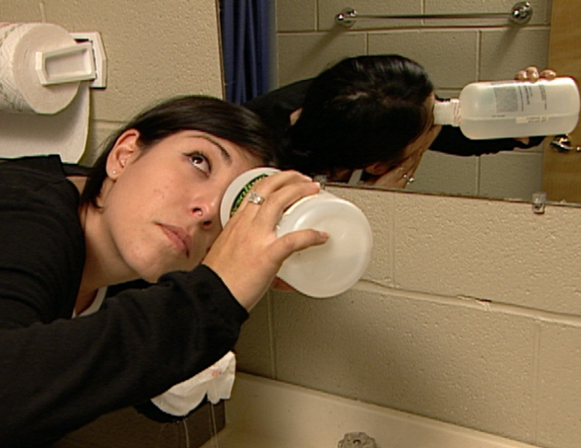
First Aid for Eye Exposure
Help the victim to:
  Immediately, using a gentle stream of water, flush the eye
  Keep the eye open and as wide as possible while flushing
  Continue flushing for at least 15+ minutes
  Report to supervisor and get medical attention
Image credit: Chazzbo Media
Notes:
Information required to be covered:
If pesticide gets into someone’s eye, help the victim to:
Rinse the eye gently with clean water.
Hold the eye under a shower, or pour water into the eye using a clean water container. Keep the eye open and as wide as possible while flushing. Continue flushing for at least 15 minutes.
Report to supervisor or person in charge.
Seek immediate medical treatment after flushing.
Workers and handlers should refer to safety data sheets if there is an exposure.
Notes for trainers of workers and pesticide handlers:
Workers and handlers need to know how to assist a person if pesticides get into his or her eyes. Knowing what to do for an eye emergency can save valuable time and possibly prevent vision loss.
If a contact lens is in the eye, begin flushing over the lens immediately. Then, if possible, help the victim remove the lens. Lens might hold the chemical against the cornea.
The person providing first aid must make sure the water is not too hot or have a temperature that might cause further damage to the eye tissue. The water flow must be gentle.
The person’s head must be turned so that the affected eye is lower than the unaffected one. This will keep contaminated water from getting into the other eye.
Never add any kind of medicine or substance to the eye rinsing water, nor administer any substance or lotion to the victim after rinsing.
DO NOT bandage the eye.
Suggested Activity:
Section 7. Activities for First Aid for Pesticide Illnesses and Injuries: “First Aid and Signs and Symptoms of Common Pesticide Poisoning”
Source:
Washington State Department of Agriculture (WSDA) Farmworker Education Program. Worker Protection Standard Train the Trainer Manual. WSDA Pesticide Management Division. Washington State 2014.

Slide 80
First Aid for Inhalation Exposure
Move the exposed person into fresh air
Loosen tight clothing
Keep air passages clear
Perform artificial respiration if necessary
Get medical attention as soon as possible
Notes:
Information required to be covered:
If a person has inhaled pesticides, the first aid responder should:
Before rescuing anyone from a closed area, make sure that you do not expose yourself to the same danger. Wear the appropriate protective equipment.
Move the person to fresh air.
Loosen any clothing that makes breathing difficult.
Give mouth to mouth resuscitation if the person is not breathing. Only a person trained in CPR should give mouth to mouth.
Get medical attention for the victim.
Workers and handlers should refer to safety data sheets if there is an exposure.
Notes for trainers of workers and pesticide handlers:
Make sure that both workers and handlers understand that before rescuing anyone, the first aid responder must be wearing the appropriate PPE to avoid putting himself at risk.
Suggested Activity:
Section 7. Activities for First Aid for Pesticide Illnesses and Injuries: “First Aid and Signs and Symptoms of Common Pesticide Poisoning”
Source:
Washington State Department of Agriculture (WSDA) Farmworker Education Program. Worker Protection Standard Train the Trainer Manual. WSDA Pesticide Management Division. Washington State 2014.

Slide 81

First Aid for Oral Exposure
Never induce vomiting if the person is not fully conscious, or suffering convulsions
Never induce vomiting without specific instructions from the label or a medical professional
Get person to a medical facility as quickly as possible
Image credit: Ed Crow, Penn State Pesticide Education Program
Return to Table of Contents
Notes:
Information required to be covered:
Never induce vomiting if the victim is unconscious, suffering convulsions, or lying face up.
Some products have ingredients that make regurgitation worse, so check the label or safety data sheet (SDS) before proceeding. The label and or safety data sheet should have information about whether to induce vomiting.
Always read the label or call the poison control center.
Get medical attention for the victim.
Workers and handlers should refer to safety data sheets if there is an exposure.
Notes for trainers of workers and pesticide handlers:
The most important decision a worker or handler providing first aid needs to make when a person has swallowed pesticides is whether or not to induce vomiting. The victim’s life may depend on this decision; therefore, it must be made accurately.
This concludes Section 7: First Aid for Pesticide Illnesses and Injuries. Continue on to Section 8: Responsibilities and Rights or return to the Table of Contents by clicking on the “Return to Table of Contents” in the bottom-right corner of this slide (when in presentation view only).
Suggested Activity:
Section 7. Activities for First Aid for Pesticide Illnesses and Injuries: “First Aid and Signs and Symptoms of Common Pesticide Poisoning”

Slide 82
Section 8: Additional Employer Responsibilities
Training Topics for both Workers and Handlers
Return to Table of Contents
Notes:
Notes for trainers:
This section contain training requirements for both workers or handlers.
This section will inform workers and handlers of employer responsibilities. The purpose of this section is to make workers and handlers aware of the protections that their employers must provide them under the WPS.
Specific worker and handler training topics that are included in this section include:
The rule prohibits agricultural employers from intimidating, threatening, coercing or discriminating against any worker or handler for complying with or attempting to comply with the requirements of this rule, or because the worker or handler provided, caused to be provided or is about to provide information to the employer or the EPA or its agents regarding conduct that the employee reasonably believes violates this part, and/or made a complaint, testified, assisted or participated in any manner in an investigation, proceeding, or hearing concerning compliance with this rule.
The responsibility of agricultural employers to provide workers and handlers with information and protections designed to reduce work-related pesticide exposures and illnesses. This includes ensuring workers and handlers have been trained on pesticide safety and application and hazard information, decontamination supplies and emergency medical assistance, and notifying workers of restrictions during applications and on entering pesticide treated areas. A worker or handler may designate in writing a representative to request access to pesticide application and hazard information.
How to report suspected pesticide use violations to the state or tribal agency responsible for pesticide enforcement.

Slide 83
Employer’s WPS Responsibilities
The employer’s responsibility to make sure the worker or handler gets annual pesticide safety training before they begin their work to remind them of the basic steps they can take to protect themselves, their families, and in the case of a handler, other people and the environment, from pesticides that can cause harm
The agricultural employer needs to provide pesticide application and hazard information, for the worker or handler to refer to if they wish to know about pesticides used on the establishment, what kinds of risks those pesticides pose, and where those restrictions on entry into an area are on the establishment
A worker or handler can ask their employer for a copy of the application information and the safety data sheets, or they may designate a representative to ask for them on their behalf. The designation of a representative must be in writing
Notes:
Information required to be covered:
It is the employer’s responsibility to make sure the worker or handler gets annual pesticide safety training before they begin their work to remind them of the basic steps they can take to protect themselves, their families, and in the case of a handler, other people and the environment, from pesticides that can cause harm.
The agricultural employer needs to provide pesticide application and hazard information, for the worker or handler to refer to if they wish to know about pesticides used on the establishment, what kinds of risks those pesticides pose, and where those restrictions on entry into an area are on the establishment.
A worker or handler can ask their employer for a copy of the application information and the safety data sheets, or they may designate a representative to ask for them on their behalf. The designation of a representative must be in writing.

Slide 84
Employer’s WPS Responsibilities
Your employer must tell workers and handlers where the central location is and where the decontamination supplies are on the establishment
The safety information display at the central location and at some places with supplies for washing up (decontamination supplies) is a reminder about the steps workers and handlers can take to reduce exposures. It has the name and address of a nearby medical facility, in case of an emergency where a worker or handler is made sick from a pesticide. In case a worker or handler needs to report a violation involving a pesticide, contact information for enforcement is on the display
The employer must provide water, soap, and towels near where workers and handlers are working so they can wash up when they leave the work area, and if there is an accidental exposure like a spill on a handler, the supplies may be used in an emergency to remove pesticides and reduce their effect. Handlers using products that require eye protection, or are under pressure, must have access to water for emergency eye flushing, too
Notes:
Information required to be covered:
Your employer must tell workers and handlers where the central location is and where the decontamination supplies are on the establishment.
The safety information display at the central location and at some places with supplies for washing up (decontamination supplies) is a reminder about the steps workers and handlers can take to reduce exposures. It has the name and address of a nearby medical facility, in case of an emergency where a worker or handler is made sick from a pesticide. In case a worker or handler needs to report a violation involving a pesticide, contact information for enforcement in is on the display.
The employer must provide water, soap, and towels near where workers and handlers are working so they can wash up when they leave the work area, and if there is an accidental exposure like a spill on a handler, the supplies may be used in an emergency to remove pesticides and reduce their effect. Handlers using products that require eye protection, or are under pressure, must have access to water for emergency eye flushing, too.

Slide 85
Employer’s WPS Responsibilities
If a worker or handler is made sick, and pesticides may have been the cause, the employer needs to be told so he can make sure they are taken to a medical facility, and provide the medical personnel with information about the exposure
Workers have to be notified by the employer of restrictions on areas where applications are taking place and where an REI is in effect. Those notifications may be in the form of oral warnings or the posted warning signs that will be around the treated area
Notes:
Information required to be covered:
If a worker or handler is made sick, and pesticides may have been the cause, the employer needs to be told so he can make sure they are taken to a medical facility, and provide the medical personnel with information about the exposure.
Workers have to be notified by the employer of restrictions on areas where applications are taking place and where an REI is in effect. Those notifications may be in the form of oral warnings or the posted warning sign that will be around the treated area.

Slide 86
Pesticide Safety Training
Annual training is required
Training must be provided to a
  Worker before starting work in a treated area
  Handler before performing any handling task
A worker or handler can ask for a record of the training
Notes:
Information required to be covered:
Pesticide safety training has to be given to the worker or handler every year and they can ask their employer for a copy of the training record to give to their next employer to show they have had training in the year. The training will remind them of the steps they can take to protect themselves and their families.
Notes for trainers of workers and pesticide handlers:
The safety training reminds workers and handlers that by paying attention to warnings about application and treated areas, using the supplies provided to wash after being in an area where pesticides have been used, and being careful to wash up when they get home, they can minimize their routine exposure to pesticides.
WPS training is not required for licensed/certified crop advisors who are licensed/certified by a program acknowledged as appropriate by EPA, a state or tribe.

Slide 87
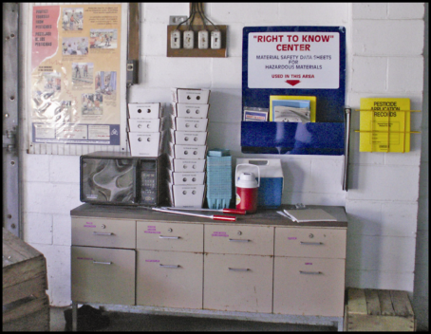
Pesticide Safety Information
Pesticide safety information must be displayed at:
  Central location
  Permanent decontamination supply sites
  Other decontamination locations where supplies are provided for 11 or more workers or handlers
Image credit: Ed Crow, Penn State Pesticide Education Program
Notes:
Information required to be covered:
Pesticide safety information must be displayed at Central Location and also at certain places where decontamination supplies must be provided on the agricultural establishment according to the rule; specifically, when the decontamination supplies are located at permanent sites or are provided at locations and in quantities to meet the requirements for 11 or more workers or handlers
Information can be displayed in any format. Must be conveyed in a manner that workers and handlers could understand
Also includes:
Name, address and telephone number of state or tribal pesticide regulatory agency.
Includes a nearby operating medical care facility.
Notes for trainers of workers and pesticide handlers:
The safety information poster is a reminder of the correct ways for workers and handlers to limit their exposure, by washing up and avoiding areas that have been treated.
There is also a medical facility listed on the poster that workers and handlers can contact if someone is made sick.
Workers and handlers should be familiar with medical facility information so they can act if they, or another worker, becomes ill.
Use examples of how pesticide safety training inform workers and handlers. The central location is a good source of information about areas that have been treated, so a worker or handler can see what was used and how long they should stay out of the area.
Explain that pesticide safety information has traditionally been in the form of a pesticide safety poster (Far upper left in image).
New poster will be developed by January 2, 2018.
Beginning in January 2018 the poster will include the name, address and phone number of the state or tribal regulatory agency. Workers and handlers can use this information to report suspected violations.

Slide 88
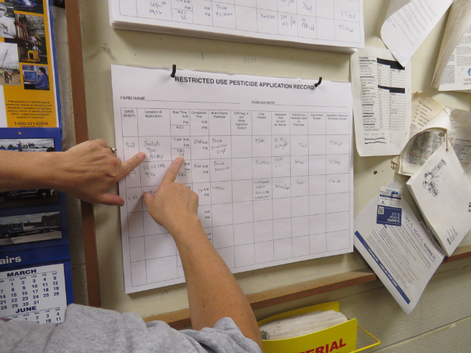
Pesticide Application Information and Safety Data Sheets
Name, EPA registration number and active ingredient
Crop or site treated and location and a description of treated area
Date(s) and times the pesticide application started and ended
Duration of the restricted-entry interval (REI) for that application
A copy of the Safety Data Sheets (SDS)
Image credit: Ed Crow, Penn State Pesticide Education Program
Notes:
Information required to be covered:
If workers and handlers are unsure of what areas are prohibited for entry, they can refer to the application information to know where there is an REI in effect and what pesticide was used.
Workers and handlers can use the pesticide name to look up its health hazards in the safety data sheets (SDS) that will be located there as well.
It is important for workers and handlers to know where the EPA registration number is – if someone is made sick, and they are taken to a medical facility, the registration number of the pesticide is very helpful to the doctor to know more about what they may have been exposed to.
Employers must display specific pesticide application information at a central location such as a break room or common gathering area that is accessible to all employees during their work hours.
Notes for trainers of workers and pesticide handlers:
The application information will tell workers and handlers:
where treated areas are located, and how long they should stay out of them,
what was applied, and
that the application information and the SDS can tell workers and handlers what risks from pesticides may be present to their health.
This information will enable workers and handlers to avoid areas that are being treated with pesticides or still under a REI.
The information can be displayed in any format as long as it is legible, accessible to all employees and contains:
The product name, EPA registration number, and active ingredient(s) of the pesticide
The crop or site treated and the location and description of the treated area(s)
The dates and times of the pesticide application
The time that the application was completed
The duration of the REI for that application
A copy of the SDS
The employer must display application information and SDS at central location within 24 hours of end of application and before workers enter that treated area; display both for 30 days after the REI expires; and keep application information and SDS records for 2 years from end of REI.

Slide 89
Requesting Pesticide Application Information and Safety Data Sheets
Workers and handlers can request the pesticide application information and SDS from their employer, or they may designate a representative to do so on their behalf
  A treating medical person can also request access to or a copy of the application information and SDS
Notes:
Information required to be covered:
Workers and handlers can also request records themselves, through medical personnel or through a designated representative. A designated representative is a person, chosen, by a worker, who can request and obtain a copy of the pesticide application and Safety Data Sheets on behalf of the worker.
Notes for trainers of workers and pesticide handlers:
The designated representative must be designated in writing.

Slide 90
Other Employer Responsibilities in Relation to Pesticide Information
Employers must inform workers and handlers where the pesticide safety, application and hazard information is located
Allow workers and handlers unrestricted access to the posted information
Notes:
Information required to be covered:
Employers must inform workers and handlers where the pesticide safety, application and hazard information is located
Allow workers and handlers unrestricted access to the posted information
Notes for trainers of workers and pesticide handlers:
The information is there for the worker’s and handler’s reference, so they need to know the location of the central display, and that the information should be current and clear

Slide 91
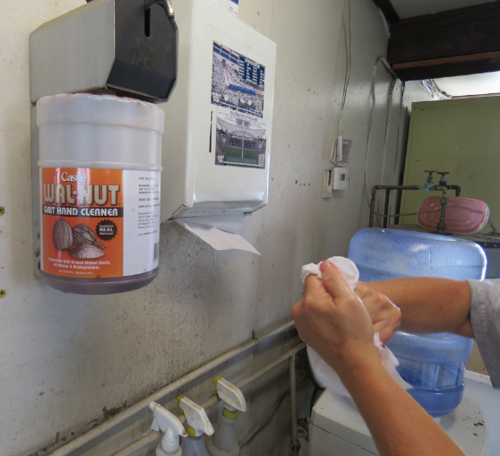
Decontamination Supplies for
Agricultural Workers
Water
Soap
Single use towels
Image credit: Ed Crow, Penn State Pesticide Education Program
Notes:
Information required to be covered:
The agricultural employer must provide at least 1 gallon of water for each worker at the beginning of the work period,
and enough soap and single use towels for the workers’ needs.
The supplies must be near to the worker’s work location
Notes for trainers of workers and pesticide handlers:
Focus the training more on the need for workers to USE the decontamination supplies, emphasizing that the supplies are nearby for their use and health and safety. The consequences of not washing up can result in, at least, uncomfortable rashes.

Slide 92
Decontamination Supplies for
Pesticide Handlers
Water
Soap
Single use towels
Clean change of clothes to be used in case the handler’s clothes or PPE become contaminated
Decontamination supplies must be located within ¼ mile of the pesticide handler, at mixing and loading site, and at the site where PPE is removed
Notes:
Information required to be covered:
The agricultural employer must provide:
Clean running water or at least 3 gallons of water for each handler,
Enough soap and single use towels for the workers’ needs, and
A clean change of clothes to be used in case the handler’s clothes or PPE become contaminated
The supplies must be located within ¼ mile of the pesticide handler, at mixing and loading site, and at the site where PPE is removed
Notes for trainers of workers and pesticide handlers:
Focus the training more on the need for handlers to USE the decontamination supplies, emphasizing that the supplies are nearby for their use and health and safety. The consequences of not washing up can result in, at least, uncomfortable rashes.

Slide 93

Decontamination Supplies for
Pesticide Handlers
Emergency eye flushing station: a system or container of water that can provide a gentle stream to rinse the pesticide from the eye
Located at any site where handlers are mixing or loading a pesticide that requires protective eyewear or are using a closed system that is under pressure
Applicators using products that require protective eyewear must be provided a pint of water that they need to keep close by so they have ready access in case of an exposure to their eyes
Image credit: Ed Crow, Penn State Pesticide Education Program
Notes:
Information required to be covered:
Emergency eye flushing station: a system or container of water that can provide a gentle stream to rinse the pesticide from the eye.
Located at any site where handlers are mixing or loading a pesticide that requires protective eyewear or are using a closed system that is under pressure.
Applicators using products that require protective eyewear must be provided a pint of water that they need to keep close by so they have ready access in case of an exposure to their eyes.
Notes for trainers of workers and pesticide handlers:
Emphasize the urgency for getting pesticide out of the eye promptly, using the supplies that have to be provided if the product requires protection.

Slide 94
Provide Emergency Medical Assistance
If a worker or handler has been made ill and it is reasonable to think it was from pesticides, they should:
  Inform their employer, who must make transportation available to a medical facility
  Get first aid, if there is time, but do not delay getting to medical personnel!
  The employer needs to give this information to the medical personnel: the safety data sheet for the product, the name of the product, its registration number and active ingredients, and the circumstances of the use of the product and of the exposure
Notes:
Information required to be covered:
If a worker or handler has been made ill and it is reasonable to think it was from pesticides, they should:
Inform their employer, who must make transportation available to a medical facility
Get first aid, if there is time, but do not delay getting to medical personnel!
The employer needs to give this information to the medical personnel: the safety data sheet (SDS) for the product, the name of the product, its registration number and active ingredients, and the circumstances of the use of the product and of the exposure.
Notes for trainers of workers and pesticide handlers:
Emphasize that, if a person is made ill, and it might be pesticides, they should tell their employer and get to medical attention immediately.
The employer can give the information directly to the medical staff or to the worker or handler to give to medical staff. But ultimately the employer is responsible for the information getting to the medical staff.
Sources:
Washington State Department of Agriculture (WSDA) Farmworker Education Program. Worker Protection Standard Train the Trainer Manual. WSDA Pesticide Management Division. Washington State 2014.
US Environmental Protection Agency, Pesticide Worker Protection Standard “How to Comply” Manual<https://www.epa.gov/pesticide-worker-safety/pesticide-worker-protection-standard-how-comply-manual> (October 20, 2016)

Slide 95
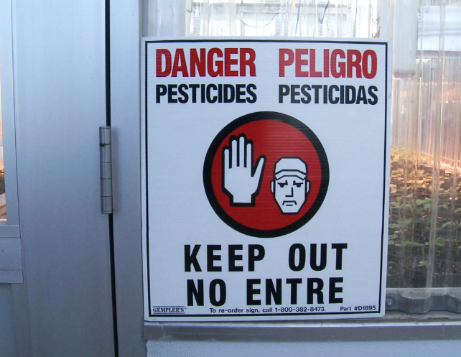

Oral and Posted Notification of Treated Areas
Workers must be notified by the employer of restrictions on areas where applications are taking place and where an REI is in effect
Notifications may be in the form of oral warnings or the posted warning sign that will be around the treated area
Image credits: Betsy Buffington, Iowa State University and James Hollyer, Associate Director for Extension, University of Guam
Notes:
Information required to be covered:
Tell workers that the notification may be either oral or posted, and they should heed the signs because the area is still under the restricted-entry interval (REI).
Even if the REI has expired, workers should not enter the treated area until the signs are covered or removed. BUT their employer may, in rare cases, direct workers to enter a treated area where the REI is still in effect (early entry) – but if that happens, they must get information about the pesticide that was used and its risks, information about how long they can stay in the area and what tasks they may do, and they probably would have to wear PPE.
Notes for trainers of workers and pesticide handlers:
Stress that, if workers see the sign, THEY SHOULD NOT ENTER THE AREA.
Workers should heed the oral warning as well.
Inform workers that they can refer to the application information in case they aren’t sure about an area.
Posting requirements are dependent on the label instructions and the length of the REI
Ensure handlers know not to remove signs before the required time. Remind them that others may be exposed if they take the sign down too soon, and that workers are prohibited from entry (except for early entry) while signs are posted.

Slide 96
Protections During Applications:
Outdoor Production
Drift can result in contact that can make workers ill or contaminate their clothes worn home
If workers feel drift contacting them, leave the area immediately and wash up as soon as is practical
Agricultural employers must keep workers and other persons out of application exclusion zones (AEZs)
Notes:
Information required to be covered:
Remind workers that drift can result in contact that can make them ill, or contaminate their clothes that they wear home.
If workers feel drift contacting them they should leave the area immediately and wash up as soon as is practical.
Agricultural employers must make sure that no workers or other people are ‘near’ the application equipment during applications.
Application exclusion zones (AEZs) are areas around a pesticide application that should be free of all people other than trained and equipped handlers during pesticide applications. (A handler may determine, for example, that wind direction is such that the person within the AEZ will not be contacted.) Application exclusion zones minimize the potential for workers and other people being contacted by the application, either directly or through drift.
Notes for trainers of workers and pesticide handlers:
Emphasize that this protection is intended to help protect workers and handlers from spray drift and contact with pesticides.
Nearly all outdoor applications have an “application exclusion zone” or AEZ of 25 – 100 feet. The size of the zone depends on the type of application equipment used.

Slide 97


Application Exclusion Zone in Outdoor Production
When the application is concluded, the AEZ no longer exists.
Field
AEZ
Spray Area
Treated Area
Notes:
Information required to be covered:
During an application, an agricultural employer must keep workers and other people (anyone other than equipped and trained handlers) out of the treated area or AEZ that is within the boundary of the establishment owner’s property.
For aerial, air blast, spray, fumigant, smoke, mist, or fog pesticide applications and for applications with droplet sizes that are fine or smaller in outdoor production (farm, forest, nurseries), everyone other than equipped and trained pesticide handlers must be kept at least 100 feet away from the pesticide application equipment. For other types of applications with spray droplet sizes that are medium or larger in outdoor production, the distance is 25 feet.
Notes for trainers of workers and pesticide handlers:
Explain that this requirement only applies within the boundaries of the establishment because the agricultural employer cannot be expected to control persons off the establishment.

Slide 98




AEZs on Field Borders
AEZ
Spray Area
EVALUATE!
Can you ask the workers to move somewhere else until you are done with the application?
Proceed with caution.
SUSPEND!
There are workers from the neighboring field in the AEZ!
When the application is finished the AEZ no longer exists.
Treated Area
Yes, they agreed to move!
Neighboring Field
Your Field
Notes:
Information required to be covered:
A handler must immediately suspend the application if a worker or other person (other than handler) is in AEZ.
Can continue with application when people move or after an assessment of the situation guarantee no drift to people off the establishment
Not limited to boundaries of agricultural establishment
One of the three requirements with a delayed compliance date (January, 2018) to allow for handlers to be trained on new content
Explain that the “suspend application” provision does apply beyond the boundaries of the establishment because the handler (applicator) and handler employer do have control over the pesticide application and are subject to a WPS requirement to apply the pesticide in a way that will not contact workers or other persons on or off the establishment.

Slide 99
Protections During Applications:
Enclosed Space Production
Ensure that no pesticide contacts any workers and other persons directly or through drift
No worker entry to an enclosed space structure until the air concentration level specified on the label is met or, if no air concentration level is specified, until after proper ventilation criteria is met for certain types of applications
Notes:
Information required to be covered:
Ensure that no pesticide contacts any workers and other persons directly or through drift.
During a pesticide application in an enclosed space production, agricultural employers must not allow worker entry to an enclosed space structure until the air concentration level specified on the label is met or, if no air concentration level is specified, until after proper ventilation criteria is met for certain types of applications.
Notes for trainers of workers and pesticide handlers:
Emphasize that pesticide use in an enclosed space can concentrate pesticides, and that they should be very alert to signs or oral warnings.
Page 40, Table 1. Entry Restrictions During Enclosed Space Production Pesticide Applications in the How to Comply With the 2015 Revised Worker Protection Standard for Agricultural Pesticides manual, identifies the entry restrictions when applying pesticides for enclosed space production to ensure workers and other persons are not exposed to the pesticide(s) being applied. The restrictions depend on the types of pesticides or application methods used.
For example, if the pesticide is applied as a smoke, mist, or fog, the agricultural employer must keep workers and other people out of the entire enclosed space until air concentration levels or ventilation requirements are met. Then the agricultural employer must keep workers out of the entire enclosed space during the REI.
As another example, consider a pesticide that is applied as a spray with droplet sizes medium or larger. In this situation, the agricultural employer must keep workers and other people out of the treated area plus 25 feet in all directions (but not outside the enclosed space) until the application is complete. Then the agricultural employer must keep workers out of the treated area during the REI.

Slide 100
Other WPS Topics
Employer responsibilities:
  Provide records or other information required by the WPS for inspection to an employee of EPA or any duly authorized representative of a federal, state or tribal agency responsible for pesticide enforcement
  Employers cannot punish workers for attempting to comply with WPS
Workers and handlers:
  Report suspected use violations
Return to Table of Contents
Notes:
Information required to be covered:
Employers must provide records or other information required by the WPS for inspection to an employee of EPA or any duly authorized representative of a federal, state or tribal agency responsible for pesticide enforcement
WPS prohibits employers from retaliating against agricultural workers and pesticide handlers who follow the regulation. Examples of retaliation include preventing, discouraging, firing or otherwise discriminating against an agricultural employee from complying or attempting to comply with the WPS or for ensuring that the employer complies with the regulations. Furthermore, agricultural employers cannot retaliate against agricultural employees who provide information to the EPA, state, or tribal governmental agency.
Explain to workers and handlers how to report suspected WPS violations and that the contact information of their local regulatory agency must be available to them at the central location.
Notes for trainers of workers and pesticide handlers:
Emphasize to workers and handlers that the rule prohibits employers from taking retaliatory steps if the employee tries to do what the WPS says to protect themselves.
This concludes Section 8: Responsibilities and Rights. Continue on to Section 9: Pesticide Label Information or return to the Table of Contents by clicking on the “Return to Table of Contents” in the bottom-right corner of this slide (when in presentation view only).

Slide 101
Section 9: Pesticide Label Information
Training Topics for Handlers only
Return to Table of Contents
Notes:
Notes for trainers:
This section contain training requirements for handlers only.
This section will inform handlers of pesticide label information
Specific handler training topics that are included in this section include:
Format and meaning of information contained on pesticide labels and in labeling applicable to the safe use of pesticides.
Handlers must follow the portions of the label applicable to the safe use of pesticides.

Slide 102
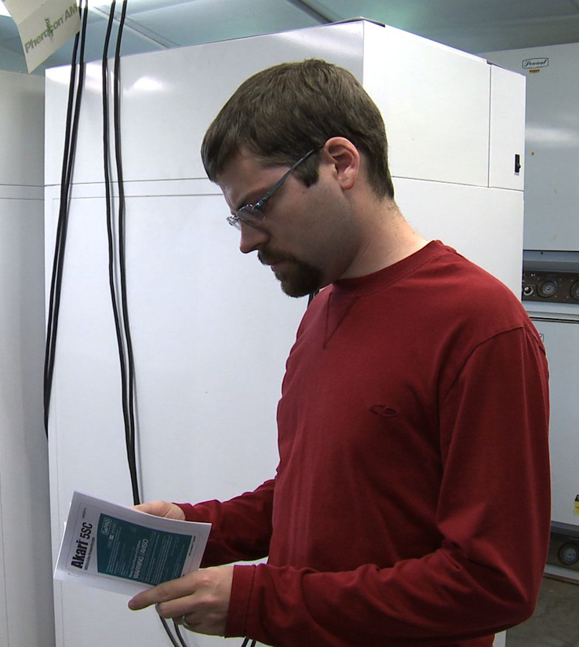
Pesticide Labels
Safety information
Legal use information
Image credit: Betsy Buffington, Iowa State University
Notes:
Information required to be covered:
The label is the most important part of the pesticide packaging. It contains information on how to use the product safely and effectively and lists the personal protective equipment (PPE) required when working with the pesticide. The label also includes details about the crops and areas to which the pesticide can be legally applied, the amounts to use, application methods, first aid instructions, and additional precautionary measures.
It is a violation of federal law to use a product in a manner inconsistent with its labeling.
Handlers must follow the label. If a pesticide handler is not able to read the label, the employer must make sure that there is always someone available to explain the health, safety, and directions for use information to the pesticide handler.

Slide 103
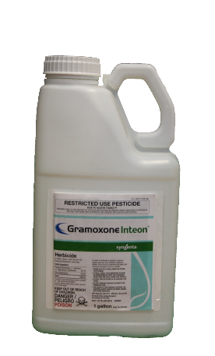
Read the Label BEFORE:
Buying the pesticide
Mixing the pesticide
Applying the pesticide
Storing the pesticide
Disposing of the pesticide container
Image credit: UC Statewide IPM Program
Notes:
Information required to be covered:
It is very important that pesticide handlers read and refer to the label information in the following 4 situations:
Buying the pesticide or taking it out of the storage area to make sure they will be using the correct product. Many products have similar names, so they must take steps to be sure they are using the right pesticide. They should check to see the type of pest it controls and the crop or site to which it can be applied. This is also a good time to review the personal protective equipment (PPE) information to make sure that they have all of the required PPE or protective clothing that they need to wear when handling the product.
Mixing the pesticide to make sure that they understand the mixing instructions. Mixing is the most hazardous activity because they are working with the product in its most concentrated form. If the instructions and precautions are not clear, they should ask their employer or supervisor clarification or to assist them.
Applying the pesticides to get instructions on how to apply it safely and details about the environmental hazards, first aid information and special precautions.
Storing the pesticide or disposing of the container to find specific instructions about temperature limits, potential fire hazards, environmental impacts, and guidelines for disposal.

Slide 104
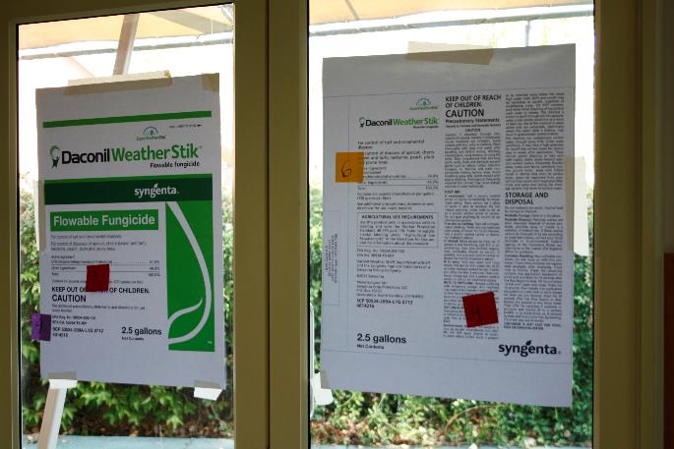
Parts of the Pesticide Label
Image credit: UC Statewide IPM Program
Notes:
Information required to be covered:
The following section describes information typically found on pesticide labels. Most of the parts listed are found on all labels, but some, such as the common name of the pesticide, may be absent. Since labels do not follow a standardized format and are often difficult to read, it is useful to know what information you can expect to find when you read a label.
Suggested Activity:
Section 9. Activities for Pesticide Label Information: “Pesticide Label Activity”

Slide 105
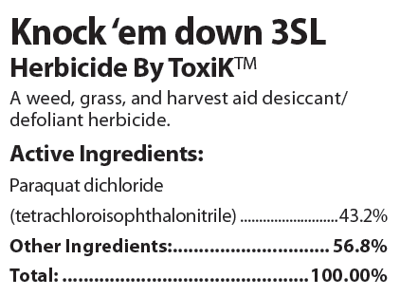
Brand Name
Commercial name
Notes:
Information required to be covered:
The brand name is the commercial name of the pesticide. It is usually the largest and most noticeable word on the front of the pesticide label.
Notes for trainers of pesticide handlers:
It is important that handlers understand that each pesticide product is different and they must read each label even if they have used a similar product. A pesticide handler who has used “GetUm 7” in the past may not take the time to read the “GetUm 7 Max” label, and miss the fact that the second “Max” product requires additional Personal Protective Equipment and has a longer restricted-entry interval.

Slide 106
Pesticide Manufacturer
Company that makes or distributes the pesticide
Notes:
Information required to be covered:
Often the manufacturer is the company that produces the pesticide. However, in some instances the name that appears on the label could be a company that purchased and packaged a pesticide product.
Notes for trainers of pesticide handlers:
The pesticide manufacturer can be a great resource for pesticide handlers and employers who may have questions about information listed on the label, the pesticide’s compatibility with other products, expiration dates, shelf life, and how to acquire additional copies of pesticide labels or safety data sheets.

Slide 107

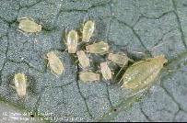


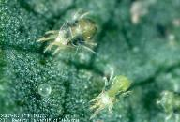

Pesticide Type
HERBICIDES
INSECTICIDES
RODENTICIDES
WEEDS/PLANTS
INSECTS
RODENTS
FUNGICIDES
ACARICIDES or MITICIDES
MOLLUSCICIDES
FUNGI/PLANT PATHOGENS
MITES
SLUGS and SNAILS
Image credits: UC Statewide IPM Program and UC Division of Agriculture and Natural Resources
Notes:
Information required to be covered:
Labels list the type of pesticide (i.e., insecticide, fungicide, rodenticide, herbicide, etc.) or the types of pests they control on the front page.
Notes for trainers of pesticide handlers:
Interestingly, pesticide safety trainers may find employers or pesticide handlers who claim, “We don’t use pesticides. We just use herbicides.” Trainers can explain that the word “pesticide” is the umbrella term that includes insecticides to control insects, herbicides to control weeds, rodenticides to control rodents, etc. The WPS training will provide them with information that will enable them to work safely and effectively with all types of agricultural pesticides.

Slide 108

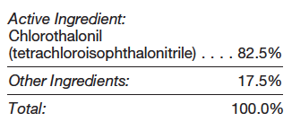
Ingredients
Active ingredient(s)
Other ingredients
Notes:
Information required to be covered:
The active ingredient is the ingredient that will perform the pest control activity. For example, it is the ingredient that will repel the mosquitoes or kill the weeds. It is the “poison.”
The other ingredients are additional ingredients in the container such as water, coloring agents, or ingredients that help the pesticide stick to the plant or more effectively control the pest. These used to be called “inert” ingredients.
Notes for trainers of pesticide handlers:
It is not uncommon for a pesticide handler to believe that the active ingredient is the ingredient with the highest percentage in the container. This is not always the case. You can clarify by defining “active” as the ingredient that will perform the pest control “action” or “activity.”
At this time, the actual names of the other ingredients are not listed on the labels. They are often listed as a percentage of the mixture or simply as “other ingredients.”

Slide 109
Pesticide Formulations
Liquid Formulations | Dry or Solid Formulations | Other Formulations
Emulsifiable concentrate (EC) | Dust (D) | Aerosol
Flowable (F) | Dry Flowable (DF) | Fogger
Liquid baits and gels | Wettable powder (WP) | Soil fumigant
Soluble liquids (SL) | Pellets (P) | Structural fumigant
Notes:
Information required to be covered:
The pesticide formulation is the mixture of active and other ingredients. Formulations are typically dry/solid, such as powders or granules, or liquids.
Notes for trainers of pesticide handlers:
The table pictured gives some examples of the different formulation types, with an example of some of the abbreviations (in parenthesis) used for them.
Some labels list the formulation, such as “pellets” on the front page of the label. Handlers can often gather information about the formulation by looking at the acronyms in a product’s name. For example, the “EC” in the product called “One ‘N’ Done EC” tells the handler that the product is an emulsifiable concentrate. The “DF” in the pesticide “FlyAway DF” indicates that it is a dry flowable. Unfortunately, not every pesticide label will contain the formulation listed on the front of the label or as an acronym in the product name. A pesticide handler may have to search for more information in the instructions for use section.

Slide 110
EPA Registration Number
Unique number
Important for pesticide emergencies
Notes:
Information required to be covered:
Once approved for use in the United States, the U.S. Environmental Protection Agency assigns a unique registration number to each pesticide product. The registration number can be very useful during a pesticide exposure situation. It gives medical personnel a way of identifying the product and enables them to gather additional details about the health effects, ingredients, first aid instructions and additional information for physicians.
Notes for trainers of pesticide handlers:
On the pesticide label, the registration number is often shortened to “EPA Reg. #”. It is not the same as the EPA Establishment number (shortened to “EPA Est. #”). Also if a state registers pesticides, the state registration number is not typically on the label, just the EPA registration number (this last part may only be pertinent in California).

Slide 111

Signal Words
I. Danger Poison
I. Peligro Veneno
Danger Poison
Danger
Warning
Caution
I. Danger
I. Peligro
II. Warning
II. Aviso
III. Caution
III. Precaución
Image credit: UC Statewide IPM Program
Notes:
Information required to be covered:
The signal words-CAUTION, WARNING, or DANGER tell you how likely the pesticide is to make you sick. Signal words are found on the first page of pesticide labels.
The word CAUTION is used for pesticides that are the least poisonous. These pesticides can still harm you if you are not careful.
A pesticide with the word WARNING is more poisonous or irritating than those with a CAUTION label. It doesn't take much of this pesticide to make you sick or to irritate your skin or eyes.
The word DANGER means that the pesticide is very poisonous or irritating. Even a small amount (often less than a teaspoon) can cause serious harm. The labels of the products that can severely burn your skin and eyes carry the signal word DANGER alone.
Along with the signal word DANGER, other labels have a skull and crossbones and the word POISON printed in red ink. These pesticides are highly poisonous. They can make you very sick-or even kill you-if you are not careful.
The labels of some lower-toxicity products may not have a signal word.
Notes for trainers of pesticide handlers:
Before a pesticide is approved for use in the U.S., the pesticide manufacturer must do a lot of research on the product, including studies on how acutely toxic it is to humans. The results of these studies determine the signal word that will be placed on the front page of the pesticide label. Many pesticides with CAUTION signal words may still be very toxic to fish, honeybees, desirable plants or beneficial organisms. Signal words do not provide information related to cancer or other long term effects.

Slide 112
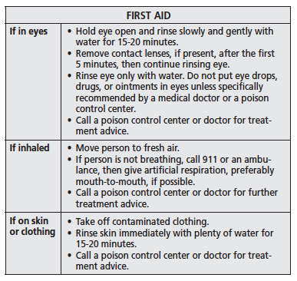
First Aid
First aid for each route of exposure:
  Eyes
  Nose
  Mouth
  Skin
Notes:
Information required to be covered:
The first aid instructions for pesticide exposure are usually found on the first or second page of the label. Sometimes there are additional instructions for medical personnel included in the same section. First aid is typically given for each route of exposure (e.g., eyes, nose, mouth, skin)
Notes for trainers of pesticide handlers:
It is extremely important that pesticide handlers read the first aid section BEFORE exposure occurs so they will be prepared to respond to any pesticide-related illness or injury. First aid instructions can vary, especially for incidences of pesticide ingestion/swallowing.

Slide 113
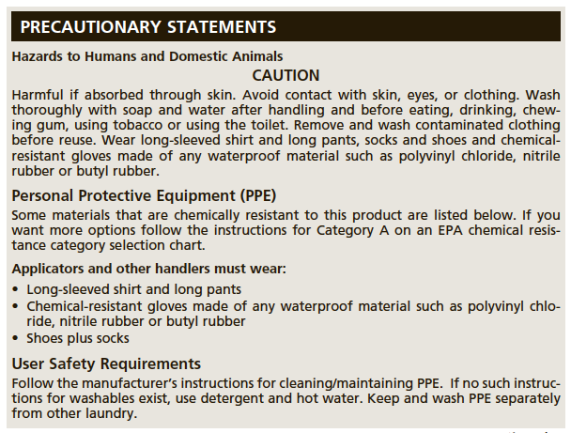
Personal Protective Equipment (PPE)
PPE could be different for each of these different tasks:
  Mixing and loading
  Applying
  Early entry
Notes:
Information required to be covered:
Personal protective equipment may also be referred to as the acronym “PPE” on the pesticide label. This section will list the minimum protective clothing or personal protective equipment items that must be worn when mixing, loading or applying the product; when entering an area during the restricted-entry interval; and when cleaning, repairing or maintaining application equipment.
Notes for trainers of pesticide handlers:
The required protective clothing and personal protective equipment can vary on a label for the type of handling activity. A pesticide handler may notice that a respirator is not required when applying the product outdoors but is required when applying it inside an enclosed space. Therefore, it is important that handlers review the entire PPE section prior to applying the product.
An applicator may have very different PPE requirements than a person who is mixing and loading a product.
The PPE listed for early entry worker activities is often listed separately and found in the Agricultural Use Requirements box.

Slide 114
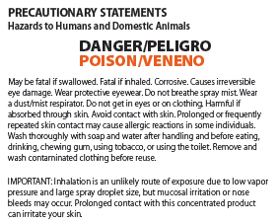
Precautionary Statements
How to protect people and the environment
Notes:
Information required to be covered:
Precautionary statements can be found throughout the pesticide label. They include measures that handlers must take to protect themselves, other people and the environment. Examples of these include statements instructing the handler to apply the pesticide in a way that doesn’t contaminate people, livestock or sensitive areas; to avoid inhaling the product; and to wash hands before eating, drinking or smoking, or using the restroom.
Precautionary statements tell the handler the route of entry by which the pesticide is toxic or harmful.
Notes for trainers of pesticide handlers:
Some pesticide handlers may skim or overlook these important precautionary measures because they believe that the information is standardized. Precautionary statements can vary from one product to the next and are an equally important part of the label.

Slide 115
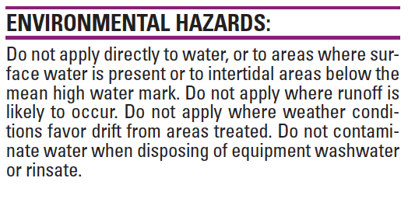
Environmental Hazard Statements
Some pesticides are harmful to:
  Birds
  Fish
  Beneficial insects
  Water resources
Notes:
Information required to be covered:
Some pesticides are harmful to birds or beneficial insects. Others may be toxic to fish or can easily move through the soil and contaminate the groundwater. The Environmental Hazards section will tell the user about the potential impacts on the environment and warn handlers to avoid harming certain species or contaminating sensitive areas such as wetlands or waterways.
Notes for trainers of pesticide handlers:
After reading the environmental hazard statements and before applying the pesticide, handlers must survey the application area for the presence of any beneficial insects, wildlife or sensitive areas that were listed on the label.

Slide 116
Restricted-Entry Interval (REI)
Period of time between the end of the application and when re-entry into the field is permitted
To enter during the REI, you must:
  Wear label-required PPE
  Receive training and information
  specific to the early entry
Notes:
Information required to be covered:
The restricted-entry interval (REI) is the time that agricultural employees must wait after an application before it is safe to enter the area without protection and additional training. The REI is often included in the Agricultural Use Requirements box, but may also be found in the Directions for Use section if the REI varies by site. It is the agricultural employer’s responsibility to keep workers and other people out of the treated area during the REI.
Notes for trainers of pesticide handlers:
Some states have set a minimum REI if one is not listed on the label or if the label states that employees can enter once the product is dry. Since these regulations are state-specific they most likely will not be found on the pesticide label. Nevertheless, all pesticide handlers and agricultural employers must be aware of and follow state-specific REI limitations.

Slide 117
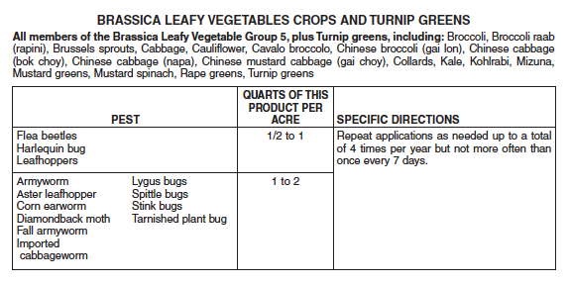
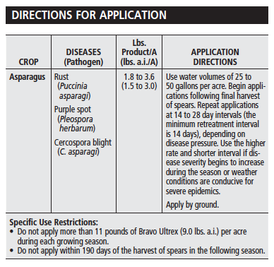
Directions for Use
Sites allowed
Pests controlled
Application rates
Mixing instructions
Application restrictions
Notes:
Information required to be covered:
The Directions for Use section provides the handler with details about the pests that the product will control, the sites to which the pesticide can be applied, application rates, mixing instructions, equipment that can or can’t be used, and application restrictions.
Notes for trainers of pesticide handlers:
It is illegal for a pesticide handler to exceed the maximum rate listed on the label. It is also illegal to apply a pesticide to a site or crop that is not listed on the label. While it is not illegal to apply the pesticide below the listed application rate or to a pest that isn’t included on the label, it is not advisable because the product might not perform well and the pest may develop resistance to the pesticide. It is also a waste of time, money and product. Agricultural employers and pesticide handlers should contact the pesticide manufacturer if they need clarification about mixing or application instructions or have questions about optional products that are available for a particular pest or site.

Slide 118
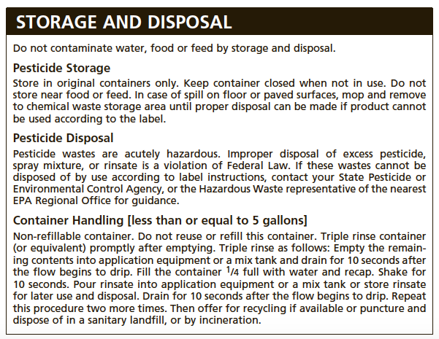
Storage and Disposal Instructions
Storage temperature range
Specific storage or disposal instructions
Return to Table of Contents
Notes:
Information required to be covered:
Storage and disposal instructions are usually found at the end of the label. They may include a storage temperature range or warnings about storing the pesticide near fertilizers, feed or in a container other than the original container.
Notes for trainers of pesticide handlers:
Storage and disposal regulations may vary between states or counties. Agricultural employers should check with their local pesticide regulatory agency for additional storage and disposal regulations, container recycling services, and unused pesticide collection programs.
The Pesticide Stewardship Alliance (TPSA) has a database of the pesticide disposal contacts in each state, and information on pesticide container recycling companies operating in each state at http://tpsalliance.org/.
This concludes Section 9: Pesticide Label Information. Continue on to Section 10: Protecting People and the Environment When Using Pesticides or return to the Table of Contents by clicking on the “Return to Table of Contents” in the bottom-right corner of this slide (when in presentation view only).

Slide 119
Section 10: Protecting People and the Environment When Using Pesticides
Training Topics for Handlers only
Return to Table of Contents
Notes:
Notes for trainers:
This section contain training requirements for handlers only.
This section will inform handlers of where they may encounter pesticides at work and how pesticides can enter their body.
Specific handler training topics that are included in this section include:
Handlers must be at least 18 years old.
Information on proper application and use of pesticides.
The responsibility of agricultural employers to post treated areas as required by this rule.
Handlers must not apply pesticides in a manner that results in contact with workers or other persons.
Handlers must suspend a pesticide application if workers or other persons are in the application exclusion zone.
Environmental concerns, such as drift, runoff, and wildlife hazards.
Safety requirements for handling, transporting, storing and disposing of pesticides including general procedures for spill cleanup.

Slide 120
Pesticide Handlers
Pesticide handlers (employees who):
  Mix, load and apply agricultural pesticides
  Flaggers or spotters for aerial applications
  Responsible for cleaning and repairing pesticide application equipment
  Irrigators may be considered pesticide handlers if they work with chemigation systems
Employees who are pesticide handlers must be at least 18 years old
Notes:
Information required to be covered:
Pesticide handlers are employees who:
mix, load and apply agricultural pesticides
Are flaggers or spotters for aerial applications
Are responsible for cleaning and repairing pesticide application equipment
Irrigators may be considered pesticide handlers if they work with chemigation systems
There are other handler activities, such as disposing of pesticides, rinsing containers, handling opened pesticide containers, and conducting crop advising tasks during a restricted-entry interval.
Employees who are pesticide handlers must be at least 18 years old.

Slide 121
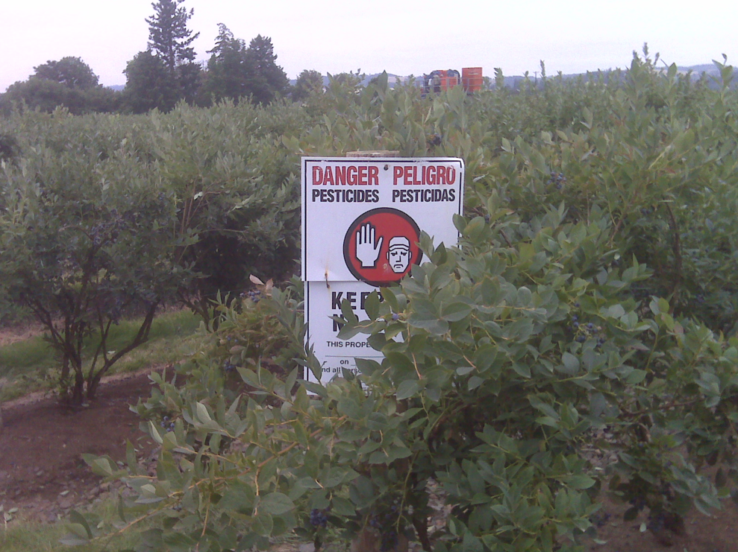
Posting Treated Areas
Required when applying a pesticide with an REI greater than:
  48 hours in outdoor areas
  4 hours in enclosed spaces
Posting is also mandatory when required by the label
Employer is responsible for checking the label for REI and posting requirements
Image credit: Betsy Buffington, Iowa State University
Notes:
Information required to be covered:
Field posting is required when apply a pesticide with an REI greater than 48 hours (outdoors) or 4 hours (enclosed spaces).
Field posting is also mandatory when required on the label.
The employer is responsible for checking the label for the REI and posting requirements. The employer must also make sure that the application area is posted if required. However, the employer may request that the handler assist with the responsibility.

Slide 122
Proper Application and Use of Pesticides
Pesticide handlers must stay alert during the entire application task and frequently check the area and application equipment to ensure that:
  The pesticide is reaching the target site
  The equipment is providing good coverage and even distribution
  Tank mixes are properly agitated and appear uniform and are not separating or clumping
  Hoses, valves, nozzles, hoppers, and other equipment parts are functioning properly
Notes:
Information required to be covered:
To ensure that the product is being applied safely and accurately, pesticide handlers must stay alert during the entire application task and frequently check the area and application equipment to ensure that:
the pesticide is reaching the target site
the equipment is providing good coverage and even distribution
tank mixes are properly agitated and appear uniform and are not separating or clumping, and
hoses, valves, nozzles, hoppers, and other equipment parts are functioning properly.

Slide 123
Safety Requirements for
Transporting Pesticides
Transport pesticides in the truck bed, cargo area, or on the back of the spray rig
Check containers for leaks before loading and unloading
Protect containers from rain and other potential weather damage
Secure or tie down all pesticide containers in the cargo area
Monitor containers at all times during transportation
Keep containers in a locked area
Notes:
Information required to be covered:
When transporting pesticides, especially containers that have already been opened, always do the following:
Transport pesticides in the truck bed, cargo area, or on the back of the spray rig
Check containers for leaks before loading and unloading
Protect containers from rain and other potential weather damage
Secure or tie down all pesticide containers in the cargo area
Monitor containers at all times during transportation
Keep containers in a locked area, if possible
Never carry pesticides in the passenger compartment of any vehicle or transport food, animal feed, or clothing with pesticide containers.
Never leave pesticide containers unattended.

Slide 124
Storage and Disposal of Pesticides
Storage and disposal instructions are usually found at the end of the label
Storage and disposal regulations may vary between states or counties
Employers should check with their local pesticide regulatory agency for additional storage and disposal regulations, container recycling services, and unused pesticide collection programs
Notes:
Information required to be covered:
Storage and disposal instructions are usually found at the end of the label.
They may include a storage temperature range or warnings about storing the pesticide near fertilizers, feed or in a container other than the original container.
Storage and disposal regulations may vary between states or counties.
Agricultural employers should check with their local pesticide regulatory agency for additional storage and disposal regulations, container recycling services, and unused pesticide collection programs.
The Pesticide Stewardship Alliance (TPSA) has a database of the pesticide disposal contacts in each state, and information on pesticide container recycling companies operating in each state at http://tpsalliance.org/.

Slide 125
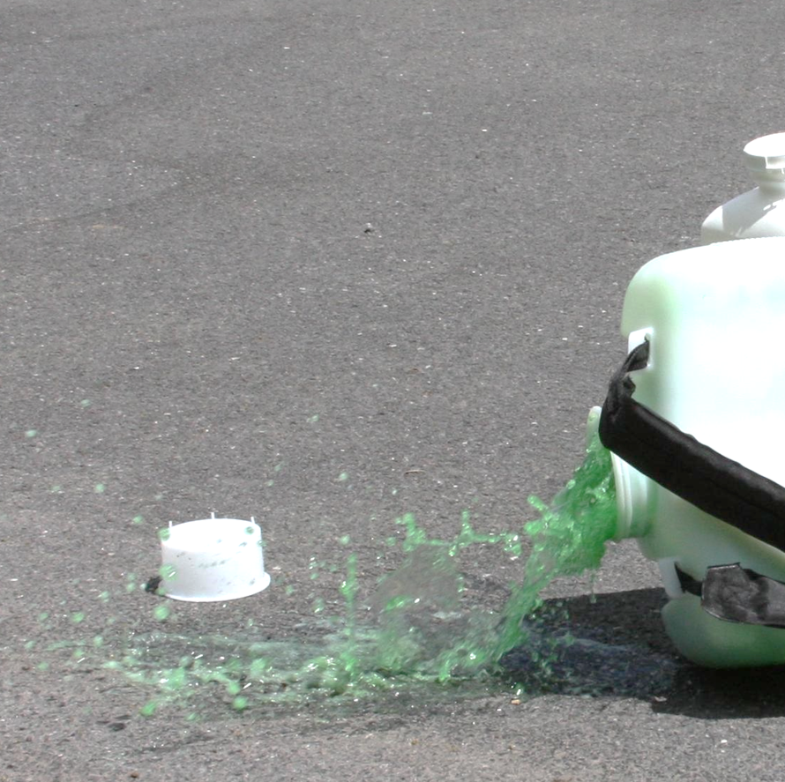
General Procedures for Spill Cleanup
Protect yourself by putting on the PPE listed on the label
Control the spill by placing the container upright to stop more from spilling or by putting a broken or leaking container into a plastic bag or other secondary container
Contain the spill and the area by using an absorbent material to keep the product from spreading
Clean up the spill according to label directions
Image credit: Penn State Extension, The Pennsylvania State University
Notes:
Information required to be covered:
If a pesticide spills, the handler must work quickly to control, contain, and clean up the spill. Many pesticide labels contain instructions on how to clean up a spill. In all pesticide spill situations handlers should:
Protect themselves by putting on the personal protective equipment listed on the label. If the situation is too dangerous, they should call for emergency help.
Control the spill by placing the container upright to stop more from spilling or by putting a broken or leaking container into a plastic bag or other secondary container.
Contain the spill and the area by using an absorbent material to keep the product from spreading. Set up cones, a rope or caution tape so people don’t accidentally walk through the area.
Clean up the spill according to label directions. Pesticide handlers must never hose down a spill. That would spread the pesticide around and could contaminate a larger area, including water sources if the liquid runs down a drain.

Slide 126

Do Not Spray Other People
Pesticide handlers are prohibited from applying pesticides in a manner that will contact workers or other people, either directly or through drift
Image credit: Chazzbo Media
Notes:
Information required to be covered:
Pesticide handlers are prohibited from applying pesticides in a manner that will contact people (other than appropriately trained and equipped handlers involved in the application), either directly or through drift.
Drift is the movement of pesticide dust, spray or vapor away from the application site.
Notes for trainers of pesticide handlers:
Handler employer & handler must follow label statement like: “Do not apply this product in a way that will contact workers or other persons, either directly or through drift. Only protected handlers may be in the area during application.”

Slide 127
Reducing Hazards from Pesticide Drift
Pesticides have a greater potential to drift when they are applied through nozzles designed to deliver small droplets.
Wind also plays an important role in the distance vapors or dust can travel
Application exclusion zones (AEZ) are intended to protect people from drift
Notes:
Information required to be covered:
Pesticides have a greater potential to drift when they are applied through nozzles designed to deliver small droplets.
Small droplets are light weight
Small droplets can be carried in the wind further than medium or coarse droplets which are heavier
Wind also plays an important role in the distance vapors or dust can travel. As the distance from the sprayer to the ground increases, so does the likelihood that pesticide vapors or dust will be impacted by any existing wind.
Application exclusion zones (AEZ) are intended to protect people from drift.

Slide 128


AEZs in Outdoor Areas
25’
100’
Applied:
Applied as a:
Applied:
Aerially
Air blast
Fine or smaller droplet size
Fumigant
Smoke
Mist
Fog
Medium or larger droplet size
>12” off ground
Notes:
Information required to be covered:
AEZ distances in outdoor production are 25 or 100 feet around the application equipment based on application method.
100 foot AEZ
Applied aerially, by air blast or spray applications using extremely fine, very fine, or fine droplet sizes
Applied as a fumigant, smoke, mist, or fog
25 foot AEZ
Applied other than 100 foot AEZ
Spray applications using medium, coarse, very coarse, extremely coarse, or ultra coarse droplet sizes
Sprayed from a height of more than 12 inches above the plant medium
No AEZ if applied otherwise.

Slide 129

Suspend Applications if People are in the AEZ
Handlers must suspend pesticide application if worker or other person is in AEZ
25’
Notes:
Information required to be covered:
Tell handlers that it is their responsibility to temporarily shut off the application equipment if workers or other people (not involved with the application) are in the AEZ. The handler should ask the workers on the same establishment to move until the application is no longer near them. The handler can also ask workers on neighboring establishments to move until he/she finishes treating the area near the neighbor. Handlers can continue the application once no one is within the AEZ or certain other conditions are met.
Not limited to boundaries of agricultural establishment
Can continue with application when people move or after an assessment of the situation guarantees no drift and the people are off the establishment
Notes for trainers of pesticide handlers:
Tell handlers that agricultural workers should leave the AEZ immediately if they are working in an area where someone is applying a pesticide and/or a pesticide from a nearby application is drifting towards them.

Slide 130
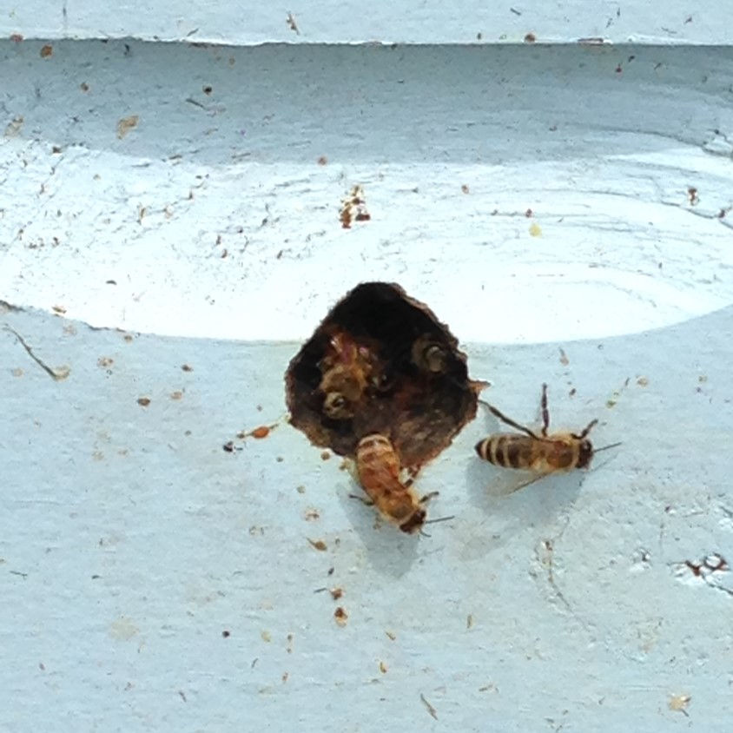
Protecting Sensitive Areas
Be exceptionally careful when applying pesticides near or adjacent to:
  Places where people and pets live, work, play, or travel
  Water sources
  Wildlife and beneficial insect habitats
  Livestock areas
The label will provide details about sensitive environmental areas, where handlers should remain careful of (under “Environmental Hazards”)
Image credit: Betsy Buffington, Iowa State University
Notes:
Information required to be covered:
Handlers must look all around the application site for the presence of people, animals, or sensitive areas that might be negatively impacted by the pesticide.
Handlers need to be exceptionally careful when applying pesticides near or adjacent to:
Places where people and pets live, work, play, or travel
Water sources
Wildlife and beneficial insect habitats, and
Livestock areas.
The label will provide details about sensitive environmental areas, where handlers should remain careful of (under “Environmental Hazards”).

Slide 131
Other Impacts of Pesticides on the Environment
Pesticides that are not absorbed by plants or soil can move from the site and contaminate other areas
Applying pesticides when it is raining or shortly before it rains can result in runoff or pesticide movement off the application site
Application during precipitation events may reduce the efficacy of the application, as well as lead to off-site movement of the pesticide
Return to Table of Contents
Notes:
Information required to be covered:
Pesticides that are not absorbed by plants or soil can move from the site and contaminate other areas.
Applying pesticides when it is raining or shortly before it rains can result in runoff or pesticide movement off of the application site.
Application during precipitation events may reduce the efficacy of the application, as well as lead to off-site movement of the pesticide.
Notes for trainers of pesticide handlers:
This concludes Section 10: Protecting People and the Environment When Using Pesticides. Continue on to Section 11: Personal Protective Equipment or return to the Table of Contents by clicking on the “Return to Table of Contents” in the bottom-right corner of this slide (when in presentation view only).

Slide 132
Section 11: Personal Protective Equipment
Training Topics for Handlers only
Return to Table of Contents
Notes:
Notes for trainers:
This section contain training requirements for handlers only.
This section will inform handlers of Personal Protective Equipment (PPE).
Specific handler training topics that are included in this section include:
Need for and appropriate use and removal of all personal protective equipment.
How to recognize, prevent and provide first aid treatment for heat-related illness.
The responsibility of handler employers to provide handlers with information and protections designed to reduce work-related pesticide exposures and illnesses. This includes providing, cleaning, maintaining, storing, and ensuring proper use of all required personal protective equipment; providing decontamination supplies; and providing specific information about pesticide use and labeling information.
The responsibility of handler employers to ensure handlers have received respirator fit-testing, training and medical evaluation if they are required to wear a respirator by the product labeling.

Slide 133
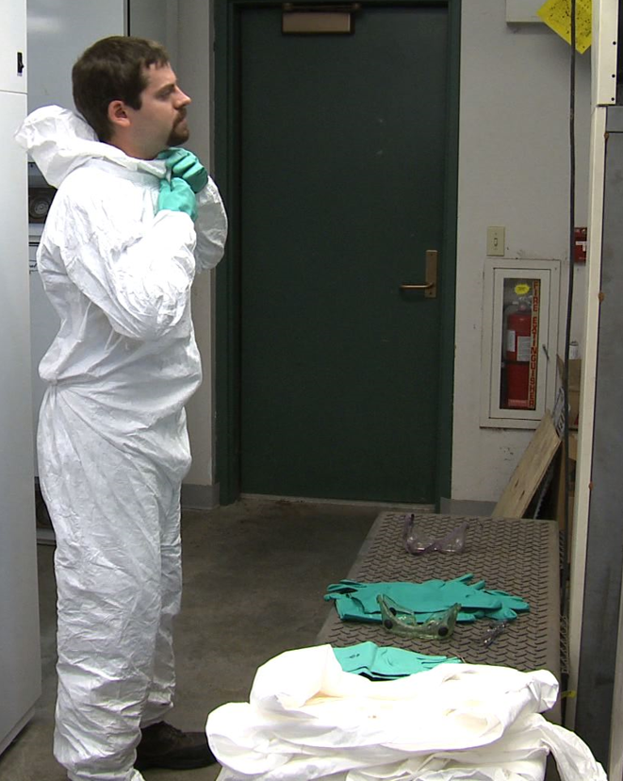
Importance of PPE
Image credit: Betsy Buffington, Iowa State University
Notes:
Information required to be covered:
Personal Protective Equipment (PPE) is worn by handlers and early-entry workers to protect themselves from exposure.
It is important for handlers – due to the potential for exposure to the concentrated pesticide during handling, and because handlers work with large amounts of pesticide as they mix, load, and apply pesticides.

Slide 134

PPE on the Pesticide Label
Select PPE based on label instructions
Some labels ask handlers to wear specific work clothing, such as
  Long-sleeved shirt
  Long pants
  Shoes and socks
  Short-sleeved shirts or shorts
Image credit: Sarah Risorto, UC Statewide IPM Program
Notes:
Information required to be covered:
After the pesticide handler has read and become familiar with the product label, the next step is to select the correct protective clothing and personal protective equipment. The type of PPE that is required is based on several factors, such as the product’s toxicity, concentration, formulation; and the application equipment, site and task. EPA has determined through risk assessment that the specific work clothing or personal protective equipment that is listed on the label must be worn by the handler or early entry worker to protect themselves from exposure.
Some pesticide labels require handlers to wear specific work clothing, such as:
Long-sleeved shirt
Long pants
Shoes and socks
Short-sleeved shirt or shorts (occasionally a label will require that these items are worn underneath a chemical-resistant suit)
The employer is not responsible for providing this work clothing – just the personal protective equipment (PPE) listed on the next slide. However, the handler is required to wear both the work clothing and the PPE identified on the label.

Slide 135
PPE on the Pesticide Label
Other pesticide labels list the PPE handlers must wear, which may include:
  Gloves
  Aprons
  Chemical-resistant footwear
  Coveralls (cloth)
  Chemical-resistant suit
  Chemical-resistant headgear
  Protective eyewear
  Respirator
If handling more than one pesticide, use the most protective PPE for that task
Notes:
Information required to be covered:
Other pesticide labels list Personal Protective Equipment (PPE), which may include:
Gloves
Apron
Chemical-resistant footwear
Coveralls (cloth)
Chemical-resistant suit
Chemical-resistant headgear
Protective eyewear
Respirator
Pesticide handlers may be instructed to mix two products together to control the pest. In this situation, the handler or the employer must compare the PPE sections of both labels and select the PPE listed on the label that provides the most protection. For example, if one product label requires a long-sleeved shirt and pants and the other requires a chemical-resistant suit, then the handler must wear a chemical-resistant suit. If one requires a respirator and the other does not, then the handler must wear the required respirator. If different types of respirators are required, the handler employer must provide the appropriate type of respirator and cartridge to protect for both.
Notes for trainers of pesticide handlers:
When a label specifies coveralls, the handler or early-entry worker is required to wear cloth coveralls. If full body chemical-resistance is required (very rarely), the label will specify a chemical-resistant suit.

Slide 136
Read the Label CAREFULLY:
Read the label thoroughly to make sure you understand ALL of the PPE requirements.
Don’t skim- it’s easy to miss important details
Personal Protective Equipment:
Some materials that are chemical-resistant to this product are listed below.
Handlers who may be exposed to the dilute through application or other tasks must wear: Long-sleeved shirt and long pants, Chemical-resistant gloves, such as Nitrile, Butyl, Neoprene, and/or Barrier Laminate, and Shoes plus socks.
Handlers who may be exposed to the concentrate through mixing, loading, application, other tasks must wear: Long-sleeved shirt and long pants, Chemical-resistant gloves, such as Nitrile, Butyl, Neoprene, and/or Barrier Laminate, Shoes plus socks, and Protective eyewear.
Notes:
Information required to be covered:
Pesticide handlers must read the label thoroughly to make sure that they understand all of the PPE requirements. A pesticide handler who merely skims the label for PPE information may miss important details.
Suggested Activity:
Section 11. Activities for Personal Protective Equipment: “Selecting Personal Protective Equipment”

Slide 137
Chemical-resistant PPE
Chemical-resistant PPE doesn’t allow a measurable amount of chemical to pass through
Chemical-resistant can refer to different types of PPE including:
  Gloves
  Footwear
  Suit
  Aprons
Notes:
Information required to be covered:
When a “chemical-resistant” item is listed on the label, it is referring to PPE that is made of a material that doesn’t allow a measurable amount of chemical to pass through. Handlers may see “chemical-resistant” used to describe certain PPE, such as gloves, footwear, suits, or aprons.
Some examples of chemical-resistant materials include nitrile, natural, neoprene, and barrier laminate rubber, and polyvinyl chloride.

Slide 138
Waterproof PPE
Waterproof PPE refers to PPE that is made of a material that doesn’t allow a measurable amount of water or pesticides mixed with water to pass through
Notes:
Information required to be covered:
Similarly, some labels require PPE to be made of “waterproof” material, which does not allow a measurable amount of water or pesticides dissolved in water to pass through the item during use.

Slide 139
Reusable vs Disposable PPE
Reusable PPE must be cleaned after use
Disposable PPE must be thrown out after the work day or if soiled by pesticides
Notes:
Information required to be covered:
Reusable PPE must be cleaned after use.
Disposable PPE must be thrown out after the work day or if soiled by pesticides.

Slide 140
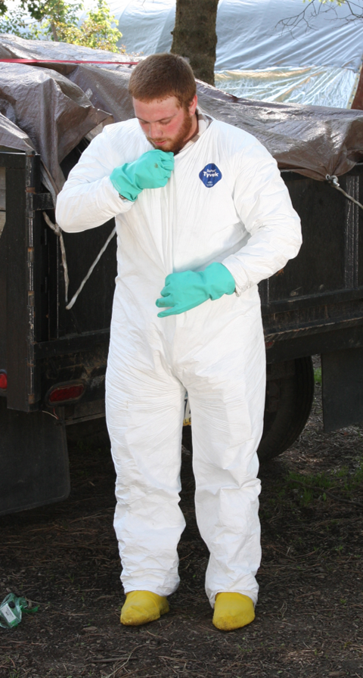
Coveralls or Chemical-resistant Suits
Must be loose fitting
1 or 2 piece garments
Must cover entire body except the head, hands, and feet
Coveralls = cloth/fabric
Chemical-resistant suit = chemical-resistant material
Image credit: Penn State Extension, The Pennsylvania State University
Notes:
Information required to be covered:
Coveralls and chemical-resistant suits must be loose fitting, one- or two-piece garments that cover, at a minimum, the entire body except the head, hands, and feet.
The difference between coveralls and a chemical-resistant suit is the material of which they are made. Coveralls are made of cloth or fabric and chemical-resistant suits are made of chemical-resistant material.

Slide 141
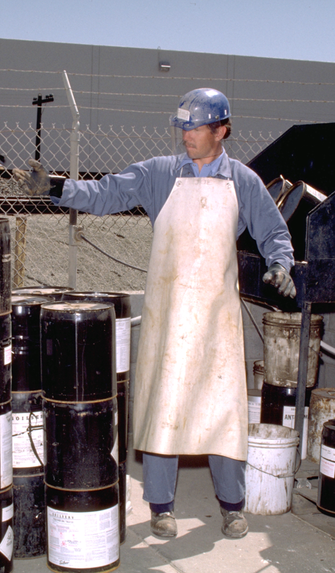
Apron
Aprons must be long enough to cover the front of the body from mid-chest to knee
Notes:
Information required to be covered:
The label may require a chemical-resistant apron if it is needed to protect the handler in a situation in which a pesticide might splash back onto the handler, such as while mixing a pesticide or hosing off application equipment. The apron must be long enough to cover the front of the body from mid-chest to knees.

Slide 142
Chemical-resistant Headgear
A chemical-resistant hood or hat, with a wide brim
Notes:
Information required to be covered:
Some pesticide labels will simply require overhead protection, while others will state that chemical-resistant headgear must be worn. If chemical-resistant headgear is specified, it must be either a chemical-resistant hood or a chemical-resistant hat with a wide brim.

Slide 143
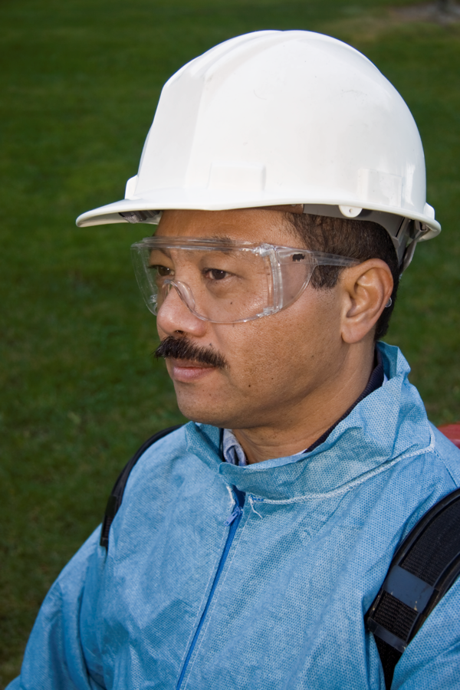
Hat or Overhead Protection
Non-absorbent material
Wash with soap and water at the end of the handling task
DO NOT WEAR absorbent hats, such as baseball caps
Notes:
Information required to be covered:
If a label requires a hat or overhead protection, handlers must wear something made of a non-absorbent material that they are willing to wash with soap and water at the end of the handling task.
Pesticide handlers should not wear hats such as baseball caps during pesticide handling activities.

Slide 144

Protective Eyewear
Provide front, brow, and temple protection
  Safety glasses
  Chemical splash goggles
  Face shield
  Full-face respirators
Image credit: Penn State Extension, The Pennsylvania State University
Notes:
Information required to be covered:
Protective eyewear options includes safety glasses with front, brow, and temple protection; chemical splash goggles; face shields; and full-face respirators. People who wear reading glasses might opt for a face shield, which will enable them to clearly see the label while mixing the product.
If the label says, “protective eyewear” the handler can wear any of the protective eyewear listed here. If the label specifies a type of protective eyewear (e.g., faceshield), then that specific eyewear must be used.

Slide 145
Chemical-resistant Footwear
Chemical-resistant shoes, boots or shoe coverings
Must be made of chemical-resistant material such as rubber or vinyl
Notes:
Information required to be covered:
While some labels will recommend shoes and socks, labels that require handlers to wear chemical-resistant footwear are referring to shoes, boots, or shoe coverings made of chemical-resistant material, such as rubber or vinyl.

Slide 146

Gloves
Gloves must be worn during handling, including repairing equipment and adjusting nozzles
If the label requires a certain material, such as nitrile, gloves must be made of specified material
Handlers MUST NOT wear cotton, suede or leather gloves
Image credit: Jennifer Weber, Arizona Department of Agriculture
Notes:
Information required to be covered:
If the label requires handlers to wear gloves, they must be worn during all handling tasks, including when repairing application equipment and adjusting nozzles.
The gloves must be the type listed on the label. Many labels will list the type of glove material (for example, nitrile gloves) or will state that the gloves can be of any chemical-resistant or waterproof material.
Handlers must not wear cotton, suede or leather gloves when they are handling pesticides unless instructed to do so by the label. These materials absorb pesticides and won’t protect handlers from the pesticides.

Slide 147
Glove Liners
Glove liners can be worn underneath gloves
They must not extend outside of chemical-resistant glove
Glove liners must be discarded either after 10 hours of use or within 24 hours after they are first put on, whichever comes first
They must be removed if they contact pesticide directly, and they cannot be reused
Glove liners should be separate from the glove itself
Cotton-lined and fleece-lined gloves are not permissible
Notes:
Information required to be covered:
Separable glove liners made of a thin lightweight fabric may be worn beneath chemical-resistant gloves as long as they are not exposed to the chemical by extending outside of the chemical-resistant gloves. If used, separable glove liners must be discarded either after 10 hours of use or within 24 hours of initially putting on the gloves, whichever comes first. They must be removed if they contact pesticide directly, and they cannot be reused.
Separable glove liners are not to be confused with cotton- or fleece-lined gloves , which are not allowed because they could absorb pesticides and contaminate the handler.

Slide 148

Respirators
Respirators are important if there is the likelihood of the handler’s exposure to droplets or vapors
Respiratory equipment tested and certified by the National Institute of Occupational Safety and Health (NIOSH)
Identified by a “TC” code
Image credit: Betsy Buffington, Iowa State Extension
Notes:
Information required to be covered:
Respirators are important if there is the likelihood of the handler’s exposure to droplets or vapors.
If respiratory equipment is required by the pesticide label, the type of respirator will be identified by the acronym “NIOSH” and a “TC” followed by a coding system (e.g., TC-23C). These acronyms tell the handler that the National Institute of Occupation Safety and Health (NIOSH) has Tested and Certified (TC) the equipment listed on the label.
If a cartridge is required, it will be identified by a description and/or an abbreviation (e.g., organic vapor (OV) filtering cartridge). Sometimes pesticide labels also require filters that fit onto the cartridges (often also called “pre-filters”). They are identified by the testing and certification code TC-84A, by the type of material the filter can be used with (N, R, P, HE) and the amount that they filter (95, 99, 100).

Slide 149
Respirators
Make sure to use the correct respirator, cartridges and filters as listed on the label
Respirators, cartridges and filters are product- and task specific
Notes:
Information required to be covered:
Respirators, cartridges and filters are product- and task-specific. It is therefore imperative that pesticide handlers wear the equipment specified on the label for the handling activity they will perform.
Notes for trainers of pesticide handlers:
PERC (http://pesticideresources.org/wps/inventory.html) has a good resource that provides more information on cartridges, canisters, filters and respirators in general.

Slide 150
Respirator-Use Requirements
When a handler uses a pesticide that requires respiratory protection THE EMPLOYER is responsible for providing the following to the handler (at no cost) before he/she uses a respirator required by the label:
  Medical evaluation
  Respirator fit test
  Respirator use and maintenance training
Notes:
Information required to be covered:
It is the employer’s responsibility to make sure that handlers who will use pesticides that require respiratory protection receive a medical evaluation, respirator use and maintenance training, and respirator fit testing – at no cost to the handler – before the handler uses the label-required respirators.
Notes for trainers of pesticide handlers:
It is the trainer’s responsibility to inform all handlers that the employer must fulfill these requirements before the handler works with a pesticide that requires respiratory protection.
Each of the elements of the respiratory protection program must be documented by the employer.

Slide 151
Medical Evaluation
Medical evaluation required before handler uses respirator
Medical history questionnaire
Possible follow-up visit
Repeat evaluation if there is a change in the conditions of use or health status of handler
Notes:
Information required to be covered:
If a pesticide label requires the pesticide handler to wear a respirator, the employer must make sure that the handler is healthy enough to use the respirator without suffering adverse health effects. This is achieved through medical evaluation before the handler is allowed to use the respirator.
During the medical evaluation, the pesticide handler will probably complete a confidential medical history questionnaire. Based on the handler’s responses to the questionnaire, a physician or medical professional may require that the handler schedules a follow-up visit or provide additional information to determine if they are physically able to use that type of respirator.
Repeat medical evaluations are not usually required every year, but only if there is a change in the conditions of how the respirator is used or in the health status of the handler. Also, the medical clearance form from the medical professional may include a time limit.

Slide 152
Respirator Fit Test
Fit tests must be performed before the handler uses the respirator and at least annually after that
Fit tests must be repeated if:
  The respirator changes
  There are changes to the size and/or shape to the handler’s face
Notes:
Information required to be covered:
The respirator must fit properly for it to provide the protection.
If the handler is given medical clearance, the employer must make sure that the respirators that he or she will use fits properly. The respirator must be fit tested before the handler uses the respirator and at least annually after that.
Respirator fit tests must be repeated if:
The respirator the handler is using changes
There have been significant changes to the size and/or shape of the handlers face, which might impact the fit of a respirator. Some of these changes might include:
Weight loss or gain of 20+ pounds
Dental surgery
Significant injury to the jaw
It’s also important to note that facial hair interferes with the seal of a tight fitting respirator. If the handler chooses not to shave, they either cannot perform tasks that require a respirator or they must wear a loose fitting respirator (like a Powered Air Purifying Respirator/PAPR).

Slide 153

Respirator Use and Maintenance Training
Handlers that use respirators must be trained
  Before they begin using the respirator
  At least annually
Training must be repeated if handler demonstrates a lack of knowledge
Image credit: Penn State Extension, The Pennsylvania State University
Notes:
Information required to be covered:
Each medically-cleared handler must also receive training before using the respirator and at least annually after that on how to properly use, store, and care for their respirators.
The handler must be re-trained if they do not demonstrate proper use or maintenance of their equipment.

Slide 154
PPE Inspection
Inspect PPE to make sure it is in good condition before wearing
Inspect PPE when cleaning at the end of the work day
If PPE is damaged or needs repair, the handler should report to employer who must fix or replace
Notes:
Information required to be covered:
After the pesticide handler has selected the PPE listed on the pesticide label, it is time to check the PPE to make sure that it is in good condition and safe to use before putting it on. It is the employer’s responsibility to ensure the PPE is in good condition but it is likely the handler will be the one doing this.
Pesticide handlers should also inspect PPE when cleaning it at the end of the handling task so that employers can replace or repair any damaged equipment.

Slide 155
PPE Inspection Checklist
Inspect boots or chemical-resistant shoe coverings for holes, tears, or weak spots.
Inspect re-usable gloves for damage, such as holes, cracks, tears, areas that have become bubbled or spongy, and any discoloration.
Check coveralls and chemical-resistant suits for rips, tears, holes or separation along seams and zippers.
Make sure that the coveralls or chemical-resistant suit that you will use is the correct size so that it will offer you optimal protection and doesn’t interfere with movement.
Check apron material for holes or damage. Make sure that apron strings are in good condition and enable you to wear the apron securely.
Notes:
Information required to be covered:
Inspect boots or chemical-resistant shoe coverings for holes, tears, or weak spots.
Inspect re-usable gloves for damage, such as holes, cracks, tears, areas that have become bubbled or spongy, and any discoloration.
Check coveralls and chemical-resistant suits for rips, tears, holes or separation along seams and zippers.
Make sure that the coveralls or chemical-resistant suit that you will use is the correct size so that it will offer you optimal protection and doesn’t interfere with movement.
Check apron material for holes or damage. Make sure that apron strings are in good condition and enable you to wear the apron securely.
Notes for trainers of pesticide handlers:
See handout: Section 11. Personal Protective Equipment Inspection Checklist

Slide 156
PPE Inspection Checklist cont.
Inspect protective eyewear for scratched or cracked lenses and replace if needed.
If you will use goggles, check the elastic parts for fraying, tears, wear, or loss of elasticity and replace if it is worn.
If you will use overhead protection, check the protective headwear for cracks, holes, and worn adjustable fittings.
Faceshields and protective headgear often have adjustable fittings for a secure fit and to prevent them from slipping or falling off. Inspect these fittings to make sure that they are working properly.
Notes:
Information required to be covered:
Inspect protective eyewear for scratched or cracked lenses and replace if needed.
If you will use goggles, check the elastic parts for fraying, tears, wear, or loss of elasticity and replace if it is worn.
If you will use overhead protection, check the protective headwear for cracks, holes, and worn adjustable fittings.
Faceshields and protective headgear often have adjustable fittings for a secure fit and to prevent them from slipping or falling off. Inspect these fittings to make sure that they are working properly.

Slide 157
Replacing Respirator Filters and Cartridges
Filters, cartridges and gas- or vapor-removing canisters must be removed and replaced when any of the following occur:
  Breathing becomes difficult
  The filter is damaged or torn
  The handler detects a pesticide taste, smell or any type of irritation
  When required by manufacturer’s label
  When instructed by pesticide label
  At the end of 8 hours of total use
Notes:
Information required to be covered:
Even if a respirator seals and fits well, handlers can still be exposed if the filters, canisters, or cartridges are old or damaged. Pesticide handlers must remove and replace respirator filters, cartridges and gas- or vapor-removing canisters when any of the following situations occur:
Breathing becomes difficult
The filter is damaged or torn
The handler detects a pesticide taste, smell or any type of irritation
When required according to the respirator manufacturer’s recommendation or the pesticide label instructions, whichever is more frequent
At the end of 8 hours of total use, if none of the above has occurred

Slide 158
Employer’s Responsibility
Provide and pay for all PPE on label
Ensure proper PPE use and care training for handlers
Maintain all PPE
Properly dispose of any damaged or disposable PPE
Train handlers on cleaning, drying and storing re-usable PPE
Provide a place away from pesticide storage for handlers to put on, remove and store PPE
Notes:
Information required to be covered:
It is often the pesticide handler who inspects the personal protective equipment before each use and cleans the items at the end of the handling activity. However, it is the employer’s responsibility to:
Provide and pay for all of the Personal Protective Equipment (PPE) listed on the label
Make sure that employees are properly trained on the proper use and care of PPE and that they follow the instructions provided.
Maintain all PPE and ensure that it is inspected for cracks, tears, holes, weak spots or damage before each day of use
Properly discard and replace any damaged and all disposable PPE. The employer must make contaminated PPE that cannot be properly cleaned unwearable.
Ensure that re-usable PPE is properly cleaned, dried and stored. The employer can train the handlers on how to do this.
Provide a place away from pesticide storage areas for pesticide handlers to put on, remove and store PPE.
Suggested Activity:
Section 11. Activities for Personal Protective Equipment: “Personal Protective Equipment (PPE) Decontamination”

Slide 159


Wearing PPE
Wear PPE in a way that prevents pesticide spray from entering boots or sleeves
Notes:
Information required to be covered:
Ground Application: Place pant legs over boots to prevent pesticides from entering the boots. Place sleeves over the gloves to prevent pesticides from entering the glove.
Overhead Application: Place pant legs over boots to prevent pesticides from entering the boots. Place gloves over the sleeves to prevent pesticides from entering the sleeves.
Coveralls with elastic at the wrist and ankle help assure there is no gap between the sleeve and glove, or between the pant leg and boot.
Notes for trainers of pesticide handlers:
Pesticide handlers may ask whether they should tuck their sleeves into their gloves or their gloves into their sleeves when applying pesticides. They may have the same question about their how to arrange their pant legs and boots.
A good way to present the correct arrangement is to mimic a ground application and an overhead pesticide application. Ask the handlers to think about these two scenarios and how they can best prevent the pesticide spray from entering and getting trapped in their boots or running down into their gloves or sleeves.
Suggested Activity:
Section 11. Activities for Personal Protective Equipment: “PPE Selection”

Slide 160
PPE and Heat Stress
Early Stages of Heat Illness
Severe Stages of Heat Illness
Fatigue
Muscle weakness
Dizziness
Headache
Nausea
Heavy sweating
Chills
Severe thirst and dry mouth
Fainting
Lack of sweat as heat stress progresses
Hot, dry, clammy skin
Slurred speech
Irrational behavior and confusion
Seek medical assistance if symptoms persist
Notes:
Information required to be covered:
Personal Protective Equipment, especially items made from non-breathable material, can increase the risk of heat stress when worn during pesticide handling and early entry work activities. Heat stress is a serious health condition and can even lead to death.
Early stages of heat stress symptoms include:
Fatigue
Muscle weakness
Dizziness
Headache
Nausea
Heavy sweating
More severe stages of heat-related illness can include:
Chills
Severe thirst and dry mouth
Fainting
Lack of sweat as heat stress progresses
Hot, dry, clammy skin
Slurred speech
Irrational behavior and confusion
If a handler is suffering from apparent heat stress (or worse) they should get medical attention if symptoms persist.

Slide 161

Employers Should Reduce the Risk of Heat Stress
Provide plenty of cool drinking water and shade
Alter work hours to cooler times
Image credit: Jennifer Weber, Arizona Department of Agriculture
Return to Table of Contents
Notes:
Information required to be covered:
Employers must take steps to prevent pesticide handlers from experiencing heat stress. Ways to reduce the risks include, providing plenty of cool drinking water and shade for pesticide handlers and altering their work hours. For example, summer applications can be scheduled in the cooler hours of the day or night and for shorter periods of time, especially when working with pesticides that require the most PPE.
Notes for trainers of pesticide handlers:
This concludes Section 11: Personal Protective Equipment. Continue on to Section 12: Early Entry and Minimum Age for Early Entry Workers or return to the Table of Contents by clicking on the “Return to Table of Contents” in the bottom-right corner of this slide (when in presentation view only).

Slide 162
Section 12: Early Entry and Minimum Age for Early Entry Workers
Information for Early-entry Workers only
Return to Table of Contents
Notes:
Notes for trainers:
This section contains information for early-entry workers only.
Early-entry workers need to know that their employer must provide specific information (and protections) for workers who are directed to perform tasks in a treated area while under a restricted-entry interval.

Slide 163
Early-Entry
If your employer needs you to enter a treated area while the REI is still in effect:
  You must be at least 18 years old at that time
  You must have had pesticide safety training
  Your employer must give you PPE and the information described on the next two slides
Notes:
Information required to be covered:
If you are a worker and your employer needs you to enter a treated area while the restricted-entry interval (REI) is still in effect,
You will have to be at least 18 years old at that time, and
You must have had pesticide safety training.
Your employer must give you PPE and the information described on the next slide.

Slide 164
Early Entry
Your employer must, before you enter the treated area, provide to you:
  Location of the early entry work to be done
  What pesticide(s) were applied
  REI start and end date and time
  The exception under which the WPS permits you to enter the area (for example, no contact, agricultural emergency, irrigation)
  Whether contact with treated surfaces is allowed
  How long you can work in the area
  Label required PPE
  Location of the decontamination supplies and the pesticide safety information
  Information from the pesticide label about the health hazards, precautions, first aid, and user
Notes:
Information required to be covered:
Your employer must, before you enter the treated area, provide to you:
The location of the early entry work to be done
What pesticide(s) were applied
REI start and end date and time
The exception under which the WPS permits you to enter the area (for example, no contact, agricultural emergency, irrigation)
Whether contact with treated surfaces is allowed
How long you can work in the area
Label required PPE
Location of the decontamination supplies and the pesticide safety information
Information from the pesticide label about the health hazards, precautions, first aid, and user

Slide 165
Early Entry
Your employer must provide this information and these protections before you start work in the area
Image credit: Betsy Buffington, Iowa State University
Return to Table of Contents
Notes:
Information required to be covered:
Your employer must provide this information and these protections before you start work in the area.
Notes for trainers:
This concludes Section 12: Early Entry and Minimum Age for Early Entry Workers. Continue on to acknowledgements or return to the Table of Contents by clicking on the “Return to Table of Contents” in the bottom-right corner of this slide (when in presentation view only).

Slide 166
Acknowledgments
Primary Author
Betsy Buffington, Iowa State University Extension
Project Coordinator
Amy Bamber, Association of American Pesticide Control Officials
Content Developers
Lisa Blecker, University of California, Davis Extension
Ofelio Borges, Washington State Department of Agriculture
Ricardo Davalos, Florida Department of Agriculture
Irene King, New Mexico Department of Agriculture
Kerry Richards, American Association of Pesticide Safety Educators
Flor Servin, Washington State Department of Labor and Industries
Thia Walker, Colorado State University Extension
U.S. EPA Office of Pesticide Programs Reviewers
Kathy Davis, Jennifer Park, Nancy Fitz, Richard Pont
PERC Administrators
Suzanne Forsyth, University of California Davis Extension
Kaci Buhl, Oregon State University
Jeff Loux, University of California Davis Extension
Jeanne Kasai, U.S. EPA
This program was developed through a cooperative agreement between the US EPA (#X8-83616301) and University of California Davis Extension in cooperation with Oregon State University.
Version Dated: May 5, 2017
Notes:
Notes for trainers:
This concludes this presentation.
Version Dated: May 5, 2017

