Slide 1
Handler Training
Worker Protection Standard Pesticide Handler Safety Training
EPA Handler PST 00018
Notes:
Welcome to the Worker Protection Standard (WPS) pesticide safety training for pesticide handlers. The WPS regulation requires agricultural employers to provide employees with information and training on ways to avoid exposure to pesticides and pesticide residues.

Slide 2
EPA has approved this material for training pesticide handlers on pesticide safety in accordance with the 2015 WPS expanded training content (40 CFR Part 170). The approval number is EPA Handler PST 00018.
​This work is licensed under a Creative Commons Attribution-NonCommercial-ShareAlike 4.0 International License by The Regents of the University of California, Davis campus, 2017. For information contact PERCsupport@ucdavis.edu.
Notes:
EPA has approved this material for training pesticide handlers on pesticide safety in accordance with the 2015 WPS expanded training content (40 CFR Part 170). The approval number is EPA Handler PST 00018.
Copyright and license conditions apply.
Additional guidance about the applicable copyright is available at http://pesticideresources.org/AdoptedPERCPolicies.pdf

Slide 3
Using these slides to train: Pesticide Handlers
This presentation provides the information required to train handlers under the Environmental Protection Agency’s Worker Protection Standard. Additional state rules may apply.
This handler training material can be used in 2017, 2018 and beyond.
This presentation must be presented in its entirety.
If you intend to add or remove slides from this EPA-approved presentation, then refer to the EPA guidance in the notes section.
The notes section of the PowerPoint presentation contains important information for the trainer. Please review the notes prior to conducting the training.
When training pesticide handlers, you must provide them with site-specific information relating to the agricultural establishment where they will be working. This includes the location of PPE, pesticide storage, pesticide application equipment, central posting, records, emergency contact information, decontamination supplies, and other WPS requirements.
Trainings must be conducted in a manner that the handlers understand the information completely.
Notes:
Notes for trainers of pesticide handlers:
Trainers must provide the training as required by the rule. Training administration revisions in the 2015 rule are required starting January 2, 2017.
Please review the National Worker Protection Standard: Manual for Trainers of Agricultural Workers and Pesticide Handlers and/or the accompanying training PowerPoint for training preparation and requirements.
If you intend to add or remove slides from this set, refer to this EPA Guidance below:
EPA’s Office of Pesticide Programs offers the following preliminary guidance on modifications to EPA-approved training materials for workers, handlers, and trainers under the Worker Protection Standard (WPS):
- Users of training materials MUST use the EPA-approved materials in their entirety and as they are provided, except as provided in the next paragraph. Changes to the content, the order of the information, or images in the presentation by a user may negate the approval for that specific use. However, users may present exercises, handouts, and additional images in their sessions to illustrate the points in the presentation (without adding these to the approved material). It is not necessary for EPA to review these additional materials, as EPA expects that they will not conflict with the original EPA-approved materials.
If a user determines that state- or region-specific information (such as crop specific images and information, or information about state/local regulations that modify those of the WPS) will enhance the presentation for their audiences, EPA prefers for those to be included separately, as described above. If it will be disruptive or impractical from a presentation standpoint (for example, to switch from one presentation to another), EPA agrees that slides – preferably as few as possible - may be added to the presentation. The added slides MUST have a statement that identifies the source, and the slide must look distinct from the EPA-approved materials. It is not necessary for EPA to review these slides, as EPA expects that they will not conflict with the original EPA-approved materials.

Slide 4
Employee Tasks
Notes:
The WPS protects agricultural workers, pesticide handlers, and other persons during pesticide applications.

Slide 5
Agricultural Worker Tasks
Work in treated fields
Agricultural activities
Exposed to pesticide residues
DO NOT HANDLE PESTICIDES
Image credit: Chazzbo Media
Notes:
Information required to be covered:
An agricultural worker is any person working in a field that has been sprayed with any type of pesticide, or that has had an REI in effect within the last 30 days.
These are people that are doing agricultural tasks with high-contact: weeding, moving irrigation equipment, pruning, harvesting, etc.
Workers DO NOT handle pesticides.
Notes for trainers of workers and pesticide handlers:
Start this section with a discussion question. “The person in this picture is an agricultural worker. As a worker, what kinds of tasks does she do?”

Slide 6
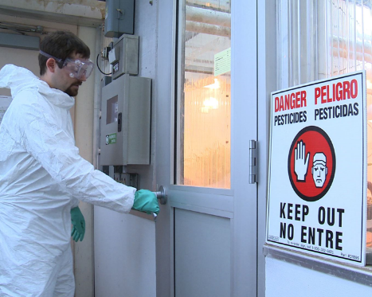
Early-Entry Worker Tasks
Enter into a treated field during the restricted-entry interval (REI)
Additional early-entry specific training and protections before entering a treated field
Must be at least 18
DO NOT HANDLE PESTICIDES
Image credit: Betsy Buffington, Iowa State University
Notes:
Information required to be covered:
Early entry means entry into a treated field or other area after the pesticide application is complete, but before the restricted-entry interval or other restrictions on entry for that pesticide have expired.
Agricultural workers who are required to go into treated areas before the REI expires are early entry employees. Agricultural employers must provide early-entry specific training and protection to workers before directing them to perform early-entry activities.
The new minimum age for early entry workers is 18 years old.

Slide 7
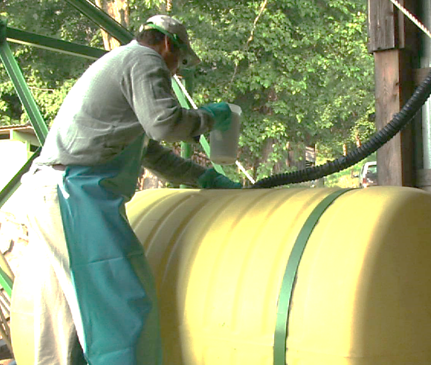
Pesticide Handler Tasks
Mix, load, apply pesticides
Fix application equipment
YES! Mechanics MAY BE handlers
Must be 18 years old
Image credit: Chazzbo Media
Notes:
Information required to be covered:
You are a pesticide handler if you:
Apply pesticides
Assist with pesticide applications
Clean, repair, or maintain pesticide application equipment – such as boom sprayers, backpack sprayers, or hoppers – that may contain pesticide residues
Mix, load, or transfer pesticides into application equipment
Work on equipment that has been used to mix, load, or apply, or otherwise have pesticide residues on them
Dispose of pesticides or materials with pesticides on them, such as containers
Act as a flagger
Perform tasks as a crop advisor (this includes Pest Control Advisors, or PCAs, in California) during the pesticide application or during the REI
The new minimum age for handlers is 18.
Agricultural employers are prohibited by the rule from allowing or directing a worker to mix/load/or apply pesticides or assist in their application unless trained as a handler.
Notes for trainers of workers and pesticide handlers:
Start this section with a discussion question. “What kind of tasks does a handler do?”

Slide 8
Where You May Encounter Pesticides at Work
Notes:
You may encounter pesticides and pesticide residues at your workplace.

Slide 9
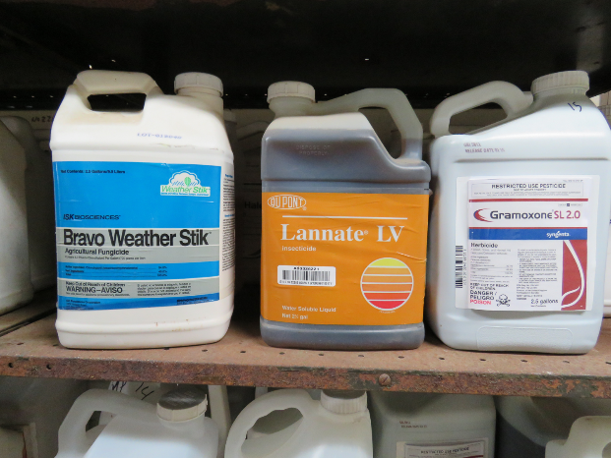
Pesticide Types
Insecticides – control insect
Herbicides – control weeds
Fungicides – control fungi and disease organisms
Image credit: Ed Crow, Penn State Pesticide Education Program
Notes:
Information required to be covered:
Pesticides protect plants from pests such as insects, weeds, fungi, and rodents.
People often use the term "pesticide" to refer only to insecticides, but it actually applies to all the substances used to control pests.
Well known pesticides include: insecticides, herbicides, and fungicides.

Slide 10
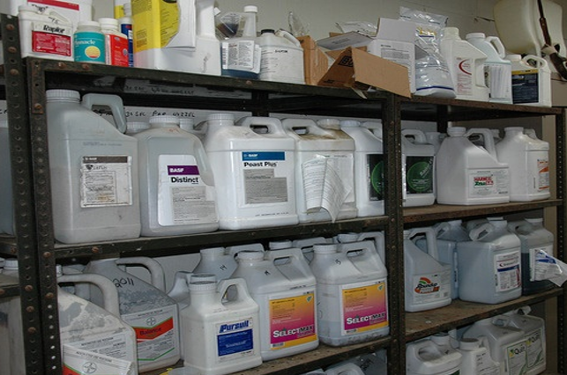
Pesticide Formulations
Liquids
Dusts
Powders
Granules
Pellets
Gases
Gels
Aerosols
Image credit: Penn State Extension, The Pennsylvania State University
Notes:
Information required to be covered:
Pesticides are formulated in different ways and are applied to agricultural crops and cropland in a variety of different forms. Some of the most commonly-used formulations are: liquids, dusts, powders, granules, pellets, gases, gels, and aerosols.

Slide 11
At Work, Pesticides and Pesticide Residues May be Found:
In or on treated plants (leaves, stems, fruit and vegetables)
In or on the soil where pesticides were applied
Tractors, sprayers, and other application equipment
Used work clothing, shoes, and personal protective equipment (including gloves)
Pesticide mixing and loading areas
In the air as drift from a nearby application
In the irrigation water or irrigation equipment, if the irrigation system is used to apply pesticides, called chemigation
In or on pesticide containers (including empty pesticide containers)
Notes:
Information required to be covered:
You must understand where you may encounter pesticides or pesticide residues at your workplace. Even people who do not mix, load, or apply pesticides can come into contact with pesticides or pesticide residues. You can come into contact with concentrated and diluted pesticides as well as residues.
Pesticides and pesticide residues can be found:
On leaves, stems, and fruit of treated plants
In the soil where pesticides have been applied
In some irrigation water and on irrigation equipment if pesticides are applied through irrigation system
In the air (as droplets, dust or vapors)
On application equipment
In or on pesticide containers including empty pesticide containers
In the form of drift during a nearby pesticide application
In mixing and loading sites
In pesticide storages
On contaminated personal protective equipment (handlers)
On measuring devices used for mixing and loading (including the scale) (handlers)
In places where handlers remove personal protective equipment after the application is done (handlers)
On empty pesticide containers and tools to open them (handlers)
On tools used to unplug nozzles (handlers)
In tractor cabs used for pesticide applications (handlers)
Notes for trainers of workers and pesticide handlers:
Make sure you cover this information with scenarios that are relevant to workers and handlers. For example, some tractor operators may become in contact with pesticide residues on tractors that have not been decontaminated after the pesticide application has been done.

Slide 12
How Pesticides Can Enter Your Body
Notes:
Pesticides and pesticide residues can enter your body.

Slide 13
There are Four Routes of Pesticide Entry into the Body:
Skin (Dermal)
Eyes (Ocular)
Nose (Inhalation)
Mouth (Oral)
Notes:
Information required to be covered:
There are four routes of pesticide entry into the body:
Skin (dermal)
Eyes (ocular)
Nose (inhalation)
Mouth (oral)

Slide 14
Routes of Entry: Dermal
Some pesticides when contacted can pass through the skin into the blood stream
Notes:
Information required to be covered:
Pesticides can enter your body through the skin if there is exposure. This route of entry is also called dermal absorption.
The majority of agricultural pesticide injuries or poisonings occur due to skin exposure. Some types of pesticides can pass through the skin into the blood stream.
It is important to remember that there are many factors affecting absorption. Some pesticides are more likely to be absorbed through the skin than others. There are also different parts of the body where skin absorption happens more than others. The form of pesticides that come in contact with skin also matters.
Notes for trainers of workers and pesticide handlers:
The majority of agricultural pesticide injuries or poisonings occur due to skin exposure. When pesticides get onto the skin, they can cause redness, rash, blisters, and irritation. Some types of pesticides readily penetrate the skin and enter the blood stream.
The skin can be exposed to pesticides and their residues through contact with treated plants or soil. Even contact with irrigation water may result in pesticide exposure if pesticides are applied through an irrigation system—or residues from soil, plants or application equipment get into the irrigation water. Skin exposure can also occur when careless pesticide applications result in pesticides drifting onto people who are working nearby or if workers are directly sprayed. Pesticides can be transferred from dirty hands to other parts of the body if workers do not wash their hands before eating, grooming or using the bathroom.

Slide 15
Routes of Entry: Ocular
Significant amounts of pesticide can penetrate the outer tissues of the eye and enter the blood stream
Notes:
Information required to be covered:
Drift from nearby applications or applications of pesticides to areas where people are working can result in you getting pesticides in your eyes.
You can also transfer pesticides from your hands into your eyes. These residues can cause eye irritation or worse.
Not wearing the required eye protection when mixing and loading or applying pesticides can result in eye exposure. You can also transfer pesticide residues into your eyes when rubbing them with contaminated hands.
The eye may or may not be damaged during the pesticide absorption process, depending on the corrosive nature of the chemical and its ability to penetrate the outer tissues.

Slide 16
Routes of Entry: Inhalation
Once pesticides have been inhaled, they enter the lungs and bloodstream
Notes:
Information required to be covered:
Pesticide drift from nearby applications can endanger you if you breathe in some of the pesticide vapor, dust or spray droplets.
You may breathe in pesticide vapor, dust or spray droplets when mixing, loading or applying pesticides.

Slide 17
Routes of Entry: Oral
Pesticide illness can occur if pesticide residues are transferred to consumed food from unwashed hands
Notes:
Information required to be covered:
While working in the fields, you can transfer residues remaining on treated plants into your mouth if you eat, drink or smoke without washing your hands beforehand.
Do not eat unwashed produce or fruit taken directly from the fields.
You could transfer pesticides and pesticide residues to your mouth if you eat, drink, smoke or chew gum while mixing, loading, applying, transporting and repairing and calibrating equipment, etc. Oral exposure may also occur if you do not wash your hands before eating or smoking.
You could transfer pesticide residues to your mouth while attempting to unplug a nozzle using your mouth.

Slide 18
Signs and Symptoms of Pesticide Poisoning
Notes:
It is important to know the signs and symptoms of pesticide poisoning.

Slide 19
Common Signs and Symptoms
Eye irritation
Nose and throat pain
Skin rash
Dizziness
Headache
Muscle aches or cramps
Exhaustion
Nausea
Diarrhea
Chest pain
Breathing difficulties
Blurred vision
Excessive salivation or drooling
Very small, pinpoint pupils
Lack of muscle control
Convulsions or seizures
Unconsciousness
Notes:
Information required to be covered:
Symptoms are any abnormal condition or change in health function that a person sees or senses, or that can be detected by medical examination or laboratory tests. These symptoms indicate the presence of an injury, disease, or disorder.
The following is a list of symptoms that may be the result from pesticide exposure:
eye irritation, nose and throat pain, skin rash, dizziness, headache, muscle aches or cramps, exhaustion, nausea, diarrhea, chest pain, breathing difficulties, blurred vision, excessive salivation or drooling, very small, pinpoint pupils, lack of muscle control, convulsions or seizures, unconsciousness.

Slide 20
Symptoms of Exposure to Fumigants
Irrational behavior
Elevated body temperatures
Notes:
Information required to be covered:
In addition, people exposed to certain fumigants may experience irrational behavior, or elevated body temperatures.

Slide 21
Pesticide Poisoning Symptoms Can be Confused with Other Illnesses
Cold
Flu
Heat illness
Food poisoning
Hangover
Notes:
Notes for trainers of workers and pesticide handlers:
If you feel sick while handling pesticides or when working in a pesticide-treated area it may be difficult to determine if the symptoms you are experiencing are related to pesticide exposure. Some common pesticide symptoms mimic those of a cold, flu, heat stress, morning sickness, food poisoning or a hangover. Diagnoses usually require careful medical examination, laboratory tests and observation.
If you start feeling sick or showing symptoms of illness, start by identifying possible causes.
For example, you left your house feeling fine, but it has been very hot out and you have not had much water to drink. You suddenly feel weak and your head begins to hurt. Your symptoms can be due to heat exhaustion.
After having lunch you experience a stomachache and nausea. You remember that your food had a funny smell. You could be experiencing food poisoning.
You start to have a sore throat and runny nose. You might be coming down with a cold or the flu.
Before thinking it might be some other type of illness, stop and ask yourself if you have entered a field where pesticides have been applied recently, and if you started feeling sick after you started working. In this case, your symptoms could be due to pesticide poisoning.
Now that you have identified the cause of the symptoms, do not wait for symptoms to worsen.
Leave the contaminated area immediately and tell your supervisor that you suspect you have been exposed to pesticides and are experiencing pesticide poisoning symptoms.

Slide 22
Mild Symptoms
Eye irritation
Skin rash
Nose and throat pain
Dizziness
Notes:
Information required to be covered:
Symptoms vary in severity from mild to severe.
Mild symptoms include:
Eye irritation
Nose and throat pain
Skin rash
Headache
Dizziness
Diarrhea
Muscle aches or cramps
Exhaustion
Nausea

Slide 23
Moderate Symptoms
Excessive saliva or drool
Breathing difficulties
Blurry vision
Notes:
Information required to be covered:
Moderate symptoms include excessive saliva or drool, breathing difficulties, and blurry vision

Slide 24
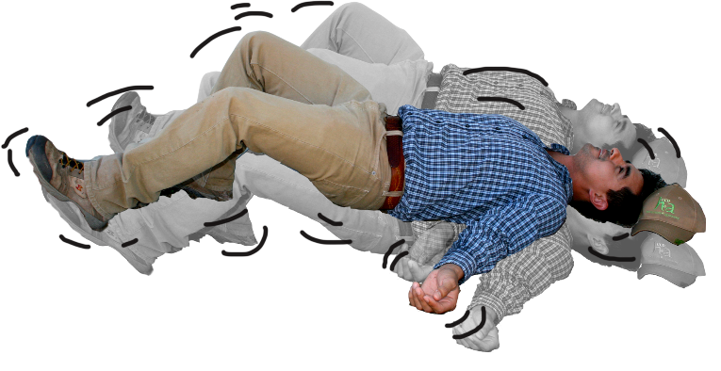
Severe Symptoms
Pinpoint pupils
Trembling, lack of muscle control
Violent convulsions or seizures
Notes:
Information required to be covered:
Severe symptoms include:
Pinpoint pupils
Trembling, lack of muscle control
Violent convulsions or seizures
Unconsciousness or death

Slide 25
The Type and Severity of Symptoms Depend on:
The pesticide
The route of exposure
The length of exposure
How often you are exposed
Age of the person
Health of the person
Notes:
Information required to be covered:
The probability that pesticides will affect your health depends on various things:
The type of pesticide
Poisoning symptoms vary among classes of pesticides and pesticides within a class. For example, pesticides that control weeds (herbicides) can be less toxic than some pesticides used to control insects (insecticides), but some insecticides are more toxic than others.
One pesticide may cause only mild eye irritation if splashed in a person’s eye, while exposure to another product may result in blurred vision. Some pesticides are extremely toxic if swallowed but not harmful if inhaled. Finally, there are also pesticides that, when used correctly and according to the safety measures listed on the label, cause no known adverse health effects.
The amount of pesticide that you are exposed to
The severity of symptoms is usually proportional to the amount of pesticide (dosage) entering the person’s body.
The type and severity of exposure symptoms can also be influenced by the amount absorbed into the body or how fast the body absorbs and excretes it.
Age and health of the person
The severity of symptoms is related to the person’s sensitivity to certain chemical ingredients.
Another factor that can significantly influence the type and severity of reaction to pesticide exposure is the overall health and genetic makeup of the individual. Each person is different. People who are elderly, sick or who have compromised immune systems may not have sufficient resistance to some types of pesticides.
People who have medical conditions such as asthma may experience breathing difficulties when working in an area where pesticides have been applied even after the restricted-entry interval (REI) has expired.

Slide 26
Potential Hazards
Notes:
Pesticides and their residues present potential hazards to workers, handlers, and other people.

Slide 27
Hazards to Children and Pregnant Women
Pregnant women
Miscarriage
Birth defects
Children
Still small
Still developing
Notes:
Information required to be covered:
Pesticide exposure can be extremely hazardous for pregnant women and may result in miscarriage or cause harm to their unborn child.
Children are also susceptible to the effects of pesticides as their bodies are small and their internal organs are still developing and may be negatively impacted by exposure.
For this reason all agricultural employees who work directly with pesticides (pesticide handlers) or in an area still under a restricted-entry interval (early-entry workers) must be at least 18 years old.

Slide 28
Potential Hazards from Pesticides
1. Acute
2. Chronic
Short-term
Symptoms appear shortly after exposure
Single exposure
Mild to serious illnesses
Long-term
Symptoms appear months or years later
Repeated exposures to a small dose
Mostly causes serious illnesses
3. Delayed effects
Notes:
Information required to be covered:
You might experience immediate (acute) and long-term (chronic) health effects if you are exposed to some types of pesticides, depending on the dosage.
The onset of acute illness or injury occurs shortly after exposure. These acute illnesses or injuries can be serious, and could cause days off work or treatment by a doctor. In most cases, acute effects are resolved relatively quickly and the exposed person fully recovers.
Long-term or chronic effects are illnesses or injuries that persist over long periods. They may result from a single exposure incident involving an extremely toxic or a large amount of pesticide or be caused by many repeated exposures at a level that is too low to produce noticeable immediate illnesses or injury.
Delayed effects are health effects that appear after a couple of hours to days from exposure. These are not chronic health effects which can take months to years to develop (i.e., cancer). However, delayed effects can appear as symptoms that were described in short-term and long-term effects.

Slide 29
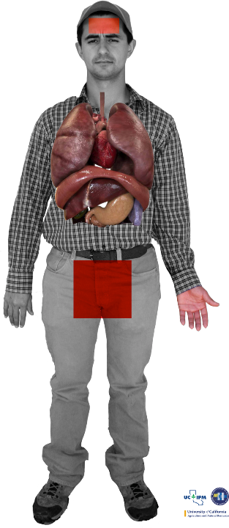
Chronic Pesticide Hazards
Cancer
Fertility problems
Respiratory illness
Nervous system disorders
Birth defects
Immune system disorders
Image credit: Sarah Risorto, UC Statewide IPM Program
Notes:
Information required to be covered:
Long-term health effects associated with exposure to certain pesticides include: cancer, inability to become pregnant (infertility), spontaneous abortion, birth defects in the children of exposed parents, nervous system damage, damage to specific organs such as the lungs or liver and damage to the immune system among other conditions.
Notes for trainers of workers and pesticide handlers:
Take for example, Miguel, pictured here. Each of the colored dots on Miguel’s body represents a low level of exposure to pesticide residues, that could have been avoided if Miguel did a better job of protecting himself. Washing up when he left the treated area to get his lunch or make a call, washing after work, and wearing clean clothes that cover his skin could reduce his exposure.
Each day you go to work, you encounter pesticide residues in the dust beneath your feet. It sticks to the bottom of your shoes and to the legs of your pants.
So little by little pesticide residues enter your body.
Each time you are exposed to a pesticide you absorb residues. The first time you might not feel any effect, but as your body absorbs more and more residues you can become sick.
Remember the saying: “little by little the jug is full” or in Spanish, “de poquito en poquito, se llena el jarrito”? This is how over the long term, you can end up with high levels of pesticides in your body.
Repeated contact with residues can lead to pesticide poisoning.
In these situations, the health effects can take years to appear. This is because small doses of different pesticides enter your body at different times and are absorbed into your internal organs.

Slide 30
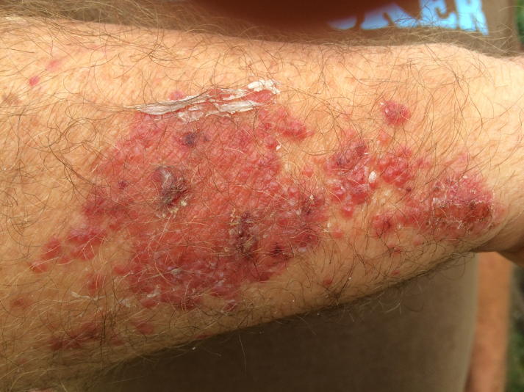
Sensitization
Not overexposure or poisoning
Allergic reaction that develops over time
Skin irritation
Respiratory problems
Image credit: Metere Pinker and Mark Morrison
Notes:
Information required to be covered:
Sensitization is the gradual development of an allergic reaction to a type of pesticide or chemicals in general. Some people get headaches, rashes, or experience dizziness each time they work with a pesticide or enter an area where pesticides were recently used.
Sometimes, even if you protect yourself you can become more sensitive to pesticides. You can start having an allergic reaction. Maybe you had no reaction to pesticides when you began working in the field, but over time you do.
Most commonly, increased sensitivity causes skin irritation or respiratory problems.
Notes for trainers of workers and pesticide handlers:
Agricultural workers and pesticide handlers may better understand sensitization if it is compared to an allergic reaction to poison oak or poison ivy. Not everyone will have an adverse skin reaction the first few times they come in contact with the plants. However, after repeated exposures some people will become sensitized and develop a rash that becomes worse with each additional exposure.
Sensitivity to pesticides is not the same thing as overexposure to pesticides. It is important to identify the causes of your symptoms so you know how to treat them.
Becoming sensitive to pesticides can take months or years depending on the person and the type of pesticide to which they are exposed.
Skin irritation means itchiness, redness, pain, or skin blisters when you come into contact with pesticide residues.
Respiratory problems mean sneezing, coughing, shortness of breath, difficulty breathing, even full asthma attacks.
If you notice you are more sensitive to pesticides, let your supervisor know. There are some steps you can take to protect yourself, like wearing a respirator or protective gloves.
Most people don’t develop allergies to pesticides, however all of us need to be careful.

Slide 31
Ways to Reduce Pesticide Exposure
Notes:
The WPS offers ways to reduce pesticide exposure.

Slide 32
Using Protective Clothing
Remember to use work clothes and/or personal protective equipment that protect your skin
Keep out of areas indicated by your supervisor
Leave the area if pesticides are carried towards the area where you are working
Wash with soap and water after working and before eating, chewing tobacco or using the bathroom and before any physical contact with your family
Notes:
Information required to be covered:
You should use clothes (e.g., long sleeve shirt, long pants, shoes plus socks and a hat) that protect your skin when working in treated areas.
You should stay away from areas indicated by your supervisor or that are being treated with pesticides.
If you feel you are being drifted on, you must inform your supervisor and leave the area immediately .
You should wash with soap and water after working in fields that have been treated with pesticides before you put anything in your mouth and before you use the bathroom.

Slide 33
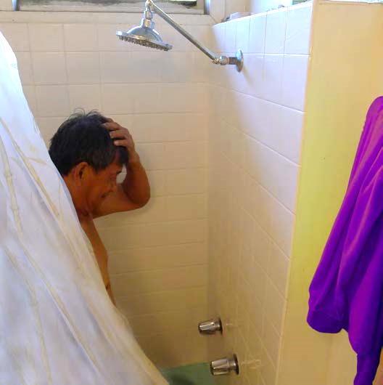
Wash and Change into Clean Clothes
Wash or shower with soap and water and shampoo hair as soon as you can after working with or in areas treated with pesticides.
Change into clean clothes after washing
Image credit: James Hollyer, Associate Director for Extension, University of Guam
Notes:
Information required to be covered:
Wash your body with plenty of soap and water and shampoo your hair as soon as you can after applying pesticides or working in treated fields.
Change into clean clothes after washing.

Slide 34
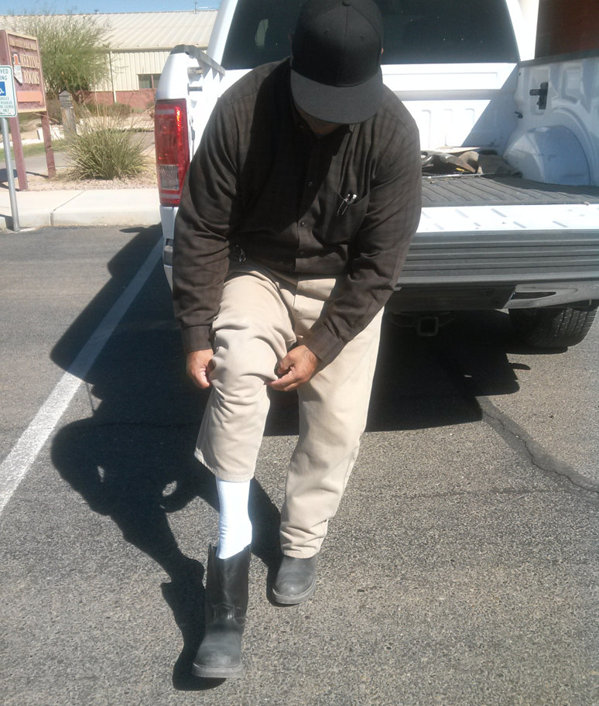
After Working in Pesticide Treated Areas
Remove work boots or shoes before entering your home
Remove work clothes and wash or shower before physical contact with children or family members
Image credit: Jennifer Weber, Arizona Department of Agriculture
Notes:
Information required to be covered:
Remove contaminated work boots or shoes before entering your home –significant amounts of pesticide can be carried in work boots and shoes, especially those worn by pesticide handlers. It is highly recommended to remove them before entering vehicles and entering your home.
Remove work clothes and shower before having physical contact with children and other family members.
If there are shower facilities at work, you should take a shower before leaving the work area.

Slide 35
Reduce Pesticide Residue on Clothing
Wear work clothes only once
Put work clothes in a plastic bag after use
Notes:
Information required to be covered:
Pesticide residues that remain on work clothing (such as long pants, long sleeve shirts, shoes, and socks) can be another source of hazard.
You can reduce your risk of exposure to these residues by:
Wearing clothing only once and have at least two sets of work clothes to avoid wearing potentially contaminated clothes before they are washed.
Keeping work clothes that may contain residues separate from other clothing (by putting it into a plastic bag, for instance) to prevent others from coming in contact with them.

Slide 36
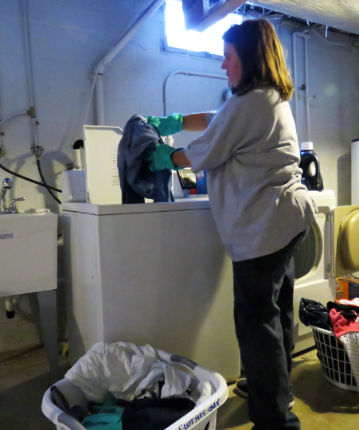
Wash Work Clothes
Wash work clothes before wearing them again
Wash work clothing separate from family laundry
Use hot water
Decontaminate washing machine
Image credit: Ed Crow, Penn State Pesticide Education Program
Notes:
Information required to be covered:
Pesticide residues that remain on clothing can be a source of pesticide exposure for you and your family. There are several ways you can avoid these hazards:
Inform those who wash agricultural work clothing that the clothes may contain pesticide residues and provide them with steps to protect themselves.
Wash work clothes after each use.
Wash work clothes separately from other clothing.
Use hot water for work clothing.
Decontaminate the washing machine by running another full wash cycle with hot water and detergent to remove any remaining pesticide residues from the machine.
Dry laundry outside in the sun to further break down pesticide residues left on the clothes.

Slide 37
Do Not Take Pesticides or Pesticide Containers Used at Work to your Home
Never take pesticides or pesticide containers home – they may contain pesticide residues that may harm you and/or your family
Typically pesticides used in agriculture are not to be used at home
Notes:
Information required to be covered:
Never take any pesticide from work because they are not safe for use around the home.
Never take any pesticide containers home, even empty ones. Pesticide containers are never completely free of pesticide residue and can never be safely used for any other purpose.
Agricultural pesticides, for the most part, are more concentrated and should never be used at home.
Do not pour pesticides from their original containers into drinking containers - Pouring pesticides from their original container into drinking containers is dangerous and illegal. Some unsuspecting person can mistake it for something edible.
Notes for trainers of workers and pesticide handlers:
Pesticide poisoning can happen when someone accidentally eats or drinks a pesticide that has been placed into a food or beverage container or drinks from a container that has been used to measure pesticides. Storing or mixing pesticides in food containers is illegal!
Avoid bringing pesticide residues home – it could be very complicated to get rid of them once they are inside.
Avoid contaminating vehicles with pesticides or pesticide residues – Handlers can transport significant amounts of pesticides in their work shoes that can heavily contaminate their vehicles. Workers can transfer pesticide residues to their vehicles from contaminated work clothes.
Handlers – Do not carry contaminated PPE in vehicles or take it home.

Slide 38
Keep Children and Family Members Away from Pesticide Treated Areas
Keep children out of places where pesticides may be found
Nonworking family members should not enter into pesticide treated areas
At home – keep pesticide out of reach of children
Image credit: Ashley Estes, Arizona Department of Agriculture
Notes:
Information required to be covered:
Do not allow minor children to enter into pesticide treated areas
Nonworking family members should stay out of areas under a restricted-entry interval or areas that have been recently treated with pesticides.
At home, keep pesticides out of reach of children

Slide 39
Decontamination and First Aid
Notes:
It is important to understand how to minimize exposure to pesticides and their residues and how to respond if an emergency occurs.

Slide 40
What is Decontamination?
Routine Decontamination
Emergency Decontamination
Cleansing face, hands or the entire human body to minimize exposure to pesticide residues
Removing pesticides from eyes, skin or clothes during emergency situations
Notes:
Information required to be covered:
Decontamination is the process of cleansing your body, clothing, personal protective equipment, and the application equipment in order to remove pesticides or pesticide residues.
There are two types of decontamination: routine decontamination and emergency decontamination.
Routine decontamination is the process of cleansing your face, hands or your entire body to minimize exposure to pesticide residues. Washing your hands with soap and water before eating or going to the bathroom, and washing reusable personal protective equipment and the application equipment are examples of routine decontamination. Routine decontamination takes place at the end of the application or when taking a break.
Emergency decontamination is the process of removing pesticides from your eyes, skin and/or clothes during emergency situations as soon as possible after exposure to avoid adverse health effects. For example, if you get drifted on, you should wash, as soon as possible, your skin with soap and water to prevent pesticides from being absorbed and getting into your body. To remove pesticide from your eye, hold the eyelid open and wash with a gentle drip of clean running water for at least 15 minutes.
Notes for trainers of workers and pesticide handlers:
Make sure you cover the following item during this portion of the training:
How to carry out routine and emergency decontamination, including emergency eye flush techniques.

Slide 41
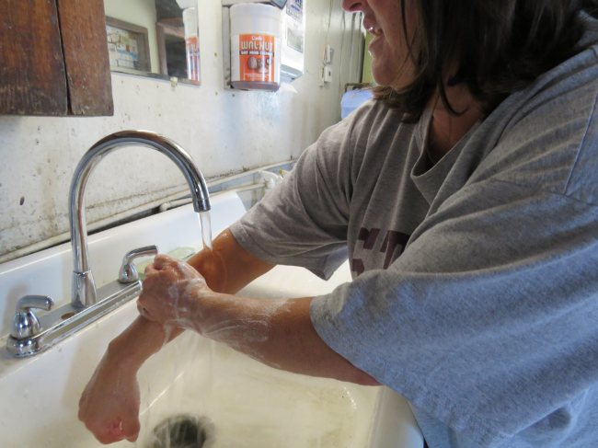
Agricultural Workers Routine Decontamination
Wash hands before eating, drinking, smoking, using the bathroom; before touching eyes or mouth; and before getting into vehicles
Change into clean clothes and shoes
Shower or bathe
Image credit: Ed Crow, Penn State Pesticide Education Program
Notes:
Information required to be covered:
There are several things that workers can do as part of their daily routine to minimize exposing themselves and their families to pesticides and pesticide residues. These include:
Washing their hands before eating, drinking, smoking, or using the bathroom while at work.
Washing their hands before touching their eyes or mouth while they are working.
Washing their hands after work and before getting into their vehicles.
Changing into clean clothes and shoes before getting into their vehicles to drive back home.
Showering or bathing, using soap and water and shampooing hair immediately as soon as possible after work.
Washing their work clothes separately from other clothes before wearing them again.

Slide 42
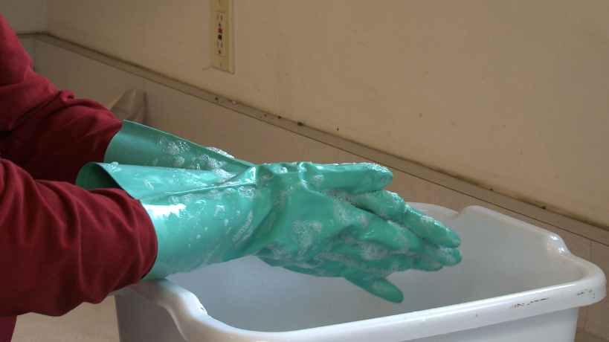
Pesticide Handlers Routine Decontamination
Follow routine procedures for workers
Decontaminate pesticide application equipment
Decontaminate re-usable personal protective equipment (PPE)
Image credit: Betsy Buffington, Iowa State University
Notes:
Information required to be covered:
You should follow all routine decontamination procedures for agricultural workers (see previous slide). In addition, you should decontaminate pesticide application equipment and re-usable personal protective equipment (PPE).

Slide 43
Emergency Decontamination Procedures For Skin Exposure
Remove any PPE as quickly as possible or remove contaminated clothing as quickly as possible
Rinse the pesticide from the skin immediately with clean water
Wash with soap and water and shampoo hair as soon as possible
Put on clean, uncontaminated clothes
Report to supervisor or person in charge
Get medical care immediately if symptoms of pesticide poisoning develop or are suspected
Notes:
Information required to be covered:
Emergency decontamination for skin exposure
Remove any PPE as quickly as possible or remove contaminated clothing as quickly as possible.
Rinse the pesticide from your skin immediately with clean water. Use decontamination supplies to wash immediately or rinse off in the nearest clean water, including springs, streams, lakes or other sources if more readily available than decontamination supplies.
Wash with soap and water and shampoo hair as soon as possible.
Put on clean, uncontaminated clothes.
Report to your supervisor or person in charge
Get medical care immediately if symptoms of pesticide poisoning develop or are suspected.
Notes for trainers of workers and pesticide handlers:
If pesticides are spilled or sprayed on the body, workers and handlers must be trained to use decontamination supplies to wash immediately. Emergency decontamination procedures are extremely important because they will help reduce the severity of the injury in case of exposure.
Important Change to the Rule: EPA has removed from the regulatory text the provision that allows employers to permit workers and handlers to use clean water from springs, streams, lakes or other sources if that water is more accessible in remote locations where the decontamination supplies are farther than one-quarter mile from where workers and handlers are working. Removal of this provision does not prohibit the practice of allowing workers or handlers to use clean water from springs, streams, lakes, or other sources to decontaminate if such water is closer than the provided decontamination supplies, but it removes the responsibility from the employer to ensure that such water meets the standard of being of a quality and temperature that will not cause illness or injury if it contacts the skin or eyes or if it is swallowed. Under the final rule, when workers or handlers are performing tasks at remote sites more than one-quarter mile from the nearest point of vehicular access, employers must provide all required decontamination supplies (soap, single-use towels, and water, plus clean change of clothing if required) at the nearest point of vehicular access. Employers are required to make the decontamination supplies available as close as possible to the remote site (as determined by how close a vehicle can get) but employers do not have to check or confirm that water from springs, streams, lakes or other sources at remote sites meets the standard of being of a quality and temperature that will not cause illness or injury.

Slide 44
Safety Data Sheets
Provide information about the pesticide product
Refer to the SDS if there is an exposure
SDS for all pesticides used on the establishment are located at central location
SDS should match up with the pesticide application records
Notes:
Information required to be covered:
The purpose of the safety data sheet (SDS) is to provide information about chemical and physical hazards, toxicity, first aid, PPE, emergency medical treatment and other information about the pesticides used on the establishment that you might come in contact with.
You should refer to safety data sheets if there is an exposure.
You should also note that there are details about the environmental hazards and safety precautions for handling, storing, and transporting the pesticide.
Employers should display SDS’s for all pesticides used on the establishment at the central location and available during normal working hours.
SDS’s should match up with pesticide application records.
Notes for trainers of workers and pesticide handlers:
Ensure workers and pesticide handlers understand what a SDS is and its purpose.
It is the responsibility of the employer to do all the following:
Display SDS’s for all pesticides used on the establishment. Copies of the SDS’s used on the establishment must be displayed at a central location on an agricultural establishment that is readily accessible at all times during normal work hours and can be easily seen and read by workers and handlers. Usually this is a location where employees congregate such as where they check in or out of work, change clothes, eat, etc.
Provide workers and handlers information about location of the SDS’s on the establishment
Provide workers and handlers unimpeded access to SDS’s during normal working hours.

Slide 45
How and When to Obtain Emergency Medical Care
Seek medical attention immediately
Employer will provide transportation
Image credit: Jennifer Weber, Arizona Department of Agriculture
Notes:
Information required to be covered:
You should seek medical attention as soon as possible if you believe you have been poisoned, injured, or made ill by pesticides.
The name, address and telephone number of a nearby medical care facility capable of providing emergency medical treatment is listed at the central location
The agricultural employer will provide transportation. They can “make transportation available” by: taking you to the medical care facility, by calling an emergency vehicle, such as an ambulance, or by making sure you have a ride to the medical care facility with someone else.

Slide 46
First Aid for Skin Exposure
Help the victim to:
Remove contaminated PPE or contaminated clothing
Rinse with water
Wash with plenty of soap and water
Image credit: Jennifer Weber, Arizona Department of Agriculture
Notes:
Information required to be covered:
If pesticide gets on your skin, the faster the chemical is washed off, the more minor the injury. The following steps should be taken in the event of a skin exposure:
Remove clothing and PPE carefully but as quickly as possible. Try to limit contact with the skin.
Rinse skin
Cleanse skin and hair thoroughly with soap and water
Dry and cover the victim with any clean item available
If there is a chemical skin burn avoid using ointments, lotions, powders, and other drugs in first aid treatments of burns, and
Get medical attention if necessary.
You should refer to the SDS for information about first aid instructions and potential symptoms if there is an exposure.
Notes for trainers of workers and pesticide handlers:
Both agricultural workers and pesticide handlers need to know about the correct first aid procedures for pesticide injuries or poisoning. There are some things workers can do immediately to lessen a potential injury before the person (victim) is taken to the medical facility.

Slide 47
First Aid for Eye Exposure
Help the victim to:
Immediately, using a gentle stream of water, flush the eye
Keep the eye open and as wide as possible while flushing
Continue flushing for at least 15+ minutes
Report to supervisor and get medical attention
Image credit: Chazzbo Media
Notes:
Information required to be covered:
If pesticide gets into someone’s eye, help the victim to:
Rinse the eye gently with clean water.
Hold the eye under a shower, or pour water into the eye using a clean water container. Keep the eye open and as wide as possible while flushing. Continue flushing for at least 15 minutes.
Report to supervisor or person in charge.
Seek immediate medical treatment after flushing.
You should refer to the SDS for information about first aid instructions and potential symptoms if there is an exposure.
Notes for trainers of workers and pesticide handlers:
Workers and handlers need to know how to assist a person if pesticides get into his or her eyes. Knowing what to do for an eye emergency can save valuable time and possibly prevent vision loss.
If a contact lens is in the eye, begin flushing over the lens immediately. Then, if possible, help the victim remove the lens. Lens might hold the chemical against the cornea. The person providing first aid must make sure the water is not too hot or have a temperature that might cause further damage to the eye tissue. The water flow must be gentle.
The person’s head must be turned so that the affected eye is lower than the unaffected one. This will keep contaminated water from getting into the other eye.
Never add any kind of medicine or substance to the eye rinsing water, nor administer any substance or lotion to the victim after rinsing.
DO NOT bandage the eye.

Slide 48
First Aid for Inhalation Exposure
Move the exposed person into fresh air
Loosen tight clothing
Keep air passages clear
Perform artificial respiration if necessary
Get medical attention as soon as possible
Notes:
Information required to be covered:
If a person has inhaled pesticides, the first aid responder should:
Before rescuing anyone from a closed area, make sure that you do not expose yourself to the same danger. Wear the appropriate protective equipment.
Move the person to fresh air.
Loosen any clothing that makes breathing difficult.
Give mouth to mouth resuscitation if the person is not breathing. Only a person trained in CPR should give mouth to mouth.
Get medical attention for the victim.
You should refer to the SDS for information about first aid instructions and potential symptoms if there is an exposure.
Notes for trainers of workers and pesticide handlers:
Make sure that both workers and handlers understand that before rescuing anyone, the first aid responder must be wearing the appropriate PPE to avoid putting himself at risk.

Slide 49
First Aid for Oral Exposure
Never induce vomiting if the person is not fully conscious, or suffering convulsions
Never induce vomiting without specific instructions from the label or a medical professional
Get person to a medical facility as quickly as possible
Image credit: Ed Crow, Penn State Pesticide Education Program
Notes:
Information required to be covered:
Never induce vomiting if the victim is unconscious, suffering convulsions, or lying face up.
Some products have ingredients that make regurgitation worse, so check the label or SDS before proceeding. The label and/or SDS should have information about whether to induce vomiting.
Always read the label or call the poison control center.
Get medical attention for the victim.
You should refer to the SDS for information about first aid instructions and potential symptoms if there is an exposure.
Notes for trainers of workers and pesticide handlers:
The most important decision a worker or handler providing first aid needs to make when a person has swallowed pesticides is whether or not to induce vomiting. The victim’s life may depend on this decision; therefore, it must be made accurately.

Slide 50
Your Employer’s Responsibilities
Notes:
Your employer must provide you specific protections under the WPS.

Slide 51
Employer’s WPS Responsibilities
It is your employer’s responsibility to make sure you get annual pesticide safety training before you begin your work to remind you of the basic steps you can take to protect yourself, your family and other people and the environment from pesticides that can cause harm
Notes:
Information required to be covered:
It is your employer’s responsibility to make sure you get annual pesticide safety training before you begin your work to remind you of the basic steps you can take to protect yourself, your family and other people and the environment from pesticides that can cause harm.

Slide 52
Pesticide Safety Training
Annual training is required
Training must be provided to a
Worker before starting work in a treated area
Handler before performing any handling task
You can ask for a record of the training
Notes:
Information required to be covered:
Pesticide safety training has to be given to you every year and you can ask your employer for a copy of the training record to give to your next employer to show you have had training in the year. The training will remind you of the steps you can take to protect yourself and your family.
Notes for trainers of workers and pesticide handlers:
The safety training reminds workers and handlers that by paying attention to warnings about application and treated areas, using the supplies provided to wash after being in an area where pesticides have been used, and being careful to wash up when they get home, they can minimize their routine exposure to pesticides.
WPS training is not required for licensed/certified crop advisors who are licensed/certified by a program acknowledged as appropriate by EPA, a state or tribe.

Slide 53
Employer’s WPS Responsibilities
Your employer needs to provide pesticide application and hazard information, for you to refer to if you wish to know about pesticides used on the establishment, what kinds of risks those pesticides pose, and where those restrictions on entry into an area are on the establishment
Notes:
Information required to be covered:
Your employer needs to provide pesticide application and hazard information, for you to refer to if you wish to know about pesticides used on the establishment, what kinds of risks those pesticides pose, and where those restrictions on entry into an area are on the establishment.
Hazard information is in the form of SDS.

Slide 54
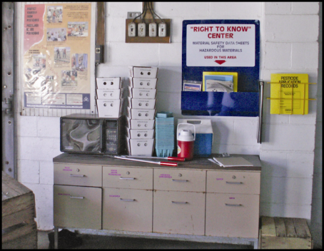
Pesticide Safety Information
Pesticide safety information must be displayed at:
Central location
Permanent decontamination supply sites
Other decontamination locations where supplies are provided for 11 or more workers
Image credit: Ed Crow, Penn State Pesticide Education Program
Notes:
Information required to be covered:
Pesticide safety information must be displayed at Central Location and also at certain places where decontamination supplies must be provided on the agricultural establishment according to the rule; specifically when the decontamination supplies are located at permanent sites or being provided at locations and in quantities to meet the requirements for 11 or more workers.
The central location is a good source of information about areas that have been treated, so you can see what was used and how long you should stay out of the area.
The pesticide safety information has traditionally been in the form of a pesticide safety poster (Far upper left in image).
Information can be displayed in any format but must be conveyed in a manner that you can understand.
The safety information poster is a reminder of the correct ways for you to limit your exposure, by washing up and avoiding areas that have been treated.
There is also a medical facility listed on the poster that you can contact if someone is made sick. You should be familiar with medical facility information so you can act if you, or another worker, becomes ill.
A new poster will be developed by January 2, 2018.
Beginning in January 2018 the poster will include the name, address and phone number of the state or tribal regulatory agency. You can use this information to report suspected violations.

Slide 55
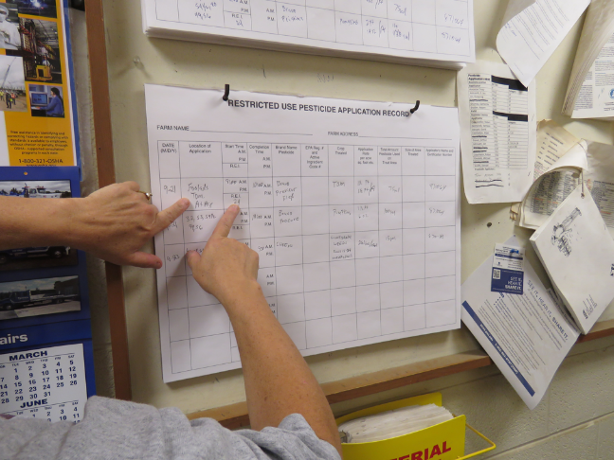
Pesticide Application Information and Safety Data Sheets
Name, EPA registration number and active ingredient
Crop or site treated and location and a description of treated area
Date(s) and times the pesticide application started and ended
Duration of the restricted-entry interval (REI) for that application
A copy of the safety data sheet (SDS)
Image credit: Ed Crow, Penn State Pesticide Education Program
Notes:
Information required to be covered:
If you are unsure of what areas are prohibited for entry, you can refer to the application information to know where there is an REI in effect and what pesticide was used.
You can use the pesticide name to look up its health hazards in the safety data sheets (SDS) that will be located there as well.
It is important for you to know where the EPA registration number is – if someone is made sick, and they are taken to a medical facility, the registration number of the pesticide is very helpful to the doctor to know more about what they may have been exposed to.
Employers must display specific pesticide application information at a central location such as a break room or common gathering area that is accessible to all employees during their work hours.
Notes for trainers of workers and pesticide handlers:
The application information will tell workers and handlers:
where treated areas are located, and how long they should stay out of them,
what was applied, and
that the application information and the SDS can tell workers and handlers what risks from pesticides may be present to their health.
This information will enable workers and handlers to avoid areas that are being treated with pesticides or still under a REI.
The information can be displayed in any format as long as it is legible, accessible to all employees and contains:
The product name, EPA registration number, and active ingredient(s) of the pesticide
The crop or site treated and the location and description of the treated area(s)
The dates and times of the pesticide application
The time that the application was completed
The duration of the REI for that application
A copy of the SDS
The employer must display application information and SDS at central location within 24 hours of end of application and before workers enter that treated area; display both for 30 days after the REI expires; and keep application information and SDS records for 2 years from end of REI.

Slide 56
Employer’s WPS Responsibilities
You can ask your employer for a copy of the application information and the safety data sheets, or you may designate a representative to ask on your behalf. The designation of a representative must be in writing
Notes:
Information required to be covered:
You can ask your employer for a copy of the application information and the safety data sheets, or you may designate a representative to ask for on your behalf. The designation of a representative must be in writing.

Slide 57
Requesting Pesticide Application Information and Safety Data Sheets
You can request the pesticide application and SDS from your employer, or you may designate a representative to do so on your behalf
A treating medical person can also request access to or a copy of the application information and SDS
Notes:
Information required to be covered:
You can also request records yourself, through medical personnel or through a designated representative. A designated representative is a person, chosen, by a worker, who can request and obtain a copy of the pesticide application and Safety Data Sheets on your behalf.
Notes for trainers of workers and pesticide handlers:
The designated representative must be designated in writing.

Slide 58
Employer’s WPS Responsibilities
Your employer must tell you where the central location is and where the decontamination supplies are on the establishment
Notes:
Information required to be covered:
Your employer must tell you where the central location is and where the decontamination supplies are on the establishment.

Slide 59
Other Employer Responsibilities in Relation to Pesticide Information
Employers must inform you where the pesticide safety, application and hazard information is located
You must have unrestricted access to the posted information
Notes:
Information required to be covered:
Employers must inform you where the pesticide safety, application and hazard information is located .
You must have unrestricted access to the posted information.
Notes for trainers of workers and pesticide handlers:
The information is there for the worker’s and handler’s reference, so they need to know the location of the central display, and that the information should be current and clear

Slide 60
Employer’s WPS Responsibilities
The safety information display at the central location and at some places with supplies for washing up (decontamination supplies) is a reminder about the steps you can take to reduce exposures. It has the name and address of a nearby medical facility, in case of an emergency where you are made sick from a pesticide. In case you need to report a violation involving a pesticide, contact information for enforcement is on the display
Notes:
Information required to be covered:
The safety information display at the central location and at some places with supplies for washing up (decontamination supplies) is a reminder about the steps you can take to reduce exposures. It has the name and address of a nearby medical facility, in case of an emergency where you are made sick from a pesticide. In case you need to report a violation involving a pesticide, contact information for enforcement is on the display.

Slide 61
Employer’s WPS Responsibilities
The employer must provide water, soap, and towels near where you are working so you can wash up when you leave the work area, and if there is an accidental exposure like a spill, the supplies may be used in an emergency to remove pesticides and reduce their effect. If you are using products that require eye protection, or are under pressure, you must have access to water for emergency eye flushing, too
Notes:
Information required to be covered:
The employer must provide water, soap, and towels near where you are working so you can wash up when you leave the work area, and if there is an accidental exposure like a spill, the supplies may be used in an emergency to remove pesticides and reduce their effect. If you are using products that require eye protection, or are under pressure, you must have access to water for emergency eye flushing, too.

Slide 62
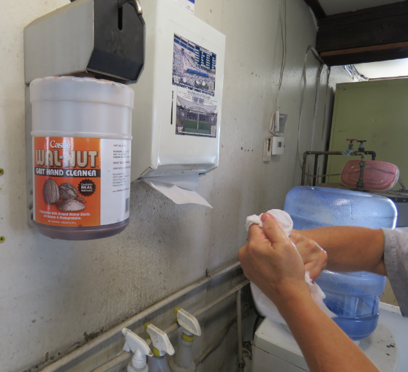
Decontamination Supplies for Agricultural Workers
Water
Soap
Single use towels
Image credit: Ed Crow, Penn State Pesticide Education Program
Notes:
Information required to be covered:
The agricultural employer must provide at least 1 gallon of water for each worker at the beginning of the work period,
and enough soap and single use towels for the workers’ needs.
The supplies must be near to the worker’s work location
Notes for trainers of workers and pesticide handlers:
Focus the training more on the need for workers to USE the decontamination supplies, emphasizing that the supplies are nearby for their use and health and safety. The consequences of not washing up can result in, at least, uncomfortable rashes.

Slide 63
Decontamination Supplies for Pesticide Handlers
Water
Soap
Single use towels
Clean change of clothes to be used in case the handler’s clothes or PPE become contaminated
Decontamination supplies must be located within ¼ mile of the pesticide handler, at mixing and loading site, and at the site where PPE is removed
Notes:
Information required to be covered:
The agricultural employer must provide:
Clean running water or at least 3 gallons of water for each handler,
Enough soap and single use towels for the workers’ needs, and
A clean change of clothes to be used in case the handler’s clothes or PPE become contaminated
The supplies must be located within ¼ mile of the pesticide handler, at mixing and loading site, and at the site where PPE is removed
Notes for trainers of workers and pesticide handlers:
Focus the training more on the need for handlers to USE the decontamination supplies, emphasizing that the supplies are nearby for their use and health and safety. The consequences of not washing up can result in, at least, uncomfortable rashes.

Slide 64
Decontamination Supplies for Pesticide Handlers
Emergency eye flushing station: a system or container of water that can provide a gentle stream to rinse the pesticide from the eye
Located at any site where handlers are mixing or loading a pesticide that requires protective eyewear or are using a closed system that is under pressure
Applicators using products that require protective eyewear must be provided a pint of water that they need to keep close by so they have ready access in case of an exposure to their eyes
Image credit: Ed Crow, Penn State Pesticide Education Program
Notes:
Information required to be covered:
Emergency eye flushing station: a system or container of water that can provide a gentle stream to rinse the pesticide from the eye.
Located at any site where handlers are mixing or loading a pesticide that requires protective eyewear or are using a closed system that is under pressure.
Applicators using products that require protective eyewear must be provided a pint of water that they need to keep close by so they have ready access in case of an exposure to their eyes.
Notes for trainers of workers and pesticide handlers:
Emphasize the urgency for getting pesticide out of the eye promptly, using the supplies that have to be provided if the product requires protection.

Slide 65
Employer’s WPS Responsibilities
If you are made sick, and pesticides may have been the cause, the employer needs to be told so he or she can make sure you are taken to a medical facility, and provide the medical personnel with information about the exposure
Notes:
Information required to be covered:
If you are made sick, and pesticides may have been the cause, the employer needs to be told so he can make sure you are taken to a medical facility, and provide the medical personnel with information about the exposure.

Slide 66
Provide Emergency Medical Assistance
If you have been made ill and it is reasonable to think it was from pesticides, you should:
Inform your employer, who must make transportation available to a medical facility
Get first aid, if there is time, but do not delay getting to medical personnel!
The employer needs to give this information to the medical personnel: the safety data sheet for the product, the name of the product, its registration number and active ingredients, and the circumstances of the use of the product and of the exposure
Notes:
Information required to be covered:
If you have been made ill and it is reasonable to think it was from pesticides, you should:
Inform your employer, who must make transportation available to a medical facility
Get first aid, if there is time, but do not delay getting to medical personnel!
The employer needs to give this information to the medical personnel: the SDS for the product, the name of the product, its registration number and active ingredients, and the circumstances of the use of the product and of the exposure.
Notes for trainers of workers and pesticide handlers:
Emphasize that, if a person is made ill, and it might be pesticides, they should tell their employer and get to medical attention immediately.
The employer can give the information directly to the medical staff or to the worker or handler to give to medical staff. But ultimately the employer is responsible for the information getting to the medical staff.

Slide 67
Employer’s WPS Responsibilities
Workers have to be notified by the employer of restrictions on areas where applications are taking place and where an REI is in effect. Those notifications may be in the form of oral warnings or the posted warning signs that will be around the treated area
Notes:
Information required to be covered:
Workers have to be notified by the employer of restrictions on areas where applications are taking place and where an REI is in effect. Those notifications may be in the form of oral warnings or the posted warning signs that will be around the treated area.

Slide 68
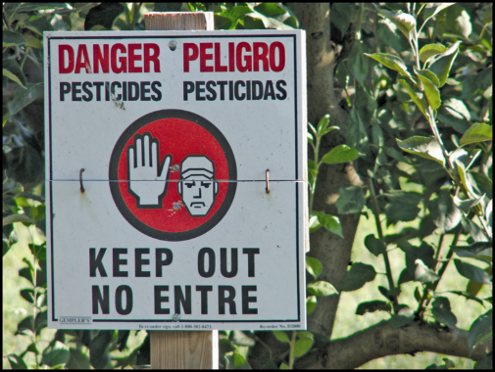
Recognize and Understand the Meaning of Posted Warning Signs
If you see this sign- or one similar to this one - Do Not Enter!
This sign means that there may be pesticides or pesticide residues present in the area
You need to receive training and special protection to enter those areas
Image credit: Chazzbo Media
Notes:
Information required to be covered:
Whenever you see this sign it means that the area is under a restricted-entry interval (REI) and pesticides may not have broken down/dissipated yet to safe levels.
Under certain circumstances, employers are required to post warning signs in pesticide treated areas to indicate the REI.
The REI is the amount of time that must pass after a pesticide application before it is safe for workers to enter the area without the proper training and protection.
During the REI, only appropriately-trained and equipped pesticide handlers and early-entry workers are allowed in the area.
Notes for trainers of workers and pesticide handlers:
Stress that, if workers see the sign, THEY SHOULD NOT ENTER THE AREA.

Slide 69
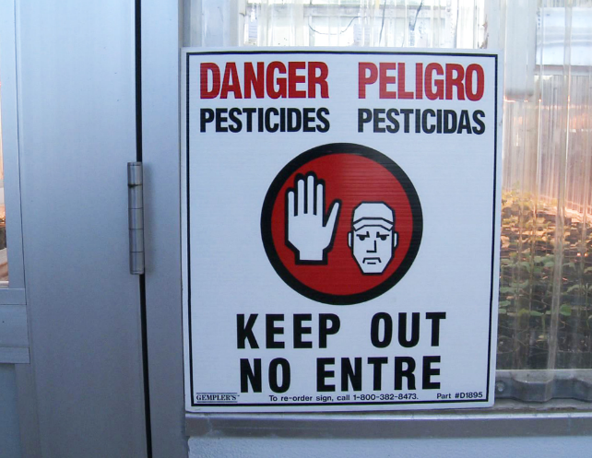
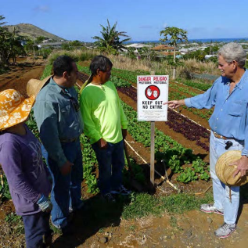
Follow Directions and/or Signs About Keeping Out of Pesticide Treated Areas
Workers must be notified by the employer of restrictions on areas where applications are taking place and where an REI is in effect
Notifications may be in the form of oral warnings or the posted warning sign that will be around the treated area
Image credits: Betsy Buffington, Iowa State University and James Hollyer, Associate Director for Extension, University of Guam
Notes:
Information required to be covered:
Your supervisor will post signs or notify you verbally about what areas are under a restricted-entry interval (REI).
The notification may be either oral or posted, and you should heed the signs because the area is still under the restricted-entry interval (REI).
Keep out of treated areas or areas being treated with pesticides.
Stay away from the application equipment during pesticide applications.
Even if the REI has expired, workers should not enter the treated area until the signs are covered or removed. BUT their employer may, in rare cases, direct workers to enter a treated area where the REI is still in effect (early entry) – but if that happens, they must get information about the pesticide that was used and its risks, information about how long they can stay in the area and what tasks they may do, and they probably would have to wear PPE.
Notes for trainers of workers and pesticide handlers:
Inform workers that they can refer to the application information in case they aren’t sure about an area.
Posting requirements are dependent on the label instructions and the length of the REI.
Ensure handlers know not to remove signs before the required time. Remind them that others may be exposed if they take the sign down too soon, and that workers are prohibited from entry (except for early entry) while signs are posted.
Workers and handlers must clearly understand the following information:
The significance of the posted signs
The importance of obeying oral and posted warnings
One of the possible ways workers may be exposed to pesticides is by entering into treated areas while the REI is still in effect. This may result from the employer failing to notify workers or to post a restricted area. It may also be the result of employers asking workers to enter into treated areas or workers disregarding posted signs or oral warnings.
Pesticide handlers should always communicate to their supervisor and worker crew supervisors about known effective REI’s and on-going pesticide applications.

Slide 70
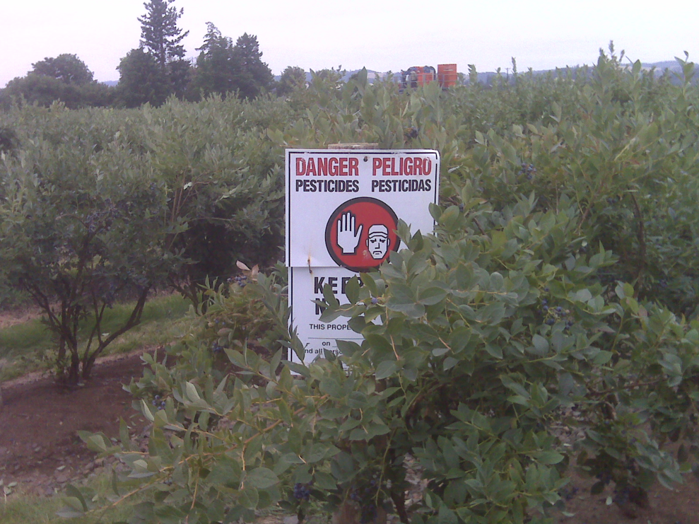
Posting Treated Areas
Required when applying a pesticide with an REI greater than:
48 hours in outdoor areas
4 hours in enclosed spaces
Posting is also mandatory when required by the label
Employer is responsible for checking the label for REI and posting requirements
Image credit: Betsy Buffington, Iowa State University
Notes:
Information required to be covered:
Field posting is required when apply a pesticide with an REI greater than 48 hours (outdoors) or 4 hours (enclosed spaces).
Field posting is also mandatory when required on the label.
The employer is responsible for checking the label for the REI and posting requirements. The employer must also make sure that the application area is posted if required. However, the employer may request that the handler assist with the responsibility.

Slide 71
Protections During Applications: Enclosed Space Production
Ensure that no pesticide contacts any workers and other persons directly or through drift
No worker entry to an enclosed space structure until the air concentration level specified on the label is met or, if no air concentration level is specified, until after proper ventilation criteria is met for certain types of applications
Notes:
Information required to be covered:
Ensure that no pesticide contacts any workers and other persons directly or through drift.
During a pesticide application in an enclosed space production, agricultural employers must not allow worker entry to an enclosed space structure until the air concentration level specified on the label is met or, if no air concentration level is specified, until after proper ventilation criteria is met for certain types of applications.
Notes for trainers of workers and pesticide handlers:
Emphasize that pesticide use in an enclosed space can concentrate pesticides, and that they should be very alert to signs or oral warnings.
Page 40, Table 1. Entry Restrictions During Enclosed Space Production Pesticide Applications in the How to Comply With the 2015 Revised Worker Protection Standard for Agricultural Pesticides manual, identifies the entry restrictions when applying pesticides for enclosed space production to ensure workers and other persons are not exposed to the pesticide(s) being applied. The restrictions depend on the types of pesticides or application methods used.
For example, if the pesticide is applied as a smoke, mist, or fog, the agricultural employer must keep workers and other people out of the entire enclosed space until air concentration levels or ventilation requirements are met. Then the agricultural employer must keep workers out of the entire enclosed space during the REI.
As another example, consider a pesticide that is applied as a spray with droplet sizes medium or larger. In this situation, the agricultural employer must keep workers and other people out of the treated area plus 25 feet in all directions (but not outside the enclosed space) until the application is complete. Then the agricultural employer must keep workers out of the treated area during the REI.

Slide 72
Protections During Applications: Outdoor Production
Pesticide handlers are prohibited from applying pesticides in a manner that will contact workers or other people, either directly or through drift
Drift can result in contact that can make you ill or contaminate your clothes worn home
If you feel drift contacting you, leave the area immediately and wash up as soon as is practical
Notes:
Information required to be covered:
You are prohibited from applying pesticides in a manner that will contact people (other than appropriately trained and equipped handlers involved in the application), either directly or through drift.
Drift is the movement of pesticide dust, spray or vapor away from the application site.
Drift can result in contact that can make you ill, or contaminate your clothes that you wear home.
If you feel drift is contacting you, you should leave the area immediately and wash up as soon as is practical.
Agricultural employers must make sure that no workers or other people are ‘near’ the application equipment during applications.
Notes for trainers of workers and pesticide handlers:
Emphasize that this protection is intended to help protect workers and handlers from spray drift and contact with pesticides.
Handler employer & handler must follow label statement like: “Do not apply this product in a way that will contact workers or other persons, either directly or through drift. Only protected handlers may be in the area during application.”

Slide 73
Reducing Hazards from Pesticide Drift
Pesticides have a greater potential to drift when they are applied through nozzles designed to deliver small droplets
Wind also plays an important role in the distance vapors or dust can travel
Application exclusion zones (AEZ) are intended to protect people from drift
Notes:
Information required to be covered:
Pesticides have a greater potential to drift when they are applied through nozzles designed to deliver small droplets.
Small droplets are light weight
Small droplets can be carried in the wind further than medium or coarse droplets which are heavier
Wind also plays an important role in the distance vapors or dust can travel. As the distance from the sprayer to the ground increases, so does the likelihood that pesticide vapors or dust will be impacted by any existing wind.
Application exclusion zones (AEZ) are intended to protect people from drift.

Slide 74
AEZs in Outdoor Areas
25’
100’
Applied:
Applied as a:
Applied:
Aerially
Air blast
Fine or smaller droplet size
Fumigant
Smoke
Mist
Fog
Medium or larger droplet size
>12” off ground
Notes:
Information required to be covered:
Application exclusion zones (AEZs) are areas around a pesticide application that should (a handler may determine, for example, that wind direction is such that the person within the AEZ will not be contacted) be free of all people other than trained and equipped handlers during pesticide applications. Application exclusion zones minimize the potential for workers and other people being contacted by the application, either directly or through drift.
Nearly all outdoor applications have an “application exclusion zone” or AEZ of 25 – 100 feet. The size of the zone depends on the type of application equipment used.
100 foot AEZ
Applied aerially, by air blast or spray applications using extremely fine, very fine, or fine droplet sizes
Applied as a fumigant, smoke, mist, or fog
25 foot AEZ
Applied other than 100 foot AEZ
Spray applications using medium, coarse, very coarse, extremely coarse, or ultra coarse droplet sizes
Sprayed from a height of more than 12 inches above the plant medium
No AEZ if applied otherwise.

Slide 75
Application Exclusion Zone in Outdoor Production
When the application is concluded, the AEZ no longer exists.
Field
AEZ
Spray Area
Treated Area
Notes:
Information required to be covered:
During an application, an agricultural employer must keep workers and other people (anyone other than equipped and trained handlers) out of the treated area or AEZ that is within the boundary of the establishment owner’s property.
For aerial, air blast, spray, fumigant, smoke, mist, or fog pesticide applications and for applications with droplet sizes that are fine or smaller in outdoor production (farm, forest, nurseries), everyone other than equipped and trained pesticide handlers must be kept at least 100 feet away from the pesticide application equipment. For other types of applications with spray droplet sizes that are medium or larger in outdoor production, the distance is 25 feet.
Notes for trainers of workers and pesticide handlers:
Explain that this requirement only applies within the boundaries of the establishment because the agricultural employer cannot be expected to control persons off the establishment.

Slide 76
AEZs on Field Borders
AEZ
Spray Area
EVALUATE!
Can you ask the workers to move somewhere else until you are done with the application?
Proceed with caution.
SUSPEND!
There are workers from the neighboring field in the AEZ!
When the application is finished the AEZ no longer exists.
Treated Area
Yes, they agreed to move!
Neighboring Field
Your Field
Notes:
Information required to be covered:
A handler must immediately suspend the application if a worker or other person (other than handler) is in AEZ.
Can continue with application when people move or after an assessment of the situation guarantee no drift to people off the establishment
Not limited to boundaries of agricultural establishment
One of the three requirements with a delayed compliance date (January, 2018) to allow for handlers to be trained on new content
Explain that the “suspend application” provision does apply beyond the boundaries of the establishment because the handler (applicator) and handler employer do have control over the pesticide application and are subject to a WPS requirement to apply the pesticide in a way that will not contact workers or other persons on or off the establishment.

Slide 77
Suspend Applications if People are in the AEZ
Handlers must suspend pesticide application if worker or other person is in AEZ
25’
Notes:
Information required to be covered:
As a handler, it is your responsibility to temporarily shut off the application equipment if workers or other people (not involved with the application) are in the AEZ. The handler should ask the workers on the same establishment to move until the application is no longer near them. You can also ask workers on neighboring establishments to move until he/she finishes treating the area near the neighbor. You can continue the application once no one is within the AEZ or certain other conditions are met.
Notes for trainers of pesticide handlers:
Tell handlers that agricultural workers should leave the AEZ immediately if they are working in an area where someone is applying a pesticide and/or a pesticide from a nearby application is drifting towards them.

Slide 78
Other WPS Topics
Employer responsibilities:
Provide records or other information required by the WPS for inspection to an employee of EPA or any duly authorized representative of a federal, state or tribal agency responsible for pesticide enforcement
Employers cannot punish you for attempting to comply with WPS
Workers and handlers:
Report suspected use violations
Notes:
Information required to be covered:
Employers must provide records or other information required by the WPS for inspection to an employee of EPA or any duly authorized representative of a federal, state or tribal agency responsible for pesticide enforcement
The WPS prohibits employers from retaliating against you by following the regulation. Examples of retaliation include preventing, discouraging, firing or otherwise discriminating against you from complying or attempting to comply with the WPS or for ensuring that the employer complies with the regulations. Furthermore, agricultural employers cannot retaliate against agricultural employees who provide information to the EPA, state, or tribal governmental agency.
Report suspected WPS violations. Contact information of your local regulatory agency must be available to you at the central location.
Notes for trainers of workers and pesticide handlers:
Emphasize to workers and handlers that the rule prohibits employers from taking retaliatory steps if the employee tries to do what the WPS says to protect themselves.

Slide 79
Pesticide Labels
Notes:
As a pesticide handler, you must understand how to read, understand, and follow a pesticide label.

Slide 80
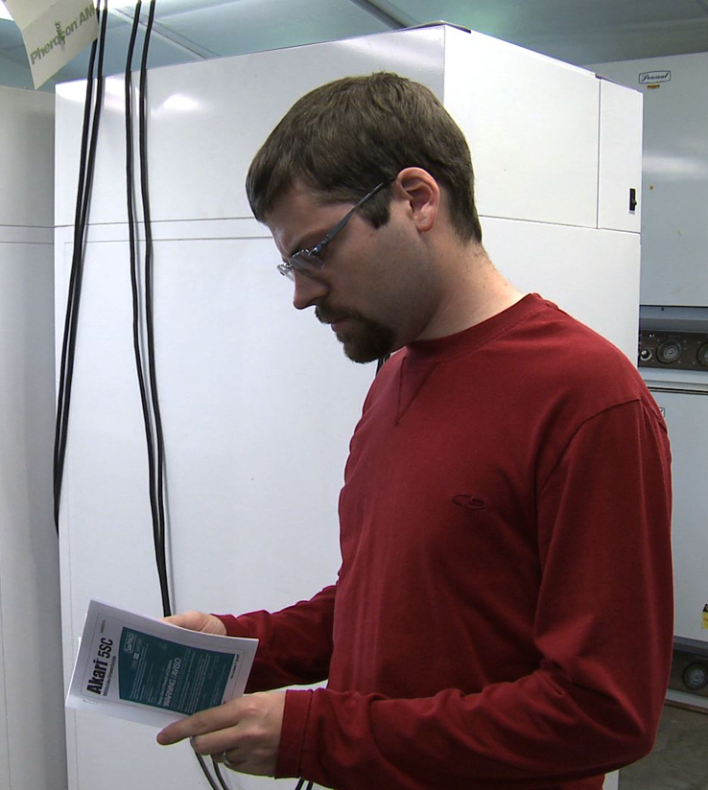
Pesticide Labels
Safety information
Legal use information
Image credit: Betsy Buffington, Iowa State University
Notes:
Information required to be covered:
The label is the most important part of the pesticide packaging. It contains information on how to use the product safely and effectively and lists the personal protective equipment (PPE) required when working with the pesticide. The label also includes details about the crops and areas to which the pesticide can be legally applied, the amounts to use, application methods, first aid instructions, and additional precautionary measures.
It is a violation of federal law to use a product in a manner inconsistent with its labeling.
You must follow the label. If you are not able to read the label, your employer must make sure that there is always someone available to explain the health, safety, and directions for use information to you.

Slide 81
Read the Label BEFORE:
Buying the pesticide
Mixing the pesticide
Applying the pesticide
Storing the pesticide
Disposing of the pesticide container
Image credit: UC Statewide IPM Program
Notes:
Information required to be covered:
It is very important that you read and refer to the label information in the following four situations:
Buying the pesticide or taking it out of the storage area to make sure you will be using the correct product. Many products have similar names, so you must take steps to be sure you are using the right pesticide. You should check to see the type of pest it controls and the crop or site to which it can be applied. This is also a good time to review the personal protective equipment (PPE) information to make sure that you have all of the required PPE or protective clothing that they need to wear when handling the product.
Mixing the pesticide to make sure that you understand the mixing instructions. Mixing is the most hazardous activity because you are working with the product in its most concentrated form. If the instructions and precautions are not clear, you should ask your employer or supervisor for clarification or to assist you.
Applying the pesticides to get instructions on how to apply it safely and details about the environmental hazards, first aid information and special precautions.
Storing the pesticide or disposing of the container to find specific instructions about temperature limits, potential fire hazards, environmental impacts, and guidelines for disposal.

Slide 82
Parts of the Pesticide Label
Image credit: UC Statewide IPM Program
Notes:
Information required to be covered:
The following section describes information typically found on pesticide labels. Most of the parts listed are found on all labels, but some, such as the common name of the pesticide, may be absent. Since labels do not follow a standardized format and are often difficult to read, it is useful to know what information you can expect to find when you read a label.

Slide 83
Brand Name
Commercial name
Notes:
Information required to be covered:
The brand name is the commercial name of the pesticide. It is usually the largest and most noticeable word on the front of the pesticide label.
Notes for trainers of pesticide handlers:
It is important that handlers understand that each pesticide product is different and they must read each label even if they have used a similar product. A pesticide handler who has used “GetUm 7” in the past may not take the time to read the “GetUm 7 Max” label, and miss the fact that the second “Max” product requires additional Personal Protective Equipment and has a longer restricted-entry interval.

Slide 84
Pesticide Manufacturer
Company that makes or distributes the pesticide
Notes:
Information required to be covered:
Often the manufacturer is the company that produces the pesticide. However, in some instances the name that appears on the label could be a company that purchased and packaged a pesticide product.
Notes for trainers of pesticide handlers:
The pesticide manufacturer can be a great resource for pesticide handlers and employers who may have questions about information listed on the label, the pesticide’s compatibility with other products, expiration dates, shelf life, and how to acquire additional copies of pesticide labels or safety data sheets.

Slide 85
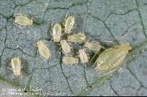
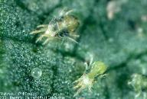
Pesticide Type
HERBICIDES
INSECTICIDES
RODENTICIDES
WEEDS/PLANTS
INSECTS
RODENTS
FUNGICIDES
ACARICIDES or MITICIDES
MOLLUSCICIDES
FUNGI/PLANT PATHOGENS
MITES
SLUGS and SNAILS
Image credits: UC Statewide IPM Program and UC Division of Agriculture and Natural Resources
Notes:
Information required to be covered:
Labels list the type of pesticide (i.e., insecticide, fungicide, rodenticide, herbicide, etc.) or the types of pests they control on the front page.
Notes for trainers of pesticide handlers:
Interestingly, pesticide safety trainers may find employers or pesticide handlers who claim, “We don’t use pesticides. We just use herbicides.” Trainers can explain that the word “pesticide” is the umbrella term that includes insecticides to control insects, herbicides to control weeds, rodenticides to control rodents, etc. The WPS training will provide them with information that will enable them to work safely and effectively with all types of agricultural pesticides.

Slide 86
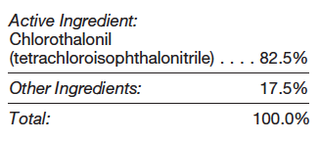
Ingredients
Active ingredient(s)
Other ingredients
Notes:
Information required to be covered:
The active ingredient is the ingredient that will perform the pest control activity. For example, it is the ingredient that will repel the mosquitoes or kill the weeds. It is the “poison.”
The other ingredients are additional ingredients in the container such as water, coloring agents, or ingredients that help the pesticide stick to the plant or more effectively control the pest. These used to be called “inert” ingredients.
Notes for trainers of pesticide handlers:
It is not uncommon for a pesticide handler to believe that the active ingredient is the ingredient with the highest percentage in the container. This is not always the case. You can clarify by defining “active” as the ingredient that will perform the pest control “action” or “activity.”
At this time, the actual names of the other ingredients are not listed on the labels. They are often listed as a percentage of the mixture or simply as “other ingredients.”

Slide 87
Pesticide Formulations
Liquid Formulations | Dry or Solid Formulations | Other Formulations
Emulsifiable concentrate (EC) | Dust (D) | Aerosol
Flowable (F) | Dry Flowable (DF) | Fogger
Liquid baits and gels | Wettable powder (WP) | Soil fumigant
Soluble liquids (SL) | Pellets (P) | Structural fumigant
Notes:
Information required to be covered:
The pesticide formulation is the mixture of active and other ingredients. Formulations are typically dry/solid, such as powders or granules, or liquids.
Notes for trainers of pesticide handlers:
The table pictured gives some examples of the different formulation types, with an example of some of the abbreviations (in parenthesis) used for them.
Some labels list the formulation, such as “pellets” on the front page of the label. Handlers can often gather information about the formulation by looking at the acronyms in a product’s name. For example, the “EC” in the product called “One ‘N’ Done EC” tells the handler that the product is an emulsifiable concentrate. The “DF” in the pesticide “FlyAway DF” indicates that it is a dry flowable. Unfortunately, not every pesticide label will contain the formulation listed on the front of the label or as an acronym in the product name. A pesticide handler may have to search for more information in the instructions for use section.

Slide 88
EPA Registration Number
Unique number
Important for pesticide emergencies
Notes:
Information required to be covered:
Once approved for use in the United States, the U.S. Environmental Protection Agency assigns a unique registration number to each pesticide product. The registration number can be very useful during a pesticide exposure situation. It gives medical personnel a way of identifying the product and enables them to gather additional details about the health effects, ingredients, first aid instructions and additional information for physicians.
Notes for trainers of pesticide handlers:
On the pesticide label, the registration number is often shortened to “EPA Reg. #”. It is not the same as the EPA Establishment number (shortened to “EPA Est. #”). Also if a state registers pesticides, the state registration number is not typically on the label, just the EPA registration number (this last part may only be pertinent in California).

Slide 89
Signal Words
I. Danger Poison
I. Peligro Veneno
Danger Poison
Danger
Warning
Caution
I. Danger
I. Peligro
II. Warning
II. Aviso
III. Caution
III. Precaución
Image credit: UC Statewide IPM Program
Notes:
Information required to be covered:
The signal words-CAUTION, WARNING, or DANGER tell you how likely the pesticide is to make you sick. Signal words are found on the first page of pesticide labels.
The word CAUTION is used for pesticides that are the least poisonous. These pesticides can still harm you if you are not careful.
A pesticide with the word WARNING is more poisonous or irritating than those with a CAUTION label. It doesn't take much of this pesticide to make you sick or to irritate your skin or eyes.
The word DANGER means that the pesticide is very poisonous or irritating. Even a small amount (often less than a teaspoon) can cause serious harm. The labels of the products that can severely burn your skin and eyes carry the signal word DANGER alone.
Along with the signal word DANGER, other labels have a skull and crossbones and the word POISON printed in red ink. These pesticides are highly poisonous. They can make you very sick-or even kill you-if you are not careful.
The labels of some lower-toxicity products may not have a signal word.
Notes for trainers of pesticide handlers:
Before a pesticide is approved for use in the U.S., the pesticide manufacturer must do a lot of research on the product, including studies on how acutely toxic it is to humans. The results of these studies determine the signal word that will be placed on the front page of the pesticide label. Many pesticides with CAUTION signal words may still be very toxic to fish, honeybees, desirable plants or beneficial organisms. Signal words do not provide information related to cancer or other long term effects.

Slide 90
First Aid
First aid for each route of exposure:
Eyes
Nose
Mouth
Skin
Notes:
Information required to be covered:
The first aid instructions for pesticide exposure are usually found on the first or second page of the label. Sometimes there are additional instructions for medical personnel included in the same section. First aid is typically given for each route of exposure (e.g., eyes, nose, mouth, skin).
Notes for trainers of pesticide handlers:
It is extremely important that pesticide handlers read the first aid section BEFORE exposure occurs so they will be prepared to respond to any pesticide-related illness or injury. First aid instructions can vary, especially for incidences of pesticide ingestion/swallowing.

Slide 91
Personal Protective Equipment (PPE)
PPE could be different for each of these different tasks:
Mixing and loading
Applying
Early entry
Notes:
Information required to be covered:
Personal protective equipment may also be referred to as the acronym “PPE” on the pesticide label. This section will list the minimum protective clothing or personal protective equipment items that must be worn when mixing, loading or applying the product; when entering an area during the restricted-entry interval; and when cleaning, repairing or maintaining application equipment.
The Hazards to Humans section of the product label describes the required handler PPE.
Notes for trainers of pesticide handlers:
The required protective clothing and personal protective equipment can vary on a label for the type of handling activity. A pesticide handler may notice that a respirator is not required when applying the product outdoors but is required when applying it inside an enclosed space. Therefore, it is important that handlers review the entire PPE section prior to applying the product.
An applicator may have very different PPE requirements than a person who is mixing and loading a product.
The PPE listed for early entry worker activities is often listed separately and found in the Agricultural Use Requirements box.

Slide 92
Precautionary Statements
How to protect people and the environment
Notes:
Information required to be covered:
Precautionary statements can be found throughout the pesticide label. They include measures that you must take to protect yourself, other people and the environment. Examples of these include statements instructing you to apply the pesticide in a way that doesn’t contaminate people, livestock or sensitive areas; to avoid inhaling the product; and to wash hands before eating, drinking or smoking, or using the restroom.
Precautionary statements tell you the route of entry by which the pesticide is toxic or harmful.
Notes for trainers of pesticide handlers:
Some pesticide handlers may skim or overlook these important precautionary measures because they believe that the information is standardized. Precautionary statements can vary from one product to the next and are an equally important part of the label.

Slide 93
Environmental Hazard Statements
Some pesticides are harmful to:
Birds
Fish
Beneficial insects
Water resources
Nontarget plants
Notes:
Information required to be covered:
Some pesticides are harmful to birds or beneficial insects. Others may be toxic to fish or can easily move through the soil and contaminate the groundwater. The Environmental Hazards section will tell you about the potential impacts on the environment and warn you to avoid harming certain species or contaminating sensitive areas such as wetlands or waterways.
Notes for trainers of pesticide handlers:
After reading the environmental hazard statements and before applying the pesticide, handlers must survey the application area for the presence of any beneficial insects, wildlife or sensitive areas that were listed on the label.

Slide 94
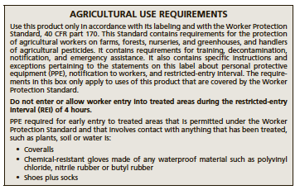
Restricted-Entry Interval (REI)
Period of time between the end of the application and when re-entry into the field is permitted
To enter during the REI to perform worker tasks, you must:
Wear label-required PPE
Receive training and information specific to the early entry from your employer
Notes:
Information required to be covered:
The restricted-entry interval (REI) is the time that agricultural employees must wait after an application before it is safe to enter the area without protection and additional training. The REI is often included in the Agricultural Use Requirements box, but may also be found in the Directions for Use section if the REI varies by site. It is the agricultural employer’s responsibility to keep workers and other people out of the treated area during the REI.
Notes for trainers of pesticide handlers:
Some states have set a minimum REI if one is not listed on the label or if the label states that employees can enter once the product is dry. Since these regulations are state-specific they most likely will not be found on the pesticide label. Nevertheless, all pesticide handlers and agricultural employers must be aware of and follow state-specific REI limitations.

Slide 95
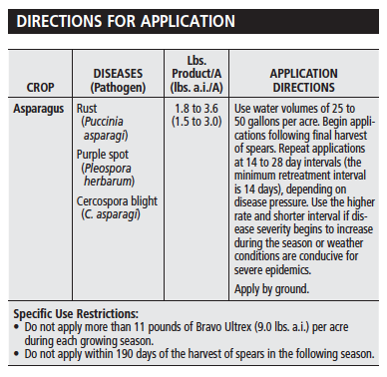
Directions for Use
Sites allowed
Pests controlled
Application rates
Mixing instructions
Application restrictions
Notes:
Information required to be covered:
The Directions for Use section provides you with details about the pests that the product will control, the sites to which the pesticide can be applied, application rates, mixing instructions, equipment that can or can’t be used, and application restrictions.
Notes for trainers of pesticide handlers:
It is illegal for a pesticide handler to exceed the maximum rate listed on the label. It is also illegal to apply a pesticide to a site or crop that is not listed on the label. While it is not illegal to apply the pesticide below the listed application rate or to a pest that isn’t included on the label, it is not advisable because the product might not perform well and the pest may develop resistance to the pesticide. It is also a waste of time, money and product. Agricultural employers and pesticide handlers should contact the pesticide manufacturer if they need clarification about mixing or application instructions or have questions about optional products that are available for a particular pest or site.

Slide 96
Storage and Disposal Instructions
Storage temperature range
Specific storage or disposal instructions
Notes:
Information required to be covered:
Storage and disposal instructions are usually found at the end of the label. They may include a storage temperature range or warnings about storing the pesticide near fertilizers, feed or in a container other than the original container.
Notes for trainers of pesticide handlers:
Storage and disposal regulations may vary between states or counties. Agricultural employers should check with their local pesticide regulatory agency for additional storage and disposal regulations, container recycling services, and unused pesticide collection programs.
The Pesticide Stewardship Alliance (TPSA) has a database of the pesticide disposal contacts in each state, and information on pesticide container recycling companies operating in each state at http://tpsalliance.org/.

Slide 97
Using Pesticides Safely
Notes:
You must handle pesticides safely to minimize your exposure, and exposure to other people and the environment.

Slide 98
Proper Application and Use of Pesticides
You must stay alert during the entire application task and frequently check the area and application equipment to ensure that:
The pesticide is reaching the target site
The equipment is providing good coverage and even distribution
Tank mixes are properly agitated and appear uniform and are not separating or clumping
Hoses, valves, nozzles, hoppers, and other equipment parts are functioning properly
Notes:
Information required to be covered:
Eliminate or minimize exposure to pesticides during mixing, loading, cleaning and applying. Always read the pesticide label for information on required personal protection equipment.
To ensure that the product is being applied safely and accurately, you must stay alert during the entire application task and frequently check the area and application equipment to ensure that:
the pesticide is reaching the target site
the equipment is providing good coverage and even distribution
tank mixes are properly agitated and appear uniform and are not separating or clumping, and
hoses, valves, nozzles, hoppers, and other equipment parts are functioning properly.

Slide 99
Safety Requirements for Handling Pesticides
Choose a safe site
Check for people and animals
Read the pesticide label
Check the SDS for additional safety precautions
Notes:
Information required to be covered:
Ask your employer where to safely mix and load pesticides. Don’t mix or load pesticides near a pond, stream, well or ditch.
Don’t handle pesticides near animals or food.
Carefully follow all mixing and loading instructions on the pesticide label.
Check the SDS for additional safety precautions.

Slide 100
Safety Requirements for Transporting Pesticides
Transport pesticides in the truck bed, cargo area, or on the back of the spray rig
Check containers for leaks before loading and unloading
Protect containers from rain and other potential weather damage
Secure or tie down all pesticide containers in the cargo area
Monitor containers at all times during transportation
Keep containers in a locked area
Notes:
Information required to be covered:
When transporting pesticides, especially containers that have already been opened, always do the following:
Transport pesticides in the truck bed, cargo area, or on the back of the spray rig
Check containers for leaks before loading and unloading
Protect containers from rain and other potential weather damage
Secure or tie down all pesticide containers in the cargo area
Monitor containers at all times during transportation
Keep containers in a locked area, if possible
Never carry pesticides in the passenger compartment of any vehicle or transport food, animal feed, or clothing with pesticide containers.
Never leave pesticide containers unattended.

Slide 101
Storage and Disposal of Pesticides
Storage and disposal instructions are usually found at the end of the label
Storage and disposal regulations may vary between states or counties
Employers should check with their local pesticide regulatory agency for additional storage and disposal regulations, container recycling services, and unused pesticide collection programs
Notes:
Information required to be covered:
Storage and disposal instructions are usually found at the end of the label.
They may include a storage temperature range or warnings about storing the pesticide near fertilizers, feed or in a container other than the original container.
Storage and disposal regulations may vary between states or counties.
Agricultural employers should check with their local pesticide regulatory agency for additional storage and disposal regulations, container recycling services, and unused pesticide collection programs.
The Pesticide Stewardship Alliance (TPSA) has a database of the pesticide disposal contacts in each state, and information on pesticide container recycling companies operating in each state at http://tpsalliance.org/.

Slide 102
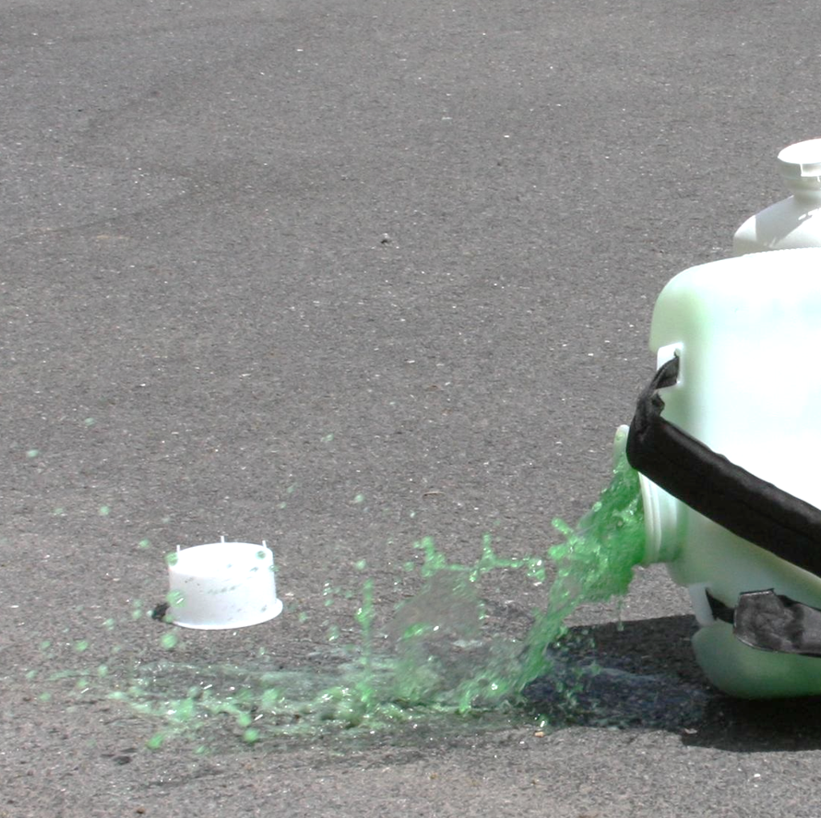
General Procedures for Spill Cleanup
Protect yourself by putting on the PPE listed on the label
Control the spill by placing the container upright to stop more from spilling or by putting a broken or leaking container into a plastic bag or other secondary container
Contain the spill and the area by using an absorbent material to keep the product from spreading
Clean up the spill according to label directions
Image credit: Penn State Extension, The Pennsylvania State University
Notes:
Information required to be covered:
If a pesticide spills, you must work quickly to control, contain, and clean up the spill. Many pesticide labels contain instructions on how to clean up a spill. In all pesticide spill situations you should:
Protect yourself by putting on the personal protective equipment listed on the label. If the situation is too dangerous, you should call for emergency help.
Control the spill by placing the container upright to stop more from spilling or by putting a broken or leaking container into a plastic bag or other secondary container.
Contain the spill and the area by using an absorbent material to keep the product from spreading. Set up cones, a rope or caution tape so people don’t accidentally walk through the area.
Clean up the spill according to label directions. Never hose down a spill. That would spread the pesticide around and could contaminate a larger area, including water sources if the liquid runs down a drain.

Slide 103
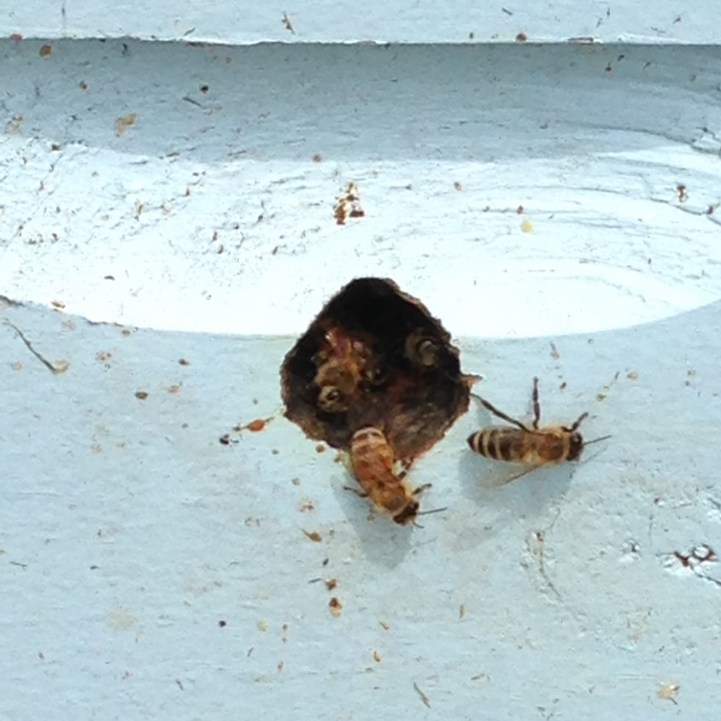
Protecting Sensitive Areas
Be exceptionally careful when applying pesticides near or adjacent to:
Places where people and pets live, work, play, or travel
Water sources
Wildlife and beneficial insect habitats
Livestock areas
The label will provide details about sensitive environmental areas, where you should remain careful of (under “Environmental Hazards”)
Image credit: Betsy Buffington, Iowa State University
Notes:
Information required to be covered:
Look all around the application site for the presence of people, animals, or sensitive areas that might be negatively impacted by the pesticide.
Be exceptionally careful when applying pesticides near or adjacent to:
Places where people and pets live, work, play, or travel
Water sources
Wildlife and beneficial insect habitats, and
Livestock areas.
The label will provide details about sensitive environmental areas, where you should remain careful of (under “Environmental Hazards”).

Slide 104
Other Impacts of Pesticides on the Environment
Pesticides that are not absorbed by plants or soil can move from the site and contaminate other areas
Applying pesticides when it is raining or shortly before it rains can result in runoff or pesticide movement off the application site
Application during precipitation events may reduce the efficacy of the application, as well as lead to off-site movement of the pesticide
Notes:
Information required to be covered:
Pesticides that are not absorbed by plants or soil can move from the site and contaminate other areas.
Applying pesticides when it is raining or shortly before it rains can result in runoff or pesticide movement off of the application site.
Application during precipitation events may reduce the efficacy of the application, as well as lead to off-site movement of the pesticide.

Slide 105
Personal Protective Equipment
Notes:
It is important to use personal protective equipment (PPE) when required.

Slide 106
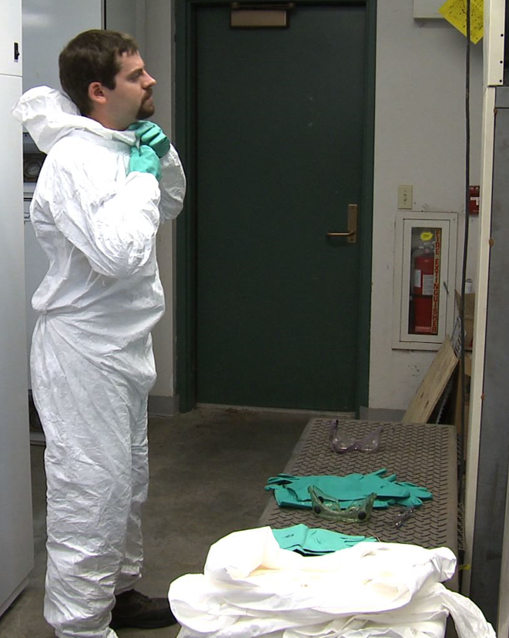
Importance of PPE
Image credit: Betsy Buffington, Iowa State University
Notes:
Information required to be covered:
Personal Protective Equipment (PPE) is worn by handlers and early-entry workers to protect themselves from exposure.
It is important for you – due to the potential for exposure to the concentrated pesticide during handling, and because you work with large amounts of pesticide as you mix, load, and apply pesticides.

Slide 107
PPE on the Pesticide Label
Select PPE based on label instructions
Some labels ask handlers to wear specific work clothing, such as
Long-sleeved shirt
Long pants
Shoes and socks
Short-sleeved shirts or shorts
Image credit: Sarah Risorto, UC Statewide IPM Program
Notes:
Information required to be covered:
After you have read and become familiar with the product label, the next step is to select the correct protective clothing and personal protective equipment. The type of PPE that is required is based on several factors, such as the product’s toxicity, concentration, formulation; and the application equipment, site and task. EPA has determined through risk assessment that the specific work clothing or personal protective equipment that is listed on the label must be worn by the handler or early entry worker to protect themselves from exposure.
Some pesticide labels require you to wear specific work clothing, such as:
Long-sleeved shirt
Long pants
Shoes and socks
Short-sleeved shirt or shorts (occasionally a label will require that these items are worn underneath a chemical-resistant suit)
The employer is not responsible for providing this work clothing – just the personal protective equipment (PPE) listed on the next slide. However, you are required to wear both the work clothing and the PPE identified on the label.

Slide 108
PPE on the Pesticide Label
Pesticide labels list the PPE handlers must wear, which may include:
Gloves
Aprons
Chemical-resistant footwear
Coveralls (cloth)
Chemical-resistant suit
Chemical-resistant headgear
Protective eyewear
Respirator
If handling more than one pesticide, use the most protective PPE for that task
Notes:
Information required to be covered:
Pesticide labels list Personal Protective Equipment (PPE), which may include:
Gloves
Apron
Chemical-resistant footwear
Coveralls (cloth)
Chemical-resistant suit
Chemical-resistant headgear
Protective eyewear
Respirator
You may be instructed to mix two products together to control the pest. In this situation, you or your employer must compare the PPE sections of both labels and select the PPE listed on the label that provides the most protection. For example, if one product label requires a long-sleeved shirt and pants and the other requires a chemical-resistant suit, then you must wear a chemical-resistant suit. If one requires a respirator and the other does not, then you must wear the required respirator. If different types of respirators are required, your employer must provide the appropriate type of respirator and cartridge to protect for both.
Notes for trainers of pesticide handlers:
When a label specifies coveralls, the handler or early-entry worker is required to wear cloth coveralls. If full body chemical-resistance is required (very rarely), the label will specify a chemical-resistant suit.

Slide 109
Read the Label CAREFULLY:
Read the label thoroughly to make sure you understand ALL of the PPE requirements.
Don’t skim- it’s easy to miss important details
Personal Protective Equipment:
Some materials that are chemical-resistant to this product are listed below.
Handlers who may be exposed to the dilute through application or other tasks must wear: Long-sleeved shirt and long pants, Chemical-resistant gloves, such as Nitrile, Butyl, Neoprene, and/or Barrier Laminate, and Shoes plus socks.
Handlers who may be exposed to the concentrate through mixing, loading, application, other tasks must wear: Long-sleeved shirt and long pants, Chemical-resistant gloves, such as Nitrile, Butyl, Neoprene, and/or Barrier Laminate, Shoes plus socks, and Protective eyewear.
Notes:
Information required to be covered:
You must read the label thoroughly to make sure that you understand all of the PPE requirements. If you merely skim the label for PPE information you may miss important details.

Slide 110
Chemical-resistant PPE
Chemical-resistant PPE doesn’t allow a measurable amount of chemical to pass through
Chemical-resistant can refer to different types of PPE including:
Gloves
Footwear
Suit
Aprons
Notes:
Information required to be covered:
When a “chemical-resistant” item is listed on the label, it is referring to PPE that is made of a material that doesn’t allow a measurable amount of chemical to pass through. You may see “chemical-resistant” used to describe certain PPE, such as gloves, footwear, suits, or aprons.
Some examples of chemical-resistant materials include nitrile, natural, neoprene, and barrier laminate rubber, and polyvinyl chloride.

Slide 111
Waterproof PPE
Waterproof PPE refers to PPE that is made of a material that doesn’t allow a measurable amount of water or pesticides mixed with water to pass through
Notes:
Information required to be covered:
Similarly, some labels require PPE to be made of “waterproof” material, which does not allow a measurable amount of water or pesticides dissolved in water to pass through the item during use.

Slide 112
Reusable vs Disposable PPE
Reusable PPE must be cleaned after use
Disposable PPE must be thrown out after the work day or if soiled by pesticides
Notes:
Information required to be covered:
Reusable PPE must be cleaned after use.
Disposable PPE must be thrown out after the work day or if soiled by pesticides.

Slide 113
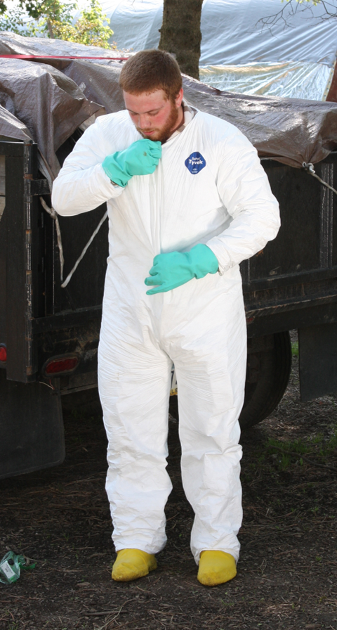
Coveralls or Chemical-resistant Suits
Must be loose fitting
1 or 2 piece garments
Must cover entire body except the head, hands, and feet
Coveralls = cloth/fabric
Chemical-resistant suit = chemical-resistant material
Image credit: Penn State Extension, The Pennsylvania State University
Notes:
Information required to be covered:
Coveralls and chemical-resistant suits must be loose fitting, one- or two-piece garments that cover, at a minimum, the entire body except the head, hands, and feet.
The difference between coveralls and a chemical-resistant suit is the material of which they are made. Coveralls are made of cloth or fabric and chemical-resistant suits are made of chemical-resistant material.

Slide 114
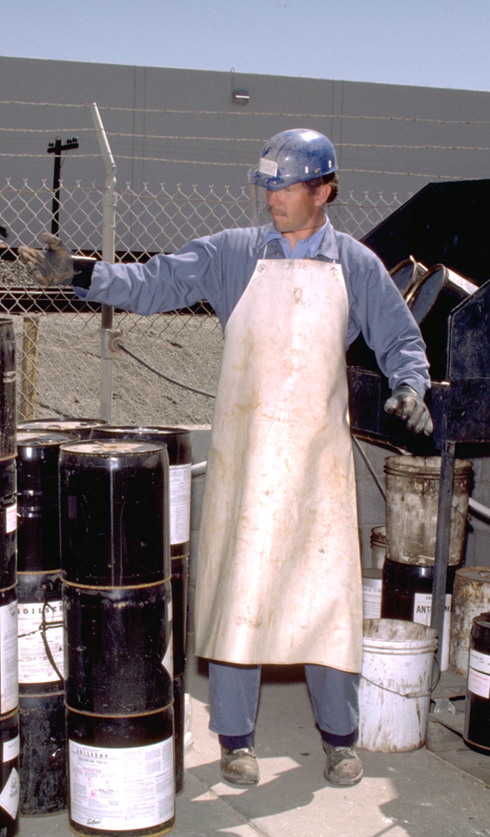
Apron
Aprons must be long enough to cover the front of the body from mid-chest to knee
Notes:
Information required to be covered:
The label may require a chemical-resistant apron if it is needed to protect you in a situation in which a pesticide might splash back onto you, such as while mixing a pesticide or hosing off application equipment. The apron must be long enough to cover the front of the body from mid-chest to knees.

Slide 115
Chemical-resistant Headgear
A chemical-resistant hood or hat, with a wide brim
Notes:
Information required to be covered:
Some pesticide labels will simply require overhead protection, while others will state that chemical-resistant headgear must be worn. If chemical-resistant headgear is specified, it must be either a chemical-resistant hood or a chemical-resistant hat with a wide brim.

Slide 116
Hat or Overhead Protection
Non-absorbent material
Wash with soap and water at the end of the handling task
DO NOT WEAR absorbent hats, such as baseball caps
Notes:
Information required to be covered:
If a label requires a hat or overhead protection, you must wear something made of a non-absorbent material that you are willing to wash with soap and water at the end of the handling task.
You should not wear hats such as baseball caps during pesticide handling activities.

Slide 117
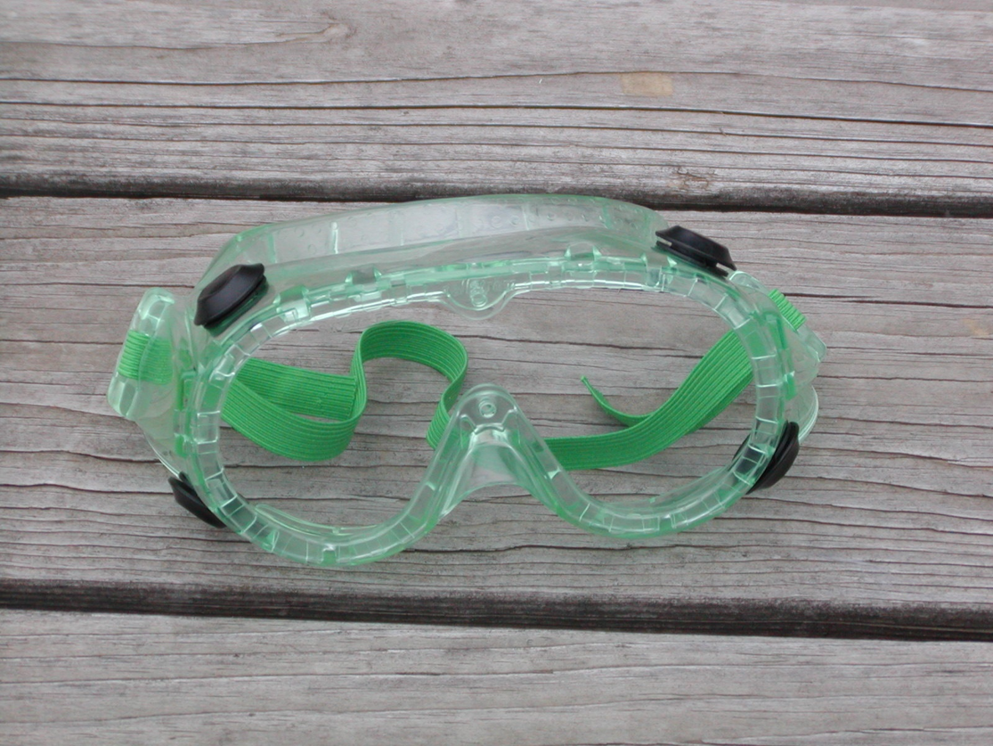
Protective Eyewear
Provide front, brow, and temple protection
Safety glasses
Chemical splash goggles
Face shield
Full-face respirators
Image credit: Penn State Extension, The Pennsylvania State University
Notes:
Information required to be covered:
Protective eyewear options includes safety glasses with front, brow, and temple protection; chemical splash goggles; face shields; and full-face respirators. People who wear reading glasses might opt for a face shield, which will enable them to clearly see the label while mixing the product.
If the label says, “protective eyewear” you can wear any of the protective eyewear listed here. If the label specifies a type of protective eyewear (e.g., faceshield), then that specific eyewear must be used.

Slide 118
Chemical-resistant Footwear
Chemical-resistant shoes, boots or shoe coverings
Must be made of chemical-resistant material such as rubber or vinyl
Notes:
Information required to be covered:
While some labels will recommend shoes and socks, labels that require handlers to wear chemical-resistant footwear are referring to shoes, boots, or shoe coverings made of chemical-resistant material, such as rubber or vinyl.

Slide 119
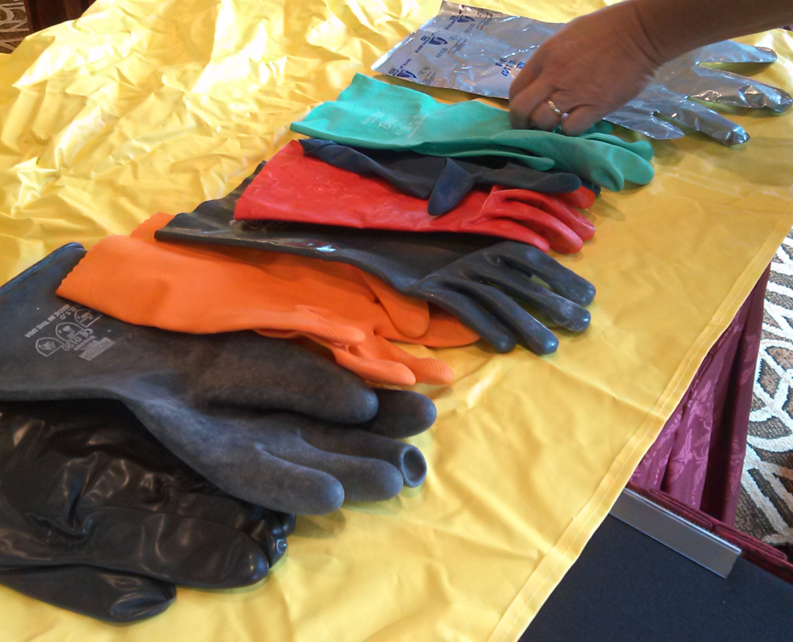
Gloves
Gloves must be worn during handling, including repairing equipment and adjusting nozzles
If the label requires a certain material, such as nitrile, gloves must be made of specified material
You MUST NOT wear cotton, suede or leather gloves
Image credit: Jennifer Weber, Arizona Department of Agriculture
Notes:
Information required to be covered:
If the label requires you to wear gloves, they must be worn during all handling tasks, including when repairing application equipment and adjusting nozzles.
The gloves must be the type listed on the label. Many labels will list the type of glove material (for example, nitrile gloves) or will state that the gloves can be of any chemical-resistant or waterproof material.
You must not wear cotton, suede or leather gloves when they are handling pesticides unless instructed to do so by the label. These materials absorb pesticides and won’t protect you from the pesticides.

Slide 120
Glove Liners
Glove liners can be worn underneath gloves
They must not extend outside of chemical-resistant glove
Glove liners must be discarded either after 10 hours of use or within 24 hours after they are first put on, whichever comes first
They must be removed if they contact pesticide directly, and they cannot be reused
Glove liners should be separate from the glove itself
Cotton-lined and fleece-lined gloves are not permissible
Notes:
Information required to be covered:
Separable glove liners made of a thin lightweight fabric may be worn beneath chemical-resistant gloves as long as they are not exposed to the chemical by extending outside of the chemical-resistant gloves. If used, separable glove liners must be discarded either after 10 hours of use or within 24 hours of initially putting on the gloves, whichever comes first. They must be removed if they contact pesticide directly, and they cannot be reused.
Separable glove liners are not to be confused with cotton- or fleece-lined gloves , which are not allowed because they could absorb pesticides and contaminate the handler.

Slide 121
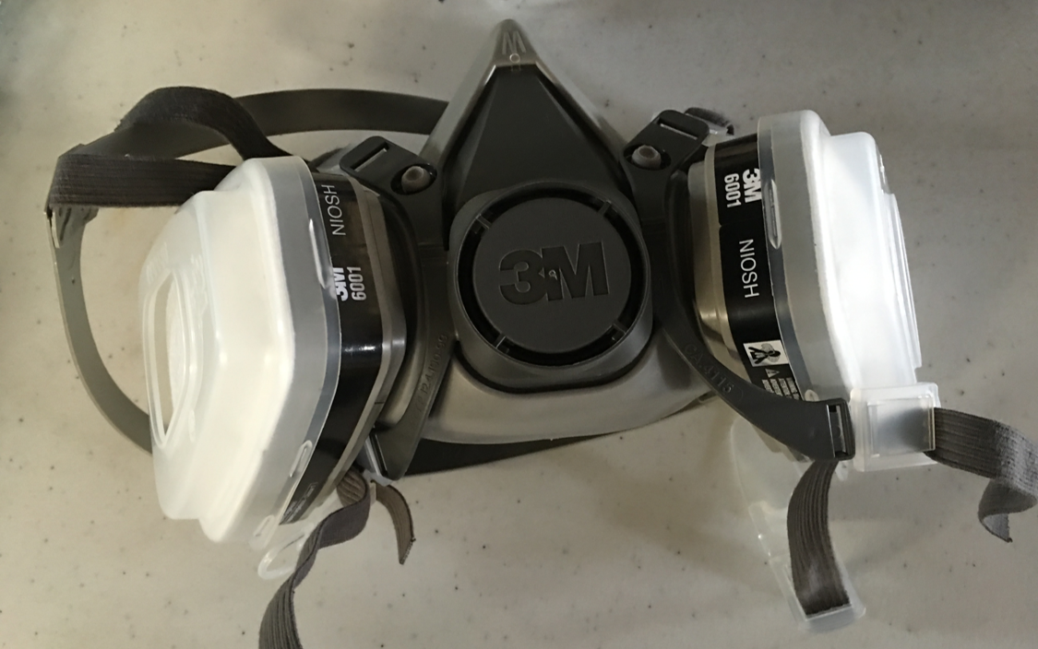
Respirators
Respirators are important if there is the likelihood of exposure to droplets or vapors that are toxic by inhalation
Respiratory equipment tested and certified by the National Institute of Occupational Safety and Health (NIOSH)
Identified by a “TC” code
Image credit: Betsy Buffington, Iowa State Extension
Notes:
Information required to be covered:
Respirators are important if there is the likelihood of exposure to droplets or vapors that are toxic by inhalation.
If respiratory equipment is required by the pesticide label, the type of respirator will be identified by the acronym “NIOSH” and a “TC” followed by a coding system (e.g., TC-23C). These acronyms tell the handler that the National Institute of Occupation Safety and Health (NIOSH) has Tested and Certified (TC) the equipment listed on the label.
If a cartridge is required, it will be identified by a description and/or an abbreviation (e.g., organic vapor (OV) filtering cartridge). Sometimes pesticide labels also require filters that fit onto the cartridges (often also called “pre-filters”). They are identified by the testing and certification code TC-84A, by the type of material the filter can be used with (N, R, P, HE) and the amount that they filter (95, 99, 100).

Slide 122
Respirators
Make sure to use the respirator, cartridges and filters as listed on the label
Respirators, cartridges and filters are product- and task specific
Notes:
Information required to be covered:
Respirators, cartridges and filters are product- and task-specific. It is therefore imperative that you wear the equipment specified on the label for the handling activity you will perform.
Notes for trainers of pesticide handlers:
PERC (http://pesticideresources.org/wps/inventory.html) has a good resource that provides more information on cartridges, canisters, filters and respirators in general.

Slide 123
Respirator-Use Requirements
When you use a pesticide that requires respiratory protection THE EMPLOYER is responsible for providing the following to you (at no cost) before you use a respirator required by the label:
Medical evaluation
Respirator fit test
Respirator use and maintenance training
Notes:
Information required to be covered:
It is the employer’s responsibility to make sure that if you will use pesticides that require respiratory protection receive a medical evaluation, respirator use and maintenance training, and respirator fit testing – at no cost to you – before you use the label-required respirators.
Notes for trainers of pesticide handlers:
It is the trainer’s responsibility to inform all handlers that the employer must fulfill these requirements before the handler works with a pesticide that requires respiratory protection.
Each of the elements of the respiratory protection program must be documented by the employer.

Slide 124
Medical Evaluation
Medical evaluation required before you use respirator and before conducting the fit test
Medical history questionnaire
Possible follow-up visit
Repeat evaluation if there is a change in the conditions of use or your health status
Notes:
Information required to be covered:
If a pesticide label requires you to wear a respirator, your employer must make sure that you are healthy enough to use the respirator type under the anticipated work conditions without suffering adverse health effects. This is achieved through medical evaluation before you are allowed to use the respirator and before conducting the fit test.
During the medical evaluation, the physician or medical professional must obtain the information listed in OSHA’s medical history questionnaire. Often this is accomplished by having you complete a confidential medical history questionnaire.
Based on your information, a physician or medical professional may require that you schedule a follow-up visit or provide additional information to determine if you are physically able to use that type of respirator under the anticipated work conditions.
Repeat medical evaluations are not usually required every year, but only if there is a change in the conditions of how the respirator is used or in your health status. Also, the medical clearance form from the medical professional may include a time limit.

Slide 125
Respirator Fit Test
Fit tests must be performed before you use the respirator and at least annually after that
Fit tests must be repeated if:
The respirator changes
There are changes to the size and/or shape to your face
Notes:
Information required to be covered:
The respirator must fit your face properly for it to provide the protection.
If you are given medical clearance, your employer must make sure that the specific type, model and size of the respirator(s) you will use fits properly. The respirator must be fit tested before you use the respirator and at least annually after that.
Respirator fit tests must be repeated if:
The respirator you are using changes
There have been significant changes to the size and/or shape of your face, which might impact the fit of a respirator. Some of these changes might include:
Weight loss or gain of 20+ pounds
Dental surgery
Significant injury to the jaw
It’s also important to note that facial hair interferes with the seal of a tight fitting respirator. If you choose not to shave, you either cannot perform tasks that require a respirator or you must wear a loose fitting respirator (like a Powered Air Purifying Respirator/PAPR).

Slide 126
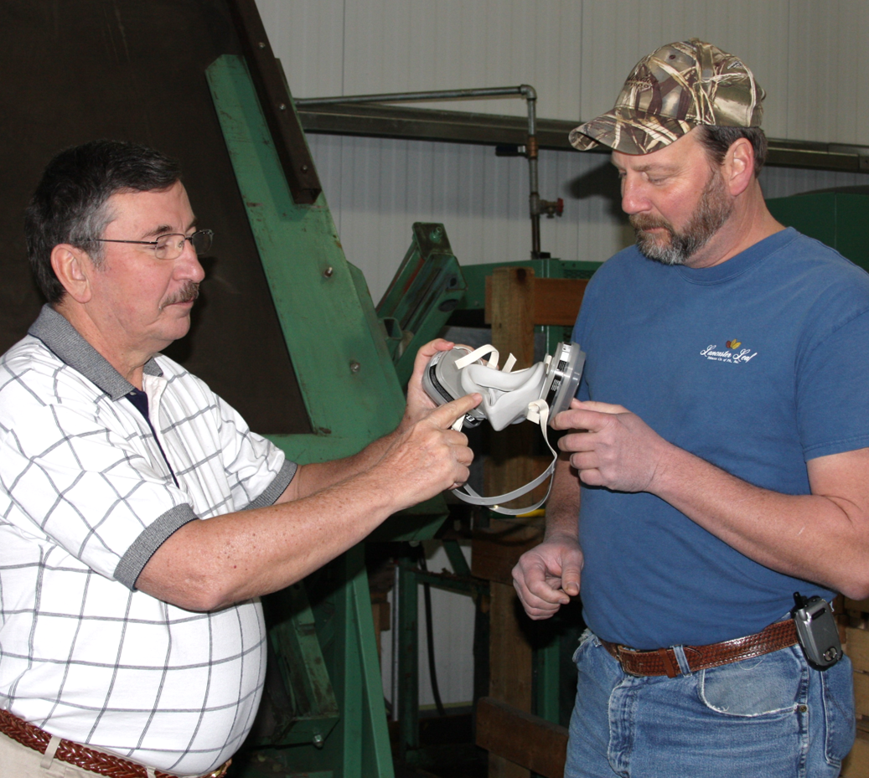
Respirator Use and Maintenance Training
If you use respirators you must be trained
Before you begin using respirator and
At least annually
Training must be repeated if you demonstrate a lack of knowledge
Image credit: Penn State Extension, The Pennsylvania State University
Notes:
Information required to be covered:
Once you are medically-cleared, you must also receive training before using the respirator and at least annually after that on how to properly use, store, and care for your respirator. The training must also cover the situations where the respirator does and does not provide protection.
You must be re-trained if you do not demonstrate proper use or maintenance of your equipment.

Slide 127
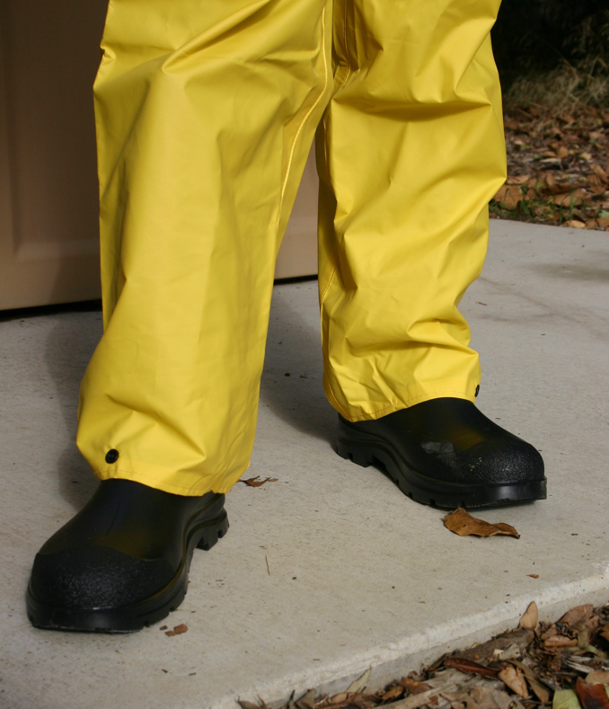
Wearing PPE
Wear PPE in a way that prevents pesticide spray from entering boots or sleeves
Notes:
Information required to be covered:
Ground Application: Place pant legs over boots to prevent pesticides from entering the boots. Place sleeves over the gloves to prevent pesticides from entering the glove.
Overhead Application: Place pant legs over boots to prevent pesticides from entering the boots. Place gloves over the sleeves to prevent pesticides from entering the sleeves.
Coveralls with elastic at the wrist and ankle help assure there is no gap between the sleeve and glove, or between the pant leg and boot.
Notes for trainers of pesticide handlers:
Pesticide handlers may ask whether they should tuck their sleeves into their gloves or their gloves into their sleeves when applying pesticides. They may have the same question about how to arrange their pant legs and boots.
A good way to present the correct arrangement is to mimic a ground application and an overhead pesticide application. Ask the handlers to think about these two scenarios and how they can best prevent the pesticide spray from entering and getting trapped in their boots or running down into their gloves or sleeves.

Slide 128
Removing PPE
Wash the outside of gloves and other chemical-resistant items
Then remove gloves, keeping the inside surface from becoming contaminated
Determine whether contaminated items should be disposed of or cleaned for reuse
Notes:
Information required to be covered:
When you finish handling pesticides, remove your PPE right away.
Start by washing the outside of your gloves with soap and water before removing the rest of your PPE.
Wash the outside of other chemical-resistant items before you remove your gloves. This practice helps you avoid contacting the contaminated part of the items while you are removing them, thus keeping the inside surface from becoming contaminated.
Determine whether contaminated items should be disposed of or cleaned for reuse.

Slide 129
PPE Inspection
Inspect PPE to make sure it is in good condition before wearing
Inspect PPE when cleaning at the end of the work day
If PPE is damaged or needs repair, you should report to employer who must fix or replace
Notes:
Information required to be covered:
After you have selected the PPE listed on the pesticide label, it is time to check the PPE to make sure that it is in good condition and safe to use before putting it on. It is your employer’s responsibility to ensure the PPE is in good condition but it is likely you will be the one doing this.
You should also inspect PPE when cleaning it at the end of the handling task so that employers can replace or repair any damaged equipment.

Slide 130
PPE Inspection Checklist
Inspect boots or chemical-resistant shoe coverings for holes, tears, or weak spots.
Inspect re-usable gloves for damage, such as holes, cracks, tears, areas that have become bubbled or spongy, and any discoloration.
Check coveralls and chemical-resistant suits for rips, tears, holes or separation along seams and zippers.
Make sure that the coveralls or chemical-resistant suit that you will use is the correct size so that it will offer you optimal protection and doesn’t interfere with movement.
Check apron material for holes or damage. Make sure that apron strings are in good condition and enable you to wear the apron securely.
Notes:
Information required to be covered:
Inspect boots or chemical-resistant shoe coverings for holes, tears, or weak spots.
Inspect re-usable gloves for damage, such as holes, cracks, tears, areas that have become bubbled or spongy, and any discoloration.
Check coveralls and chemical-resistant suits for rips, tears, holes or separation along seams and zippers.
Make sure that the coveralls or chemical-resistant suit that you will use is the correct size so that it will offer you optimal protection and doesn’t interfere with movement.
Check apron material for holes or damage. Make sure that apron strings are in good condition and enable you to wear the apron securely.

Slide 131
PPE Inspection Checklist cont.
Inspect protective eyewear for scratched or cracked lenses and replace if needed.
If you will use goggles, check the elastic parts for fraying, tears, wear, or loss of elasticity and replace if it is worn.
If you will use overhead protection, check the protective headwear for cracks, holes, and worn adjustable fittings.
Faceshields and protective headgear often have adjustable fittings for a secure fit and to prevent them from slipping or falling off. Inspect these fittings to make sure that they are working properly.
Notes:
Information required to be covered:
Inspect protective eyewear for scratched or cracked lenses and replace if needed.
If you will use goggles, check the elastic parts for fraying, tears, wear, or loss of elasticity and replace if it is worn.
If you will use overhead protection, check the protective headwear for cracks, holes, and worn adjustable fittings.
Faceshields and protective headgear often have adjustable fittings for a secure fit and to prevent them from slipping or falling off. Inspect these fittings to make sure that they are working properly.

Slide 132
Replacing Respirator Filters and Cartridges
Filtering facepiece respirators and respirator components such as filters and gas- or vapor-removing cartridges and canisters must be replaced periodically. Some of the WPS criteria for replacement are the same:
Breathing becomes difficult
When recommended by the respirator manufacturer
When instructed by the pesticide label
At the end of 8 hours of total use
Also replace filtering facepiece respirators and filters when they are damaged or torn
Also replace gas- or vapor-removing cartridges and canisters if:
The handler detects a pesticide taste, smell or any type of irritation
A different maximum use time determined under a OSHA-compliant respiratory program is reached
Notes:
Information required to be covered:
Even if a respirator seals and fits well, you can still be exposed if the filters, canisters, or cartridges are old or damaged. You must remove and replace respirator filters, cartridges and gas- or vapor-removing canisters when any of the following situations occur:
Breathing becomes difficult
When recommended by the respirator manufacturer
When instructed by the pesticide label
At the end of 8 hours of total use
Also replace filtering facepiece respirators and filters when they are damaged or torn
Also replace gas- or vapor-removing cartridges and canisters if:
The handler detects a pesticide taste, smell or any type of irritation
A different maximum use time determined under a OSHA-compliant respiratory program is reached

Slide 133
Employer’s Responsibility
Provide and pay for all PPE on label
Ensure proper PPE use and care training for handlers
Maintain all PPE
Properly dispose of any damaged or disposable PPE
Train handlers on cleaning, drying and storing re-usable PPE
Provide a place away from pesticide storage for handlers to put on, remove and store PPE
Notes:
Information required to be covered:
It is often the pesticide handler who inspects the personal protective equipment before each use and cleans the items at the end of the handling activity. However, it is the employer’s responsibility to:
Provide and pay for all of the Personal Protective Equipment (PPE) listed on the label.
Make sure that employees are properly trained on the proper use and care of PPE and that they follow the instructions provided.
Maintain all PPE and ensure that it is inspected for cracks, tears, holes, weak spots or damage before each day of use.
Properly discard and replace any damaged and all disposable PPE. The employer must make contaminated PPE that cannot be properly cleaned unwearable.
Ensure that re-usable PPE is properly cleaned, dried and stored. The employer can train the handlers on how to do this.
Provide a place away from pesticide storage areas for pesticide handlers to put on, remove and store PPE.

Slide 134
PPE and Heat Stress
Early Stages of Heat Illness
Severe Stages of Heat Illness
Fatigue
Muscle weakness
Dizziness
Headache
Nausea
Heavy sweating
Chills
Severe thirst and dry mouth
Fainting
Lack of sweat as heat stress progresses
Hot, dry, clammy skin
Slurred speech
Irrational behavior and confusion
Seek medical assistance if symptoms persist
Notes:
Information required to be covered:
Personal Protective Equipment, especially items made from non-breathable material, can increase the risk of heat stress when worn during pesticide handling and early entry work activities. Heat stress is a serious health condition and can even lead to death.
Early stages of heat stress symptoms include:
Fatigue
Muscle weakness
Dizziness
Headache
Nausea
Heavy sweating
More severe stages of heat-related illness can include:
Chills
Severe thirst and dry mouth
Fainting
Lack of sweat as heat stress progresses
Hot, dry, clammy skin
Slurred speech
Irrational behavior and confusion
If a handler is suffering from apparent heat stress (or worse) they should get medical attention if symptoms persist.

Slide 135
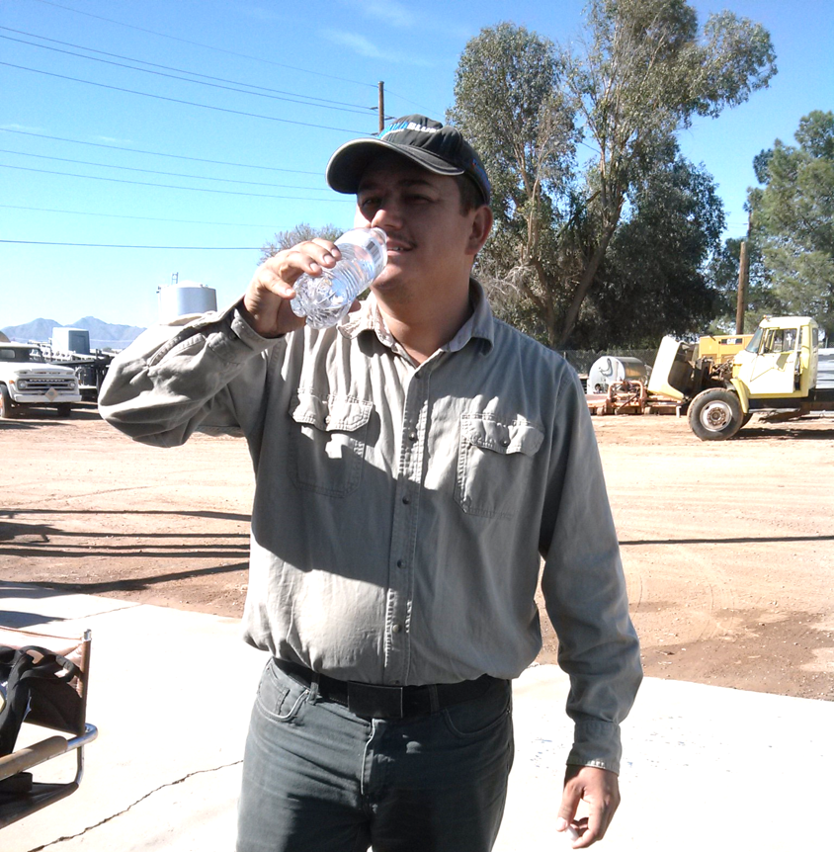
Employers Should Reduce the Risk of Heat Stress
Provide plenty of cool drinking water and shade
Alter work hours to cooler times
Image credit: Jennifer Weber, Arizona Department of Agriculture
Notes:
Information required to be covered:
Employers must take steps to prevent you from experiencing heat stress. Ways to reduce the risks include your employer providing plenty of cool drinking water and shade for you and altering your work hours. For example, your employer can schedule summer applications in the cooler hours of the day or night and for shorter periods of time, especially when working with pesticides that require the most PPE.

Slide 136
Acknowledgments
Primary Author
Betsy Buffington, Iowa State University Extension
Project Coordinator
Amy Bamber, Association of American Pesticide Control Officials
Content Developers
Lisa Blecker, University of California, Davis Extension
Ofelio Borges, Washington State Department of Agriculture
Ricardo Davalos, Florida Department of Agriculture
Irene King, New Mexico Department of Agriculture
Kerry Richards, American Association of Pesticide Safety Educators
Flor Servin, Washington State Department of Labor and Industries
Thia Walker, Colorado State University Extension
U.S. EPA Office of Pesticide Programs Reviewers
Kathy Davis, Jennifer Park, Nancy Fitz, Richard Pont
PERC Administrators
Suzanne Forsyth, University of California Davis Extension
Kaci Buhl, Oregon State University
Jeff Loux, University of California Davis Extension
Jeanne Kasai, U.S. EPA
This program was developed through a cooperative agreement between the US EPA (#X8-83616301) and University of California Davis Extension in cooperation with Oregon State University.
Version Dated: May 18, 2017
Notes:
Notes for trainers:
This concludes this presentation.
Version Dated: May 18, 2017

