Slide 1
Pesticide Safety Training for
Noncertified Applicators
Using Restricted Use Pesticides at
Non-Agricultural Sites

Slide 2

Pesticide Safety Training for Noncertified Applicators
Using Restricted Use Pesticides at Non-Agricultural Sites
This presentation was developed through a cooperative agreement between the U.S. EPA, Office of Pesticide Programs and the University of California Davis Extension, in cooperation with Oregon State University. (#X8-8361301)
This work is licensed under a Creative Commons Attribution-NonCommercial-ShareAlike 4.0 International License. © 2021 The Regents of the University of California, Davis campus.
For information contact PERCsupport@ucdavis.edu.
Disclaimer on resource translation
All non-English versions of resources are translations of the original in English
and are for information purposes only.

Slide 3
You have the right to ask for this information to be presented to you in a manner you understand, such as through a translator.

Slide 4
This presentation depicts various levels of personal protective equipment (PPE). The required PPE for each RUP can vary. Consult the RUP label you are using for actual PPE requirements.

Slide 5
Introduction

Slide 6

Welcome
Who is this training for?
Noncertified applicators using restricted use pesticides under the direct supervision of a certified applicator on non-agricultural sites.
Notes:
Welcome to the pesticide safety training for noncertified applicators. This presentation meets the training requirements for noncertified applicators using restricted use pesticides under the direct supervision of a certified applicator on non-agricultural sites.

Slide 7
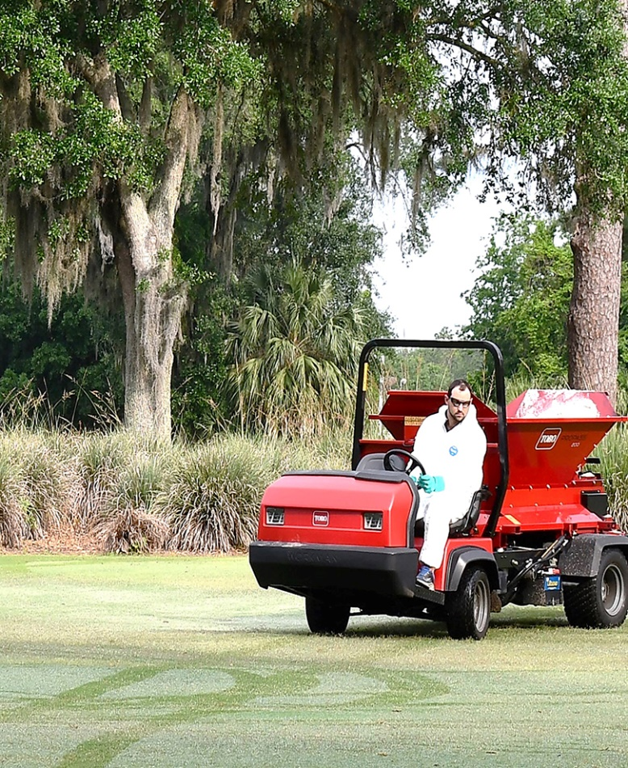
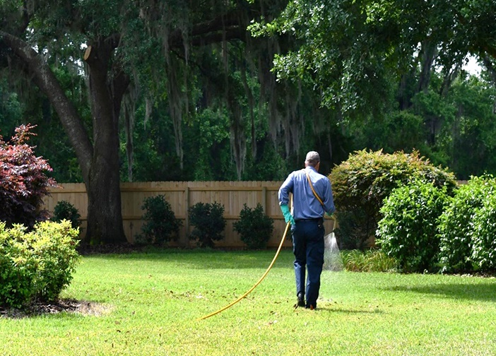
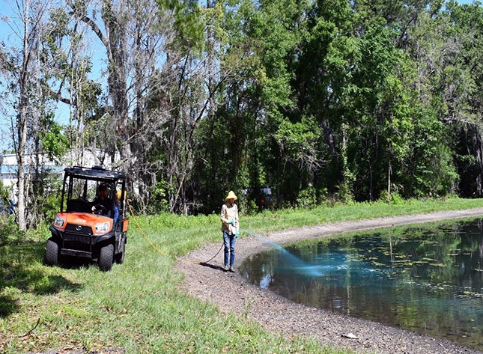
Examples of Non-Agricultural Sites
Wildland
Urban areas
Wood treatment facilities
Structures
Commodities
Landscapes
Golf courses
Other non-agricultural sites
Notes:
Examples of non-agricultural sites include wildland, urban areas, wood treatment facilities, structures, commodities, landscapes, golf courses and others.

Slide 8
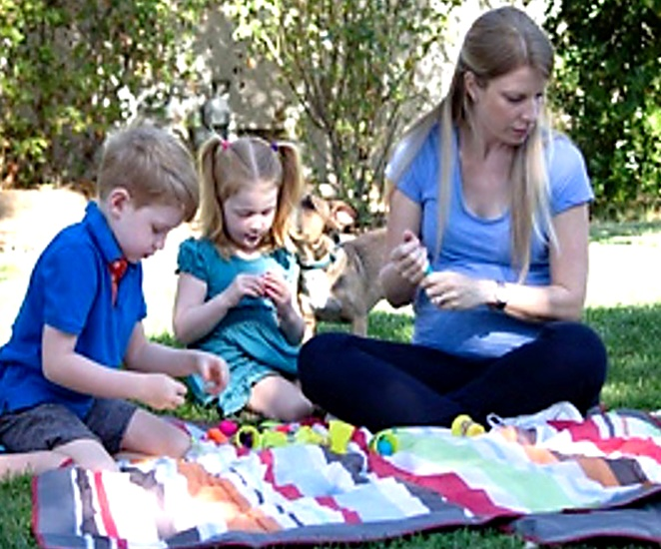
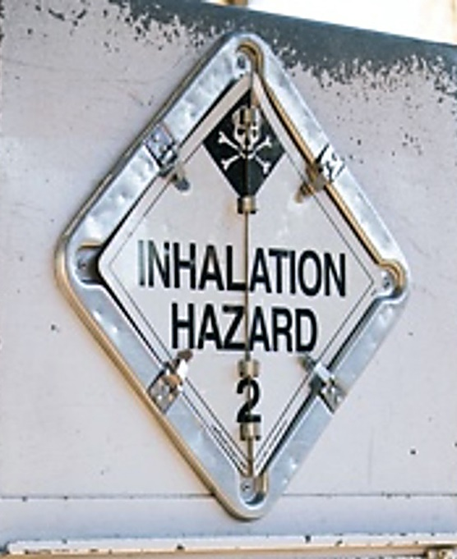

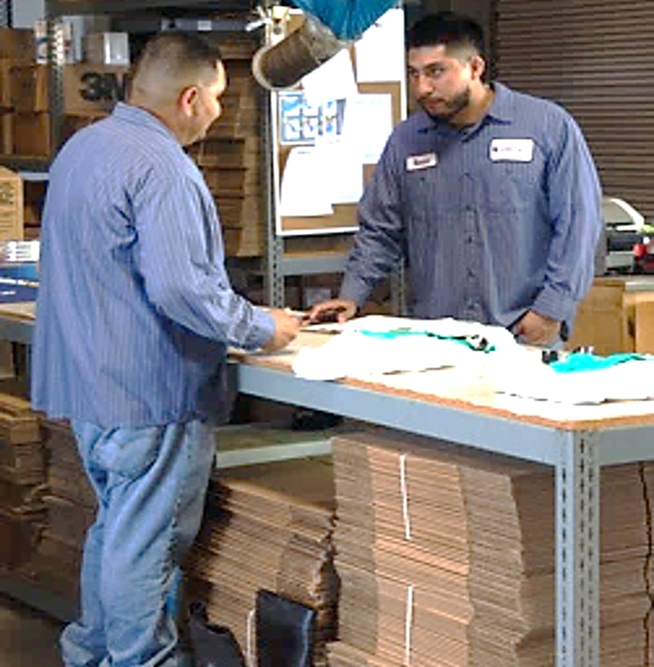
In This Training…
Inform about pesticide hazards
Protect yourself, your family and others
Responsibilities of you and your supervisor
Notes:
Federal regulations require this training to inform you about the pesticide hazards you may encounter, and demonstrate the steps you can take to protect yourself, your family, and others from pesticide exposure. You will also learn the specific responsibilities that apply to you and your supervisor when applying restricted use pesticides.

Slide 9
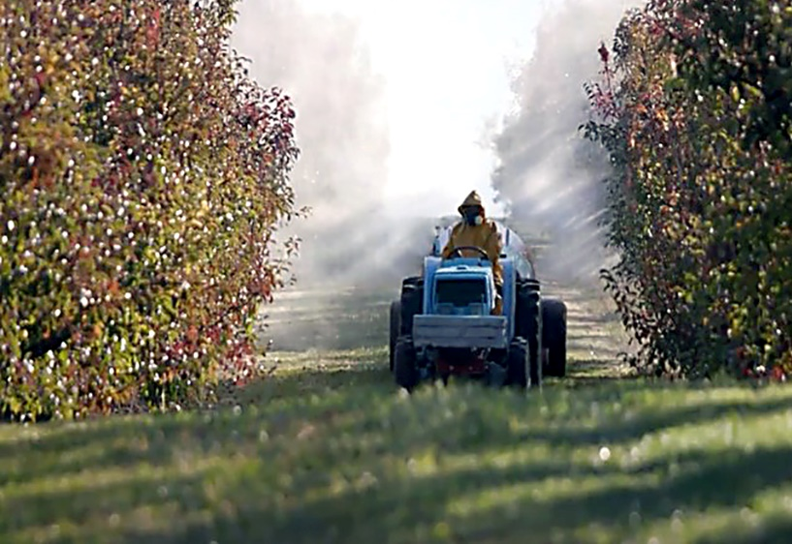
Agricultural Settings
WPS
Worker Protection Standard
Notes:
Anyone who works in an agricultural setting where pesticides are used must comply with additional training requirements outlined in the Worker Protection Standard.

Slide 10
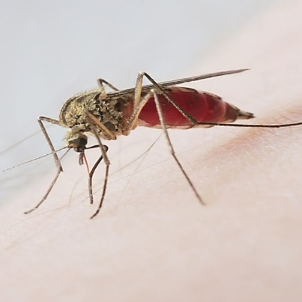

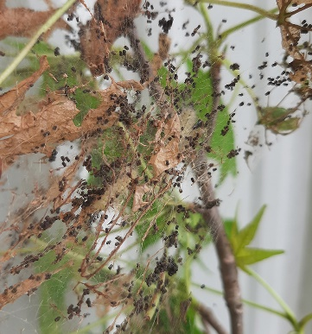

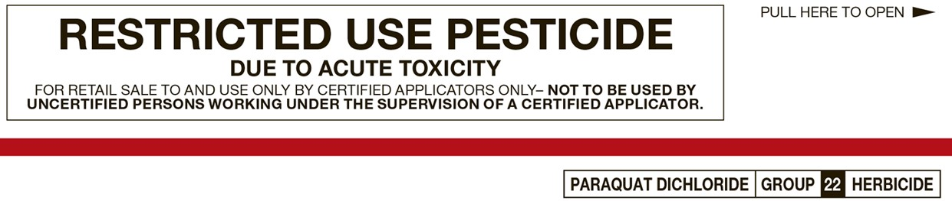


Pesticide Use
  Controls pests such as insects, weeds or pathogens
Pesticide
  General use
  Restricted use
EPA Classifications
Notes:
For applicators who are new to working with pesticides, a pesticide is a substance used to control unwanted pests, such as insects, weeds, and diseases. The EPA, or U.S. Environmental Protection Agency, classifies pesticide products as “restricted use” or “general use”.

Slide 11
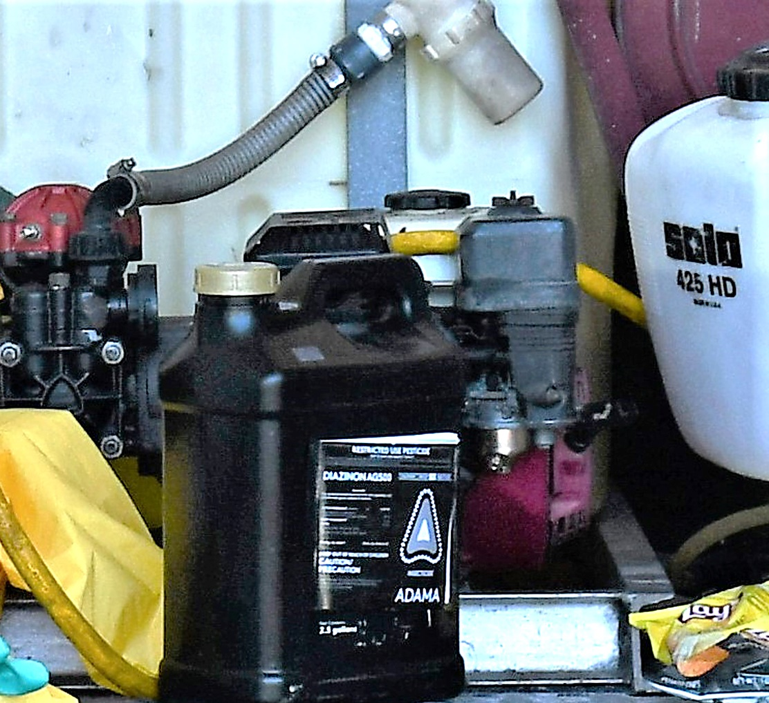
Restricted Use Pesticides (RUPs)
Purchase and use limitations
Comply with all applicable regulations
Potential to cause significant harm to people and the environment
Notes:
Restricted Use Pesticides, or “RUPs” for short are limited for purchase and use only by certified applicators or noncertified applicators working under their direct supervision under federal law. States and tribes may have more restrictive requirements and it is important to be aware of and comply with all applicable regulations. RUPs have the potential to cause significant harm to people and the environment if not used according to the label instructions and without the proper training. There are no federal requirements for users to be certified to use general use pesticides.

Slide 12
Certified versus Noncertified Applicators
Certified
  Must be at least 18 years old
  Demonstrate knowledge of pesticides and pesticide safety
Noncertified
  In most cases, must be at least 18 years old
  May use RUPs only when under direct supervision of a certified applicator
Notes:
What is the difference between a certified and noncertified applicator?
A certified applicator must be at least 18 years old. Commercial applicators and private applicators qualify as certified applicators after demonstrating their knowledge of pesticides and pesticide safety, as specified by their state, tribe, or federal agency to obtain a certificate or license in the use of RUPs.
A noncertified applicator is a person who may use RUPs only when under the direct supervision of a certified applicator. In most cases, noncertified applicators for nonagricultural pesticide applications must also be at least 18 years old.

Slide 13
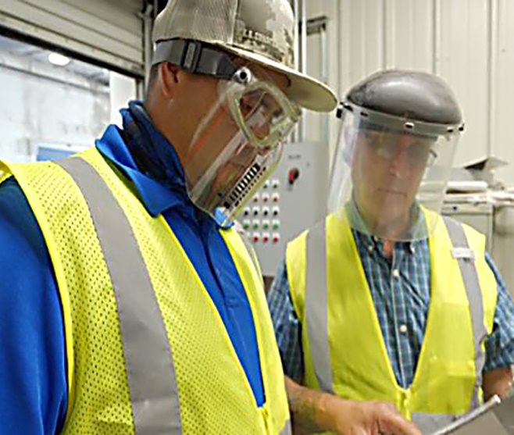
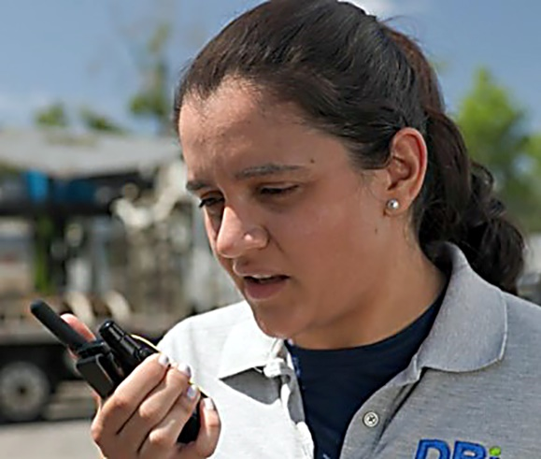
Direct Supervision
Oversees safe and legal use of RUPs
Must provide method of immediate communication with supervisor
May have to be physically present on-site during application
Notes:
Direct supervision means that a certified applicator is responsible for overseeing the safe and legal use of a RUP by a noncertified applicator. Under federal law, this means the certified applicator must provide the noncertified applicator with a way to communicate immediately with the supervisor. The labeling directions of the pesticide product being used will determine if your supervisor must be physically present on site or if they may supervise from a location off-site.

Slide 14
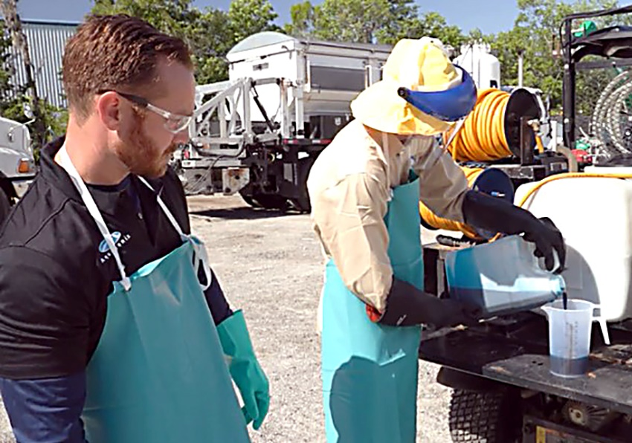
Direct Supervision
Cannot allow noncertified person to work* with RUPs without first being properly qualified
*Work includes:
Mixing
Loading
Applying
Working on equipment used for pesticide application
Cleaning pesticide containers
Any other pesticide-related activity
Notes:
Certified applicators cannot direct or allow any noncertified person to work with RUPs, including mixing, loading or applying, working on equipment used for a pesticide application, cleaning pesticide containers, or performing any other pesticide-related activity without first being properly qualified.

Slide 15
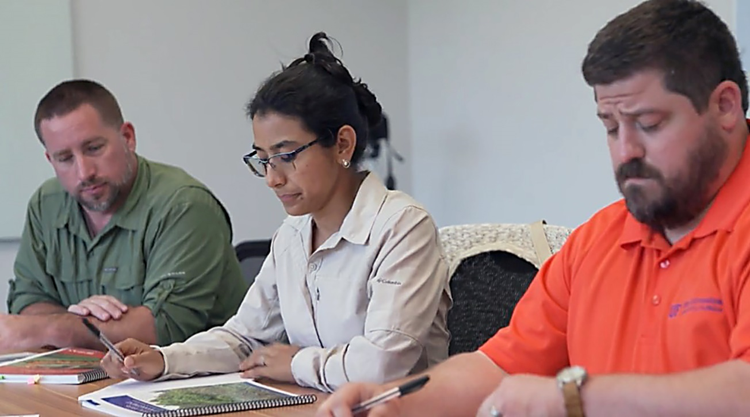
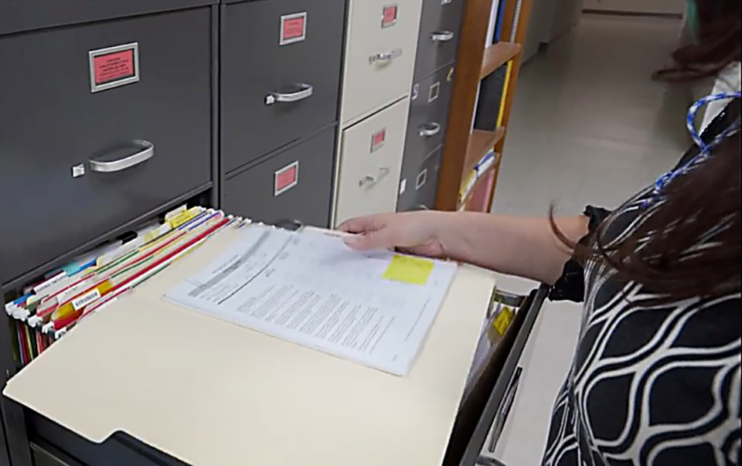
Required Training
Training required within 12 months before RUP use
Training records must be kept for at least two (2) years
Notes:
One way to be qualified is by completing this pesticide safety training within the 12 months before RUP use. Commercial applicators must keep records of the qualifications for at least two years following each application that was conducted or assisted by a noncertified applicator. States or tribes may have different or additional requirements for noncertified applicators to become qualified. Your employer or supervisor must know the local requirements that could apply to you.

Slide 16
Pesticides and Pesticide Residues

Slide 17
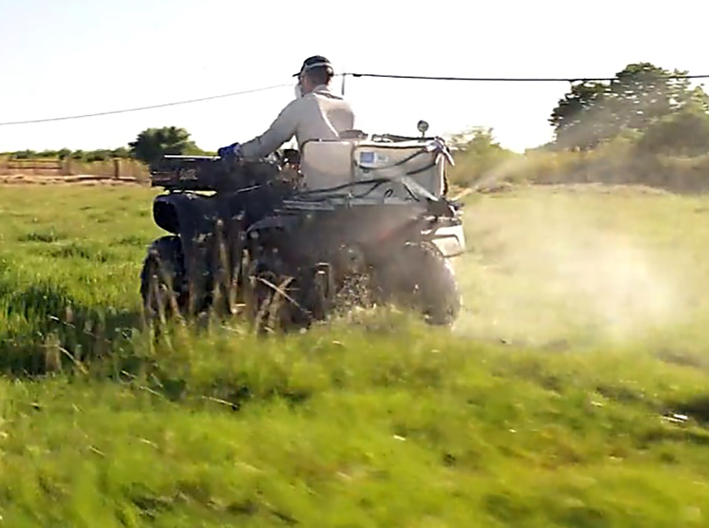
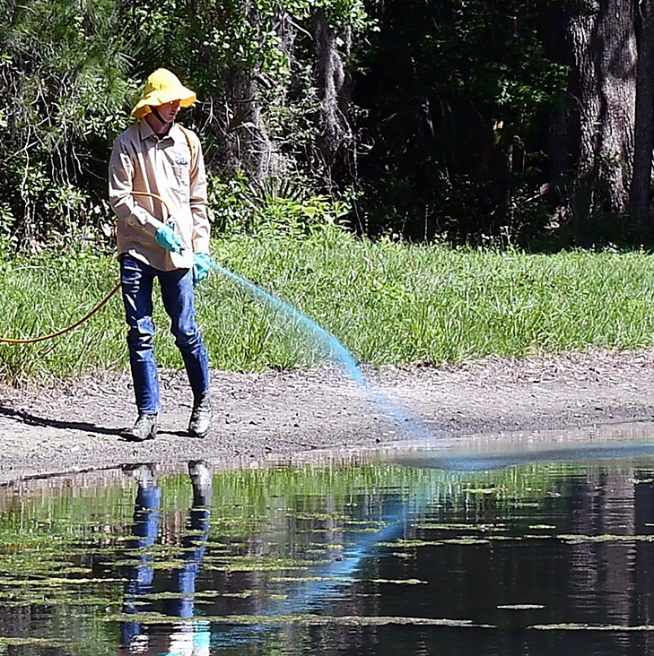
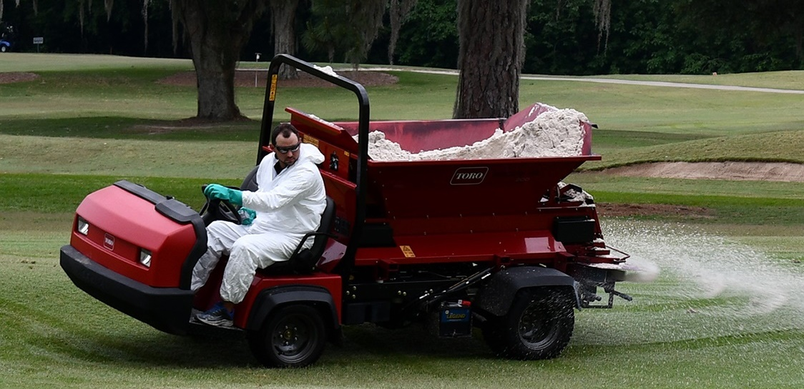
Pesticides
Insecticides
Herbicides
Fungicides
Notes:
Common types of pesticides include insecticides, herbicides, and fungicides. These are applied as liquids, sprays, powders, granules or gases, such as fumigants.

Slide 18

Pesticides and Pesticide Residues
  Insecticides
  Herbicides
  Fungicides
Common
Pesticides
Toxic to specific pests but can also be toxic to humans
  Can differ between people
  Take steps to minimize
  exposure
Protect and prevent harm to environment, fish, wildlife, endangered or threatened species
Health Effects
Notes:
Pesticides are intended to be toxic to specific pests but can also be toxic to humans. Health effects from pesticides can differ between people depending on their overall health, age or other factors, including the toxicity of the pesticide itself. For these reasons, you should always take steps to minimize exposure to pesticides. Even the least toxic pesticides may cause illness when not properly used.

Slide 19
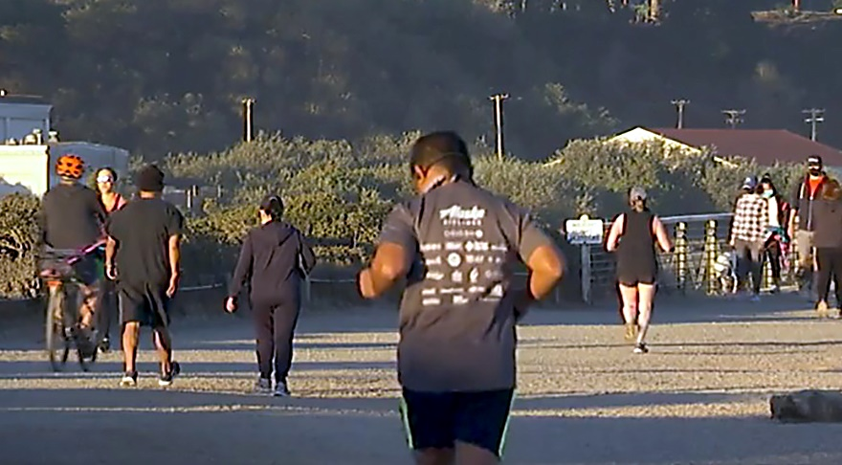

Protect and Prevent Harm
Protect people, animals and property
Prevent harm to the environment
Prevent harm to fish, wildlife, endangered or threatened species
Notes:
When using a RUP, or any pesticide, it is your responsibility to protect people, animals, and property, and prevent harm to the environment, such as fish, wildlife, endangered or threatened species or their habitats.

Slide 20
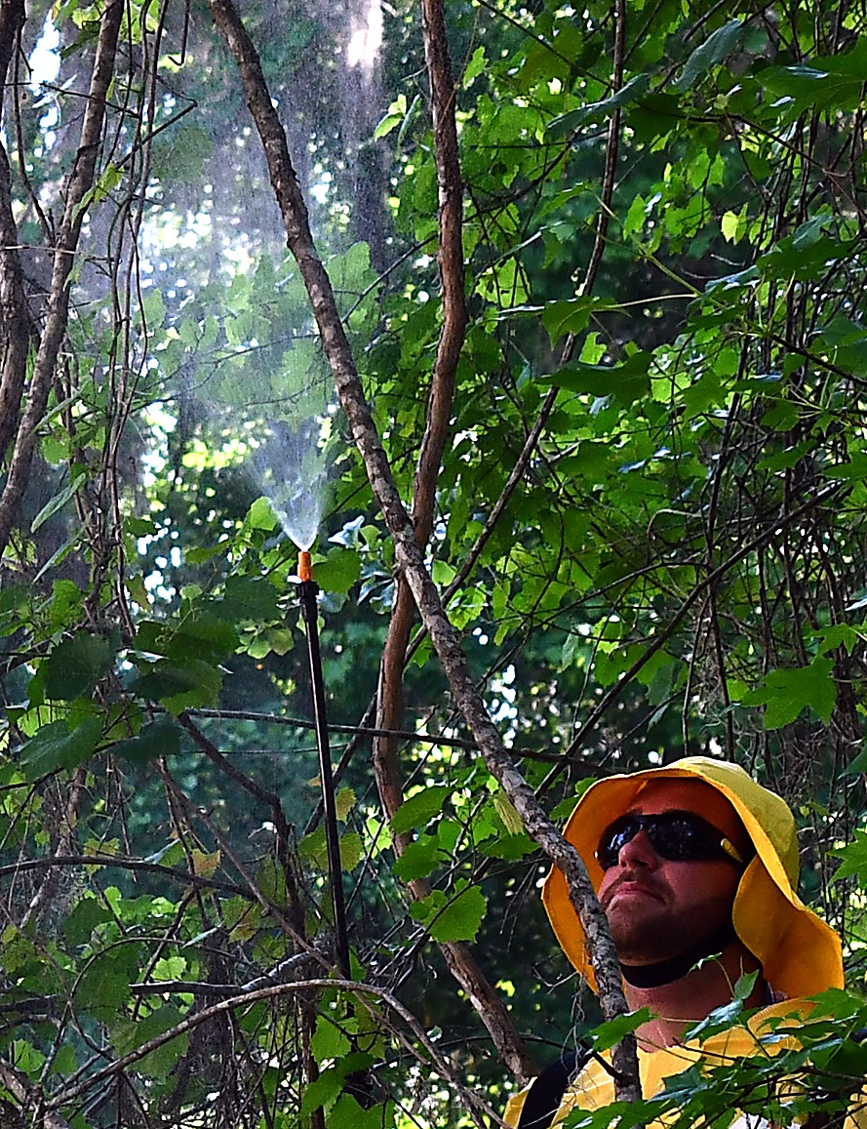
Prevent Drift
Examples of Drift:
Spray droplets
Vapor
Dust and particles
Notes:
When making an application, take precautions to prevent exposure from pesticides to yourself or others through drift. Drift is the movement of pesticide spray droplets, vapor or dust away from the application site usually due to certain weather conditions, such as a temperature inversion or wind.

Slide 21
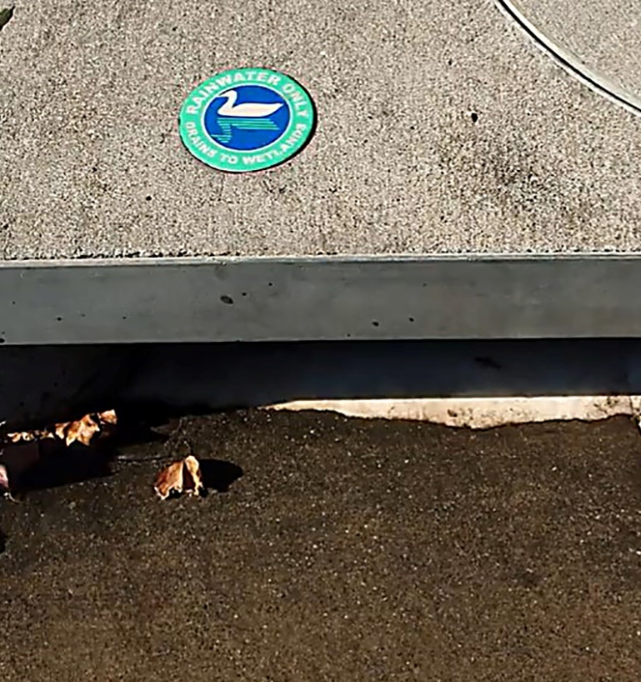
Prevent Drift
Water runoff could contaminate other bodies of water.
Notes:
The smaller and lighter the pesticide droplet is, the more prone it is to move away from the application site with air movement. Pesticides may also move away from a treated site through water runoff which could contaminate other bodies of water.

Slide 22
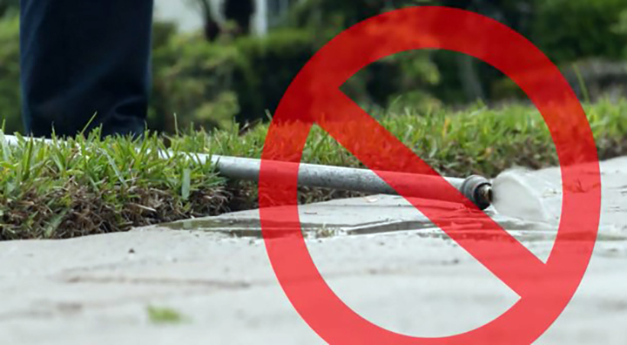
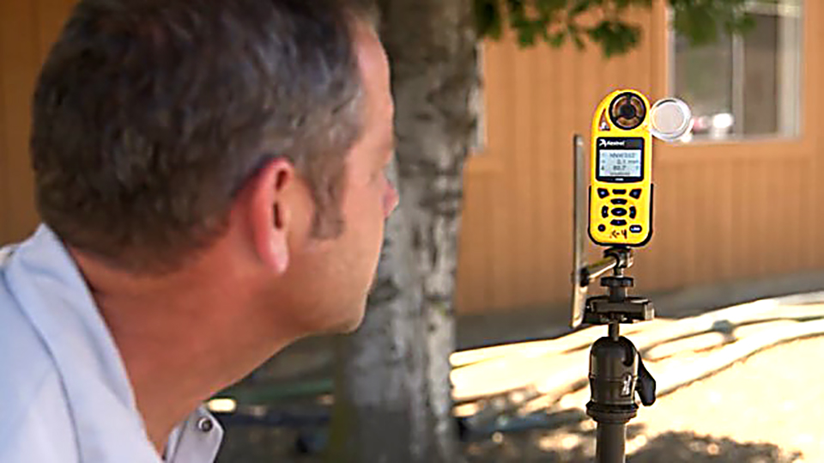
Prevent Off-Target Movement
Avoid drift, runoff, or pesticide movement.
Check weather conditions and surroundings.
Stop the application if conditions change.
Notes:
Avoid drift, runoff, or pesticide movement away from a target site at all costs. Always check weather conditions and your surroundings before making an application to determine if it could cause harm or damage to people or property. If an application cannot be made without the potential for harm, then it must be avoided or stopped. Take extreme care and follow all of the protections and restrictions on the product label. Off-site movement of pesticides is a violation of pesticide laws.

Slide 23
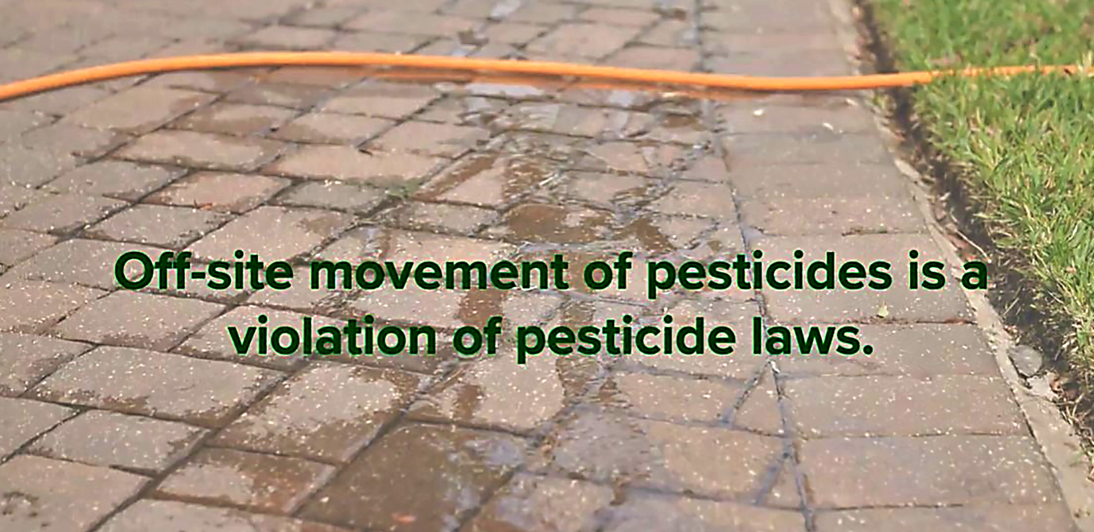
Notes:
Off-site movement of pesticides is a violation of pesticide laws.

Slide 24
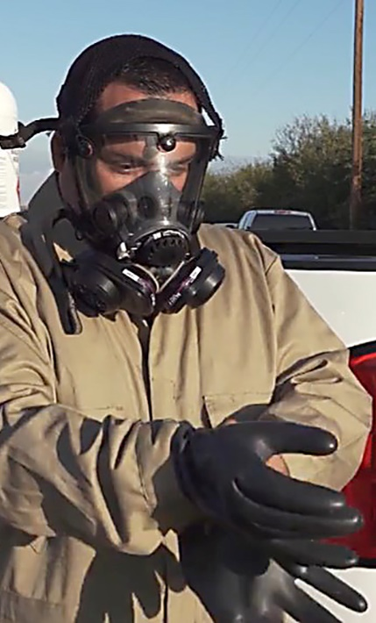
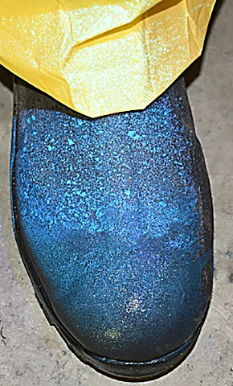
Pesticide Residue
Protect yourself and others during the application.
Notes:
Even when you are very careful to protect yourself and others during an application, there is still a chance for exposure to pesticide residue.
Pesticide residue is a small amount of pesticide that is difficult to detect but may still be harmful to your health, depending on the amount, and type of pesticide you are exposed to.

Slide 25
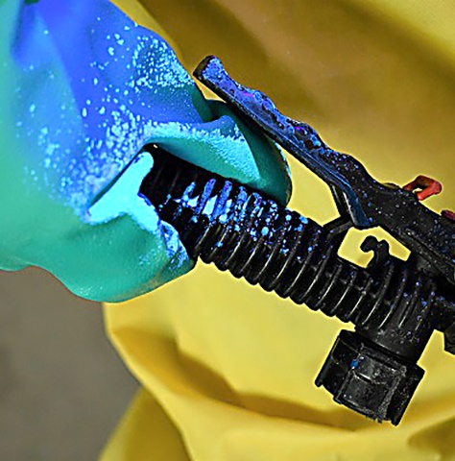
Pesticide Residue
Residues are found on:
Treated areas
Equipment
Work clothes
Personal Protective Equipment (PPE)
Pesticide containers
Soil
Notes:
Pesticide residue is found where pesticides were applied, such as on treated plants, structures, and on equipment used to make pesticide applications. Pesticide residue is also found on dirty work clothes, used personal protective equipment (PPE), empty pesticide containers, in areas used for storing and mixing pesticides, and in the soil.

Slide 26
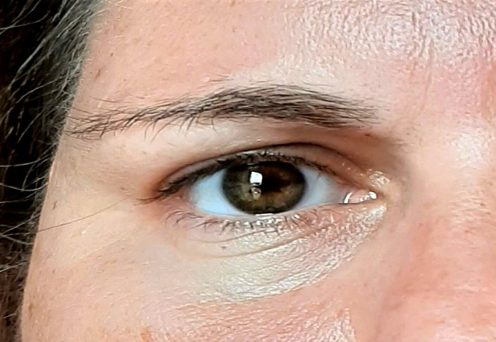
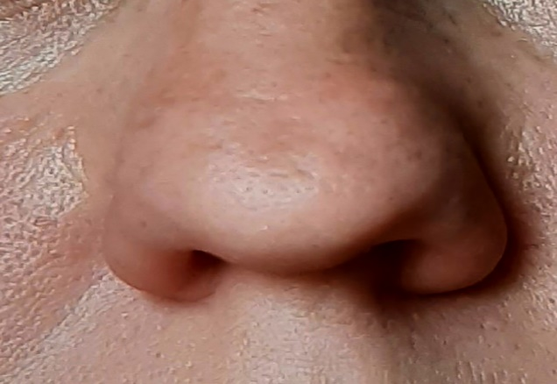
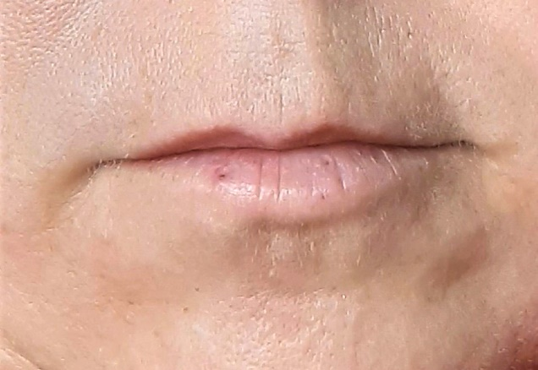
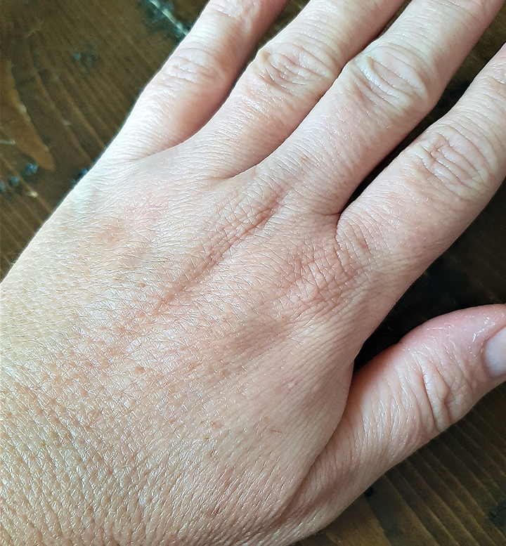
Routes of Entry
Eyes
Removing PPE
Rubbing
Splashes
Nose
Inhalation of: Sprays
Mist
Dust
Gases
Mouth
Smoking
Eating
Drinking
Biting nails
Skin
Splashes
Removing PPE
Contact with treated objects
Notes:
There are four common ways that pesticides can enter your body: your eyes, nose, mouth or skin. To reduce your health risks, always wear the protective PPE required by the product label and know where to find the decontamination supplies.

Slide 27
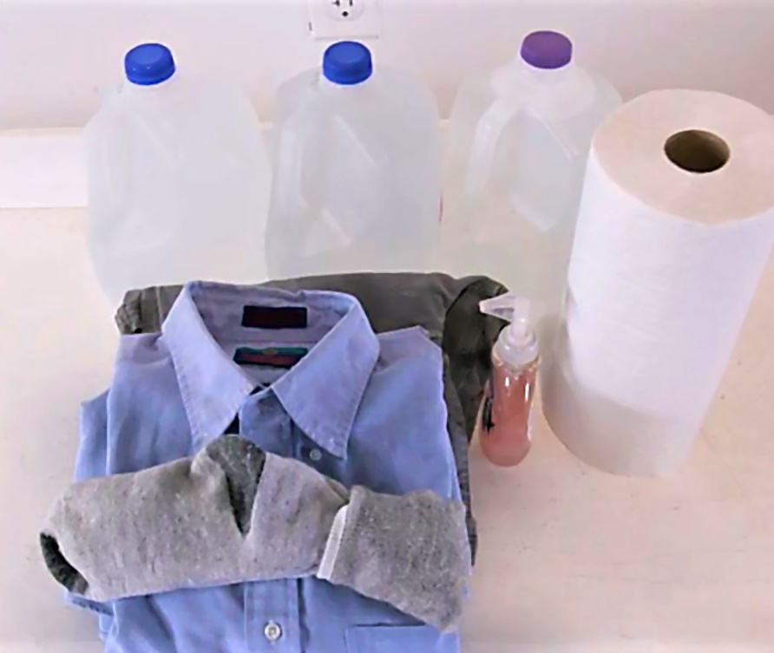
Emergency
At a minimum, have:
Soap
Single use towels
Clean clothing
Notes:
Knowing what to do in an emergency may be critical in minimizing damage to your health caused from pesticide exposure. At a minimum, decontamination supplies should include soap, single use towels, change of clothes and water for routine or emergency washing.

Slide 28
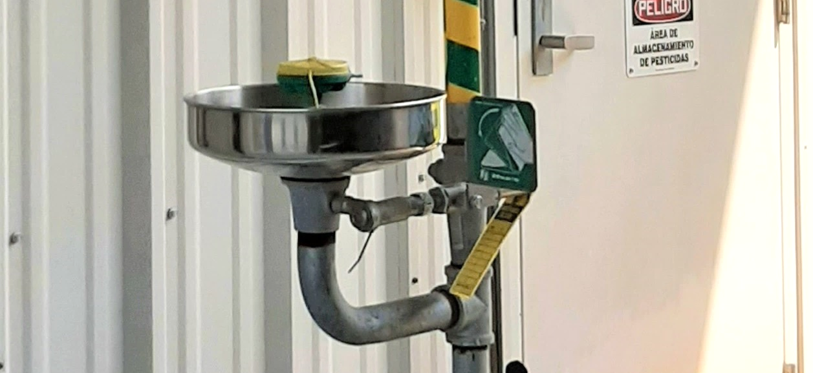
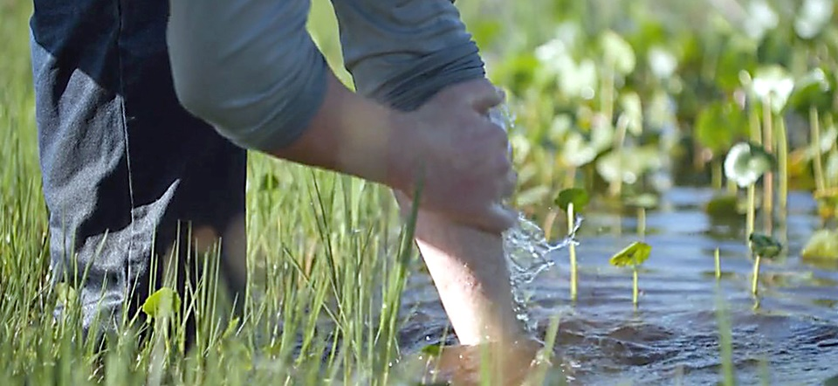
Clean Water
Routine washing:
Use eye wash station
Emergency:
Use closest clean water such as a stream, lake, or pond
Notes:
If another source of clean water, such as a stream, lake, or pond is closer to you, you should use it in an emergency. Additional emergency eye flushing supplies or an eye wash station may also be required in case of accidental exposure of a pesticide to your eyes.

Slide 29
The Pesticide Label

Slide 30
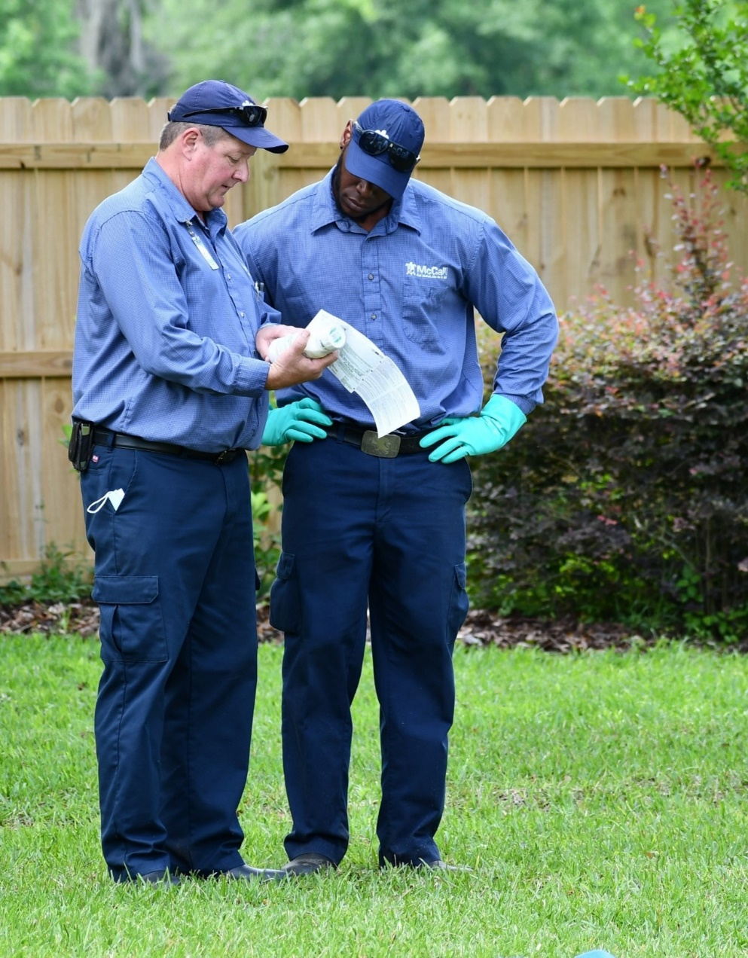
Pesticide Labels
Know how to use each pesticide correctly.
Follow the directions on the label.
Access to the label at all times.
Notes:
It is the responsibility of both you and the certified applicator supervising you to use each pesticide correctly by following the directions on the pesticide label. When you use a restricted use pesticide, your supervising applicator must give you access to the product label at all times while using the product, including mixing, loading, and/or applying.

Slide 31
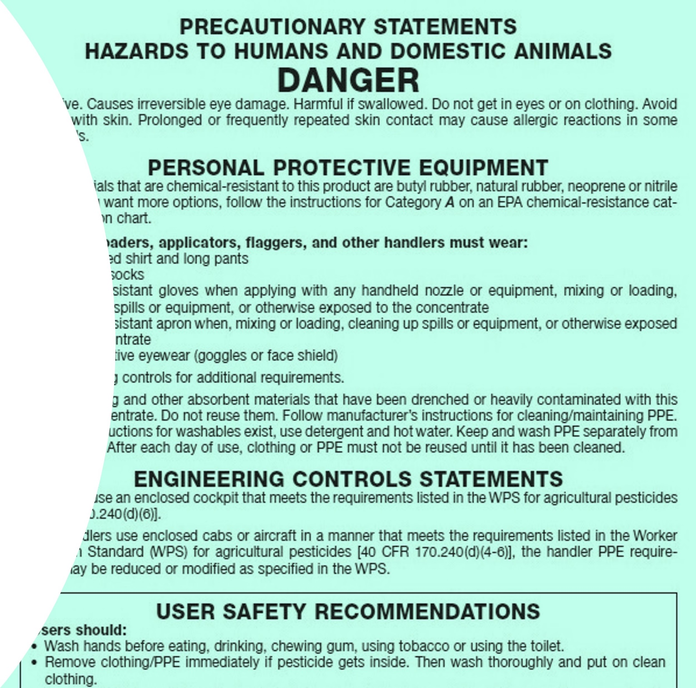
Pesticide Labels
Labels:
Provide information on safe and effective use
Follow all label directions
The label is the law
Notes:
Labels are found on pesticide product containers and give you information on the safe and effective use of the product. As a pesticide applicator, reading, understanding, and following all the directions and application restrictions on a label is one of the most important parts of your job. This includes information that might be with, and not on the container, such as a detachable pamphlet or a separate manual. If you cannot read and understand a product’s labeling, your supervisor must explain it to you. The label is the law.

Slide 32
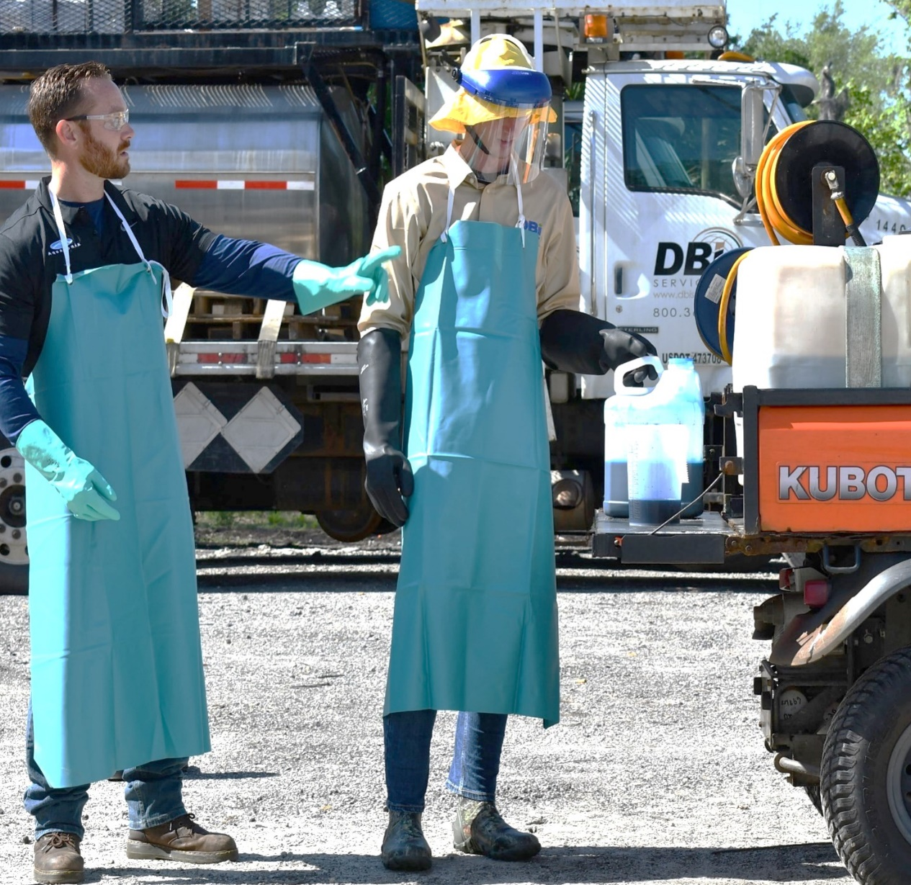
Supervisor Instructions
Know your site.
Know how to use the equipment and application method.
Know any precautions ahead of time.
Notes:
In addition to the product label directions, your supervising applicator must also provide you with instructions specific to the site, the equipment you are using, method of application, and any precautions you should take to perform the application. These instructions must also include ways to reduce risk to the environment.

Slide 33
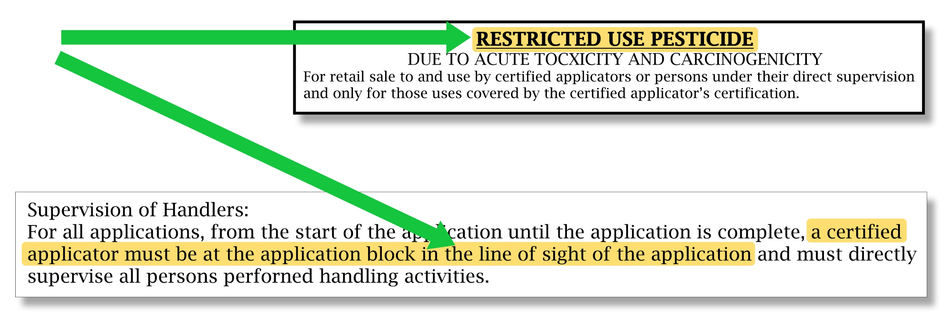
Pesticide Labels
Notes:
It is important to know the different parts of a pesticide label and the information within each part. You should always review the product label before using any pesticide.
Restricted use pesticides will contain a restricted use pesticide statement enclosed in a box located at the top of the front panel of the product label. This statement indicates why EPA classified the product as an RUP, whether its sale and use is limited to certified applicators only, or also to noncertified applicators under the direct supervision of a certified applicator. This statement will also let you know if the certified applicator must be physically present when you use the product.

Slide 34
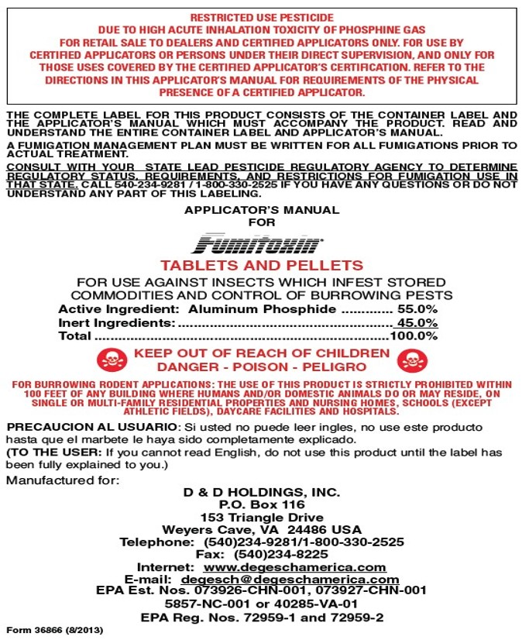
Pesticide Labels
Brand Name
EPA Registration Number
Notes:
Other important information you should know on pesticide product labels include:
- The Brand name or the commercial name of the pesticide. This is usually the biggest, most noticeable word on the front of the label.
-The EPA Registration Number is the unique number given to each pesticide by the EPA. This number identifies the product and gives medical personnel valuable information in an emergency.

Slide 35
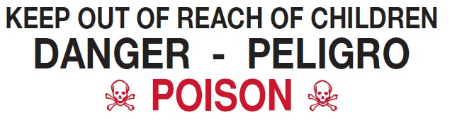



Signal Words
DANGER-POISON
  Extremely poisonous
  Very poisonous or corrosive
DANGER
  Moderately toxic or poisonous
WARNING
  Slightly toxic
CAUTION
Notes:
Signal Words are found in capital letters on the front panel of a label that indicate how poisonous the product is. There are four signal words used to describe the immediate or acute, short-term toxicity of the product:
DANGER WITH SKULL AND CROSS BONES and the word POISON printed in red ink. This means that the pesticide is highly toxic or extremely poisonous and will make you very sick or may cause death if absorbed through one or more routes, including the skin, if swallowed, or if inhaled.
DANGER means the pesticide is very poisonous if it enters your body, or it is corrosive and causes irreversible damage to the skin or eyes. Even small amounts of this product will cause serious harm.
WARNING means the pesticide is moderately toxic or poisonous through one or more routes, including if absorbed through the skin, if swallowed or if inhaled, or causes moderate eye or skin irritation.
CAUTION means slightly toxic but it can still make you sick if absorbed through one or more routes, including by the skin, if inhaled, or if it gets into the eye.

Slide 36
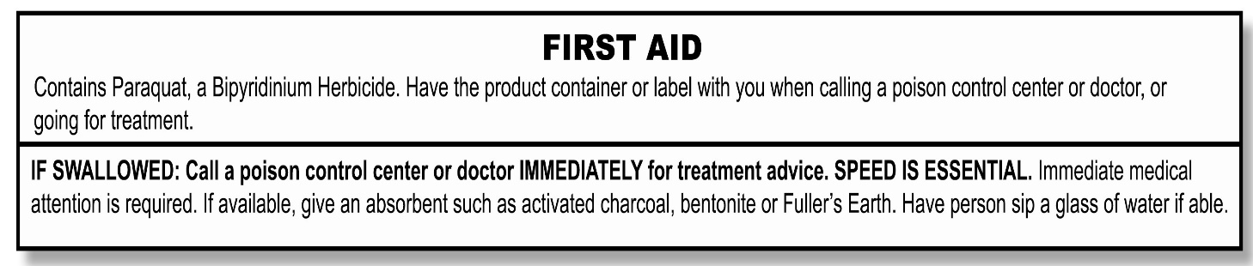
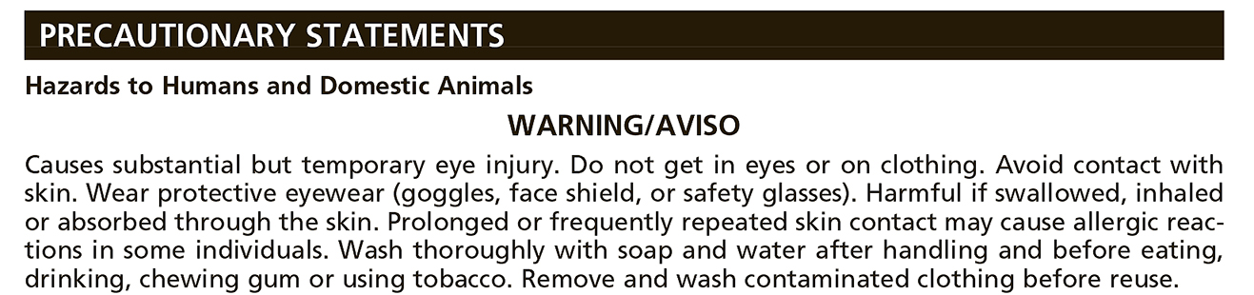
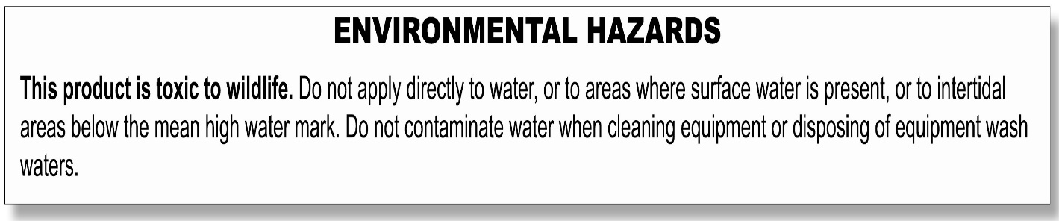
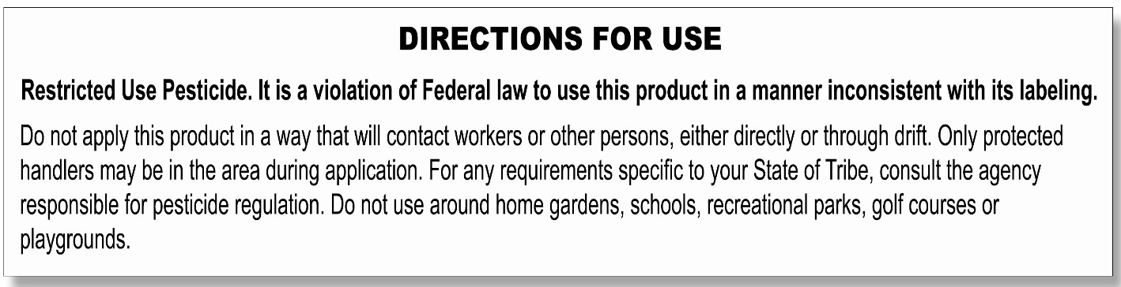
Pesticide Labels
First Aid Instructions
Precautionary Statements
Environmental Hazard Statements
Directions for Use
Notes:
The First Aid Instructions tell you what to do if you get the pesticide in your eyes, inhale it into your lungs, swallow it, or get it on your skin. It also provides a number to call in case of an emergency.
-The Precautionary Statements explain the potential hazards to humans and domestic animals, health risks, and the protections you need to take while using the product. It will also tell you what personal protective equipment (PPE) you must use when mixing, loading or applying the pesticide, or when you clean, repair and maintain application equipment. The type of PPE depends on the toxicity of the product.
-The Environmental Hazards Statement is found under the Precautionary Statements. It gives you information about how the pesticide can harm the environment and the steps you must take to prevent contamination.
-The Directions for Use section opens with two important statements reminding the applicator to follow all pesticide label directions and not to allow the pesticide to contact anyone directly or indirectly. This section identifies the sites where you may use the pesticide, the application rates, the type of equipment to use, and any application restrictions.

Slide 37
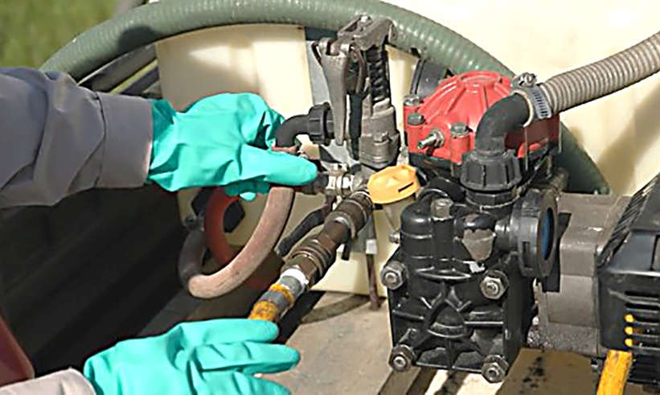
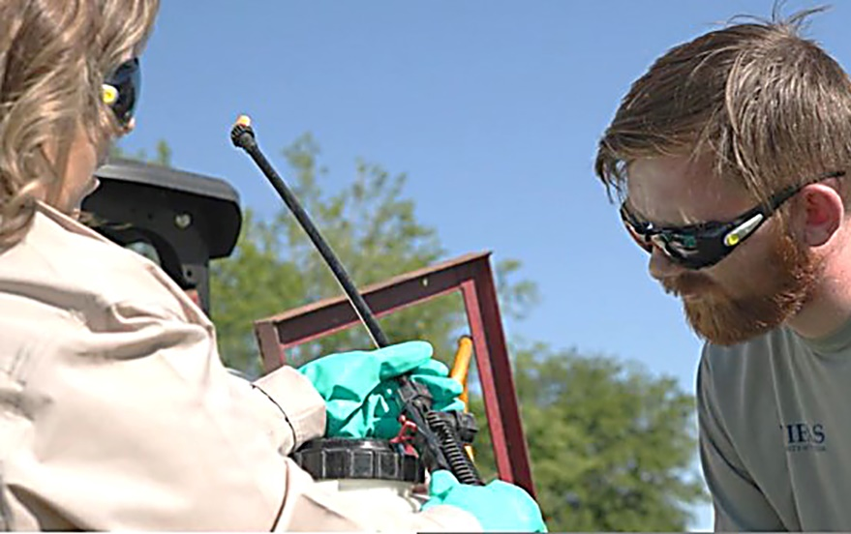
Supervising Certified Applicator
Inspect your equipment each day.
Know how to use the equipment safely.
Prevent exposure to yourself, others and the environment.
Notes:
All the information on the product label is very important to the safety and success of your work. Other things your supervising certified applicator must do (and that you may do) to be safe when applying pesticides are:
Your supervising certified applicator is responsible for inspecting your equipment each day before it is used for mixing, loading, transferring, or applying pesticides to make sure it is working correctly. They must also ensure that you know how to use the equipment safely to prevent accidents or pesticide exposure to you, others or the environment.

Slide 38
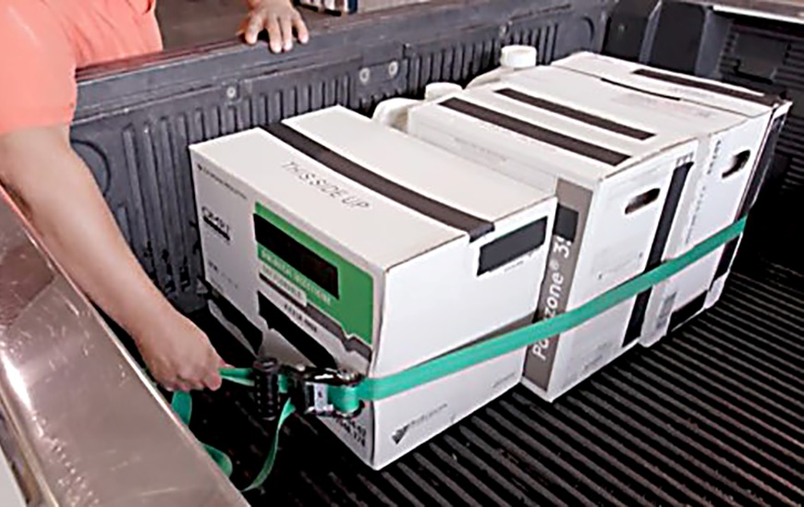
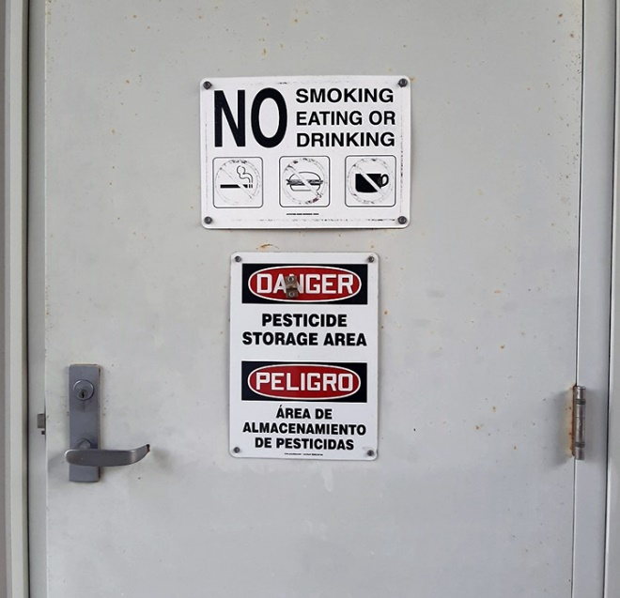
Transporting Pesticides
Secure pesticides away from driver or passenger compartment.
Check container for leaks and protect them from damage.
NEVER leave pesticides unattended.
Notes:
Always transport pesticides securely in a truck bed, cargo area or other area away from the driver or passenger compartment. Check containers for leaks before loading and unloading, protect them from damage, and monitor them during transport. Never leave pesticides unattended and when possible store them in a locked area.

Slide 39
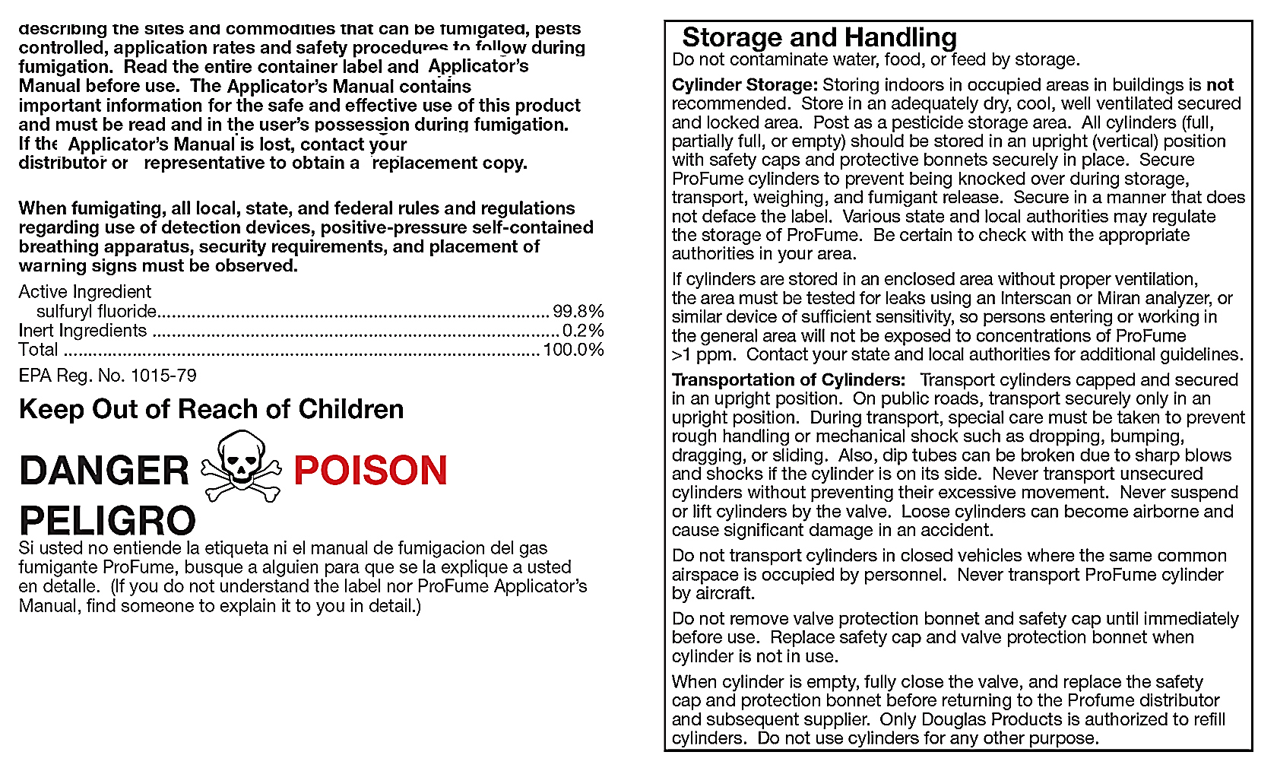
Pesticide Labels
Storage, handling and disposal information.
Notes:
Information on how to store or dispose of unused product is typically found near the end of the label. Specific storage conditions, such as the temperature range or distance from other products may be required to keep the product safe for future use or from creating a hazard, such as a fire or environmental contamination.

Slide 40



Emergency Spills
Call
Protect yourself with PPE.
Protect
Contact your supervisor,
9-1-1 or the emergency number on the label.
Use the four C’s for emergency spills.
Clean
Notes:
It is also important to read the label before using a pesticide in case of a spill. If a spill does occur, first protect yourself by using the PPE listed on the product label. Always contact your supervisor for instructions or in an emergency, call 9-1-1. For additional help call the emergency contact number listed on the product label.

Slide 41




The Four C’s
Control
  Upright container, turn off pump, close valve.
Contain
  Use absorbent material.
Control
Contain
Clean up
  Dispose of waste according to label.
  Report to your supervisor and other required authorities.
Contact
Clean up
Contact
Notes:
The four C’s for emergency spills are:
Control the spill. Stop the spill or leak by returning the container to an upright position, turning off the pump, or closing valves.
Contain the spill with absorbent material, such as kitty litter, sand or clay. Keep others away from the spill area.
Clean up the spill. Never wash it down as this will only contaminate a much larger area. Dispose of pesticide waste according to label directions and in a safe and legal manner.
Contact your supervising applicator immediately. States and tribes may require reporting of pesticide spills.

Slide 42
Personal Protective Equipment (PPE)

Slide 43

Personal Protective Equipment (PPE)
Use PPE required on the label.
Notes:
The most effective way to protect yourself from pesticides and pesticide residue before, during and after using a pesticide, is to use the PPE required by the pesticide label. The product label will tell you which type of PPE you must use.

Slide 44



PPE
Wear the PPE required by the label.
Clean reusable PPE properly.
Discard disposable PPE and PPE that is damaged or saturated with pesticides.
Notes:
It is the responsibility of the certified applicator supervising you to provide the PPE that is required by the product label and make sure it is worn and used correctly when mixing, loading, applying or otherwise using RUPs. PPE must be clean and in proper operating condition. Depending on the protection that is needed for the pesticide you are using, PPE is made from different types of materials and can be reusable or disposable. Reusable PPE, such as gloves, aprons, eye protection, coveralls, boots and respirators, must be properly cleaned and maintained after each use. If PPE is torn or saturated with pesticides, throw it away.` Never use damaged PPE and never clean and reuse single use PPE.

Slide 45


Respirators
Notes:
If a pesticide label requires you to wear a respirator, it must be clean, working correctly and inspected prior to use. Your supervising applicator is responsible to ensure you take all the steps necessary to wear a respirator safely.

Slide 46



PPE
Avoid contact with pesticides and residues.
Remove PPE in proper order.
Wear gloves, eye protection, and boots when washing dirty PPE.
Notes:
To avoid contact with pesticides and pesticide residue, never remove your PPE when you are doing activities such as mixing and loading, or working on application equipment.
When finished using a RUP, remove each piece of PPE in a specific order to prevent exposure to residues. Remember that dirty gloves touch the outside of dirty PPE, and clean gloves or clean hands touch the clean parts of your PPE. Always wear gloves, eye protection and boots when washing dirty PPE, and keep your clean clothes and clean PPE in an area free from pesticides or pesticide residues.

Slide 47


Protect Yourself
Keep clean clothing away from pesticides.
Wash your body with soap and shampoo your hair.
Change into clean clothing.
Notes:
Immediately at the end of your work period, wash your body with soap, shampoo your hair and change into clean clothes, especially before having any physical contact with others. This is important as your work clothes may have pesticide residues on them and these steps reduce the risk of pesticide exposure to yourself and others.

Slide 48
Protecting Yourself, Co-Workers and Family

Slide 49

Protecting Yourself, Co-Workers and Family
Notes:
Since it is possible that harmful pesticide residues may be on you and your work clothes, there are things you can do to protect yourself, your co-workers, your children and other family members from being exposed to pesticide residues. Children and pregnant individuals are especially at risk as pesticide exposure may lead to birth defects, learning problems, low birthweight, premature birth or miscarriage.

Slide 50


Protecting Yourself, Co-Workers and Family
Wash hands before eating, drinking, smoking, tobacco use, using the toilet or handling the phone.
DO NOT take pesticides or containers home.
DO NOT put pesticides in any other containers.
Notes:
To keep everyone safe, you should:
Wash your hands before touching your eyes or mouth and before eating, drinking, and smoking, chewing gum or tobacco, using the toilet, and handling your phone.
Never take pesticides or empty pesticide containers home with you. Even if they are rinsed they are never completely free of pesticides. Do not put pesticides in any unmarked container and never pour pesticides from their original containers into food or beverage containers. This is very dangerous and illegal. An unsuspecting adult or child may mistake the pesticide for food or drink and swallow it.

Slide 51



Protecting Yourself, Co-Workers and Family
Remove work shoes before entering your home.
Wash work clothes separately from family laundry.
Air-dry work clothes outside if possible.
Notes:
Remove your work shoes or boots before entering your home.
Keep dirty work clothes separate from family or other clothes and away from children.
Wash your work clothes in hot, soapy water before wearing them again. Do not wash your work clothes and any non-work clothes together.
When possible, rinse the washing machine at least twice before doing family laundry.
Air-dry work clothes outside when possible to allow sunlight to help breakdown any remaining pesticide residue.

Slide 52

Protecting Yourself, Co-Workers and Family
Keep pesticides out of the reach of children.
Notes:
Exposure to pesticides and pesticide residues can be harmful to anyone, so keep household members away from treated areas or items that may have pesticide residue on them. Remember to always keep pesticides out of the reach of children.

Slide 53
Pesticide Illnesses

Slide 54

Pesticide Illnesses
  Some people more affected than others
Exposure
  Potential harm to your health
Hazard
Notes:
Contact with a pesticide or pesticide residue is called pesticide exposure and may affect some people more than others.
Since pesticides are different from one another, so is the potential hazard, or harm, they may have on your health.

Slide 55


Pesticide Illnesses
Acute
  Single event- symptoms usually within 24 hours
Chronic
  Small doses over a long period of time
Delayed
  Long after exposure
Sensitization
  Can progress with additional exposures
Notes:
An acute pesticide illness is one that occurs shortly after a single or short-term exposure incident and the symptoms are usually seen within 24 hours. Some of the most common symptoms include headaches, sweating, weakness, rapid or slow pulse, nausea, or loss of consciousness. Acute pesticide poisoning can be serious and require medical treatment and in extreme cases people can die.
A chronic pesticide illness can result from repeated exposures to small amounts of pesticides over a long period of time. The symptoms of a chronic pesticide illness may be delayed, meaning they may not show up until long after the exposure has taken place. Serious chronic or delayed effects may include cancer or damage to your respiratory or nervous system.
Repeated pesticide exposure may cause sensitization to the pesticide you were exposed to. This is similar to an allergic reaction that may get worse with each time you are exposed and can even become life-threatening. Typical reactions from sensitization are rashes and breathing problems. If you think you have symptoms caused by any type of pesticide exposure, contact your employer or supervisor at once and get medical attention.

Slide 56
Emergency Decontamination and First Aid

Slide 57




Four Routes of Entry
Skin
Eyes
Nose
Mouth
Notes:
Exposure to pesticides can be hazardous. As previously mentioned, pesticides can enter your body through four routes: your skin, eyes, nose and mouth.

Slide 58


Emergencies
Your supervising applicator must provide a way to immediately communicate with you the entire time you are working with RUPs.
Notes:
Knowing the symptoms of exposure through these routes, and knowing what to do if you, or a co-worker, are exposed to pesticides is important for everyone’s safety. Your supervising applicator is required to provide a way to immediately communicate with you the entire time you are working with RUPs in case of a pesticide emergency.

Slide 59



Exposure to Skin
Mixing
Loading
Splashes
Drips
Drift
Plants
Soil
Equipment
Dirty work clothes
Cell phones
Notes:
Many of the pesticide exposures and injuries are from pesticides entering the body through the skin. Pesticide contact with skin can occur while mixing, loading, making applications, splashes, drips or drift, or if you contact pesticide residue on plants, soil, dirty work clothes, contaminated equipment, or even your phone. Some pesticides cause skin irritation or may pass through the skin and be absorbed into the blood stream causing more severe reactions or complications.

Slide 60

Exposure to Skin
Remove contaminated clothing.
Wash immediately with soap and water.
Seek medical attention if you develop symptoms.
Notes:
If you think your skin has contacted a pesticide or pesticide residue, remove the pesticide-contaminated clothing and wash the affected area immediately with soap and water to slow or stop the skin from absorbing more of the pesticide. If decontamination supplies are far away, use the nearest clean water such as a stream or pond in an emergency. As soon as possible, follow up by washing with soap and water, shampooing your hair, and changing into clean clothes. If you develop any symptoms from pesticide exposure, seek medical attention.

Slide 61


Exposure to Eyes
Dust
Airborne particles
Splashes
Spills
Broken hoses
Spray mists
Rubbing your eyes
Dirty PPE
Notes:
Pesticides can get into your eyes from airborne dust or particles, splashes or spills, broken hoses, spray mists, by rubbing them with contaminated hands, or residues from dirty PPE. The tissues of the eye are extremely absorbent. Because of this, pesticides can easily move from your eyes to other parts of your body and cause other serious health effects.

Slide 62

Exposure to Eyes
Flush eye(s) immediately.
Hold eye open and flush for at least 15 minutes.
Seek medical attention as soon as possible.
Notes:
If a pesticide gets into your eye, flush it out immediately by rinsing with an eye wash kit or any source of clean water. Make sure that the water flow is gentle and that you turn your head so the injured eye is below the good eye. This will stop contaminated water from going into the unaffected eye. Keep the injured eye as wide open as you can and continue flushing for at least 15 minutes. To avoid further eye injury, make sure that the water is clean, not too hot, and never put anything in the water or in the eye. Get medical attention as soon as possible.

Slide 63

Exposure by
Mouth
Eat
Drink
Smoke
Chew gum
Tobacco
Notes:
Pesticides can enter your mouth when you eat, drink, smoke, or chew gum or tobacco without first washing your hands. Never eat or drink from any container used for pesticides, even if the container has been washed.

Slide 64


Exposure by Mouth
Follow first aid instructions on the label.
Never make a person vomit who is unconscious, having convulsions or is lying face up.
Seek medical attention as quickly as possible.
Notes:
If a person accidently swallows a pesticide, follow the emergency first aid directions on the pesticide label. Never make a person vomit if a person is unconscious, having convulsions, or is lying face up. The most important step is to get the person to a nearby medical facility as quickly as possible.

Slide 65

Exposure by
Inhalation
Vapors
Dust
Spray Particles
Notes:
Pesticide exposure can also occur by inhalation or breathing in pesticide vapors, dust, or spray particles through your nose and mouth. This type of exposure is more serious with some pesticides than with others, particularly fumigant pesticides which form gases. Once in the lungs, pesticides can enter other parts of the body quickly, and damage other organs. Inhalation of fumigants may cause permanent breathing difficulties or death.

Slide 66

Exposure by Inhalation
Assess the area before helping a person.
Remove the person and get to fresh air.
Seek medical attention as quickly as possible.
Notes:
If you or someone else has inhaled a pesticide, assess the situation to make sure it is safe to enter the area and never go into an enclosed area unless you protect yourself with the appropriate respiratory equipment. If it is safe to enter, get the person to fresh air and loosen any clothing that might make breathing difficult. Inhalation of a pesticide can be very serious and it is important to get emergency medical treatment as quickly as possible.

Slide 67

Heat-Related Illnesses
Besides pesticides, heat can also harm you.
Notes:
Besides pesticide exposure, hot working conditions can also harm you. If you are working in excessive heat with limited air movement or high humidity, and start to feel sick or dizzy, it could be heat stress and not pesticide exposure. If you have heart problems, high blood pressure, diabetes or other medical issues you are at a much higher risk for heat-related illnesses than someone without these conditions. Heat-related illnesses happen when you sweat and your body loses much needed moisture and salt. The results can be mild or very serious and the action you take can make a difference. Take precautions to prevent heat-related illnesses by considering the heat and humidity you are working in, the PPE you are wearing, your access to shade, taking frequent short breaks, and most importantly, drinking plenty of water.

Slide 68

Heat-Related Illnesses
Heat Rash
  Skin irritation, hives or blisters
Heat Cramps
  Early warning sign of heat illness
Heat Exhaustion
  Heavy sweating, extreme weakness, rapid breathing
Heat Stroke
  Serious overheating that can lead to death
Notes:
The four most common heat-related illnesses, their symptoms and the first aid steps you can take are:
Heat rash. This is a skin irritation, such as hives and blisters. If you develop a skin irritation, keep the affected area dry, and if possible, change your work environment.
Heat cramps. Depleting your body of salts and water leads to cramps usually in the stomach, arms, and legs. This is an early warning sign of heat illness.
Symptoms of heat exhaustion include heavy sweating, clammy/moist skin, extreme weakness or fatigue, dizziness, nausea, and rapid breathing. Heat exhaustion can become a heat stroke.
Heat stroke is the most dangerous heat-related illness. This is where the body seriously overheats and cannot cool itself down. Symptoms include hot and dry skin, little if any sweating, chills, a throbbing headache, confusion, and seizures. A person can become unconscious, suffer permanent disabilities, or die very quickly from heat stroke. Take these symptoms seriously and call 9-1-1 immediately, inform your supervisor, and stay with the person until professional medical help arrives.

Slide 69

Heat-Related Illnesses
Move the person to cool or shaded area.
Remove PPE or extra clothing and drink water.
Seek medical attention as quickly as possible.
Notes:
If you or someone else shows signs of heat-related illness, move to a cool or shaded area, remove PPE and extra clothing, and drink water. If possible, use a fan or cool wet compresses on the head and neck to cool down or take a cool bath or shower. When your body overheats and cannot control its temperature, you can die quickly without immediate medical treatment.

Slide 70

Get Medical Help Immediately
Notes:
As you can see, many of the symptoms of heat-related illnesses and pesticide poisonings are similar. This can make it difficult to determine the cause of the symptoms without knowing the circumstances behind them. Both pesticide poisoning and heat stroke can be life-threatening and require immediate treatment. You must know how and when to obtain medical care. If you suspect either pesticide poisoning or a heat-related illness, the most important thing to do is to get medical help immediately. Take these symptoms seriously. Call 9-1-1 immediately, and inform your supervisor. Stay with the person until professional medical helps arrives. Never drive yourself as you may be placing yourself and others in even more danger.

Slide 71
Closing

Slide 72


Review
Hazards of using RUPs
Reading, understanding, and following the label directions
Using correct personal protective equipment
Notes:
This training has covered many topics related to the potential hazards of pesticides especially when using restricted use pesticides. We have explained the responsibilities that belong to you and of your supervisor to prevent pesticide exposures. These responsibilities include reading, understanding and following the pesticide label directions, and the importance of using the correct personal protective equipment required by the label.

Slide 73

Review
Recognize signs of pesticide exposure and heat-related illness.
Know basic decontamination and first aid.
Know who to contact for information.
Notes:
We have also reviewed what to do should an exposure occur, how to recognize the signs and symptoms of pesticide exposure and heat-related illness, and the importance to know basic decontamination and emergency first aid procedures. If you suspect a pesticide use violation, contact your state or tribal agency responsible for pesticide enforcement. Know who regulates the use of pesticides in your area and have those contacts available. Remember that states and tribes may have more restrictive requirements and it is important to be aware of and comply with all applicable regulations.

Slide 74
Review
Notes:
Industries that use noncertified applicators to apply restricted use pesticides under the direct supervision of a certified applicator want you to have the information you need to be safe. These regulations are in place not only for your own protection, but also for the protection of your co-workers, your family, and our environment.
If you want a copy of your training record or if you have any questions about the topics covered in this video, be sure to ask your trainer or supervising applicator.

Slide 75
Contributors
Pesticide Educational Resources Collaborative (PERC)
Director—Suzanne Forsyth, University of California Davis
Deputy Director—Kaci Buhl, Oregon State University
Project Officers—Matthew Lloyd and Stephanie Burkhardt, U.S. EPA, Office of Pesticide Programs
Project Coordinator
Jolene Hendrix, Agricultural Consultant
Layout
Steve Tomasko
Translation
Juan Concha-Holmes, Web Art Hosting (Lead)
Claudia Arrieta, Agricultural Consultant
Carmina Hanson, North Carolina Department of Agriculture and Consumer Services
Hector Nuñez-Contreras, Agricultural Consultant

Slide 76
Content Reviewers
Jolene Hendrix, Agricultural Consultant
Matthew Lloyd U.S. EPA, Office of Pesticide Programs
Suzanne Forsyth, University of California Davis
Photography
Janet Fults, Agricultural Consultant
Jolene Hendrix, Agricultural Consultant
Anna Katrina Hunter, University of California Statewide IPM Program
Videography & Digital Delivery
Hal Sloane, Emotion Video

Slide 77
Actors and Site Cooperators
Mark Bostick Golf Course
Paul Bridges
University of Florida
Paul Bridges
Brett Bultemeier
Taylor Darnell
Stephen Enloe
Erin Harlow
Luke Harlow
Jolene Hendrix
John-Paul Keller
Candice Prince
Tatiana Sanchez
Daisy Taylor
Homeowner
Philip G. Koehler
McCall Service
David Larson
Shannon Mann
DBI Services
Lucy Asmar
Jim Conroy (Supervisor)
Josh Lundy
John Oxborough
Sacramento-Yolo Mosquito & Vector Control
Demetris Dokos
Kellee Prasad
Luz Robles
John Snell
Ryan Wagner
Mariani Nut Company
Hextor Jimenez
Jesus Torres
Cardinal Professional Products
Jose Argueta
Ramiro Arriago
Ernesto Guzman
Accurate Fumigation
Juan Cruz
Izac Deharo
Alejandro Luna
Omar Sosa
Home Shoot
Lisa Blecker
Steve Blecker
Janet Fults
Anna Katrina Hunter
Hannah Strauss
Luca Strauss
Heidi Strauss
Sacramento Metropolitan Fire District
Bryan Gray
Nick Fenyoe

Slide 78
Special Thanks To
Ed Hosada, Cardinal Professional Products
Accurate Fumigation
Blecker Household
Cardinal Professional Products
DBI Services
Mariani Nut Company
Mark Bostick Golf Course at the University of Florida
McCall Service
Sacramento Metropolitan Fire District
Sacramento-Yolo Mosquito & Vector Control District
University of Florida IFAS Center for Aquatic and Invasive Species
University of Florida IFAS Pesticide Information Office

Slide 79
This presentation was developed through a cooperative agreement between the U.S. EPA, Office of Pesticide Programs and the University of California Davis Extension, in cooperation with Oregon State University. (#X8-8361301)
This work is licensed under a Creative Commons Attribution-NonCommercial-ShareAlike 4.0 International License. © 2021 The Regents of the University of California, Davis campus.
For information contact PERCsupport@ucdavis.edu.
Disclaimer on resource translation
All non-English versions of resources are translations of the original in English
and are for information purposes only.

